Slide 1
The Digital Dissertation:
How to Embark on Digital Scholarship
at the Graduate Level
Anke Finger
Literatures, Cultures, and Languages /
DMD
anke.finger@uconn.edu

Slide 2
What is a dissertation?
What is a book?

Slide 3
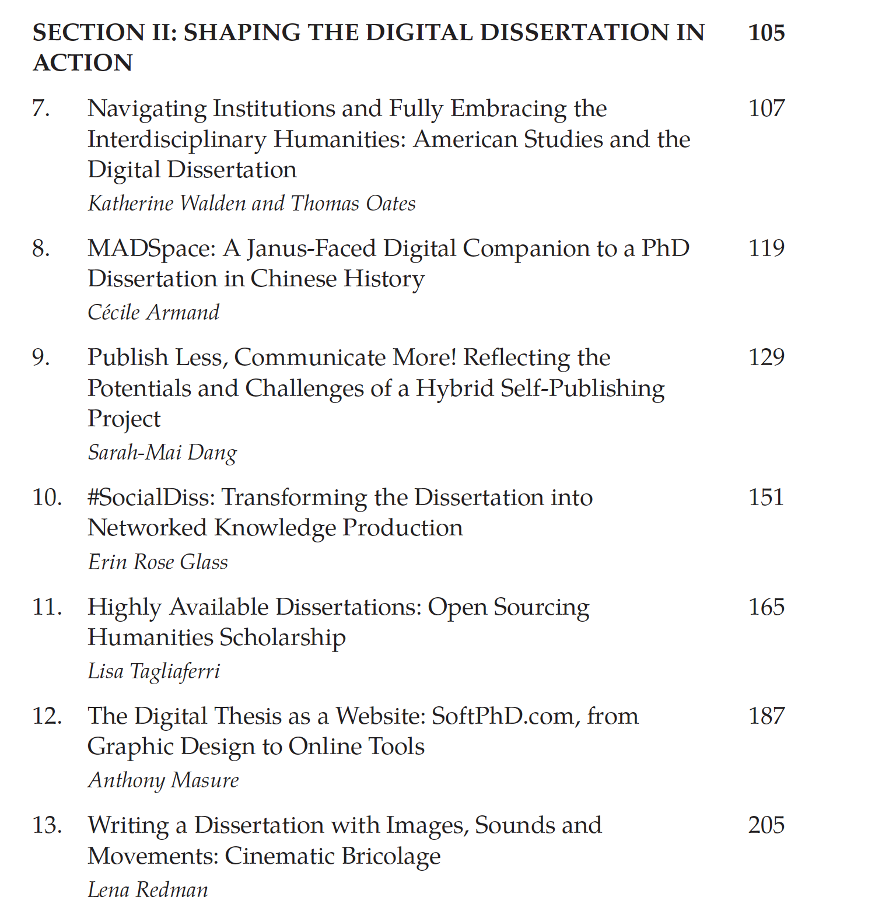
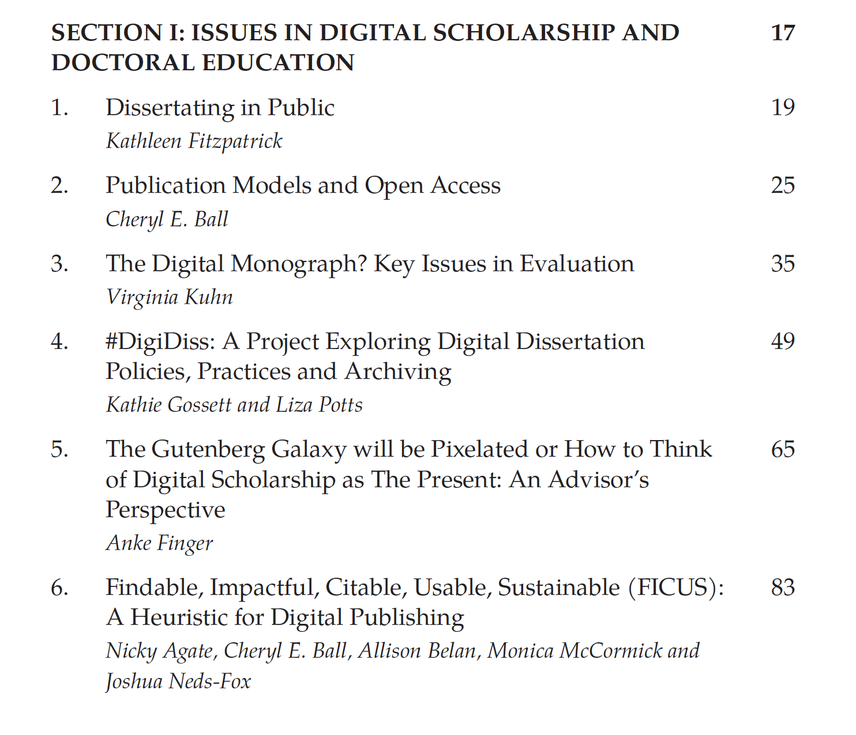
Contents
Section 2: Case Studies
Section 1: Contexts

Slide 4
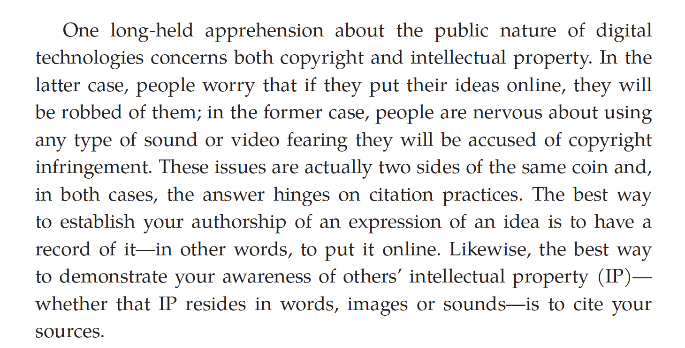

Slide 5
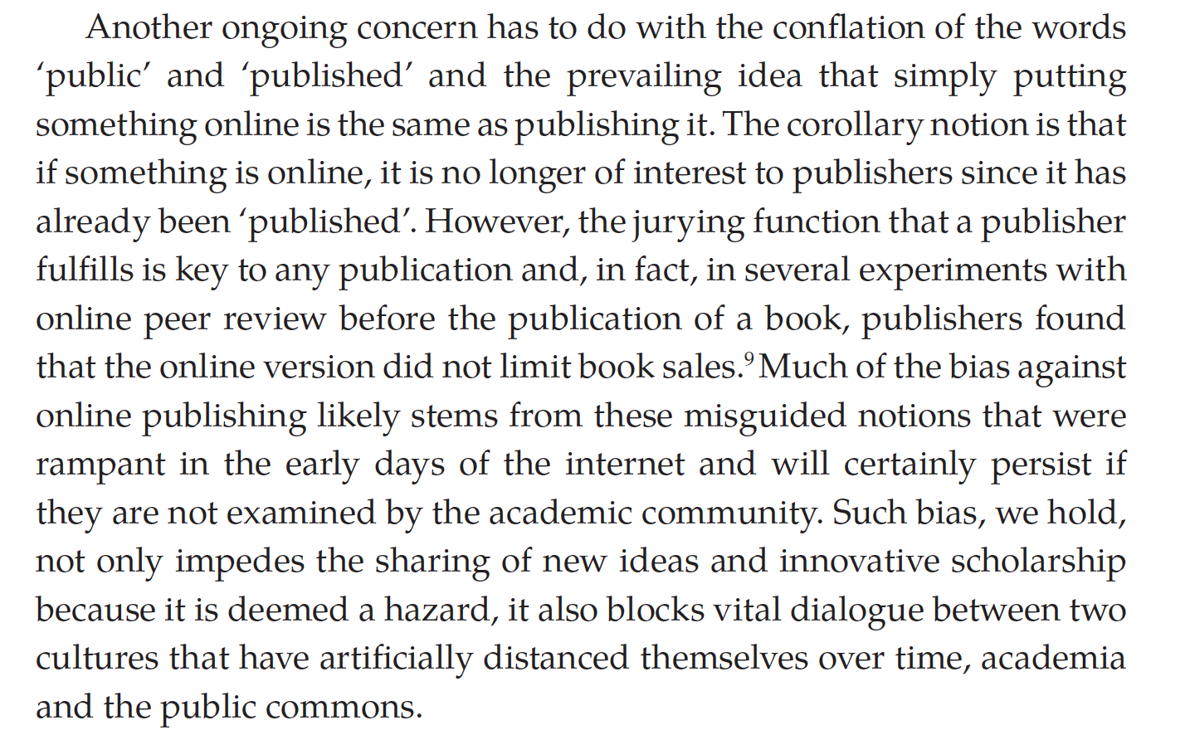

Slide 6
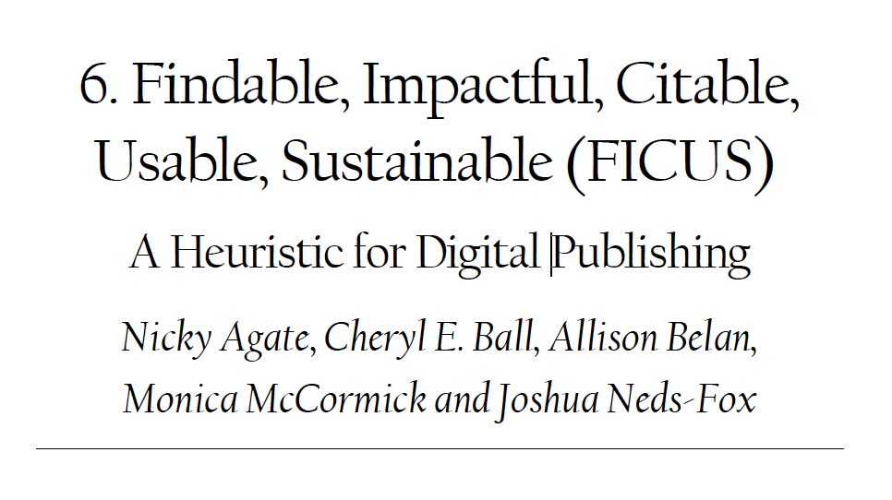
FICUS

Slide 7
The Book and the Blog
https://www.openbookpublishers.com/product/1287
https://blogs.openbookpublishers.com/burst-the-frames-open-access-at-the-dissertation-level/

Slide 8
Support and Logistics at the local level
(with thanks to Dr. Gabriel Morrison)
Clarity of procedure: What? When? Who? How? Where?
Templates for processing born-digital theses: what are steps towards graduation?
Academic support centers / consulting services
Grant support to hire tech or designers
Credit for digital publishing projects during course-work or as ABD
Collaboration with local library and digital scholarship librarians

Slide 9
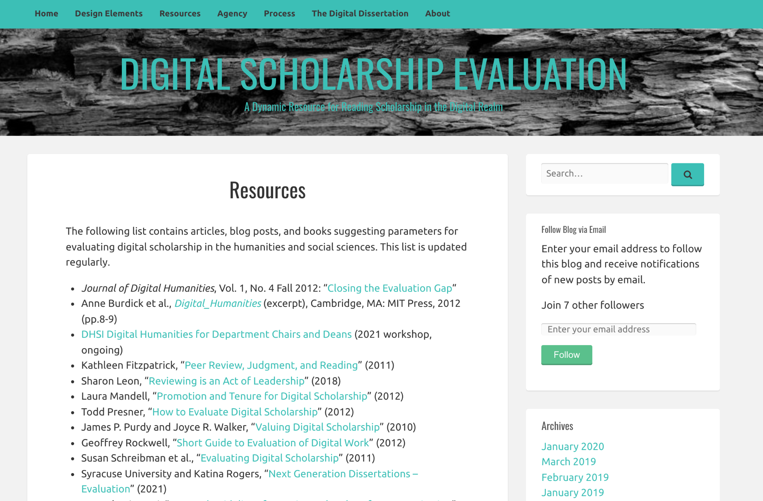

Slide 10
Upcoming Events – Timely Topics
Timely Topics is a series of opportunities to engage with subject matter experts on topics relevant to those who support and advise graduate students and programs. Every session is available to all UConn faculty and staff. If you have any questions or topic suggestions for the Timely Topics Series, please contact Megan Petsa (megan.petsa@uconn.edu).
Understanding Employment Rules and Opportunities for International Students: CPT, OPT and On Campus Employment
Thursday, April 7, 2022 at 2:00 pm
Register
Supporting Graduate Students in Communication of Their Research Through 3MT
Thursday, April 21, 2022 at 11:00 am
Register
Graduate Admissions Forum
Thursday, May 19, 2022 at 11:00 am
Register
Notes:
Basically part 2 – Gena Twarz from Payroll will tell you all the things you need to go to get all of your GAs on payroll as smoothly as possible for fall. That session will be June 1.

Slide 11
Upcoming Events – GradSlate
Upcoming Events – GradSlate
GradSlate Training Presentations are a series of conversations and demos focused on a specific aspect The Graduate School’s online application and CRM system, Slate. These events are appropriate for faculty and staff involved in recruitment and admissions to UConn graduate programs. Please join us to get a deeper understanding about a topic, ask your questions, provide feedback, get tips and tricks, and see new features. If you have any questions or topic suggestions, please contact gradslate@uconn.edu.
Intro to GradSlate / Slate for Graduate Admissions
Wednesday, April 6, 2022 at 2:00 PM Register

Slide 12
Thank you!

