Slide 1
The Graduate School’s
Timely Topics Series
Holistic Admissions Review and Diversity Recruitment
Kent Holsinger - Dean of The Graduate School
Meg Drakos - Director of Graduate Admissions
Stuart Duncan - Director of Programming and Diversity Recruitment
October 20, 2022

Slide 2
Admitting graduate students
“[I]n PhD programs that enrolled and graduated more women and underrepresented minority students than their field, every single one reformed admissions criteria and practices.” p. 18

Slide 3
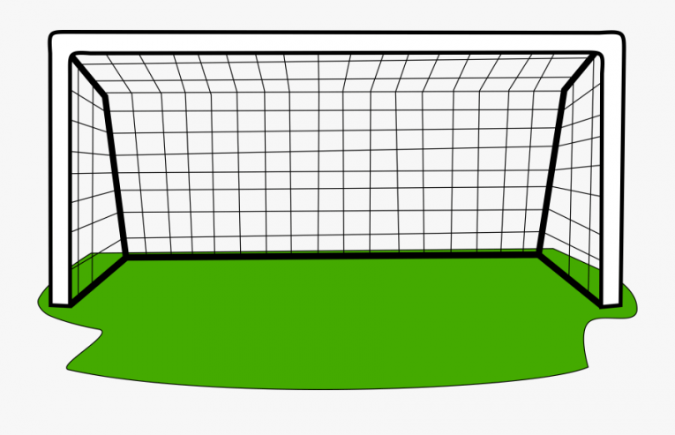
Admitting graduate students
Our Goal
Diverse
Talented
Likely to succeed

Slide 4
Admitting graduate students
The evidence we have
Institutions attended
Transcripts - courses, grades
GRE scores
Personal statement
Letters of recommendation

Slide 5
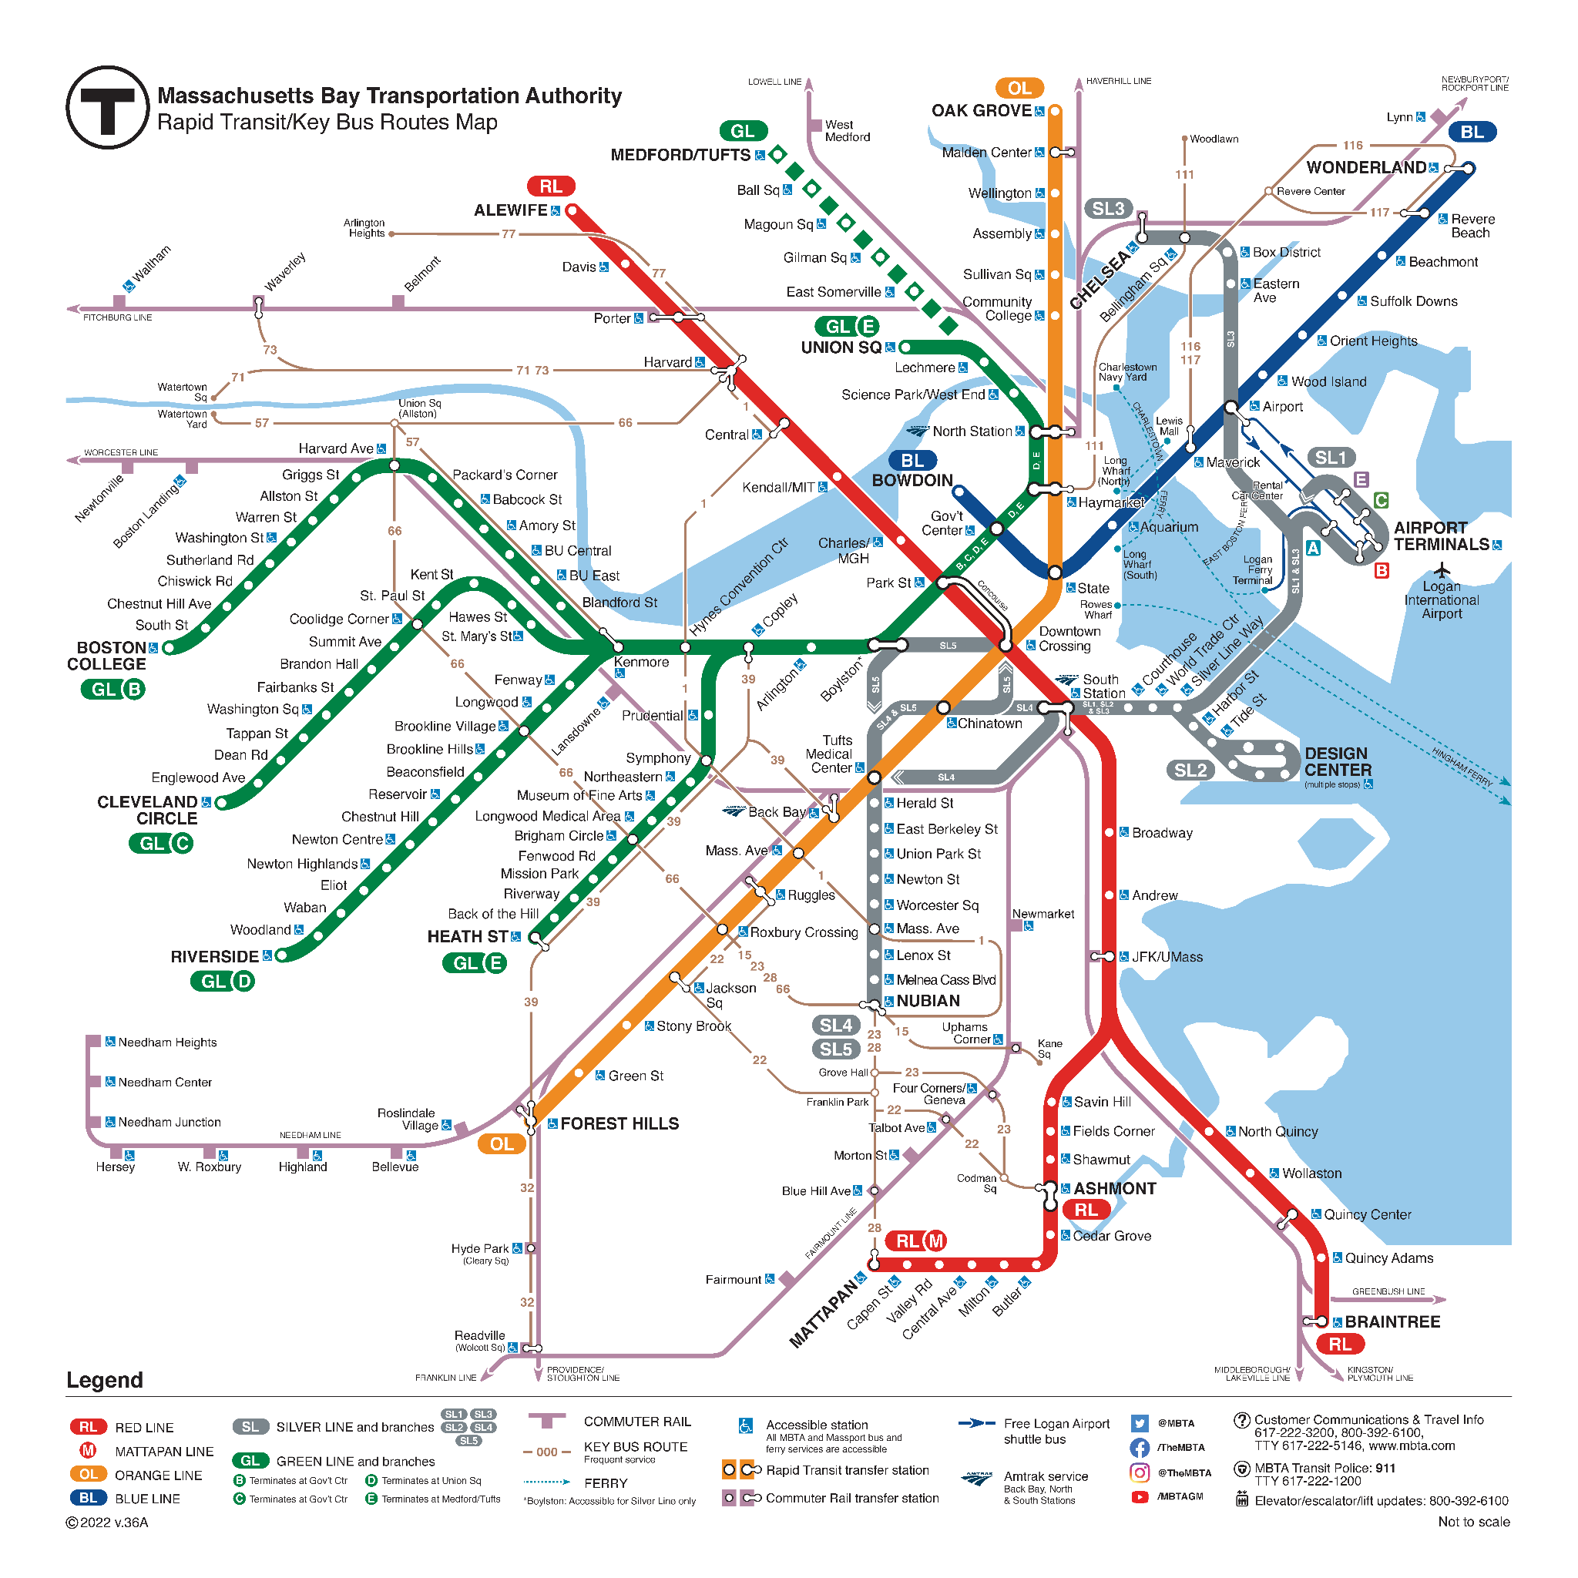
Our problem
Evidence ≠ Goal
https://cdn.mbta.com/sites/default/files/2022-09/2022-09-12-subway-map-v36A.pdf

Slide 6
Our problem
A map is not the territory.
Alfred Korzybski

Slide 7
Holistic evaluation
The qualities that foster success
Academic preparation
Leadership
Teamwork
Grit
Creativity
Resilience
Motivation

Slide 8
Holistic evaluation
The qualities that foster success
Academic preparation
Leadership
Teamwork
Grit
Creativity
Resilience
Motivation
The evidence we have
Institutions attended
Transcripts - courses, grades
GRE scores
Personal statement
Letters of recommendation

Slide 9
Holistic evaluation
Interpreting GRE scores
Three components. Indicate different skills.
Verbal reasoning - ability to comprehend and synthesize written material
Quantitative reasoning - ability to apply quantitative thinking
Analytical writing - ability to construct and evaluate arguments

Slide 10
Holistic evaluation
The qualities that foster success
Academic preparation
Leadership
Teamwork
Grit
Creativity
Resilience
Motivation
The evidence we have
Institutions attended
Transcripts - courses, grades
GRE scores
Personal statement
Letters of recommendation

Slide 11
Holistic evaluation
The evidence we have
Institutions attended
Transcripts - courses, grades
GRE scores
Personal statement
Letters of recommendation
Influenced by
Socioeconomic status
Family stability
Parental education

Slide 12
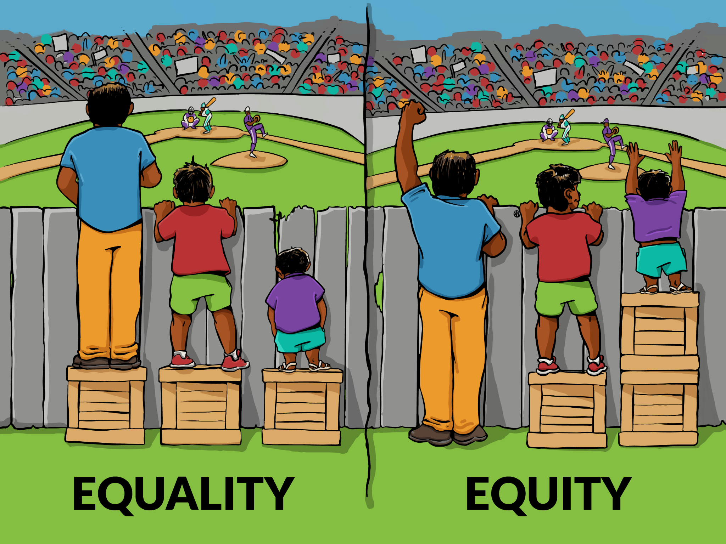
Holistic evaluation

Slide 13
Admitting graduate students
Rethink what excellence means
Assess non-cognitive competencies
Contextualize achievements

Slide 14
Holistic evaluation
Student A
Williams College
Undergraduate honors thesis
GPA > 3.9
All-American in 400m
Strong GRE scores, strong quantitative skills
Admit or not?

Slide 15
Holistic evaluation
Student B
University of Evansville
MS at Michigan State (did not complete PhD)
Fulbright Fellowship in New Zealand
Moderately strong GRE scores, weak quantitative skills
Admit or not?

Slide 16
Holistic admission resources
Navigating holistic admissions for a stronger graduate program
Diversity and inclusion
Master Class in Holistic Admissions
Free, asynchronous
Five modules
Note: Resources provided by the Educational Testing Service

Slide 17
Admissions- Application Requirements
Graduate School Requirements
Program Requirements
(Common Examples)
Transcripts With proof of degree conferral
Degree equivalent to a US 4-year bachelor’s degree
GPA Requirements
Test of English Proficiency
TOEFL, IELTS, PTE, Duolingo, or
Waiver, or
UCAELI Proficiency Certificate
Letters of Recommendation (0-3)
GPA Requirements
Program may have higher GPA requirements than TGS*
Test Scores
GMAT*
GRE *
Essays
Personal Statement
Supplemental Essays
Uploaded documents
Resume/CV
Writing/research samples
Licensure/Certifications
*The use of numerical boundaries to determine who will or will not be considered for admission should be avoided.
Notes:
Meg

Slide 18
Changing Program Requirements
Things to note:
Current program requirements and deadlines can be found on the Program Details form under Graduate Application Requirements.
It is important to make these requirement changes between admission cycles (July-August), so that every applicant has the same requirements. (Apples to apples.)
Changing requirements mid-cycle of application review may be problematic, as not all applicants have met same requirements. (Liability)
Website requirements need to match Slate requirements.
If programs would like to make changes to their own requirements, it’s easy!
Please submit your program’s requirement changes using the Program Details form.
Notes:
Meg

Slide 19
Applicant Experience
Program required materials are required at the time of application submission.
Uploaded materials should be reviewed by programs, to ensure documents are appropriate.
Checklist to be updated appropriately for student to see missing required materials.
Applicants will be notified of missing items in their checklist by email.
Applicants will not be able to submit applications if they do not have all required materials.
*Note* Letters of recommendation are not required to be submitted by recommenders at time of application submission.
Recommenders are notified when student adds recommender.
Notes:
Meg

Slide 20
GPA Requirements for The Graduate School
Except in exceptional circumstances, to be considered for admission to a graduate degree or certificate program, a student’s prior coursework must meet one of the following criteria:
A cumulative GPA for their most recent degree of 3.0 or higher for the entire degree, or
If the most recent degree is an undergraduate degree or the student has not yet completed their undergraduate degree:
A GPA of 3.0 or higher for the entire two most recent years of full-time undergraduate coursework, or
A GPA of 3.5 or higher for the entire most recent year of full-time undergraduate coursework, or
If a student has taken at least one semester of full-time study following the completion of the most recent undergraduate or graduate degree, a GPA of 3.0 or higher for all of their post-degree coursework.
Notes:
Meg

Slide 21
Regular VS. Provisional Admission
Regular admission requires applicant to meet The Graduate School’s GPA requirements. (Previous slide.)
Provisional admission
Is an option for students to MS and Certificate programs who’s most recent overall GPA is 2.60 or above.
Student must receive an overall GPA at 3.0 or above for their first 12 credits as a matriculated student, then will be switched to regular admission.
Student is no eligible to be place on Graduate Payroll until regular admission has been achieved.
International students who require F-1 or J-1 visa sponsorship from ISSS are not eligible.
Notes:
Meg

Slide 22
Letters of Justification
Letters of Justification are accepted/reviewed by TGS for the following situations:
Regular Admission-any applicant with a most recent overall GPA of 2.60 or above.
Provisional Admission- any applicant that does not require F-1 or J-1 visa sponsorship from ISSS with a most recent overall GPA of 2.30 or above.
*GPA Justifications should be written by a major advisor or admissions chairperson. Justification reasons should state why the applicant is a good fit despite their low GPA. Often reasons include research experience, GRE scores, recommendations, etc.*
Notes:
Meg

Slide 23
Optional Requirements:
Statement from the General Counsel about Optional Requirements
2019
Cliffs Notes:
Recommends that programs make admissions decisions based upon required application materials only.
Consideration of extraneous materials could cause problematic consequences to both program and UConn.
Risk increases based on particular population of students with extra materials being considered vs students with only required materials.
*Official statement on next slide*
Resources about Admission Requirements can be found here.
Notes:
Meg

Slide 24
Optional Requirements:
Statement from the General Counsel about Optional Requirements
2019
The General Counsel’s Office makes this statement:
The Office of the General Counsel recommends that departments make admissions decisions based upon review of required application materials only. Consideration of extraneous materials as part of the admissions decision could cause problematic consequences to the institution and to the individual decision-makers on behalf of admitting departments. The risk is two-fold. First, consideration of extraneous materials beyond those required as part of an application packet exposes the University to a claim from a denied applicant that his or her non-relevant materials were considered unfairly, leading to an inappropriate denial of admission. Second, consideration of additional materials when reviewing some but not all applicants exposes the institution and the reviewers personally to claims of bias. That risk is increased if the group with extraneously-considered materials trends toward a particular protected classification, such as gender, race, ethnicity, sexual orientation, disability, veteran status, etc., as compared to the group whose admissions decisions were based only on required application materials. In the event of a discrimination claim, the focus of the claim would be centered upon the individual decision-makers. To both ensure equal consideration of all applicants and to protect our faculty and staff who make admissions decisions, the most prudent course of action would be to only consider the required application materials and not accept extraneous materials from applicants.
Notes:
Meg

Slide 25
Waiving Program Requirements
Program establishes waiver criteria (if any).
The applicant meets the quality requirement in another way.
e.g., GPA of 3.5 or greater or a minimum amount of work experience
Waivers must be applied for all applicants who meet the waiver criteria.
Waiving criteria based on citizenship status is not legally allowed.
If your program offers requirement waivers, please outline your waiver criteria on your website.
Any program that wants to allow waivers should work closely with the Office of the General Counsel to ensure that the guidelines are fair and transparent.
NOTE: Waiving a requirement is not the same thing as making a requirement optional. The Graduate School strongly discourages the use of optional materials within a program, but we recognize that materials required for some programs (e.g., a portfolio for Studio Arts, a writing sample for Philosophy) may not be required for others.
Notes:
Meg

Slide 26
Conferences for diversity recruiting
IRT - Institute for Recruitment of Teachers
COMPACT - Institute on Teaching and Mentoring
ABRCMS - Annual Biomedical Conference for Minoritized Scientists
SACNAS - Society for the Advancement of of Chicanos/Hispanics and Native Americans in Science
oSTEM - Out in Science, Technology, Engineering, and Mathematics

Slide 27
Conferences for Diversity Recruitment

Slide 28
Students and Export Control
*Students are required to be in the US before the first day of the semester*
Students should not work or study until they are in the US
Currently, there are export control concerns due to U.S. government sanctions that apply to international students from the countries listed below.
Students from these countries cannot participate remotely in their courses or start their GA related duties until they physically arrive in the US. If the student is not able to arrive by the 1st day of the semester, they will need to arrange a plan with their instructors to satisfy any course assignments missed until they are able to arrive in the U.S. for in-person instruction.
Cuba
North Korea
Syria
Iran
Russia
Ukraine as of February 22, 2022
Belarus as of February 24, 2022
If you have any questions about Export Control, please email exportcontrol@uconn.edu.

Slide 29
Students and Export Control
Had a few issues this year with students from Iran studying/working abroad when advised not to.
UConn is responsible to report any situations that violate U.S. government sanctions to Department of the Treasury.
Big deal!
Timely Topics presentation on Thursday, November 3, 2022 with Bieu Tran, Export Control officer from the Office of Research and Regulatory Affairs.
Please attend, and ask your faculty to attend if your program admits and employs students from any of the countries listed on the slide above.
Register through this link.

Slide 30
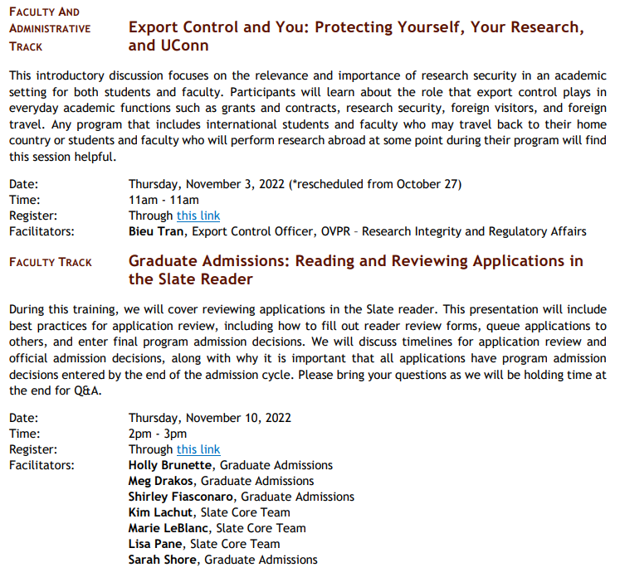
Upcoming Events – Timely Topics

