Slide 1
TIMELY TOPICS
Mentoring Graduate Students of Color
Presented February 2, 2023

Slide 2
Introductions
Dr. Stephany Santos, Assistant Professor in Residence, Biomedical Engineering; Director, Vergnano Institute for Inclusion; and Office for Diversity and Inclusion (ODI) Affiliate
Dr. David G. Embrick, Associate Professor in Sociology and Africana Studies; Director, Research on Resilient Cities, Racism, and Equity (UConn Hartford); and Office for Diversity and Inclusion (ODI) Affiliate

Slide 3
itinerary
What do we know?
Experiences of Graduate Students
Experiences of Graduate Students of Color
Challenges of Mentoring
Best Practices toward Better Mentoring

Slide 4
What do we know?
Studies indicate, overwhelmingly, that good mentoring is one the best predictors of graduate student success
Mentoring (good mentoring) varies by discipline and department, but in general, units are inconsistent when it comes to equitable and consistent mentoring of graduate students; for many graduate students, it is the luck of a draw whether they can find a good mentor
Rewards for good mentoring are often individual-based; however less attention is paid to how the unit (e.g., department) can do a better overall job in mentoring its graduate students
Academia, in general, does not do a good job of mentoring graduate students of color

Slide 5
Experiences of Graduate Students
High Stress (finances, performance, expectations, goals)
Insecurity
*feelings of inadequacy
*lack of training/professional development
Uncertainty
*about the job market (prospects)
*about being fitting in with academia

Slide 6
What They want vs what they get
According to the longitudinal Academic Life Project that surveyed 2000 graduate students (using a nationally representative sample) starting in 1994 and continuing every three years...graduate students pursue higher education:
...out of a desire for knowledge in the field
To do research
To teach
To benefit others through their work
There is data to suggest that many graduate students view their department climate as largely positive—but this varies by discipline, funding levels, strength of cohort, etc.

Slide 7
However...
Graduate student views of department climate are not indicative of good mentorship.
In general, many graduate student feel they did not receive the mentoring they wanted (Austin 2002)
What do graduate students want?
More mentoring, advising, and feedback
Structured opportunities to observe, meet, and talk with peers
Diverse teaching opportunities
Information and guidance
Regular and guided reflection

Slide 8
Graduate students of color...
….face the same challenges, emotions, desires/needs as their white counterparts

Slide 9
Experiences of Graduate Students of Color
Lack of Integration and Sense of Belonging
Isolation
Mental Health, Health, and Coping
Identity (more intense forms of imposter syndrome)
Fear of Retaliation
The Deleterious (and cumulative) Effects of Racial Micro and Macroaggressions
Gaslighting
Lack of Mentoring, i.e., providing guidance through academia, the degrees, networking, or in developing critical professional skills

Slide 10
Mentoring graduate students of color
The data is clear when it comes to mentoring students of color in higher education—historically excluded and racially oppressed students in academia do not receive good mentorship in comparison to their white counterparts.
They are less likely to receive adequate support for their research
They are less likely to be taken seriously as academic scholars
They are less likely to be included in collaborative projects with faculty (or even with their white peers)
They are less likely to be included in networking opportunities
They are less likely to have a sense of belonging

Slide 11
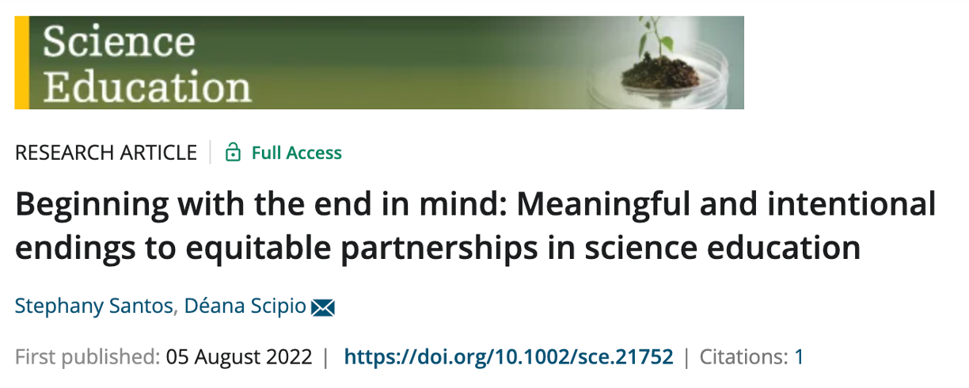
Best practices in mentoring students of color
Mentoring can be intentionally planned as a partnering relationship.
Deficit Language:
You are my GA and I can fund you with this grant
Asset Language:
I am because we are
(Ubuntu)

Slide 12
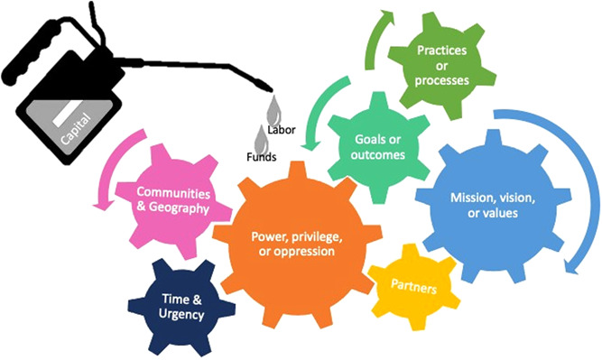
Best practices in mentoring students of color
Mentoring can be intentionally planned as a partnering relationship.

Slide 13
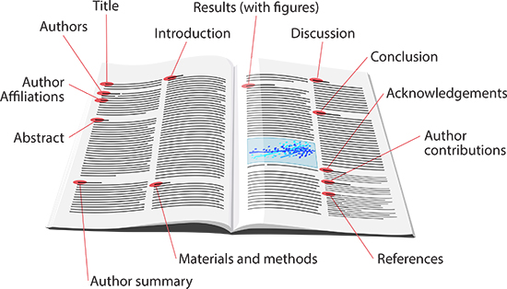
Best practices in mentoring students of color
An effective mentor need not share the students’ experiences and feelings, but they should be aware of and sensitive to them.
Deficit Language:
You don't know how to read a paper!?
Asset Language:
You get to learn the most effective way to learn from academic papers!
Assumptions of knowledge or experience
. For example, assumptions on
"How to read an academic paper"
Notes:
Another example is that we know the system.

Slide 14
Deficit language is demoralizing
How does what I say affect
my student's
Imposter Syndrome?
How does what I say affect
my student's
Internalized Oppression?

Slide 15
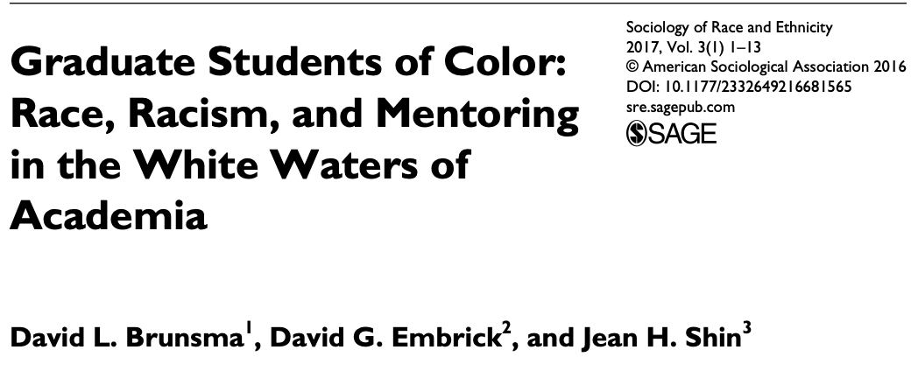
Best practices in mentoring students of color
Mentoring roles should be defined and revisited often.
Deficit Language:
I can’t help you – look on the website
Asset Language:
Here’s the domains I’d love to contribute to towards your success

Slide 16
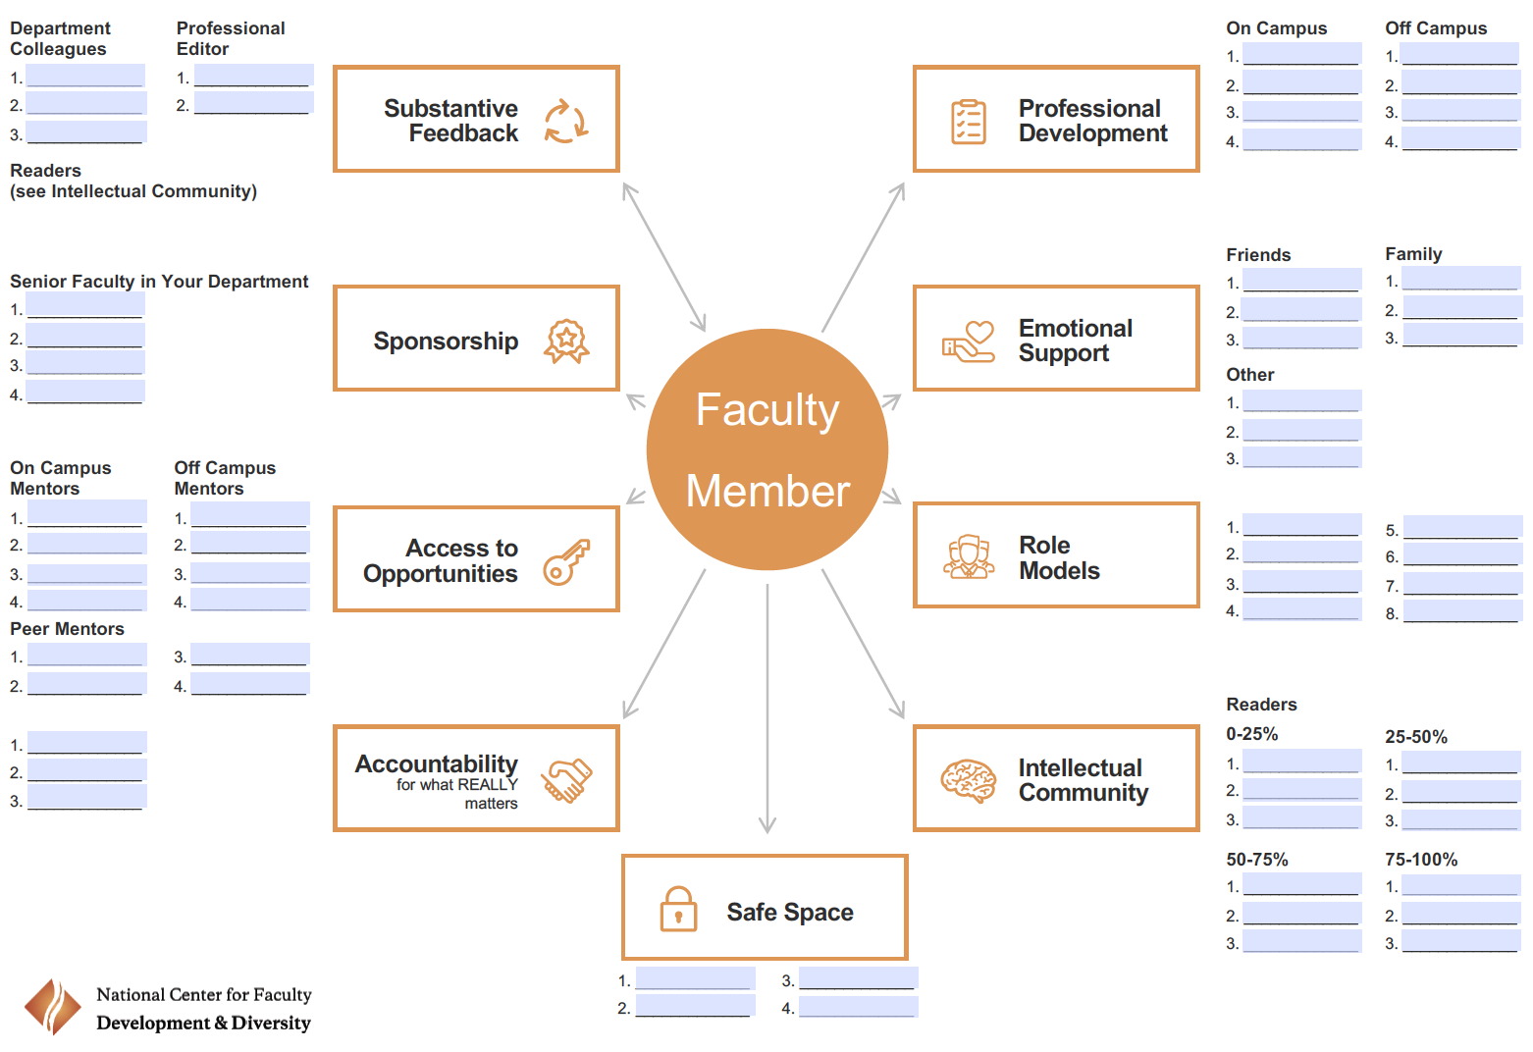
Best Practices in mentoring students of color
Mentoring roles should be defined and revisited often.

Slide 17
Role uncertainty is demoralizing
How does what I say (or don’t) affect my student's
Imposter Syndrome?
Am I allowing careerism/time constraints to govern this mentoring?
How does what I say (or don’t) affect my student's
Internalized Oppression?
How am I encouraging a
feedback loop?

Slide 18
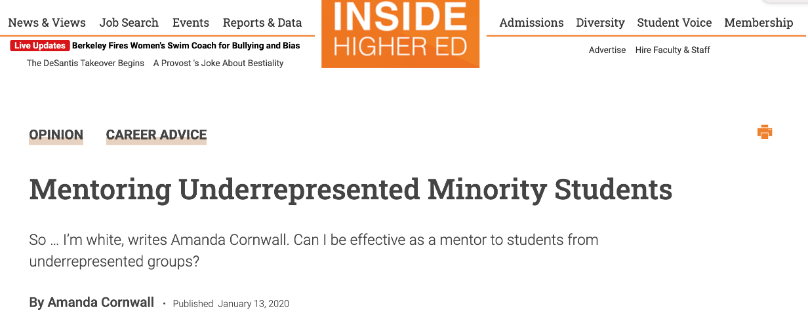
Best practices in mentoring students of color
Feedback should be given and sought by both parties regularly.
Deficit Language:
You’re good, right?
Asset Language:
Are we meeting at a frequency that supports your needs?

Slide 19
Inadequate and inappropriate feedback is demoralizing
How does what I say affect
my student's
Imposter Syndrome?
Am I operating on a precedence or “how it’s been” for others?
How does what I say affect
my student's
Internalized Oppression?
How am I affirming my student?

Slide 20
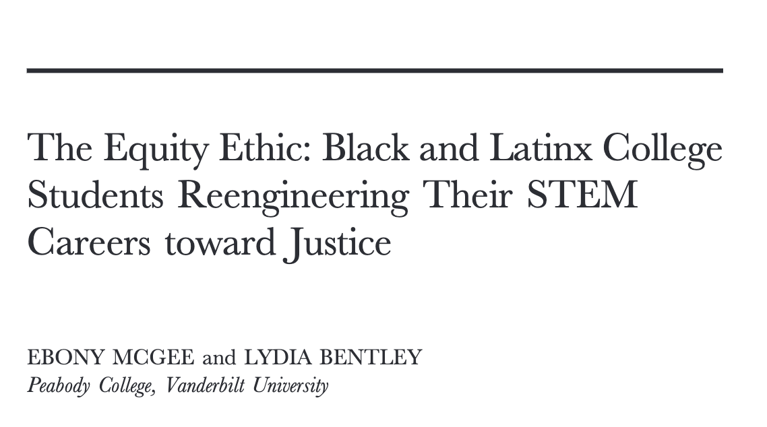
Best practices in mentoring students of color
In particular, [many] Black and Latine/x students seek work and careers that integrate social justice, empathy, and equity matters.
Deficit Language:
Your research
comes first.
Asset Language:
It would be a great opportunity for you to present at the NSBE conference.

Slide 21
Dismissing cultural needs is demoralizing
How does what I say affect
my student's
Imposter Syndrome?
How do we integrate equity and social justice into
our research group values?
How does what I say affect
my student's
Internalized Oppression?
How do I promote affinity-based programs and events?

Slide 22
Best Practices Summary
Mentoring can be intentionally planned as a partnering relationship.
An effective mentor need not share the students’ experiences and feelings, but they should be aware of and sensitive to them.
Mentoring roles should be defined and revisited often.
Feedback should be given and sought by both parties regularly.
In particular, [many] Black and Latine/x students seek work and careers that integrate social justice, empathy, and equity matters.
Grounded by:
1. How does what I say affect Imposter Syndrome? (individual level)
2. How does what I say affect Internalized Oppression? (systems level)

Slide 23
questions
Notes:
How do I check in on how a student who I think may be subject to a lot of stresses related to minoritization without making their status as minoritized feel centered in my lab?

