Slide 1
Celebrate and Embrace the Gifts of Neurodiversity
Image from: Google Image Search

Slide 2
Neurodiversity and the Advisor/Advisee Relationship: Supporting and Empowering Neurodiverse Grad Students in STEM (and Beyond)
Connie Syharat, NSF IGE Graduate Researcher & Program Manager of CEE Include Program (NSF RED)
Lexi Hain, Assistant Professor in CEE & Program Manager for NSF IGE Project
Timely Topics | March 2, 2023

Slide 3
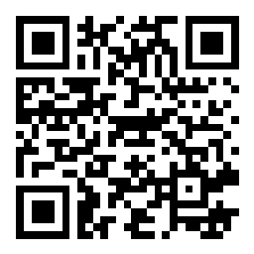
Slido!

Slide 4
Neurodiversity: What is it?
A term coined in 1998 by Australian sociologist Judy Singer and popularized by journalist Harvey Blume
A Social justice movement that grew out of the autism activism during the 1990s
Natural variations in the human genome that result in differences in brain structure and/or function

Slide 5
Some examples of the cognitive variations that fall under the neurodiversity umbrella are:
Autism Spectrum
ADHD
Dyslexia
Dyspraxia (DCD)
Anxiety
Depression
Dyscalculia
Notes:
I feel like the contrast ratio might not be high enough with text and background colours

Slide 6
Traditionally, neurodiversity has been viewed through a deficit lens.
Historically, invisible neurological differences have been defined as an illness or disorder to that needs to be treated
Education often focuses on remediating weaknesses, rather than identifying and developing student strengths
Our program takes a strengths-based approach

Slide 7
Outline
Program History at UConn
Overview of IGE Project
Research Results
Open Discussion and Q&A

Slide 8
Program History
Since 2014, several programs focused on Neurodiversity have been launched at UConn.
The focus of the programs was initially on ADHD and has since expanded.
In addition, programs have since expanded from Engineering to STEM, and beyond the undergraduate level to both K-12 programs as well as graduate education.
All program take a Strength-Based Approach to these neurological differences.
Notes:
Many of the participants joined a PhD program after graduation, one received an NSF GRFP fellowship in 2019

Slide 9
NSF
Research Initiation Grant: Nurturing the Creativity of Students with ADHD in Engineering Disciplines, 2014 to 2017
REU Site: Research Experience in Cyber and Civil Infrastructure Security for Students with ADHD: Fostering Innovation, 2015 to 2019
Past Programs
Current Programs
>$7.5 million
CAREER: Promoting Engineering Innovation Through Increased Neurodiversity by Encouraging the Participation of Students with ADHD, 2017-2022
IUSE/PFE:RED Innovation Beyond Accommodation: Leveraging Neurodiversity for Engineering Innovation, 2020-2024
REU Site: Research Experience for Neurodiverse Students: Transforming the Nation's Aging Infrastructure by Advancing Radical Solutions, 2021-2024
IGE: Encouraging the Participation of Neurodiverse Students in STEM Graduate Programs to Radically Enhance the Creativity of the Professional Workforce, 2021-2024
MCA: Leveraging Artificial Intelligence to Enhance the Creativity of the STEM Professional Workforce by Transforming Education for Neurodiverse Learners, 2021-2024
NRT: Transdisciplinary Convergence in Educational Neuroscience Doctoral Training Program (TRANCEND), 2022-2027
Notes:
Many of the participants joined a PhD program after graduation, one received an NSF GRFP fellowship in 2019

Slide 10
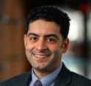
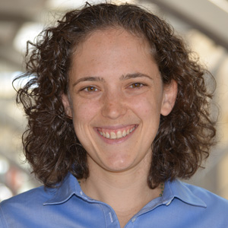
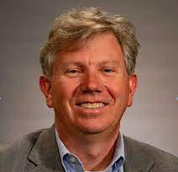
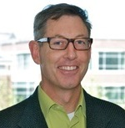
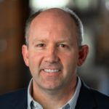
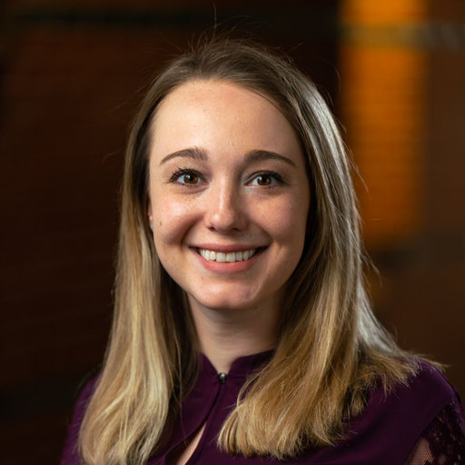
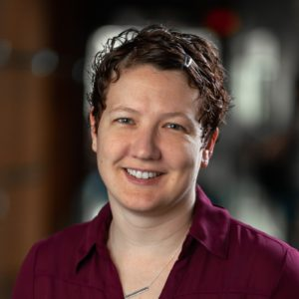
Project Team
Dr. Arash Zaghi, PI
Engineering Education
arash.esmaili_zaghi@uconn.edu
Dr. Rachael Gabriel, Co-PI
Education Research rachael.gabriel@uconn.edu
Prof. Joseph Madaus, Co-PI
Postsecondary Education
joseph.madaus@uconn.edu
Prof. Tom Deans, Co-PI
Director of UConn Writing Center
tom.deans@uconn.edu
Prof. Richard Christenson, Co-PI
Director of NIUVT
richard.christenson@uconn.edu
Dr. Alexandra Hain
Project Manager
alexandra.hain@uconn.edu
Connie Syharat
Graduate Research Assistant
connie.syharat@uconn.edu

Slide 11
Objective of NSF IGE Project
This project is aimed at enhancing the creativity and productivity of the STEM workforce by increasing participation of neurodiverse graduate students whose unique abilities are largely undervalued.

Slide 12
Presentation of Findings from Focus Groups
Presentation of Findings from Focus Groups

Slide 13
Focus Group Demographics: N=25
Neurodiverse Identity (over 10%) | N | %
Anxiety | 13 | 52%
ADHD | 13 | 52%
ASD | 5 | 20.%
Depression | 6 | 24%
Gender Identity | N | %
Woman | 17 | 68%
Non-binary | 2 | 8%
Man | 6 | 24%
Race/Ethnicity | N | %
Multiracial/biracial | 2 | 8%
Hispanic or Latinx | 1 | 4%
White | 22 | 88%
Graduate Program | N | %
MS | 6 | 22%
PhD | 19 | 76%

Slide 14
A novel model for understanding neurodiverse graduate student experiences in STEM

Slide 15
Overarching factors
Assumptions about what makes a good graduate student
Encoded power and policies in graduate education
Advisor-Advisee Relationship
Neurodiverse students are subject to systemic power dynamics and policies that privilege certain ways of thinking, learning, knowing, socializing, and being.
(Lynch, et al., 2020)

Slide 16
Core Experience:
Invisibility of Neurodiversity
Neurodiversity is not apparent without disclosure
Stigma and stereotype threat impacts performance and wellbeing
Self-stigma (internalization), lack of disclosure, masking
“Nonvisible stigmatized identities… are at particular risk for poor mental health.”
(Haft & Hoeft, 2021)

Slide 17
Shared Graduate School Experiences
Imposter syndrome/ Lack of Sense of Belonging
Work-life imbalance
Increased mental health challenges
“Nonvisible stigmatized identities… are at particular risk for poor mental health.”
(Haft & Hoeft, 2021)

Slide 18
Theme 1: Internalization of Neurotypical Norms
What kind of student is a “good fit”?
Culture of perfectionism, must be good at everything
Shame, blame, anxiety, and self-loathing
“the ethic of higher education still encourages students and teachers alike to accentuate ability, valorize perfection, and stigmatize anything that hints at intellectual (or physical) weakness”
(Dolmage, 2017)

Slide 19
Theme 2: Self-Silencing to Make it Through Grad School
Power structures, importance of advisor approval
Inhibition of self-expression, selfless behavior, and pleasing behavior
Real consequences for funding, career options
“students faced with the perception of threatening power relationships, whether gender-based or otherwise, might be especially likely to be willing to sacrifice autonomy as an ill-fated strategy for preserving relatedness with the powerful other, the teacher”
(Patrick et al., 2019)

Slide 20
Theme 3: Neurodiverse Burnout Due to Overwork & Masking
“Neurodivergence can be hidden due to real or anticipated stigma, and this may be detrimental to students who expend energy masking their difference. Faculty can expand the window of what is acceptable by self-disclosing their own neurodivergence or identifying as an ally.”
(Shmulski, et al., 2021)
Work long hours to compensate, neglect self-care
Expenditure of energy related to masking
Increase in anxiety and burnout

Slide 21
Break Out Group Discussions
Each group will be given 1-2 quotes to discuss from our focus group.
Introduce yourselves!
How did the quote make you feel? Did it surprise you?
Thinking about grad students in your department... Have you witnessed something similar to this?
If you are a major advisor, how could you help?
If you are staff or in another support role, how could you help?
Can similar methods be applied to all advisees?

Slide 22
Focus Group Meta Themes (Group 1)
Group 1
Neurotypical Norms
“Yeah, I think the main thing that I struggle with is the self-deprecation and the comparison. Because I work in an office with a lot of neurotypicals, who just like can write and ponder about these things all day, and like, don't ever shut off… So, listening to these people and be like, Why can't I be like them? Why can't I be like them? Why can't I be like them? And I'm like, I'm lucky if I get one good day, a week, let alone a month, where I can do something partially similar to what they're doing.”

Slide 23
Focus Group Meta Themes (Group 2)
Group 2
Neurotypical Norms
“not every advisor knows… that people are different and can't just like all work the same way. And then you know, maybe they don't care. Maybe they're just like, if you don't fit, you don't fit.”
“Like, you might say, ‘Oh, I will operate differently.’ And they say, ‘You can’t do that.’ And it’s like, well I can’t control that. So, now I’m just being punished for who I am.”

Slide 24
Focus Group Meta Themes (Group 3)
Group 3
Self-Silencing
“I’ve had the chance to talk to numerous students about their experience with mental health in our program. And every single time, it’s been awful… if you dare tell somebody that you have an issue. I mean, they’re not going to say that they’re taking you out of the lab because of the issue. But they will tell you that they have a problem with your mental health status. And, oh, all of a sudden, I don’t have funding anymore. So sorry.”

Slide 25
Focus Group Meta Themes (Group 4)
Group 4
Self-Silencing
“I know many people just in my program who hide it, because people who do mention it to faculty members are treated much differently. And so, it’s kind of easier to just deal with it on your own and not tell anyone, and maybe struggle behind the scenes. But that’s still sometimes better than letting them know and having them treat you much worse or much differently.”

Slide 26
Focus Group Meta Themes (Group 5)
Group 5
Masking Neurodiversity
“…the program is a circle, like chute thing and like some of us are squares and they're trying to press the squares through a circular tube and like not all of us fit. And so sometimes we get left out of things. And we're not included in things because the program and the institution were not built for people like us in mind. And sometimes, like, professors don't have the skills or the knowledge to understand our perspectives… So, like, sometimes, the burden is placed on students to kind of like dull their personality or like, be a certain way, just so they can make it through the program”

Slide 27
Focus Group Meta Themes (Group 6)
Group 6
Masking Neurodiversity
“I do this masking where I put on that I'm very together for - in front of her and I have all these plans, and my calendar is all marked, but then my day to day, I don't feel like that. So, like revealing that side of me, is something that gives me anxiety.”

Slide 28
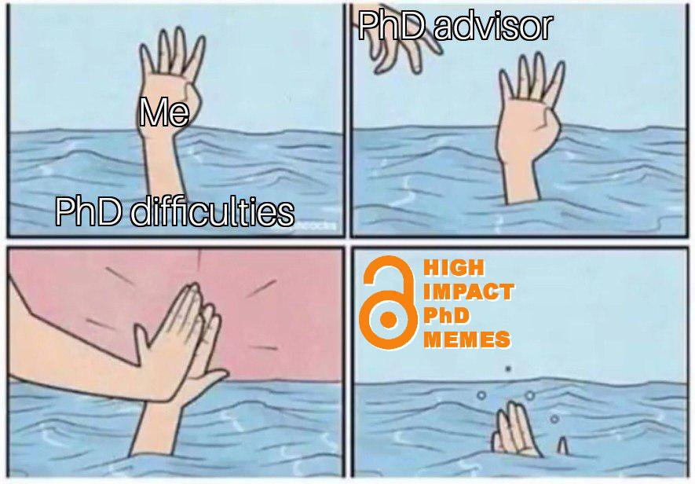
Focus Group Meta Themes (Group 7)
Burnout
“…some people might be able to do that for long periods of time and like maybe not experience burnout, but then other people might experience burnout more quickly with those things… But I think there's this expectation of like, you should just do X, Y, and Z and overload yourself, and you'll be fine, because everyone else has been fine doing that. But that would take me out longer. And I would need a longer period for recovering from that.”
Group 7

Slide 29
Questions?
Thanks!
Questions?

Slide 30
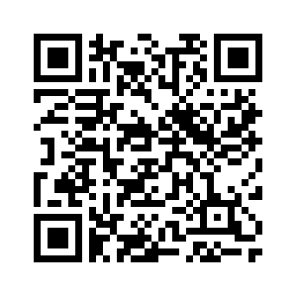
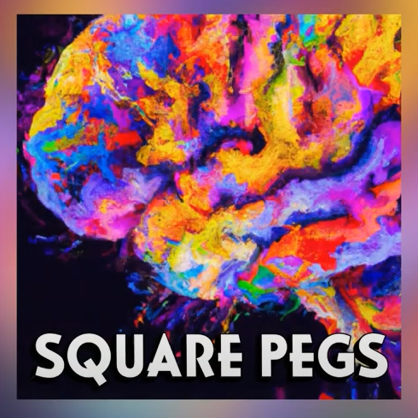
Listen to the Square Pegs Podcast!
In-depth conversations with:
neurodiverse faculty
current & recent graduate students
experts in the field
Find the links at:
https://neurodiversity.engr.uconn.edu/squarepegspodcast/
Notes:
Opening up help to everyone in the school of engineering
https://www.instagram.com/neurodiversity.at.uconn/

