Slide 1
The Graduate School’s
Timely Topics Series
Preparing for Fall: Graduate Assistant Payroll Procedures
Alison Cutler, Labor Relations
Megan Petsa, The Graduate School
Joanna Smith, Human Resources
Gena Twarz, Payroll Department
June 1, 2023
Notes:
Add for next year:

Slide 2
Graduate Assistants
- Eligibility to Hire/Offer Letter Guidance
- Prepping for Fall
- Supplemental Description of Duties Forms
- Stipend Levels
- TA English proficiency
- Overrides and the GA Hire Level Report
- Things You Might Need to Know
- Mid-semester separations
Megan Petsa, Director of Graduate Student Administration, The Graduate School
megan.petsa@uconn.edu | https://grad.uconn.edu/staff/assistantship-information/
Alison Cutler, Labor Relations Associate, Labor and Employment Attorney, Office of Faculty & Staff Labor Relations
alison.culter@uconn.edu | laborrelations@uconn.edu
June 1, 2023

Slide 3
Offer Letters Guidance
Questions about eligibility to hire and offer letters
  "Setting Up for Success: Recruitment, Offer Letters, and Hiring of GAs”
    Slides
    Video
  Information about Assistantships webpages
  Past Timely Topics sessions on GAs

Slide 4
Prepping for Fall
Fall Offers
  June 1st deadline
    If not confident in funding, offer can be held
      This does not include waiting for a new KFS to be set up
    Extenuating circumstances
    Still keep payroll deadlines in mind
Withdrawing a GA Offer
  You must work with Labor Relations to do this
  TGS has templates available for:
    A GA who deferred admission to a future semester
    A GA who did not respond to the GA offer by the deadline
GA Onboarding Page
  Resources and action items for GAs who fall under the GEU
    Webpage link should be provided with offer letter
GA Registration Deadline
  8/23 – must be enrolled in at least six credits prior to their start date
  GEMB hold
Notes:
Decreasing FTE

Slide 5
Prepping for Fall
Late Arrivals
    Academic policy is in the Grad Catalog
    Day 10 deadline
    GA offer letter language. Review for GAs is case-by-case
    Requests for exceptions must be submitted by the department
Last Day of Work for F- and J-visa GAs
  Day before conferral date
Remote Work
  Requires advance approval from graduatedean@uconn.edu and may involve review by additional areas
  Extenuating circumstances
Supplemental Description of Duties (SDD) Forms
  New online workflow for SDDs available for use by all departments
    Email gradschool@uconn.edu or jack.Corcoran@uconn.edu for access
  Department-specific templates and the Word docs on HR’s website can also be used
Notes:
Remote work – contact Dean Holsinger for approval through graduatedean@uconn.edu
Depts/fac/staff should not contact the union directly—that is LR’s role. Depts should reach out to alison.cutler@uconn.edu for assistance.

Slide 6
Supplemental Description of Duties (SDD) Forms
SDDs are essential if performance or workload issues arise and are required every semester by the GEU-UAW contract (Article 5, section 6)
  Must include specific duties, including:
    assigned course, lab, research project, or position;
    the faculty member(s) or supervisor(s) to whom the GA will report;
    the duties that the GA will be required to perform;
    course meeting times and location;
    the maximum number of students for which the GA will be responsible per class, section, lab, etc.;
    work location.
SDD Timeline:
  Make every effort to issue at least 30 days prior to start of semester and no later than the first day of the semester
    Better to issue on time and then amend as needed
  GAs must be given 24 hours to review the SDD and raise concerns
Maintaining Records:
  Make sure you receive a signed copy of the SDD from the GA
  Copies of SDDs should be maintained within the department (no longer sent to Payroll)
Notes:
Depts/fac/staff should not contact the union directly—that is LR’s role. Depts should reach out to alison.cutler@uconn.edu for assistance.

Slide 7
Stipend Levels
GA stipend levels
  Level 1 (B) - Master’s degree students and doctoral students without a master’s or master’s equivalency
  Level 2 (M) - Doctoral students with 30 grad-level credits or previous master’s degree in a related field of study
  Level 3 (PhD) – Doctoral students with the General Exam milestone
GA Pay Level Adjustment Form
  Can be used to pay above contract minimum
  Can be used to manually change a grad feeding to SmartHR as Level 2 to Level 1 if their previously completed master’s is not related to their UConn doctoral field of study

Slide 8
Hiring TAs Without English Proficiency
Admission requirement vs TA requirement
Anyone whose primary language is not English must provide proof of proficiency to be a TA with instructional contact duties
  UConn’s English Proficiency Policy
  4/26 listserv email, “Info to share with TAs - English proficiency policy”
Check Slate for incoming students or refer to GA Hire Level Report for current students
  Next microteaching test is in August (June test registration deadline was 5/25)
  Waiver interviews take place every month; reach out to ana.s.colon@uconn.edu to set up an interview.
TAs who have not provided proof of English proficiency will have a block on their payroll authorization

Slide 9
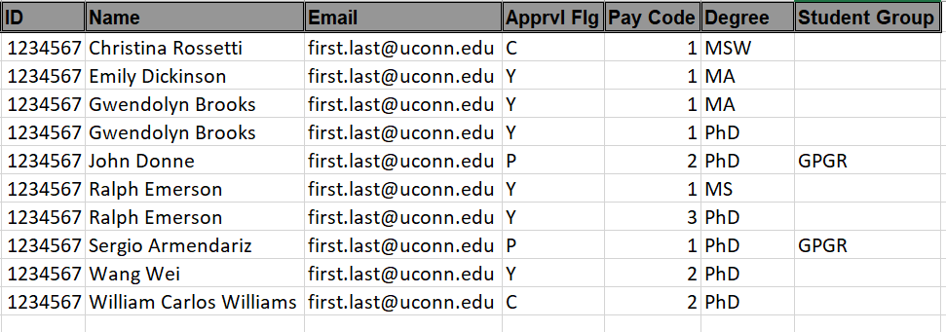
Overrides, GA Hire Level Report
“GA Hire Eligibility and Stipend Level Report”
  Report includes all matriculated grads
  Approval Flag column shows blocks on their payroll transaction
  Shows the level they will auto-populate as in SmartHR
    Check this report to make sure the level on the offer letter matches what you will see in SmartHR

Slide 10
Overrides, GA Hire Level Report
Blocks:
  Provisional – will not be overridden
  Classroom English proficiency (more information on this policy)
Override Requests for Speech Block
  When you get the error message saying “Contact Grad School”, the transaction has automatically saved to DRAFT status
  Request an override from jack.corcoran@uconn.edu
    Include name, ID, and justification for override
      Example: “TA will not be assigned instructional contact duties” or “TA is signed up for the August microteaching test and will be assigned to non-instructional contact duties only if they do not pass.”
  Make sure you close out of the transaction before requesting an override.

Slide 11
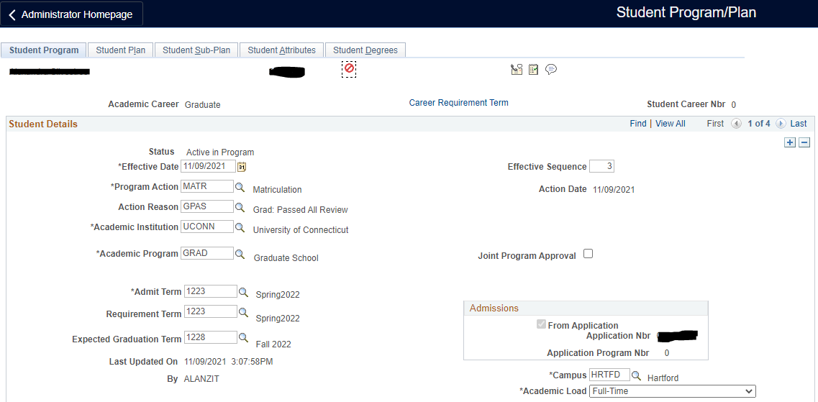
Can’t Find a Record in SmartHR?
Has the student been matriculated?
Deferred students cannot be placed on payroll yet
  Check status on the Program/Plan panel in Student Admin
  Once they are term activated, they can be added to payroll
Reach out to TGS for assistance

Slide 12
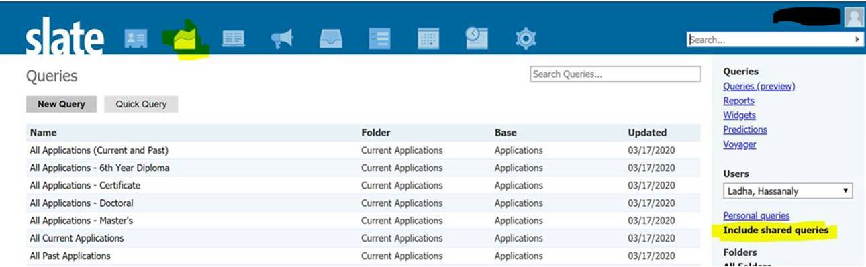
Checking Matriculation Status in Slate
Users can find specific information about applicants in the back end of Slate by using queries we have set up (make sure to select “include shared queries).
https://connect.grad.uconn.edu/manage/
Queries for Past and Current Applications – describes all queries
Most popular queries:
Offer of Admission Released and Received - Current applications with an admissions decision which has been received by the applicant. These are the applicants to whom you may communicate confidently about their admission to your program.
Offer of Admission Replied - The applicant has replied to their offer of admission on a current application, either Yes or No.
Official Matriculation in Process of Complete - Applications for which the Graduate School is reviewing to matriculate or for which they have released an official matriculation decision. (If applications are in the Matriculation Audit bin, we are waiting for transcripts. If applications are in the Matriculation bin, we will be sending them a matriculation letter in Slate and matriculating them in SA shortly If applications are in the Closed bin, The Graduate School has already sent the applicant the matriculation letter in Slate and matriculated them in SA.)

Slide 13
Things You Might Need to Know
GA appointments with either a retroactive date of hire or a retroactive increase in percentage of appointment are prohibited
Certificate only GAs
  Send justification to TGS
Supplemental Employment
  Refers to employing a GA above 20 hr/wk or on another UConn payroll while classes are in session and GAs who wish to hold a GA and internship simultaneously
  Employment external to the university requires written confirmation from major advisor, per The Graduate Catalog. No Supplemental Employment Form required but form can be used to document approval
  International students are restricted to 20 hours per week while classes are in session.
  Requires major advisor approval.

Slide 14
Things You Might Need to Know
Who Processes the Payroll Transaction?
GAs appointed outside their academic home department
  NEW website with guidance
  Hiring department should communicate with academic home department BEFORE issuing a formal or informal offer
  Hiring department creates offer letter
  Academic home department inputs payroll transaction
    Hiring department should provide fully executed offer letter, SDD, KFS, determine if I-9 is needed and who will handle that
GAs working at UConn Health
  GAs who will be working at UCH should be appointed through UCH
GAs in UConn Health-based grad programs working at Storrs
  Reach out to TGS for assistance

Slide 15
Mid-Semester Separations
Defending does not consequently terminate GA
Alternate Completion Date Request
  A GA who completes all degree requirements and wishes to terminate GA early must complete this form
  This process aligns the completion date and GA termination and notifies all relevant parties
Separating without Completing
  A GA who is terminated without completing their degree within seven calendar days will be responsible for paying pro-rated tuition
Academic Leave of Absence
  Academic leave (not GA leave) is a temporary suspension of student status. A student cannot hold a GA on academic leave.
  As part of the VSN process, the department payroll processor is notified what effective date to use on the payroll separation transaction.

Slide 16
Payroll Processing Overview
GA Payroll Processing
GA Payroll Audit
GA Tuition Waivers
Delayed Processing Consequences
I-9 Forms and Tax Forms
MISC Info
Gena Twarz, Graduate Payroll Manager, Payroll Department
gena.twarz@uconn.edu
June 1, 2023

Slide 17
GA Payroll Processing
SmartHR/CoreCT Payroll Transactions:
  UC_TBH_GA Hire – never employed or returning from a break in service
  UC_TBH_GI Provost Professional Internship- only a few departments have Grad Interns
  UC_TBH_DC_GRAD_DAT Fall continuation following spring 2023 assistantship
To be used after the start of the semester has been processed:
  UC_TBH_DC_GA_PAY Pay level changes or FTE changes
  UC_TBH_DC_FUND_GA Funding KFS changes
  UC_DC_TERM_GRD Termination / remove from payroll
July 14, 2023 - 1St processing deadline
Notes:
Stipend Rates, Payroll Dates and Deadlines for processing are posted on the Payroll’s website. Currently, the posted rates are available through the end of spring 2026. This academic year’s 1st deadline is July 15, 2022.
Graduate Assistant Offer Letters: Grad offer letters are posted on the HR website. New letters should be downloaded each academic year and modified for your department needs. The legal language should not be changed or deleted. If you have questions about modifying a GA letter, please contact either Megan or myself for guidance.
Link to Grad Contract: SDD forms are a requirement of the contract. If you are waiting for the SDD form, do not hold up entering the SmartHR transaction. These forms can be uploaded to the SmartHR template if it has not already been completed by Payroll, or emailed to Payroll later. They should be saved using the format: Last Name, First Name SDD fall or spring and the year.
SmartHR/CoreCT transactions: The following SmartHR templates are the only templates that should be used to start the FALL semester because they transmit data to the Bursar’s Office for the tuition waiver. If the fall renewal will include a pay change, FTE change, or coding change that differs from the spring semester, these changes can be reflected using the general data change template - UC_TBH_DC_GRAD_DAT.
UC_TBH_GA – never employed as a GA or a GA that is returning from a break in service (following a separation action).
UC_TBH_GI – Provost Professional Internship- only a few departments have Grad Interns.
UC_TBH_DC_GRAD_DAT – Fall continuation following spring 2022 assistantship.
A pay change, or coding change template can be used after the start of the semester. The appropriate information will not be transmitted to the Bursar’s Office if the wrong template is used to start the semester.

Slide 18
GA Payroll Audit
Compare offer letter against SmartHR Hire/Continuation transaction:
Name: Full legal name.
Stipend level: PeopleSoft SA feeds pay rate information to SmartHR.
If level 2 rate is expected, but not yet applied to the SmartHR transaction, use the following language in the offer letter:
“Compensation at the Level 2 stipend rate of [state the numerical amount] is conditional upon the submission of the final transcript which reflects the successful completion of the Master’s Degree program to the University of Connecticut Graduate Admissions team (gradadmissions@uconn.edu). Until such time, compensation will be at the Level 1 stipend rate of [state the numerical amount].”
Stipend Charts are determined by the GEU-UAW contract period 2023-2024.
Hours: FTE Full-time = 20hrs 100%, Part-Time Minimum of 10 hours 50%, or any amount of time between 50% & 100%.
Semester Dates: Full Academic Year 08/23/2023-05/21/2024 Fall only 8/23/2023-01/06/2024; Spring continuation 01/07/2024-05/21/2024; Spring new hire 01/06/2024-5/21/2024
Employment Code: UT Teaching assistant, UR Research assistant, US both Teach and Research. Do not use GA-UCONN, this is not a valid code even though it is still listed in the drop-down menu.
Signatures: Offer letters with a “font signature” or digital signature will be accepted as well as wet signatures.

Slide 19
Computer-Generated Components Needed for Graduate Assistant (GA) Tuition Waiver
If at any time any of these components are not in sync, the tuition waiver might “fall off” the fee bill and the tuition charge will show as an amount due by the GA.
1) An active graduate student record in Student Administration System (SA - PeopleSoft)
2) A valid graduate assistant payroll authorization entered into Core-CT SmartHR for a minimum of one semester.
3) Social Security Number (SSN) match in SA (PeopleSoft) and Core-CT (Payroll)
4) Full-time registration of six (6) or more credits on the GRAD career.
Caution regarding SS numbers:
PeopleSoft does not require incoming graduate assistants to enter their Social Security number. This is an optional field.
If a payroll record is initiated with a ‘placeholder’ number, Payroll can still pay the individual and the tuition waiver will show on the fee bill as long as Core-CT and Student ID/PeopleSoft numbers match. When the GA updates one of the systems with their valid SSN, they must also update the other system. Biographical-Info-Update-Request
Once the payroll record has been established, there isn’t an automatic update of SSNs. Upload SSN here

Slide 20
Delayed Processing of GA Payroll
Tuition waiver will not be added to GA’s account.
Payroll deductions: GAs cannot apply for a payroll deduction without a valid payroll authorization in SmartHR/CoreCT.
Student Late Fees are applied if the GA hasn’t paid the University fees by the Bursar’s deadline.
Separation Transaction will be automatically processed for any GA not continued.
Medical benefits will end effective 8/31/2023.
Monetary compensation: Late payment to graduate assistant
Violation of Labor Laws if GA is working without compensation.
Delay in funding is not an acceptable reason to delay adding a GA to SmartHR.

Slide 21
Employment Eligibility - Form I-9s
Form I-9s are required for:
Newly hired graduate assistants never employed by UConn
Rehired graduate assistants following a break in service
Protocol on how to complete Form I-9 while working remotely can be found here: https://payroll.uconn.edu/i-9-protocol-working-remotely/
Additional information can be found on the Payroll Department website in the I-9 Center Link https://payroll.uconn.edu/form-i9/
  Forms can be sent to Payroll via SharePoint: Upload I9 here. Forms should not be faxed, mailed, or walked over to the Payroll office.

Slide 22
Tax Forms
Payroll Tax Forms:
  US and Resident Alien citizens can complete their Federal tax forms online through Employee Self Service ess.ucon.edu. CT W4s are still completed using the CT-W4_1221.pdf and submitted to the Payroll office: Upload Completed Tax Forms Here
  Foreign Nationals employed by UConn are subject to Federal and Connecticut state income taxes. The actual amount that an individual is liable for will depend on various factors, such as visa type, amount of time in the United States, foreign tax treaties, etc. Foreign National Information Form
More information about foreign national taxation can be found at https://payroll.uconn.edu/foreign-national-student/

Slide 23
MISC Information
Foreign & Out of State mailing address: Update address in the SmartHR template to the Department’s campus address.
Grad Payroll ListServ: GAPROC-L – Sign up to receive GA specific information
Stipend Changes: SmartHR transactions are required for pay changes.
SDD Forms: Required by the GEU-UAW contract, but does not need to be attached to SmartHR
1st pay - Grad Processing Deadline: is 7/14/2023

Slide 24
MISC Information
FTE (Full Time Equivalent) changes: Increase or decrease percent employed should not be retroactive.
Fellowship Awards: Service-free money awarded to the GA. There isn’t a work component associated with this award.
Separation Actions: Payroll will process a mass-separation action for any GA that hasn’t been continued for the Fall semester. Graduating and ending early in PeopleSoft is not enough to stop a GA’s payment.
  If a GA was initially set up to start the fall semester and a SmartHR transaction was entered, you MUST contact Payroll as soon as you are aware the GA will not be starting the fall semester and then follow up with a separation transaction in SmartHR.
Graduate Assistants not returning in the Fall: Graduate assistants will have access to CoreCT until the middle of August.
Concurrent employment: Student labor or special payroll, but NOT the classified or unclassified payrolls.
Direct Deposit: GAs can sign up for Direct Deposit through Employee Self Service at https://ess.uconn.edu/
First payment: Mailed directly from Hartford CoreCT to the address on the hire transaction.

Slide 25
Graduate Assistant/Intern/Fellow Benefits Overview
Medical & Dental Benefits Information
Enrollment in Medical, Dental & Life Insurance
Joanna Smith, Benefits Team Lead, Human Resources
joanna.smith@uconn.edu | benefits@uconn.edu
June 1, 2023

Slide 26
Graduate Assistant/Intern/Fellow Benefits Overview
Medical & Dental Insurance options for newly hired Grad Assistants/eligible Interns/eligible Fellows
(Different from the Student Health Insurance SHIP)
Action Required:
Submit election to either Enroll or Waive the Medical and Dental insurance options within 31 days of your employment start date.
For those who enroll in Medical and/or Dental coverage, it will become active the 1st of the month following your employment start date. (Typically September 1st for Fall hires and February 1st for Spring hires)
You do not need to re-enroll each semester/year if you remain continuously employed in your position for multiple semesters/years.

Slide 27

Medical & Dental Benefits Information
Effective Date
  First of month following hire date
  FALL: September 1st
  SPRING: February 1st
Changing Your Elections
  Annual Open Enrollment held in August
  Changes effective September 1st each year
  Qualifying Status Change/Life Event:
  Notify HR within 31 days
  Changes effective first of the month following life event date
  Proof documentation required
Life Event Examples
  Marriage
  Divorce/Legal Separation
  Birth/Adoption
  Loss of Coverage through another source

Slide 28
Medical & Dental Monthly Plan Premiums
2022-2023 Monthly Premiums
Coverage | Medical | Dental
Employee Only | $21.67 | $10.76
Employee + 1 | $120.00 | $21.51
Family | $151.83 | $43.03
Rates are subject to change each year on September 1st and are communicated during the annual open enrollment, held in August each year.

Slide 29
Enrolling in Medical, Dental & Life Insurance
HR emails you enrollment instructions
You enroll for benefits online using ebenefits in Core-CT
    Carriers mail benefit ID cards to your home
    You review deductions for accuracy
HR sends an email to your UConn email account notifying you of the system availability and instructions for submitting your election to Enroll/Waive
Newly hired employees will have access to CORE-CT the day following their date of hire
A job aid for enrolling in benefits is available at www.ess.uconn.edu
*Graduate FELLOWS do not have CORE-CT access and will be directed to an online form to submit elections
Upload proof documents required for dependents you are enrolling
HR will provide a confirmation email to you, detailing your elections, after your enrollment has been processed
Review the confirmation email and notify HR of any changes within the printed deadline
Anthem for Medical/Prescription
CIGNA for dental
ID cards are mailed to an employee’s address listed in CORE-CT
The UConn Payroll Office will set up deductions manually to collect monthly premiums, as Grads are not paid over a 12-month period
Paycheck dates where you will see deductions may be found at https://hr.uconn.edu/ga-health-insurance/
*Graduate FELLOWS are charged via their Fee Bill, at the start of each Fall/Spring semester in which they are enrolled in coverage

Slide 30

Questions?

