Slide 1
The Graduate School’s
Timely Topics Series
Information for
New Graduate Faculty Advisors
Mary Bernstein
Associate Dean and Professor of Sociology
Karen L. Bresciano
Assistant Dean
November 9, 2023

Slide 2
Overview of today’s topics
How does graduate student advising work at UConn? What are the roles and responsibilities of advisors?
What are some tips for being a “good” advisor?
What are some advising challenges and how can you work through them?
What resources are available to help advisors?

Slide 3
Things to Keep in Mind
Past: What do you remember (good and/or bad) about your own advisor, and what can you learn from your own experience?
Future: What kind of advisor do you hope to be?
Notes:
As you keep this in mind, note that not all graduate students are alike. Having a plan– CIMER can help…

Slide 4
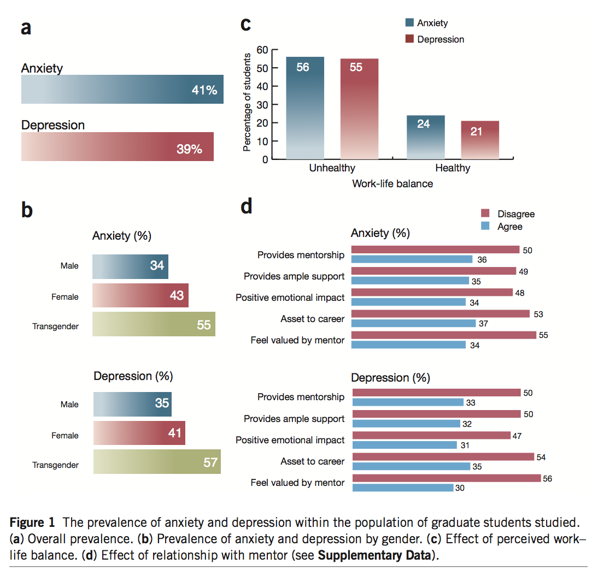
Opportunity for Positive Impact
Evidence for a mental health crisis in graduate education
Teresa M Evans, Lindsay Bira, Jazmin Beltran Gastelum, L Todd Weiss & Nathan L Vanderford
VOLUME 36 NUMBER 3 MARCH 2018 NATURE BIOTECHNOLOGY
Notes:
I show this to you, not to highlight what some are calling an epidemic and crisis in Graduate Education, but rather to emphasize where small efforts can make huge impacts.

Slide 5
Advising at UConn
Every UConn graduate student must have a major advisor (or co-major advisors) who is a member of the Graduate Faculty.
How to Request Appointment to the Graduate Faculty
Change of Graduate Major Advisor form (will update advisor information in Student Admin)
Most also have a 3-4 person advisory committee, chaired by the major advisor.
Some programs have a non-faculty director or other staff person who does most of the advising and acts on behalf of the faculty member who is the designated major advisor
At UConn, major advisor/advisory committee determines when/if a student has met the requirements for a given degree (or certificate), subject to Graduate School (and potentially program-level) minimum requirements.

Slide 6
Degree Requirements
The Graduate School sets minimum degree requirements
Minimum credit requirements (30 for master’s, 30-45 for PhD, including required research credits)
Minimum GPA requirements (3.0)
Allowable credit sharing and transfer credits
Time limits (6 years for master’s, 8 for PhD)
Programs can set additional requirements.
Major advisors/advisory committees can also set requirements for students, as long as they are clearly articulated to students and applied equitably.

Slide 7
Key Forms of Advisor-Student Relationships
In course-based programs:
advisor primarily provides information to students
In research-based programs:
“apprenticeship model”
advisor works closely with student
relationship often evolves from supervision to collaboration

Slide 8
Key Roles and Responsibilities of (Major) Advisors
Information and advice about program completion
Courses to take
Other program requirements
Places to look for information (e.g., graduate catalog, Graduate School, program handbooks, websites)
Research supervision and training
Professional development assistance
Career advice/counseling
Career enhancement opportunities
Approvals (or recommendations) related to academic program
Completion of degree requirements (plans of study, general exams, dissertation defenses, etc.)
Some course-related approvals (e.g., withdrawals, Pass/Fail)
Program interruptions/terminations (e.g., academic leaves of absence, dismissals)
Advice and referrals to address student needs and concerns

Slide 9
Mentorship Defined
“Mentorship is a professional, working alliance in which individuals work together over time to support personal and professional growth, development, and success of the relational partners through the provision of career and psychological approach”
Notes:
There can be many types of mentors and one person, say an advisor, does not have to be all things to a student. Mentorship is better thought of as a team of mentors.

Slide 10
Tips for Good Advising/Mentoring
NEW Graduate Student Mentoring: A Mentor’s Guide
Created in collaboration with faculty, professional staff, and graduate students and endorsed by the GFC
A set of best practices for graduate faculty and departments
Intended as a baseline
Programs are encouraged to developed specific guidelines as it pertains to their programmatic needs

Slide 11
Tips for Good Advising/Mentoring
Overarching Tip: Foster meaningful 2-way communication
Communicate clearly, constructively, and regularly
Provide clear, constructive, and regular feedback to students
Seek feedback from students on the effectiveness of communication
Source: https://rackham.umich.edu/downloads/how-to-mentor-graduate-students.pdf

Slide 12
Tips for Good Advising/Mentoring
Expectations
Be transparent about expectations
Academic expectations and standards
Needed training (and where to get it)
Personal and professional boundaries
Academic Success
Set and review milestones, and acknowledge student accomplishments
Look for and create opportunities for students to succeed
Help students learn from mistakes
Encourage students to develop new skills and think critically and independently
Overall Well-being
Be open, approachable, and accessible
Listen to student concerns and respond constructively
Look for and respond to signs of stress/distress, and reach out as appropriate
Source: https://rackham.umich.edu/downloads/how-to-mentor-graduate-students.pdf

Slide 13
Aligning Expectations
Mentors should have the knowledge and skills to:
Listen to and consider the expectations of their mentee in the mentoring relationship
Consider how personal and professional differences may impact expectations
Clearly communicate expectations for the mentoring relationship
Align mentee and mentor expectations

Slide 14
Aligning Expectations
What strategies do (or can) you use to identify your own expectations, those of your mentee, and align the two?
Mentorship Action Plan
Identifies mentee needs, mentor ability and the domain to align expectations
E.g., Domain of mentoring need could be:
- Oral Communication, work-life balance, data analysis, networking with research community

Slide 15
Addressing Equity and Inclusion
Mentors should have the knowledge and skills to:
Understand the concepts of equity and inclusion and their influence on mentor-mentee interactions
Recognize the impact of conscious and unconscious assumptions, preconceptions, biases, and prejudices on the mentor-mentee relationship and acquire skills to manage them
Identify concrete strategies for learning about and addressing issues of equity and inclusion

Slide 16
Annual Academic Reviews
Annual academic reviews can help advisors and students articulate and document both progress toward degree and expectations going forward.
TGS has developed a customizable template for doing annual reviews for doctoral/MFA students
Allows students to report and reflect on their progress and accomplishments during the previous year and plan their activities and efforts for the coming year
Aids major advisors in providing their graduate students with feedback on their progress to date and plans

Slide 17
Possible Advising Challenges
Student is not making adequate academic progress
Not completing coursework
Not progressing adequately on research
Student appears to be suffering from non-academic challenges (e.g., physical/mental health issues, other personal/family issues)
Failure to see “eye-to-eye” or agree on plans moving forward
Difficult inter-personal dynamics between advisor and advisee (personalities play a role in all relationships)
Misunderstandings (typically due to communication issues)

Slide 18
Resources to Help
TGS website:
Graduate Faculty Onboarding
An overview of resources helpful to new graduate faculty advisors
Advising and Mentoring: Supporting Your Graduate Students
Includes resources for advisement meetings, mentoring, supporting graduate student mental health, cultural competency, and more
Graduate Student Mentoring: A Mentor’s Guide
Timely Topics
Slides and videos from prior sessions that include a variety of topics surrounding advising and mentoring, GAs, and admissions/recruitment

Slide 19
Resources to Help
TGS staff: Graduate Student and Postdoctoral Affairs Team
Things they can help with:
Having difficult conversations
Referrals to other university resources (e.g., mental health, CSD)
Making changes when more is needed
Karen Bresciano: karen.bresciano@uconn.edu
Megan Petsa: megan.petsa@uconn.edu
Stuart Duncan: stuart.duncan@uconn.edu
Ombuds Office
Things they can help with:
Neutral resource that provides confidential and informal assistance
Assistant Ombuds for Graduate Students and Postdocs

Slide 20
When More is Needed
Reduced course/credit load
Implications for GA, financial aid, visa status
Change of major advisor
Separation
Academic leave of absence
Voluntary exit/change of program
Dismissal
Student Care Team

Slide 21
Dismissal
Criteria for Dismissal
Failure to maintain the minimum cumulative grade point average required by The Graduate School (3.0);
Receiving a grade of “D+,” “D,” “D-,” “F,” or “U” in any course;
If required, failure to satisfy a foreign language requirement for a degree;
Failure of the doctoral General Examination, if one is required;
Failure to produce an acceptable Doctoral Dissertation Proposal, if one is required;
Unsatisfactory performance in any aspect of the research or writing for a required master’s thesis or doctoral dissertation;
Failure of a required final examination for the master’s or doctoral degree; or
Failure to satisfy any other requirement of the student’s graduate degree program.
Dismissal vs Resignation

Slide 22
Graduate Assistants
GAs have a dual relationship to the university as both students and employees
In addition to resources available as part of their student status, GAs have access to employee benefits such as GA Leave, employee accommodations, the Employee Assistance Program (EAP), and more
Ask for guidance – decisions made on the academic side can have GA implications and vice versa
Union Contract for GAs employed at Storrs/regionals (not UCH yet)
Protected work
Time off (10 days per semester)
Progressive discipline (Labor Relations)
Alison Cutler (alison.cutler@uconn.edu)
Additional resources and referrals for GAs
Timely Topic: “Supervising Graduate Assistants”

Slide 23
International Students
Visa status is impacted by enrollment
add/drop
program change
dates of separation
OPT/CPT and I-20 end dates
Ask ISSS for guidance
Notes:
Advisors need to be aware of work authorization.
GAs have to stop working at certain points and advisors should help plan their duties accordingly so the job is complete.
International grads also cannot work over 20 hours per week while classes are in session.
And they are only authorized to work on campus with a F-1 visa, so if the grad has an internship, they can't take it without authorization from ISSS, which may also require enrollment.
Be aware of the rules for remote work and prohibitions on working/research outside the U.S

Slide 24
Please…
Know what you know
and what you don’t know
Know what things are your responsibility
to know
Know who is supposed to know
what you don’t know

Slide 25
It’s not all you…
Center for Career Development
Student Health & Wellness
Counseling & Mental Health
Financial Aid
Office of National Scholarships & Fellowships
Writing Center
Student Care Team
Cultural Centers
International Student & Scholar Services
Center for Students with Disabilities
Registrar
Library
Graduate Student Senate
Assoc of Area Religious Communities
Ombuds Office
Graduate Employee Union
And more…

Slide 26
Questions
How to support grad students who are struggling
Setting accountability goals for student success
Why, when and how to terminate an advising relationship if it is not working out
I hope to be educated about resources that the University makes available to students, as well as advice on how to introduce the resources to students who may benefit from them.
Other?
Notes:
Questions were submitted in advance

Slide 27
And, of course…
The Graduate School
860.486.3617
gradschool@uconn.edu

Slide 28
Upcoming Events – Timely Topics
Timely Topics is a series of opportunities to engage with subject matter experts on topics relevant to those who support and advise graduate students and programs. Every session is available to all UConn faculty and staff.
SCOTUS Decision on Race in Admissions and Impacts on Graduate Admissions
Thursday, November 16, 2023 at 11:00 am
Updating Your Catalog Copy and Using the GPAR System
Thursday, November 30, 2023 at 11:00 am
Fellowships Process and Updates
Thursday, December 7, 2023 at 11:00 am
Register for a Session

