Slide 1
A Comprehensive Overview of Degree Audit Processes
Degree Audit
Office of the Registrar
Sandra Cyr - Registrar Specialist
Jenn Horan – Registrar Specialist
Laura Mlyniec-Beam – Assistant Registrar
February 8, 2024

Slide 2
Overview
Degree Audit
Who we are
What we do
Master’s / Graduate Certificates / 6th Year
Credits (transfer, shared)
Final Exams
Terminal Masters
Extra Degree Track
Doctoral
Required Paperwork
Completion vs. Conferral
Timelines
Masters on the way

Slide 3
Degree Audit
What We Do:
Award All University Degrees:
Associates  Bachelors
Masters  Doctoral
Graduate & Post Baccalaureate Certificates
Diploma ordering (including CeDs*)
*CeDs = Certified Electronic Diplomas
NCAA compliance (academics only)
Resource for faculty and staff

Slide 4
Degree Audit
Who We Are:
Master’s & Graduate Certificates: Sandra Cyr
Doctoral: Jenn Horan
Bachelors: Laura Albrecht, Kristen Hargis, & Liz Laskarzewski
Assistant Registrar: Laura Mlyniec-Beam

Slide 5
Degree Audit Procedures
Review Advisement Reports
Review Committee approved Plans of Study
Review Final Exam Reports
Review Thesis & Dissertation submissions
Ensure Final Grades are received
Post Degrees to Student Records
Final Exam/Thesis Submission
Grades

Slide 6
Contact Us
Email: degreeaudit@uconn.edu
Main Line: 860-486-6214
Individually: Best reached via Teams or Email

Slide 7
All Graduate Programs
Graduate Catalog
Graduate Catalog
https://gradcatalog.uconn.edu/pdf-catalog/
Best reference for
Current graduate school practices & policies
Program Requirements

Slide 8
All Graduate Programs Steps to Graduation
Student Action
Visit Steps to a Successful Graduation webpage
https://registrar.uconn.edu/graduation/
Review Steps Specific to Degree Level
Four(4) Options Available to Graduate Students

Slide 9
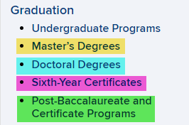
All Graduate Programs Steps to Graduation
https://registrar.uconn.edu/
https://registrar.uconn.edu/graduation/masters-degrees/
https://registrar.uconn.edu/graduation/doctoral-degrees/
https://registrar.uconn.edu/graduation/sixth-year-diplomas/
https://registrar.uconn.edu/graduation/post-baccalaureate-and-certificate-programs/

Slide 10
All Graduate Programs Steps to Graduation
Student Action
Apply for Graduation
Should be done by the fourth week of the term graduating in
Verify Diploma Name
Verify or Create Diploma Mailing Address (at the time of applying)
Diplomas are shipped from the vendor approximately two (2) months after the graduation date
International addresses can take up to sixteen(16) weeks for delivery from the notification of mailing

Slide 11
All Graduate Programs
Completion Date vs. Conferral Date
Completion date
Date that program requirements are completed
Dissertation uploaded & committee approval received
OR
Final exam completed and submitted
Final grades received
Completion and conferral dates may be the same, but not always
Conferral date
Graduation date the university has established for each term
Spring(May), Summer (August) and Fall (December)

Slide 12
All Graduate Programs
First Ten Days
Registration
Not required if completing degree requirements within first ten(10) days of the Fall or Spring term
Required for Fall and Spring to remain active in their program
Zero credit registration if credits not needed
GRAD 5998 / 5999(Masters) or GRAD 6998 / 6999 (Doctoral)
GA’s
Should not offer a GA appointment if student will complete within first ten days of semester

Slide 13
Doctoral Degrees
Documents Required Before Final Defense
Plan of Study – submit by the time 18 credits are completed
General Exam – submit within 30 days of passing
Proposal – submit by the time announce final defense on university events calendar
Approvals
Wet ink (scan and email document)
Email: reply all
Electronic signature on document
Email Submission Only
no hard copies submitted to the office

Slide 14
Doctoral Degrees
Plan of Study
Submit by the time 18cr completed
Committee required (major advisor & two(2) associate advisors)
Department research credits cannot fulfill Dissertation Research(GRAD 6950)
Included completed and anticipated credits
Plan Changes
Changes are submitted by email for
Classes (additions & removal)
Advisory Committee

Slide 15
Doctoral Degrees
Plan of Study
Common Questions / Issues
Advisory committee not selected
Future course offerings unknown
There is not a final Doctoral plan of study required when applying for graduation
The only plan submission required is by the time students have completed 18 credits

Slide 16
Doctoral Degrees
General Exam
Five (5) attendees required(PhD, DMA, EdD)
Exam Committee vs. Advisory Committee
Three (3) attendees (DNP)

Slide 17
Doctoral Degrees
General Exam
Common Questions / Issues
Department requires more than a one-part exam to be considered passed
Proposal defense is used to fulfill exam requirement and exam report is not submitted
Not enough attendees
Exam passing date not included
Exam report is submitted long after passed
*cannot receive retroactive GA pay upgrade after 30 days

Slide 18
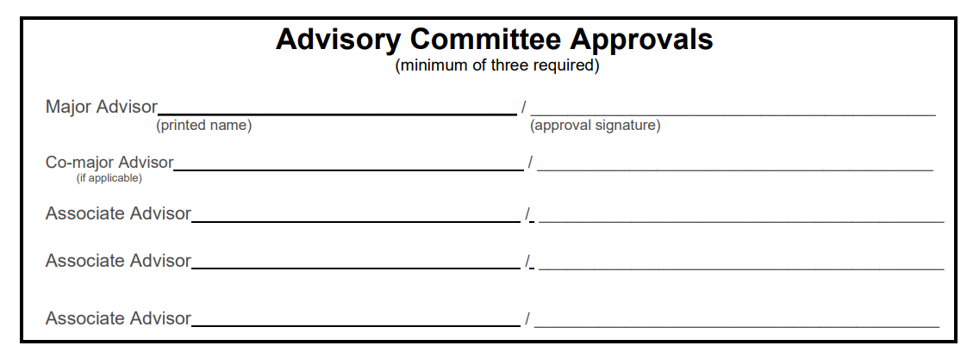
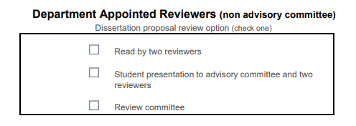
Doctoral Degrees
Dissertation Proposal
Required Approvals
Full committee
Department Dean / Committee Chair
If this person is part of the committee they need to sign both sections

Slide 19
Doctoral Degrees f
Dissertation Proposal
Common Questions / Issues
There is not a required timeframe to defend the proposal before final dissertation
Outdated Practice: 3-6 mos. before final defense
The prospectus does not need to be submitted to our office
IRB / IACUC / Stem Cell approvals
Can take time for approval
Should be submitted when received
In-progress status
Something is pending

Slide 20
Doctoral Degrees
Final Defense
Calendar announcement (required)
There is not a ‘defend by date’
5 members in attendance (committee + x = 5)
Dissertation should not be uploaded until fully approved by committee
Including committee requested revisions during the defense
Required Documents
Dissertation upload to Submittable
Dissertation approval page or Final Exam Report(DNP)
Survey of Earned Doctorates
Required by all doctoral students even if not defending a dissertation or final exam

Slide 21
Doctoral Degrees
Final Defense
Common Questions / Issues
Who approves electronic approval page?
Why aren’t external advisor approvals viewable on approval page?
How do I know who has approved?
Are there exceptions to the submission deadline?

Slide 22
Doctoral Degrees
Timeline for Review & Degree Conferral
Submissions are reviewed in the order they are received
No portion of the review is automated
Takes several weeks(or longer) to get through all submissions and graduates
Completion Verification Letters
Not automatic, only issued at student request
Cannot be issued until dissertation is uploaded and all committee members have submitted their approval
ABD status - we do not offer ABD(All But Dissertation) status

Slide 23
Doctoral Degrees
GA’s in final semester
Registration Required (6 credit minimum )
Dissertation submission
If international cannot submit dissertation before the posted deadline with requesting an Alternate Completion Date
Alternate Completion Request
Required when a student has a GA and will complete(submit dissertation) before the submission deadline

Slide 24
Masters on the Way Plan B, non-thesis (PhD)
Plan B (non-thesis) only
Thirty(30) content credits required (excludes GRAD 6950) on the PhD plan of study
A separate Master’s plan is not required
Recommendation by committee, on General Exam Report, at the time of exam submission
Awarded at the end of term recommendation is made
OR when content credits are completed, at the end of a term

Slide 25
Master's on the Way Plan A (thesis)
Email recommendation from major advisor
International Students
ISSS must be notified by the student they are earning a Master’s Degree while pursuing the PhD
After extra degree track is added
details regarding program requirements are emailed to the student
required paperwork and thesis information(for Plan A) will be communicated to student

Slide 26
Master’s Degree & Graduate Certificates
Graduation Audit Process
Plan of Study(emailed to Sandra Cyr and degreeaudit@uconn.edu)
Submitted within the first four(4) weeks of the students graduating term
Advisement Reports (if used by program)
Email spreadsheet to Sandra Cyr and degreeaudit@uconn.edu
Requirements must be satisfied with only final semester grades pending
Email any changes required to adjust each student’s requirement during each semester
Include student ID, student name, approval (by email) from major advisor or program director program
EX:

Slide 27
Master’s Degree & 6th Year Certificate
Graduation Audit Process
Grades must be received by Academic Calendar deadline
https://registrar.uconn.edu/academic-calendar/
Comprehensive Exam (Final Exam Report)
Must be completed in final semester (if exam is required by program)
Exam must be completed before the graduation date of the term student is graduating in

Slide 28
Master’s Degree & Graduate Certificates
Plan of Study ~ Updates & Changes
Student or department must notify of changes to plan of study
Email from the student’s major advisor to update plan of study on file
Changes Include
Changing committee members
Add and remove courses listed on the plan of study
Add or change area of concentration

Slide 29
Master’s Degree & Graduate Certificates
Final Exams for Master’s Degree & Sixth Year Certificate in Education
Create electronic final exam report (if program requires a final exam)
https://registrar.uconn.edu/graduation/masters-degrees/
Report of the Final Examination for the Master’s Degree
Student must include their committee members on the webform
Must be the same faculty members who signed the plan of study
Webform is routed by email to committee members for approval or denial
Students receive an email as each committee member approves
Once the webform is approved or denied, it’s routed to Degree Audit for final review
Students receive an email after it is accepted by Degree Audit
Follow deadlines on the Academic Calendar

Slide 30
Master’s Degree & 6th Year Certificate External Transfer Credits
Can Be:
25% of total credits required for a Masters / 6th year certificate program (Ed)
Required:
Official transcript required
If the official transcript has been received by the graduate school a new one is not required
Submit Transfer Credit Request form,, approved by major advisor
Courses cannot be older than 6 years
Courses must be GRADUATE level
Grades must be B- or higher
Cannot:
Have been used toward a previously earned degree
Be planned to complete at a future date at an external institution

Slide 31
Master’s Degree & Graduate Certificate
International External Transfer Credits for Master’s Degree & 6th Year Certificate
Courses were not used to earn a degree from an international institution and
Courses are not older than 6 years
Official transcript must be evaluated to confirm
US Course level
Credits awarded and
Grades earned
Advisor approved a) Transfer credit Request and b) International evaluation must be submitted to Sandra Cyr
Approved Evaluation Services students can use are:
https://www.wes.org/
https://myiee.org/
https://www.ece.org/

Slide 32
Shared / Internal UConn Credits
Master’s Degree & Graduate Certificate
Includes Undergraduate credits from:
4+1 programs
Accelerated programs
Fastrack programs
Graduate School Policy
Maximum 12 total credits can be shared from UG / non-degree to GR
Courses @ GRAD level only
Grades C- or higher
Courses cannot be older than 6 years than date matriculated into Master’s / Graduate Certificate in Education
Shared credits must be required for graduate degree
Submitted Transfer Credit Request form, approved by major advisor
Maximum of 6 credits shared from UG / non-degree for Graduate Certificate programs
Courses cannot be older than 3 years than the date matriculated into the Graduate Certificate program

Slide 33
Master’s Degree Terminal Masters Plan A or B
Process
Email from student’s major advisor recommending
Student discontinues PhD program
Earn masters Plan A or B
International Students
ISSS must approve program level change before updates can be made to student’s record
After program level is changed, details will be communicated to student about
program requirements,
required paperwork and
thesis information(for Plan A)

Slide 34
Questions

