Slide 1
“How Are You Doing?”… And Other Scary Questions
Kim Curry, Director of Graduate Student and Postdoctoral Scholar Support, The Graduate School
Karen Bresciano, Assistant Dean, The Graduate School
John Armstrong, Interim Director, Office of Care and Concern
March 28, 2024

Slide 2
Tell Us About Your Goals…
Why did you decide to join us today?
What are you hoping to learn?

Slide 3
Our Goals for Today
Ethic of Care - The Rules vs Best Practices
Conversation Starters and Stoppers
Resources
Student Care Team

Slide 4
Ethic of Care – What is it?
Ethic of Care is a feminist theory based in virtue ethics and developed by psychologist Dr. Carol Gilligan that believes:
Context can ofttimes overrule some universal code of conduct.
Emphasizes interconnectedness of humanity, and
Places a moral significance on our relationships as ‘care givers’ and ‘care receivers.’

Slide 5
Ethic of Care – Why Should We Care?
Overall, rates of self-reported depression and anxiety are six times higher among graduate students compared to those of the general population, and higher than their same-aged, college educated peers.
Consistent with existing literature, results indicate that lack of funding, poor faculty mentorship, and institutional discrimination are related to depressive symptoms among graduate students.
Susan T. Charles, Melissa M. Karnaze & Frances M. Leslie (2022) Positive factors related to graduate student mental health, Journal of American College Health, 70:6, 1858-1866

Slide 6
Ethic of Care
Recognize each student is a whole person.
Ask questions. You have “permission.”
Show you care. Caring does not mean you have to be a counselor or friend.
We can help you and your students foster a stronger mentor/mentee relationship.

Slide 7
Stories from the Field
1. An academic meeting with a student from a minoritized group/identity affected by local or global political/civil unrest.
2. A student who is continuing to ask for extensions on assignments/projects and has also missed some assignments.
3. An international student has stopped communicating with you despite emails, texts, and Slack reach outs. This is not the first time they have stopped communicating and you are starting to see a pattern.

Slide 8
When Outreach is in Order
Behavior has changed
Quality of work has diminished
Deadlines have not been met
Communication is reduced or stopped
Student is present but distracted
You hear concern from others
Others that have come up for you?

Slide 9
Conversation Starters
Behavior that you noticed. Question about how to help.
I've noticed you seem more stressed lately. How are you doing? How can I be helpful?
You don't seem like yourself lately. Is there anything that you would like to talk about?
You seem distracted lately. Is there anything going on?
What have you used to start a conversation?

Slide 10
Points to Consider
Myth: Needing help is weakness.
Mental health is a growing concern within graduate education.
Imposter Syndrome is real.
Power differential.
Elements of privilege and bias.
What expectations have been established?
How you feel about engaging in conversation?
Documentation.

Slide 11
What Not to Say
"What’s wrong with you?"
"It doesn’t seem like you are cut out for this."
"Your lab mates are not having these problems."
Things that actually WOULD break a rule…
ADA
You should be able to do this.
Why do you need this accommodation?
You should not need this accommodation.
I’ll need to see a doctor’s note.
Title IX
You should have waited to have kids until after you were done.
Notes:
Often times the things we shouldn’t ask or say don’t follow an ethic of care, they are often judgmental in nature.
Faculty and admin do not need to interpret medical documentation, CSD is a great resource for that (HR for graduate assistantships)
Graduate school is not always for everyone, but it is helpful to ask if there are circumstances that if they were different would the student be able to be successful? There is a place to have conversations with students about whether a graduate program is appropriate for them at the current time.
Using threats to motivate. Some students will share that their advisor often threatens to take away their funding if they do meet deadlines or expectations. Meeting deadlines and expectations are important, but constantly threatening can set up an environment of fear and added anxiety. There are other ways to hold students accountable and ultimately if students cannot meet expectations there are disciplinary process in place that we will discuss at a future timely topic.

Slide 12
I might need to consult someone first…
The Graduate School
Kim
Karen
Center for Students with Disabilities
Student Health and Wellness (SHaW)
University Ombuds
Student Care Team
Notes:
Office websites are the best way to get up to date contact information.

Slide 13
Resources and Referrals
Kim and Karen work with faculty and students to determine resources and next steps, this is often a good first step for any graduate student concern
Student Health and Wellness (SHaW) Mental Health
The Graduate School
Consultation appointments for students (via phone or telehealth), follow up services or referrals
Student Care Team
Center for Student with Disabilities (CSD)
Mental Health Resource Centers at regional campuses serve graduate students
Student Behavioral Health Service for UConn Health
SBHS provides evaluation and treatment to graduate students at UConn Health
Red Folder https://studenthealth.uconn.edu/redfolder/
Work with graduate students to determine appropriate and reasonable accommodations when there is a documented disability (they often collaborate with SHaW Mental Health and Medical Care Services)

Slide 14
UConn Office of Student Care and Concern
Wilbur Cross Building, Suite 29 233 Glenbrook Road, Unit 4131 Storrs, CT 06269-4131
Email: oscc@uconn.edu Phone: (860) 486-8777

Slide 15
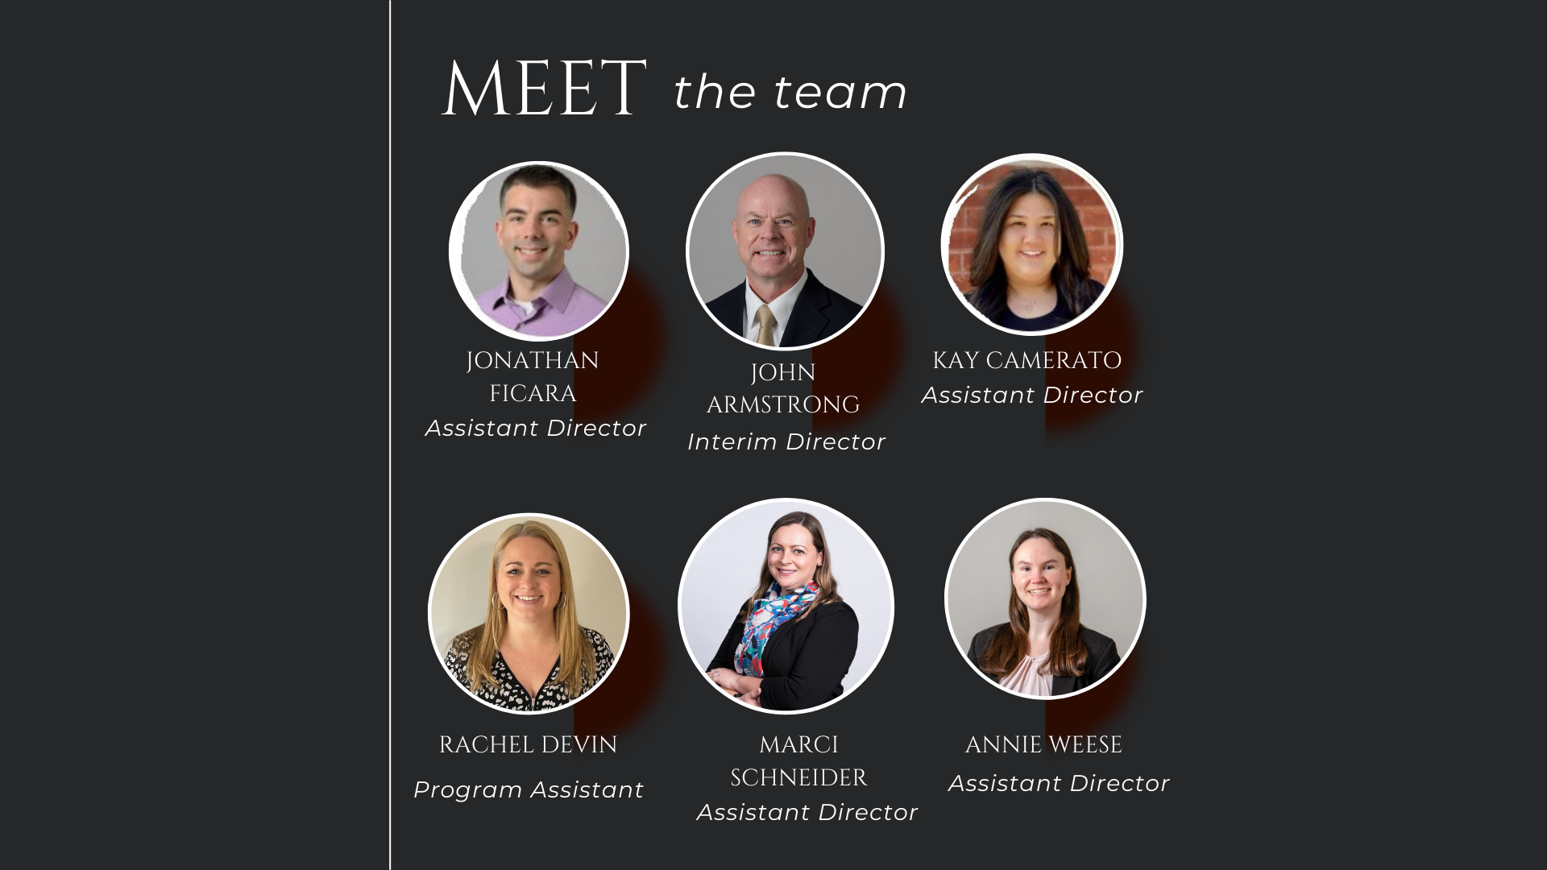
Meet the Team
Office of Student Care and Concern
Wilbur Cross, Suite 29
(860) 486-8777
oscc@uconn.edu

Slide 16
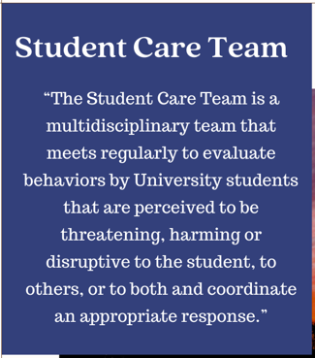
UConn Student Care Team

Slide 17
UConn Threat Assessment Teams

Slide 18
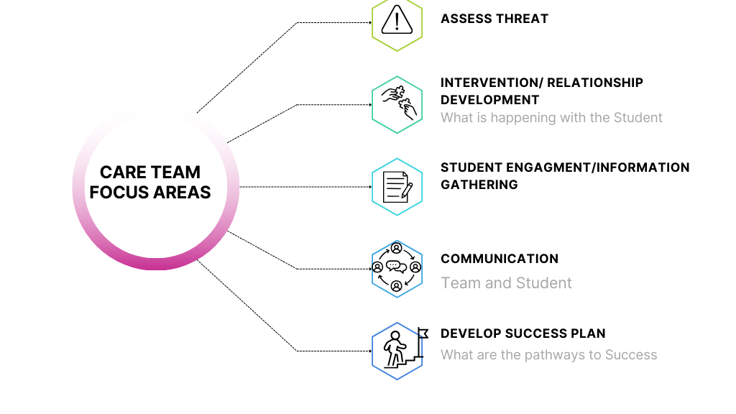
Care Team Focus Areas

Slide 19
Types of Care Team Referrals

Slide 20
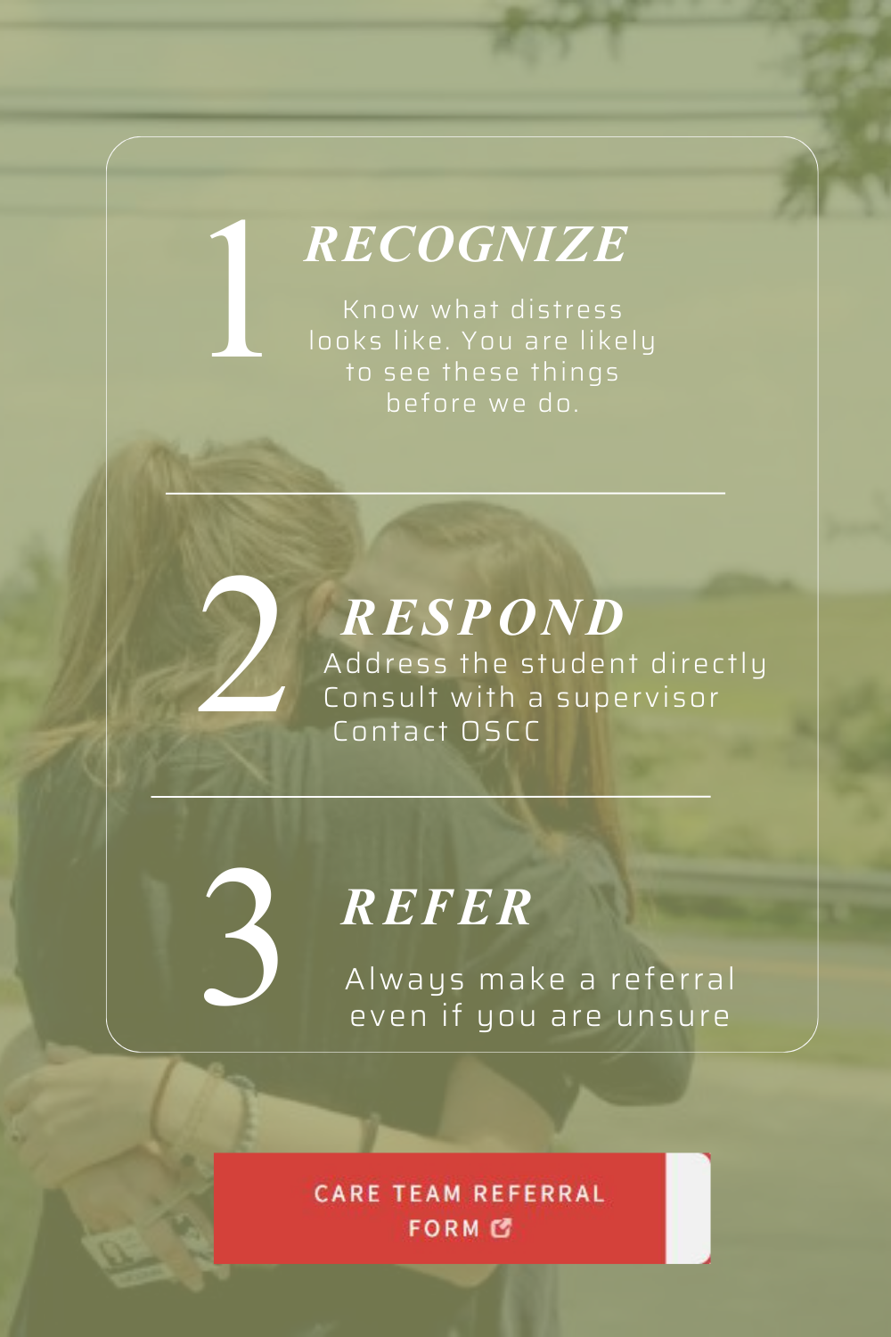
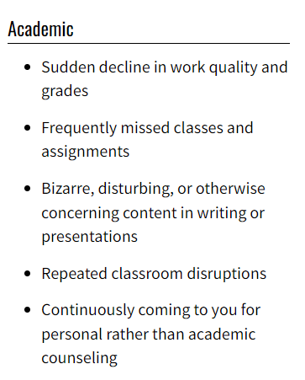
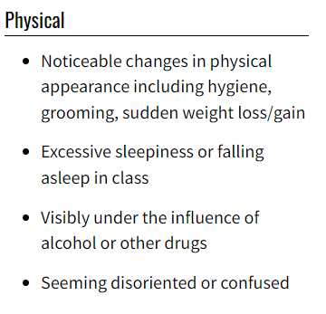
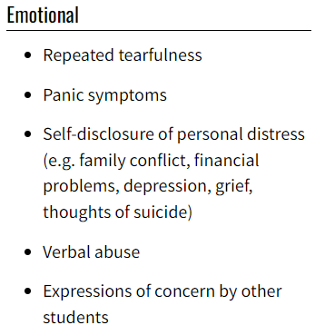
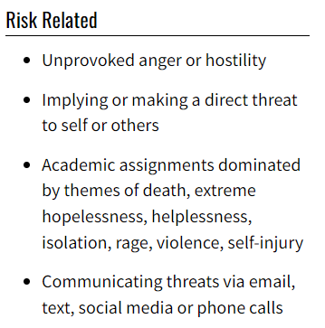
Care Team Referral Form

Slide 21
The Care Team Referral Process

Slide 22
Students in Distress Response Protocol
Question: Is the student a danger to self or others?
Yes
Student is clearly and imminently reckless, disorderly, dangerous or threatening (this include self harm)
Call 911
No
Not concerned with student's immediate safety but student is having significant academic and/or personal issues and could use some support
Fill out a care team referral at studentcareteam.uconn.edu
Then fill out a care team referral at studentcareteam.uconn.edu
Notes:
Claudia

Slide 23
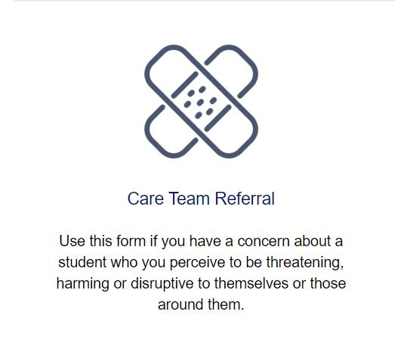
Inform
inform.uconn.edu
Please provide a detailed description of the incident/concern using specific concise, objective language
(who, what, where, when, and how).
studentcare.uconn.edu

Slide 24
Office of Student Care and Concern
Wilbur Cross Suite 29
Phone: (860) 486-8777
Website: studentcare.uconn.edu
If you have any questions, please email us at oscc@uconn.edu
Notes:
Claudia

