Slide 1
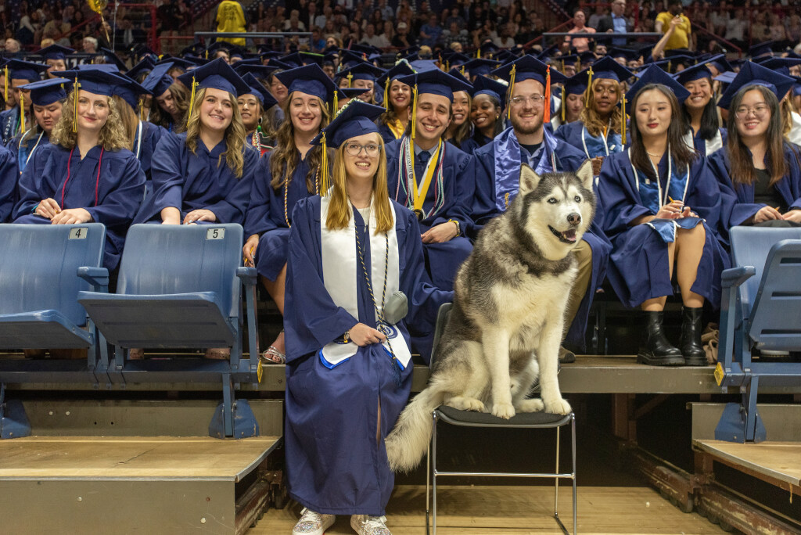
Graduating and Onboarding International Students
April 11, 2024

Slide 2
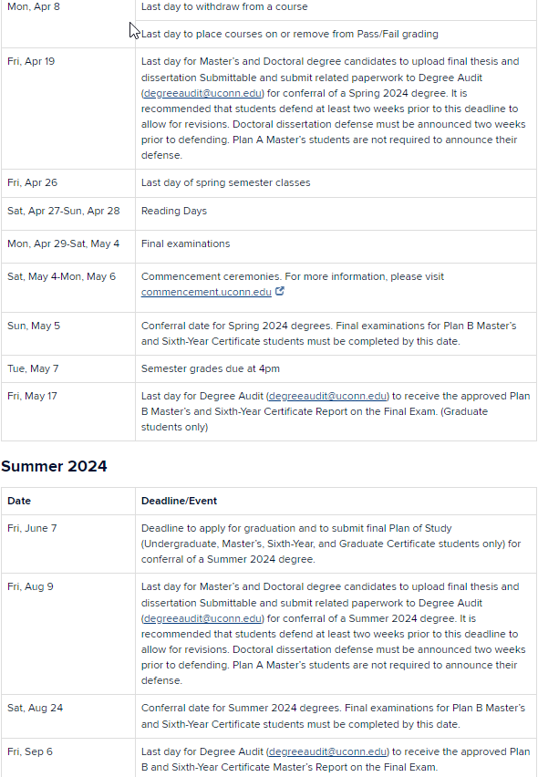
AGENDA
Continuing Students
Taxes
Summer work and travel
Graduating Students
End Dates
Working on campus
Changing Plans
Preparing for New Students in Fall 2024
ITA Testing
I-20 Forms and Visas
Arrival, CISS Welcome & Support Program
Postdoc Support
Notes:
Arthur

Slide 3
Continuing Students Topics
Taxes
6 workshops
5 filing sessions
Tax Software
Summer Work Permission
Off-campus work requires special authorization
Weekly workshops on OPT and CPT
Advisor Recommendation
Travel Signatures
Report travel before departing U.S.
Restrictions on remote work and online study
Notes:
Neena

Slide 4
Spring Term Grads
Program End Date = May 4, 2024
Last day for on-campus employment
= May 4, 2024
Need more time to finish?
Extend form I-20/DS-2019 BEFORE May 4, 2024
Options for Graduates- Grace Period
Depart the U.S.
Transfer to new grad program/Start new grad program @ UConn
Apply for Post Completion OPT
No Travel Internationally
Change of Academic Plans
Terminal Masters
Confirm the end date w/ the program
Start new Master's/PhD program
Request new I-20 form w/ funding
Changing campuses?
Requires a new I-20
See ISSS to update form I-20/DS-2019
Notes:
Huong

Slide 5
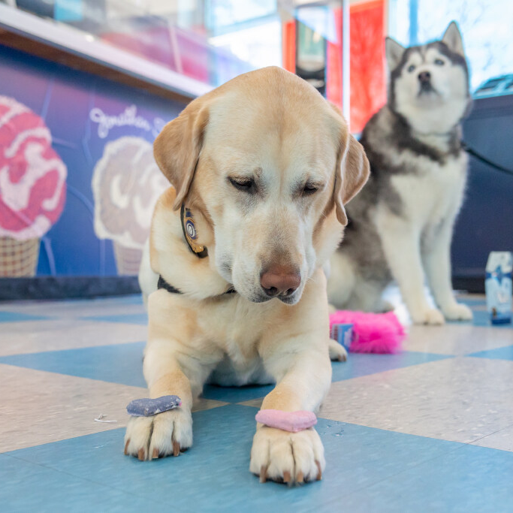
Summer Term Grads
Program End Date = Dissertation Submission Date
Last day for on-campus employment
= Dissertation Submission Date
August 9, 2024 is the latest summer submission date
Summer Term Starters
No Summer Starters except required summer programs.
SEVIS transfer students
Optional study
May work on campus over summer
Transfer form I-20
Check in w/ ISSS
Enroll in Fall term
Registered in SEVIS
Notes:
No Summer Starters except required summer programs. - because you must be full-time enrolled and in in-person classes.
Athletic Training, Doctor Physical Therapy
Nadine

Slide 6
ITA Testing
Every academic unit must ensure that each international graduate student has the appropriate oral proficiency in English before they are assigned direct instructional duties.
Upcoming Screenings:
Monday, May 6
Monday, June 3
Monday, June 17
ITA Orientation: Monday, August 12
Last date for Language Screening before September: Tuesday, August 13th.
Notes:
Jeannie

Slide 7
Student Visa Application
Request I-20/DS-2019
1 yr funding covering COA
Spring starters request confirmation of funding for 1 year
Challenges: Iran
Schedule Visa Interview
Admin Processing may require research plan and advisor CV
ISSS Pre-arrival Emails
ISSS Website
Video Guides
New Student Webinars
https://isss.uconn.edu/webinars/
Notes:
The purpose of this slide is not to necessarily walk you through the process of obtaining the F or J visa but we want you to know that we are supporting your incoming students in these different ways. ISSS provides support with the visa process. When ISSS issues the I-20, we send a pre-arrival email that includes information how to secure the F-1 visa, there is a webpage on our website dedicated to the step by step process on how to get the visa alonside a video guide. We have two webinars for grad and undergrad respectively that is dedicated to getting the I-20 and F-1 visa. Specifically departments should be aware that showing proof of funding up to 1-year of the academic program is required for I-20 and visa purposes because it is a non-immigratn visa. There can be some challenges in this situation. If the student is a fully funded student but the will start in the Spring you may only give GA for 1-semester but student can't get the I-20/DS-2019 and F or J visa unless the GA letter is for 1-year. Students maybe come back asking for more money and this is why. Students can show both GA funding and personal funds if for example the GA is part-time. We have many students from Iran at UConn, it is a top 5 country with almost 100 students on-campus. Iran has unique challenges in that there is no formal banking relationship. There is not way they can get money from home unless they carry cash or have family in another countrythat can send it to them so that is whe students from Iran may ask for funding. May not come because there is not way they can support themselves with personal funds. Last Fall, their currency tanked so student with personal funds and may go through a difficult period. Globally we are going through inflation and economic challenges, engineering and fine arts. All this information would be particular useful for Directors of Graduate studies at your school ,

Slide 8
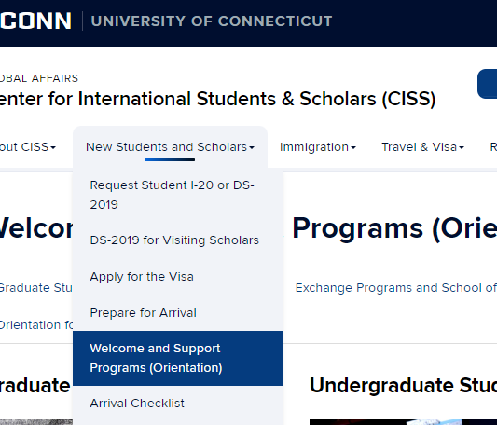
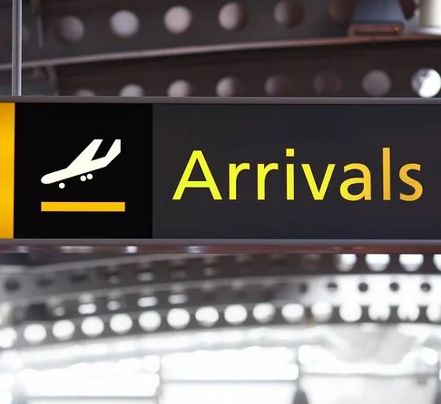
Welcome & Support Program - Storrs
Arrival to Campus ---> 8/16/2024 (Move in to On-Campus Housing)
CISS Welcome & Support Program (required) ---> 8/19/2024 SAVE THE DATE!
Submit Arrival Documents online
F/J Immigration Presentation
Apply Social Security Number, DMV
Open Bank Accounts/Cell Phone
*Submit Foreign National Information Form
*Review TGS GA Onboarding Page
*Academic Department Initiated Support
https://isss.uconn.edu/gr-orientation/
Notes:
Jenn

Slide 9
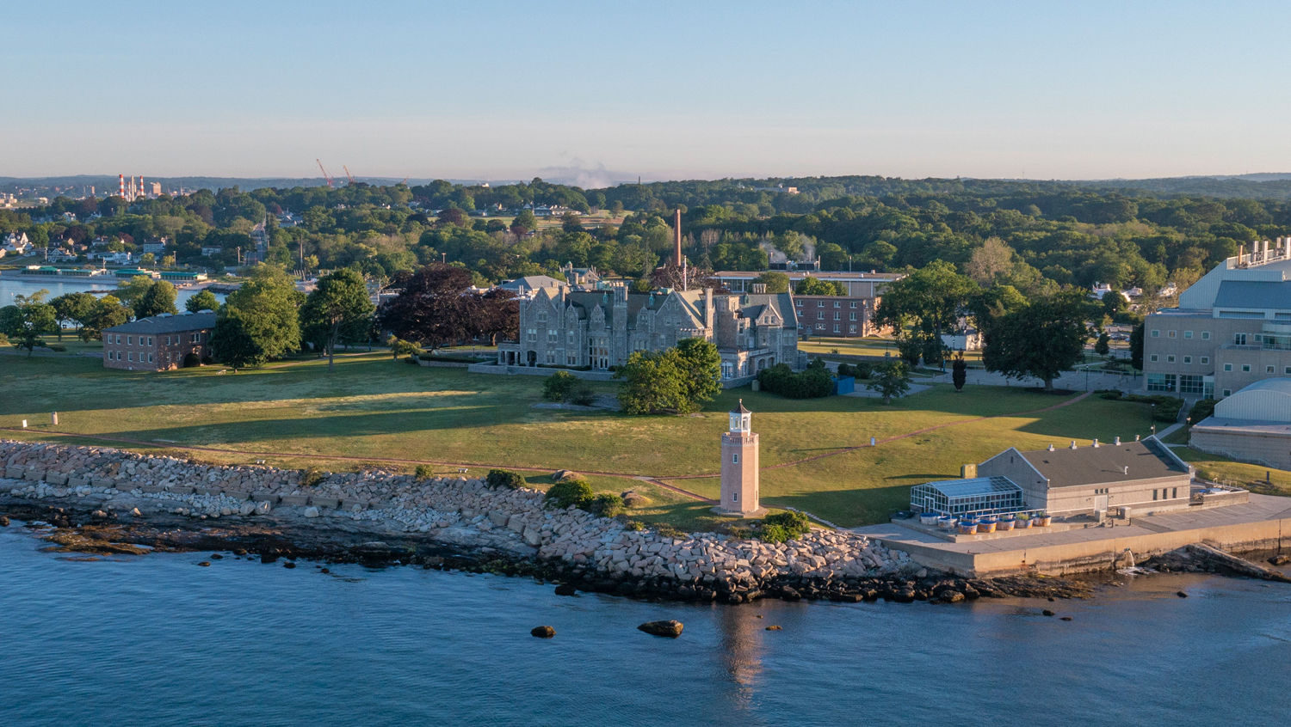
Welcome and Support Program - Regional Graduate Students
HARTFORD/AVERY POINT
STAMFORD/WATERBURY
Hartford Welcome Program
August 19
Avery Point Welcome Program
Individualized
Students invited to attend Storrs program
Stamford Welcome Program
August 19 for graduate students, ISSS session and university and campus resources
August 21 for undergraduate students, academic advising/major review, ISSS session, campus tour, city tour, residence life tour
Waterbury Welcome Program
One on one individualized
Currently only UG students in Waterbury
https://isss.uconn.edu/gr-orientation/

Slide 10
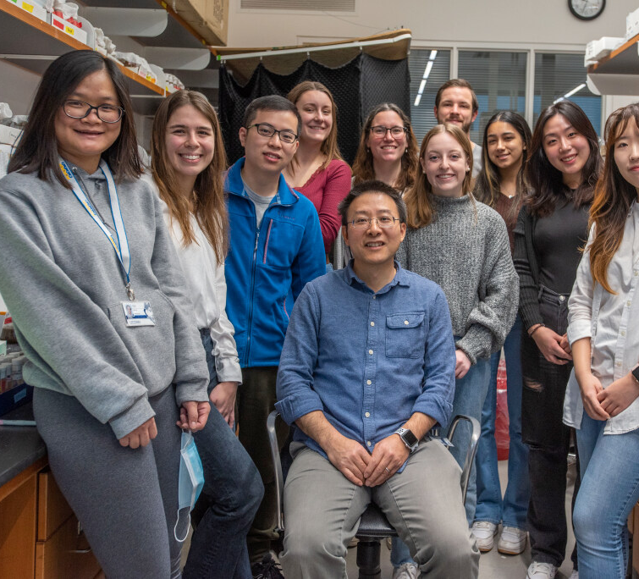
Postdoctoral Research Associates:
J-1 Exchange Visitors
DS-2019 Sponsorship Request Timeline
Orientation/Walk-In Hours – Th, 2 – 4 pm
Cultural Programming
Travel and Remote Work
Notes:
Catherine: Postdocs may have many visa types
OPT, J-1, H-1B and Other Visas. You may have international postdocs in your departments but who are not connected with ISSS. You could have post-docs on OPT from other institutions or on H-1B visas. We maintain a scholar listserv for J-1 postdocs and visiting scholars, you are welcome to share our events and messaging with your postdocs in other visa categories. Reminder – UConn is not registered with the E-Verify program university wide. Therefore if you do have any postdocs on OPT they will not be able to apply for the OPT STEM extension to work at UConn and they will need to work with you for other visa sponsorship options.
STEM extension (UConn is not an e-verify employer).
Visa Services, Orientation, Cultural Programming (Regional campuses: Neena (GBLC, Hartford, AP; Lulu – Stamford, Waterbury; Leslie – School of Law)
Travel and Remote Work
Keep in Touch
ISSS offers J-1 visa sponsorship to postdocs on a J-1 visa. Scholar Portal, Research Scholars (up to 5 years program duration), academic department/research unit-driven; at least 7 weeks between the request completion and the program start date (preferably, more, especially for scholars from certain countries – e. g., Iran, China).
Walk-In orientation hours – pre-arrival outreach.
Cultural programming – annual report to the DoS, CISS programs and events, scholar listserv.
Important: keep in touch w/CISS on such issues as travel (duration recommendations) and remote work (requires HR approval in advance).

Slide 11
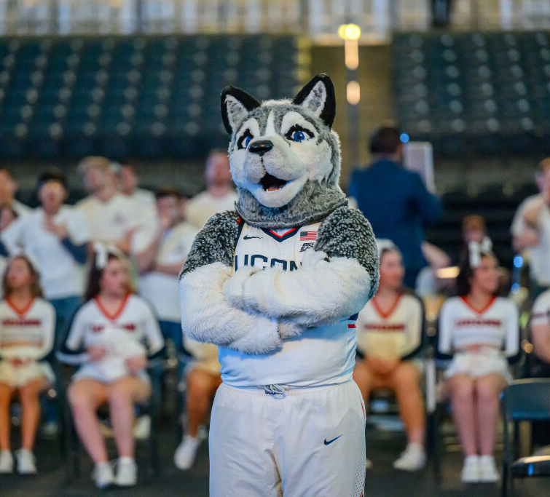
Questions
International@uconn.edu
Scholar/Postdoc Advising
Ekaterina.Barachkova@uconn.edu
Student Advisors
Nadine.Boudissa@uconn.edu
Annie.Casarella@uconn.edu
Lulu.Dong@uconn.edu (Stamford/WTBY)
Neena.Kapoor@uconn.edu (Hartford/AP)
Leslie.Lawrence@uconn.edu (Law)
Huong.Pham@uconn.edu

