Slide 1
The Graduate School’s
Timely Topics Series
Preparing for Fall: Graduate Assistant Payroll Procedures
Ana Colón-Wallace, UCAELI
Megan Petsa, The Graduate School
Kacey Pilver, Payroll Department
Jeannie Slayton, UCAELI
May 23, 2024
Notes:
Add for next year:

Slide 2
Graduate Assistants
- Eligibility to Hire/Offer Letter Guidance
- Prepping for Fall
- Supplemental Description of Duties Forms
- Stipend Levels
- TA English Proficiency
- ITA Screenings and Orientation
- Overrides for SmartHR Transactions
- GA Hire Level Report
- “Missing” Records in SmartHR
- Things You Might Need to Know
- Mid-semester Separations
Megan Petsa, Director of Graduate Student Administration, The Graduate School
megan.petsa@uconn.edu | https://grad.uconn.edu/staff/assistantship-information/
Ana Colón-Wallace, Educational Program Assistant, UCAELI
ana.s.colon@uconn.edu
Jeannie Slayton, Director of Intercultural Programs and Support/UCAELI
jeannie.Slayton@uconn.edu
May 23, 2024

Slide 3
Offer Letters Guidance
Questions about eligibility to hire and offer letters
  "Setting Up for Success: Recruitment, Offer Letters, and Hiring of GAs”
    Slides
    Video
  Information about Assistantships webpages
  Past Timely Topics sessions on GAs
Fellowships
  Typically service-free
  Keep fellowship offers separate from GA offers
  NEW Departmental Fellowship Award Letter Template
    Includes required language (e.g., taxability)
    Includes language about eligibility criteria (e.g., restricts recipients from holding a full GA)

Slide 4
Prepping for Fall
Fall Offers
  June 1st deadline
    If not confident in funding, offer can be held
      This does not include waiting for a new KFS to be set up
    Extenuating circumstances
    Still keep payroll deadlines in mind (University and school/college-specific)
Withdrawing a GA Offer
  You must work with Labor Relations to do this
  TGS has templates available for:
    A GA who deferred admission to a future semester
    A GA who did not respond to the GA offer by the deadline
GA Onboarding Page
  Resources and action items for GAs who fall under the GEU
    Webpage link should be provided with offer letter
GA Registration Deadline
  8/23 – must be enrolled in at least six credits prior to their start date
  Exception for GAs with GEMB enrollment hold

Slide 5
Prepping for Fall
Late Arrivals
    Academic policy is in the Grad Catalog
    Day 10 deadline
    Requests for exceptions must be submitted by the department; all parties, including GA supervisor, should be in agreement before request is submitted
    GA start date will not change; time off will be used (i.e., no new offer letter is issued)
Remote Work
  Requires advance approval from graduatedean@uconn.edu and may involve review from additional areas
  Extenuating circumstances only
  International students have an in-person requirement for their visa; extended remote work may affect SEVIS record
Export Control
  Additional review for remote work, research activities
  GEMB enrollment hold
  Comprehensively sanctioned countries

Slide 6
Prepping for Fall
Last Day of Work for F- and J-visa GAs
  Day before conferral date
  Time between last day of work and end date on offer letter is considered part of time off allocation (for GAs who are part of the GEU)
  Depts should ensure supervisors are aware
  Make arrangements to complete duties prior to that date
Department GA Orientation Slides
  Created in collaboration with Payroll, HR, ISSS, and UCH
  For use by departments. Available on TGS’s Forms page
Contract-related questions?
  Contact Labor Relations (Alison Cutler)
  Do not reach out to the union directly; LR will facilitate

Slide 7
Supplemental Description of Duties (SDD) Forms
SDDs
  Essential if performance or workload issues arise
  Overview | Article 5, section 6 of the GEU-UAW contract
    Required every semester by the contract
  Online workflow for SDDs available for use by all departments
    Email gradschool@uconn.edu or jack.corcoran@uconn.edu for access
  Department-specific templates and the Word docs on HR’s website can also be used
Must include specific duties, including:
    assigned course, lab, research project, or position;
    the faculty member(s) or supervisor(s) to whom the GA will report;
    the duties that the GA will be required to perform;
    course meeting times and location;
    the maximum number of students for which the GA will be responsible per class, section, lab, etc.;
    work location.

Slide 8
Supplemental Description of Duties (SDD) Forms
SDD Timeline:
  Make every effort to issue at least 30 days prior to start of semester and no later than the first day of the semester
    Better to issue on time and then amend as needed
  GAs must be given 24 hours to review the SDD and raise concerns
Maintaining Records:
  Make sure you receive a signed copy of the SDD from the GA
  Copies of SDDs should be maintained within the department (no longer sent to Payroll)

Slide 9
Stipend Levels
GA stipend levels
  Level 1 (B) - Master’s degree students; doctoral students without a master’s or master’s equivalency
  Level 2 (M) - Doctoral students with 30 grad-level credits or previous master’s degree in a related field of study
  Level 3 (PhD) – Doctoral students with the General Exam milestone
GA Pay Level Adjustment Form
  Can be used to pay above contract minimum
  Can be used to manually change a grad feeding to SmartHR as Level 2 to Level 1 if their previously completed master’s is not related to their UConn doctoral field of study
  Can be used to honor pay level errors

Slide 10
Hiring TAs Without English Proficiency
Admission requirement vs TA requirement
  Expanded language in GA Offer Letter template
TAs who have not provided proof of English proficiency will have a block on their payroll authorization
Anyone whose primary language is not English must provide proof of proficiency to be a TA with instructional contact duties
  UConn’s English Proficiency Policy
  4/18 listserv email, “Info to share with TAs - English proficiency policy”

Slide 11
ITA Screenings
Microteaching Test
Eligibility
English test scores on file, check Slate!
TOEFL: 22-27 speaking score
IELTS: 7.0 and 7.5 speaking band
Upcoming Test Dates
Monday, June 3 2024 (online)
Tuesday, August 13 2024 (online and in-person)
Proficiency Assessment
Eligibility
Students with Duolingo scores
Students who are not eligible for the microteaching test
Students eligible for microteaching testing that need to be screened sooner from the next available testing date.
Students who qualified for the Waiver of Language Proficiency Examinations.
Scheduled 1-2 days per month depending on the demand

Slide 12
ITA Screening Results
These results apply to all ITA screenings.
Pass | Cleared to teach. Student meets the English requirement to teach undergraduate students.
Conditional Pass | Cleared to teach and may begin teaching. However, the student must successfully complete the recommended English course during the semester immediately following the test. If the conditional pass expires because the student did not register or complete the course, the student will need to be retested with the Microteaching Test.
Fail | Not cleared to teach. Student does not meet the English requirement to teach undergraduate students. Must either successfully complete an English course or submit an updated TOEFL speaking score demonstrating improvement. The student will need to be retested with the Microteaching Test.

Slide 13
Please contact UCAELI if...
Students who listed English as their primary language on their graduate application, do not need an ITA screening
Contact UCAELI if the student has a speech test hold
Contact UCAELI if the student has previous TA experience at another U.S. institution of higher education

Slide 14
International Teaching Assistant Orientation
Monday, August 12, 2024 9am-12pm.
Rowe Center for Undergraduate Education, Room 122
Register: ita.uconn.edu/orientation
International Teaching Assistant Orientation is recommended for newly appointed or prospective international teaching assistants that never taught in the United States. Participation is not mandatory, but it is available to support international students in their transition to the TA role.
Students who arrive before the orientation date are encouraged to attend.

Slide 15
Overrides for SmartHR Transactions
Blocks:
  Provisional – will not be overridden
  Classroom English proficiency (more information on this policy)
    TAs who have not provided proof of English proficiency will have a block on their payroll authorization
Override Requests for Speech Block
  When you get the error message saying, “Contact Grad School”, the transaction has automatically saved to DRAFT status
    Coming soon: “This transaction requires an override from The Graduate School before it can be submitted. The transaction has been saved in DRAFT status. Please close this transaction and reach out to gradschool@uconn.edu to request an override.”
  Request an override from jack.corcoran@uconn.edu
    Include name, ID, and justification for override
      Example: “TA will not be assigned instructional contact duties” or “TA is signed up for the August microteaching test and will be assigned to non-instructional contact duties only if they do not pass.”
  Make sure you close out of the transaction before requesting an override.

Slide 16
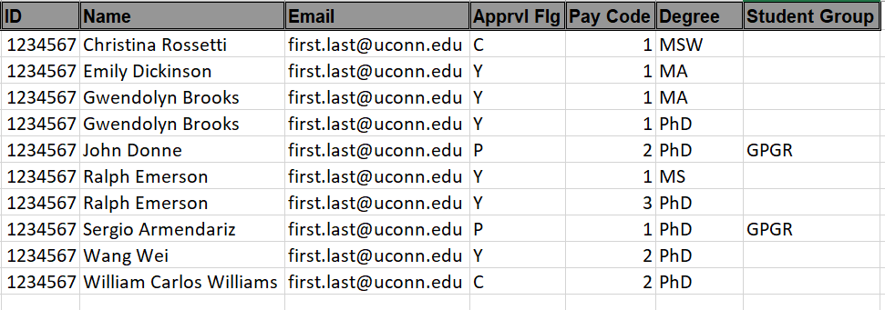
GA Hire Level Report
“GA Hire Eligibility and Stipend Level Report”
Report includes all matriculated grads
Approval Flag column shows blocks on their payroll transaction
Shows the level they will auto-populate as in SmartHR
  Check this report to make sure the level on the offer letter matches what you will see in SmartHR

Slide 17
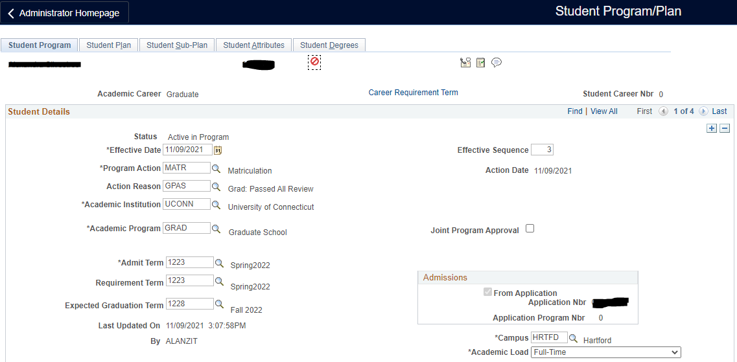
Can’t Find a Record in SmartHR?
Did they accept admission?
  Verify incoming grads have accepted offer of admission through Slate
Has the student been matriculated?
Were they on academic leave?
Deferred students cannot be placed on payroll yet
  Check status on the Program/Plan panel in Student Admin
  Once they are term activated, they can be added to payroll
Reach out to TGS for assistance

Slide 18
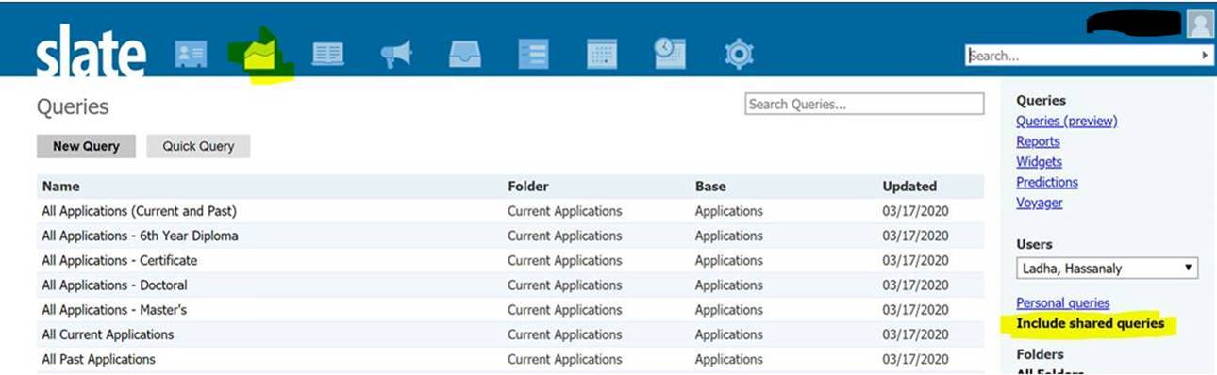
Checking Status in Slate
Users can find specific information about applicants in the back end of Slate by using queries Grad Admissions has set up
https://connect.grad.uconn.edu/manage/
  Queries/Reports > Select “Include shared queries”
  Bulk Data
  Quick Data
  “Offered Admit, Replied”

Slide 19
Things You Might Need to Know
GA appointments with either a retroactive date of hire or a retroactive increase in percentage of appointment are prohibited. Non-standard start dates require TGS review in advance.
Certificate only GAs
  Send justification to TGS
Supplemental Employment
  Updated catalog language: “Because graduate assistants divide their full-time efforts between study and assistantship responsibilities, they may not hold concurrent employment without the written consent of their major advisor and The Graduate School as recorded by a Supplemental Employment Approval Form.”
  Includes employing a GA above 20 hr/wk or on another UConn payroll while classes are in session; GAs who wish to hold a GA and internship simultaneously; external employment
  International students are restricted to 20 hours per week while classes are in session.

Slide 20
Things You Might Need to Know
Who Processes the Payroll Transaction?
GAs appointed outside their academic home department
  Website with guidance
  Hiring department should communicate with academic home department BEFORE issuing a formal or informal offer
  Hiring department creates offer letter
  Academic home department inputs payroll transaction
    Hiring department should provide fully executed offer letter, SDD, KFS, determine if I-9 is needed and who will handle that
GAs working at UConn Health
  GAs who will be working at UCH should be appointed through UCH
GAs in UConn Health-based grad programs working at Storrs
  Reach out to TGS for assistance

Slide 21
Mid-Semester Separations
Defending does not automatically terminate GA
Alternate Completion Date Request
  A GA who completes all degree requirements and wishes to terminate GA early must complete this form
  This process aligns the completion date and GA termination and notifies all relevant parties
Separating without Completing
  A GA who is terminated without completing their degree within seven calendar days will be responsible for paying pro-rated tuition
Academic Leave of Absence
  Academic leave (not GA leave) is a temporary suspension of student status. A student cannot hold a GA on academic leave.
  As part of the VSN process, the department payroll processor is notified what effective date to use on the payroll separation transaction.
Grads completing prior to Day 10
  GA eligibility criteria includes, “must be enrolled in a graduate degree program scheduled to extend through the entire period of the appointment or reappointment”
  Completion by Day 10 does not require registration, however, a GA appointment (even a partial one) does

Slide 22
Payroll Processing Overview
GA Payroll Processing
GA Payroll Audit
GA Tuition Waivers
Delayed Processing Consequences
I-9 Forms and Tax Forms
MISC Info
Kacey Pilver, GA Payroll Manager, Payroll Department
kacey.pilver@uconn.edu
May 23, 2024

Slide 23
GA Payroll Processing
SmartHR/CoreCT Payroll Transactions:
  UC_TBH_GA Hire – never employed or returning from a break in service
  UC_TBH_GI Provost Professional Internship - only a few departments have Grad Interns
  UC_TBH_DC_GRAD_DAT Fall 2024 continuation following Spring 2024 assistantship
To be used after the start of the semester has been processed:
  UC_TBH_DC_GA_PAY Pay level changes or FTE changes
  UC_TBH_DC_FUND_GA Funding KFS changes
  UC_DC_TERM_GRD Termination / remove from payroll
Fall 2024 SmartHR Opening Date – Anticipating June 10, 2024
1St Processing Deadline – July 19, 2024
Notes:
Stipend Rates, Payroll Dates and Deadlines for processing are posted on the Payroll’s website. Currently, the posted rates are available through the end of spring 2026. This academic year’s 1st deadline is July 15, 2022.
Graduate Assistant Offer Letters: Grad offer letters are posted on the HR website. New letters should be downloaded each academic year and modified for your department needs. The legal language should not be changed or deleted. If you have questions about modifying a GA letter, please contact either Megan or myself for guidance.
Link to Grad Contract: SDD forms are a requirement of the contract. If you are waiting for the SDD form, do not hold up entering the SmartHR transaction. These forms can be uploaded to the SmartHR template if it has not already been completed by Payroll, or emailed to Payroll later. They should be saved using the format: Last Name, First Name SDD fall or spring and the year.
SmartHR/CoreCT transactions: The following SmartHR templates are the only templates that should be used to start the FALL semester because they transmit data to the Bursar’s Office for the tuition waiver. If the fall renewal will include a pay change, FTE change, or coding change that differs from the spring semester, these changes can be reflected using the general data change template - UC_TBH_DC_GRAD_DAT.
UC_TBH_GA – never employed as a GA or a GA that is returning from a break in service (following a separation action).
UC_TBH_GI – Provost Professional Internship- only a few departments have Grad Interns.
UC_TBH_DC_GRAD_DAT – Fall continuation following spring 2022 assistantship.
A pay change, or coding change template can be used after the start of the semester. The appropriate information will not be transmitted to the Bursar’s Office if the wrong template is used to start the semester.

Slide 24
GA Payroll Audit
Compare offer letter against SmartHR Hire/Continuation transaction:
Name: Full legal name.
Stipend level: PeopleSoft/Student Admin feeds pay rate information to SmartHR.
If level 2 rate is expected, but not yet applied to the SmartHR transaction, use the following language in the offer letter:
“Compensation at the Level 2 stipend rate of [state the numerical amount] is conditional upon the submission of the final transcript which reflects the successful completion of the master’s degree program prior to the start date of the appointment to the University of Connecticut Graduate Admissions team (gradadmissions@uconn.edu). Until such time, compensation will be at the Level 1 stipend rate of [state the numerical amount].”
Stipend Charts are determined by the GEU-UAW contract period 2024-2025.
Hours: FTE Full-time = 20hrs 100%, Part-Time Minimum of 10 hours 50%, or any amount of time between 50% & 100%.
Semester Dates: Full Academic Year 08/23/2024-05/22/2025; Fall only 8/23/2024-01/07/2025; Spring continuation 01/08/2025-05/22/2025; Spring new hire 01/07/2025-5/22/2025
Employment Code: UT Teaching assistant, UR Research assistant, US both Teach and Research. Do not use GA-UCONN, this is not a valid code even though it is still listed in the drop-down menu.
Signatures: Offer letters with a “font signature” or digital signature will be accepted as well as wet signatures.
**Friendly Reminder to Approvers - Be sure that you are reviewing transactions thoroughly, not just clicking the approve button.
Questions about transactions? Reach out to kacey.pilver@uconn.edu.

Slide 25
Computer-Generated Components Needed for Graduate Assistant (GA) Tuition Waiver
If at any time any of these components are not in sync, the tuition waiver might “fall off” the fee bill and the tuition charge will show as an amount due by the GA.
1) An active graduate student record in StudentAdmin (PeopleSoft)
2) A valid graduate assistant SmartHR transaction entered into Core-CT SmartHR for a minimum of one semester.
3) Social Security Number (SSN) match in StudentAdmin (PeopleSoft) and Core-CT (Payroll)
4) Full-time registration of six (6) or more credits on the GRAD career.
Caution regarding SSNs:
StudentAdmin/PeopleSoft does not require incoming graduate assistants to enter their Social Security number. This is an optional field.
If a payroll record is initiated with a ‘placeholder’ number, Payroll can still pay the individual and the tuition waiver will show on the fee bill as long as Core-CT and Student ID/PeopleSoft SSNs match. When the GA updates one of the systems with their valid SSN, they must also update the other system. Biographical-Info-Update-Request
Once the payroll record has been established, there isn’t an automatic update of SSNs. Upload Completed Forms Here

Slide 26
Delayed Processing of GA Payroll
Tuition waiver will not be added to GA’s account.
Payroll deductions: GAs cannot apply for a payroll deduction without a valid payroll authorization in SmartHR/CoreCT.
Student Late Fees are applied if the GA hasn’t paid the University fees by the Bursar’s deadline.
Separation Transaction will be automatically processed mid-August for any GA not continued in the fall.
Medical benefits will end effective 8/31/2024.
Monetary compensation: Late payment to graduate assistant.
Violation of Labor Laws if GA is working without compensation.
Delay in funding is not an acceptable reason to delay adding a GA to SmartHR.

Slide 27
Employment Eligibility - Form I-9s
Form I-9s are required for:
Newly hired graduate assistants never employed by UConn
Rehired graduate assistants following a break in service where the last new I-9 is more than 3 years old
  Breaks in service do not include summers off between spring and fall.
Form I-9s are NOT required for:
Returning graduate assistants
Active graduate assistants who will begin assistantship without break in service
  Ex: GA hired on Student Labor or Special Payroll during summer session and completes an I-9 at that time. A new I-9 is not needed for their GAship beginning in the fall if there is no break in service between end of summer session and start of fall
Employees must present their documents in person to complete Section 2 of the I-9.
  If a GA is unable to complete their I-9 in person, Contact Jessica Lowrey-Manning in Payroll, jessica.lowrey-manning@uconn.edu
Additional information can be found on the Payroll Department website in the I-9 Center Link https://payroll.uconn.edu/form-i9/
  Forms can be sent to Payroll securely via SharePoint: Upload Completed Forms Here. Forms should not be faxed, mailed, or walked over to the Payroll office.
Form I-9 Questions? Contact Jessica Lowrey-Manning in Payroll, jessica.lowrey-manning@uconn.edu

Slide 28
Tax Forms
Payroll Tax Forms:
  US and Resident Alien citizens can complete their Federal tax forms online through Employee Self Service (https://ess.uconn.edu/). CT W4s are still completed using the form CT-W4 and submitted to the Payroll office: Upload Completed Forms Here
  Foreign Nationals employed by UConn are subject to Federal and Connecticut state income taxes. The actual amount that an individual is liable for will depend on various factors, such as visa type, amount of time in the United States, foreign tax treaties, etc. Foreign National Information Form
More information about foreign national taxation can be found at https://payroll.uconn.edu/foreign-national-student/
Questions? Contact Jessica Lowrey-Manning in Payroll, jessica.lowrey-manning@uconn.edu

Slide 29
MISC Information
Grad Processing Deadline for guaranteed first paycheck on time: 7/19/2024
Grad Payroll ListServ: GAPROC-L – Sign up to receive GA specific information
Foreign & Out of State mailing address: Update address in the SmartHR template to the Department’s campus address. **Once the semester begins, have the GA log into ESS Core CT portal and update their local mailing address as soon as possible.
Stipend Changes: SmartHR transactions are required for pay changes. Payroll does not automatically update stipends for eligible active GAs. If a GA is issued an offer letter for a higher level and they should have been a lower level, we are required to honor the higher level.
FTE (Full Time Equivalent) changes: Increase or decrease percent employed should not be retroactive, if processed after start of semester. The change is effective when work requirement is changed and the revised offer letter is signed. **Retroactive FTE changes before the start of the semester – contact The Grad School for approval and attached email approval to SmartHR transaction. Contact kacey.pilver@uconn.edu ASAP so this can be processed before the start of the semester. If the decrease is due to disciplinary issues, contact The Grad School and Labor Relations before making any changes.

Slide 30
MISC Information
Department Changes: If a GA is switching departments from spring to fall, a Department Change template must be submitted in SmartHR BEFORE the other department can submit another transaction to continue the GA.
SDD Forms: Required by the GEU-UAW contract, but does not need to be attached to SmartHR
Fellowship Awards: Service-free money awarded to the GA. There isn’t a work component associated with this award. Fellowships are processed through the Financial Aid Office.
Separation Actions: Payroll will process a mass-separation action for any GA that hasn’t been continued for the Fall semester. Graduating and ending early in StudentAdmin/PeopleSoft is not enough to stop a GA’s payment.
  If a GA was initially set up to start the fall semester and a SmartHR transaction was entered, you MUST contact Payroll as soon as you are aware the GA will not be starting the fall semester and then follow up with a separation transaction in SmartHR.
Graduate Assistants not returning in the Fall: Graduate assistants will have access to CoreCT until the middle of August. GAs should print/download any past paystubs and W2 forms as well as update their mailing address.

Slide 31
MISC Information
Concurrent employment: GAs can work on student labor or special payroll during the academic year in certain cases, but NOT the classified or unclassified payrolls. Contact the Grad School regarding concurrent employment and necessary forms.
Direct Deposit: GAs can sign up for Direct Deposit through Employee Self Service at https://ess.uconn.edu/. Questions about DD? Visit https://payroll.uconn.edu/direct-deposit/ or contact the Payroll Help Desk. **This is not the same direct deposit as in StudentAdmin for fee bills. If they want to have DD for payroll they must sign up via ESS.
GA is unable to start on time or doesn't show up: Contact The Grad School and kacey.pilver@uconn.edu ASAP with the GA's name, employee ID, StudentAdmin/PeopleSoft#, reason for not arriving on time or at all, etc. to determine the best course of action
First Fall 2024 Payments: First payment will be on 9/6/2024 and will be mailed, provided SmartHR template has been entered AND approved and fully executed offer letter is attached to template. Second payment may also be mailed. **Crucial that mailing address is accurate in CoreCT. If a new GA hire does not yet have a local address at the time the SmartHR transaction is submitted, departments should contact the GA to find out what their address will be. If they don't know yet, departments should use their own UConn mailing address. Once the GA has a local address, they MUST update it in CoreCT!

Slide 32

Questions?

