Slide 1
THE GRADUATE SCHOOL PRESENTS Timely Topics: Graduate Admissions Cycle Debrief
May 2024
Notes:
Meg

Slide 2
Presenters
Meg Buckley Director of Graduate Admissions The Graduate School meg.buckley@uconn.edu
Holly Brunette Graduate Admissions Specialist The Graduate School holly.brunette@uconn.edu
Shirley Fiasconaro Graduate Admissions Specialist The Graduate School shirley.fiasconaro@uconn.edu
Katie O’Keefe Graduate Admissions Specialist Specialty: School of Business katie.okeefe@uconn.edu
Sarah Redlich Shore Assistant Director of Graduate Admissions The Graduate School sarah.shore@uconn.edu
Lisa Pane Director for CRM & Data Management The Graduate School lisa.pane@uconn.edu
MB
Notes:
Meg

Slide 3
REMINDERS
Participation is encouraged.
Please mute your microphone when not speaking.
Use the chat (send to “Everyone”).
We will also have space for Q&A at the end of the presentation.
We are recording. This presentation will be available:
Within the GradSlate User Portal: connect.grad.uconn.edu/portal/user
Among the Timely Topics resources: grad.uconn.edu/timely-topics/
Notes:
Meg

Slide 4
AGENDA
Graduate Admissions Best Practices
Communication best practices
Cohort closes early
Rolling admissions practices
GradSlate User Portal
Data Tab- Queries and Reports
Forms Tab- Updating Application Requirements/Program Details
Documentation Tab- Where to find help and resources?
Reminders
Late Arrival Process
Export Control
Program Fee Waivers
Applicants Switching Programs
What to do when a staff member is also an applicant
Application Deadlines
When to enter decisions?
Term Open/Close for Applicants
Deferral/Withdrawal
Questions? Comments? Feedback?
Admissions Cycle Debrief 2024
Notes:
Meg

Slide 5
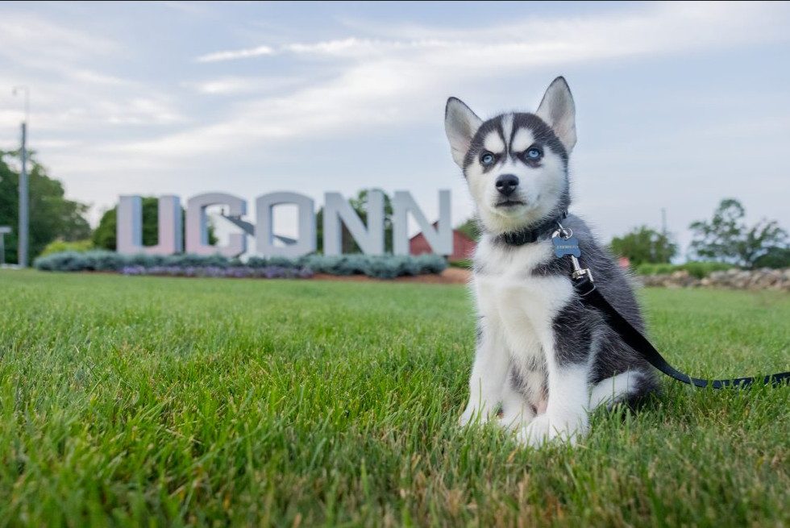
The Graduate School’s Mission Statement
The Graduate School will be the heart of graduate and postdoctoral education at the University of Connecticut. It will foster excellence in graduate and postdoctoral education, and it will guide graduate students and postdoctoral scholars to personal and professional success.
Copy of The Graduate School’s Strategic Plan can be found on our website.
Notes:
Meg

Slide 6
Graduate Admissions Best Practices
Notes:
Meg

Slide 7
Communications Best Practices
Keep communications informative and use your white space!
Bullets
Lists
If your program sends out departmental admission letters:
Please wait to send the letter until admission has been officially processed by TGS
Do not send out denial letters
The Graduate School sends denial notifications every Wednesday, no need to send additional letter.
Do not assume gender identity of applicants
Not recommended to use Mr. or Ms. to address an applicant unless program is certain of the applicant's preferences

Slide 8
What to do when you fill your cohort fills early:
Things to consider when this happens:
Communications to all applicants regarding status
Deferral vs refunds
Promote deferrals not refunds!
Refunds are last resort
Applicants may have turned down other programs to attend UConn or made arrangements to relocate.
Update website that applications for the term are filled, and to please consider for later semester.
Feel free to contact The Graduate School for wording on communications and procedures.
Notes:
Meg

Slide 9
Rolling Admission VS Deadline Best Practices
Hard Deadline
Coded into Slate, applicants are denied the ability to submit an application after this deadline passes.
Program deadline date cannot be later than The Graduate School’s default deadlines.
Every application has a hard deadline, whether it be the program’s deadline or The Graduate School’s default deadline.
Preferred/Soft Application Date or Rolling Admissions
Not a deadline, or defers to The Graduate School’s deadline
Applications received by date X are assured for consideration. (This implies that programs will not be making decisions before day X.)
Applications received after date X will be reviewed on a space available basis.
Notes:
Meg

Slide 10
GradSlate User Portal
Data Tab - Forms Tab - Documentation Tab
LP
Notes:
Lisa

Slide 11
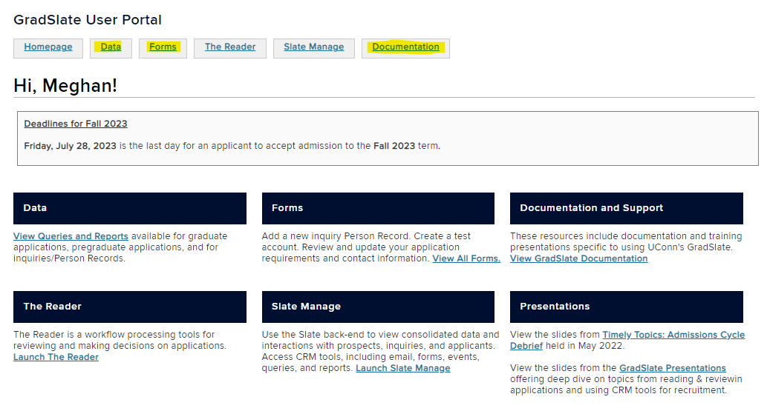
GradSlate User Portal
There are many helpful tabs on the GradSlate User portal:
Notes:
Lisa

Slide 12
User Portal: Data Tab
Queries & Reports
Notes:
Lisa

Slide 13
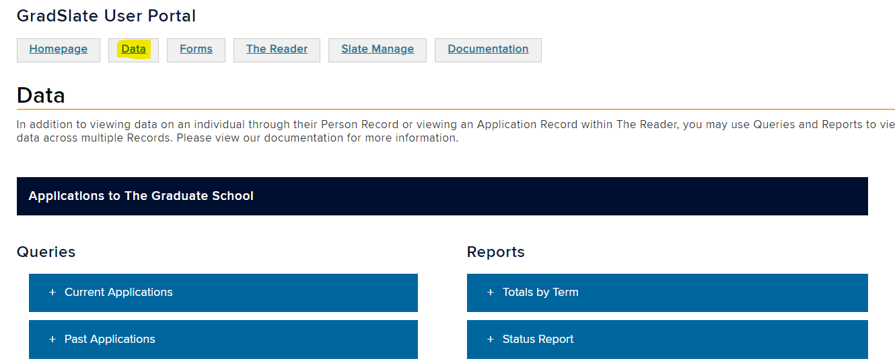
Program Details Form
The Data Tab is located on the GradSlate User Portal:
Notes:
Lisa

Slide 14
User Portal: Data Tab
Links to available Queries and Reports are now available within the GradSlate User Portal!
connect.grad.uconn.edu/portal/user?tab=data.
This is the best way to access available Queries & Reports.
Includes resources for graduate applications, pregraduate applications, and inquiry/Person Records.
Single page with links and tips.
Graduate Application Queries
Bulk Data for Export
Quick List, by Status
Quick List, by Milestone
Graduate Application Reports
Totals by Term
Status Report
Configurable Report
Notes:
Lisa

Slide 15
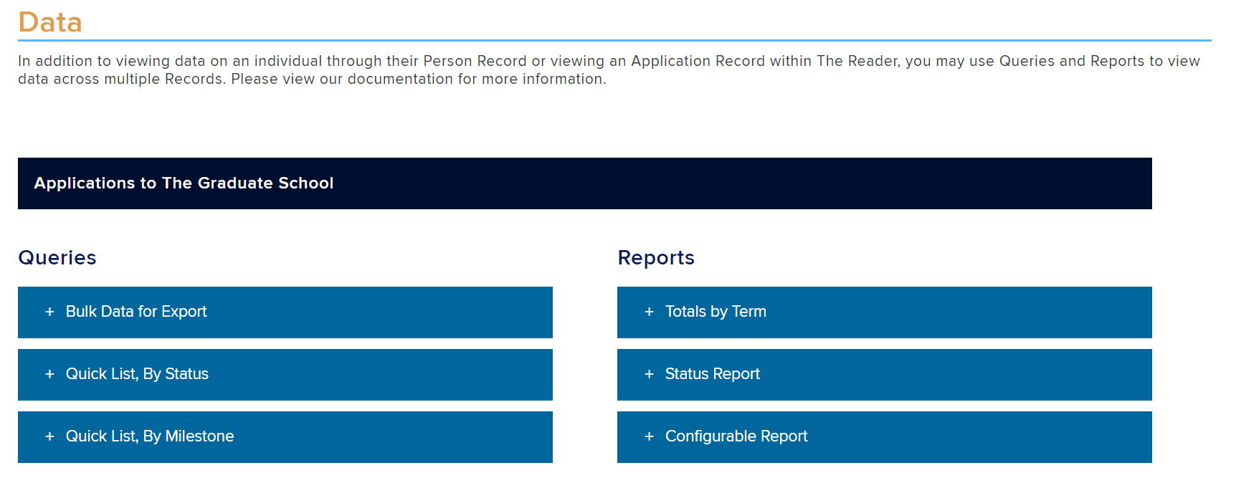
Data
Links to available Queries & Reports are presented on one webpage.
Notes:
Lisa

Slide 16
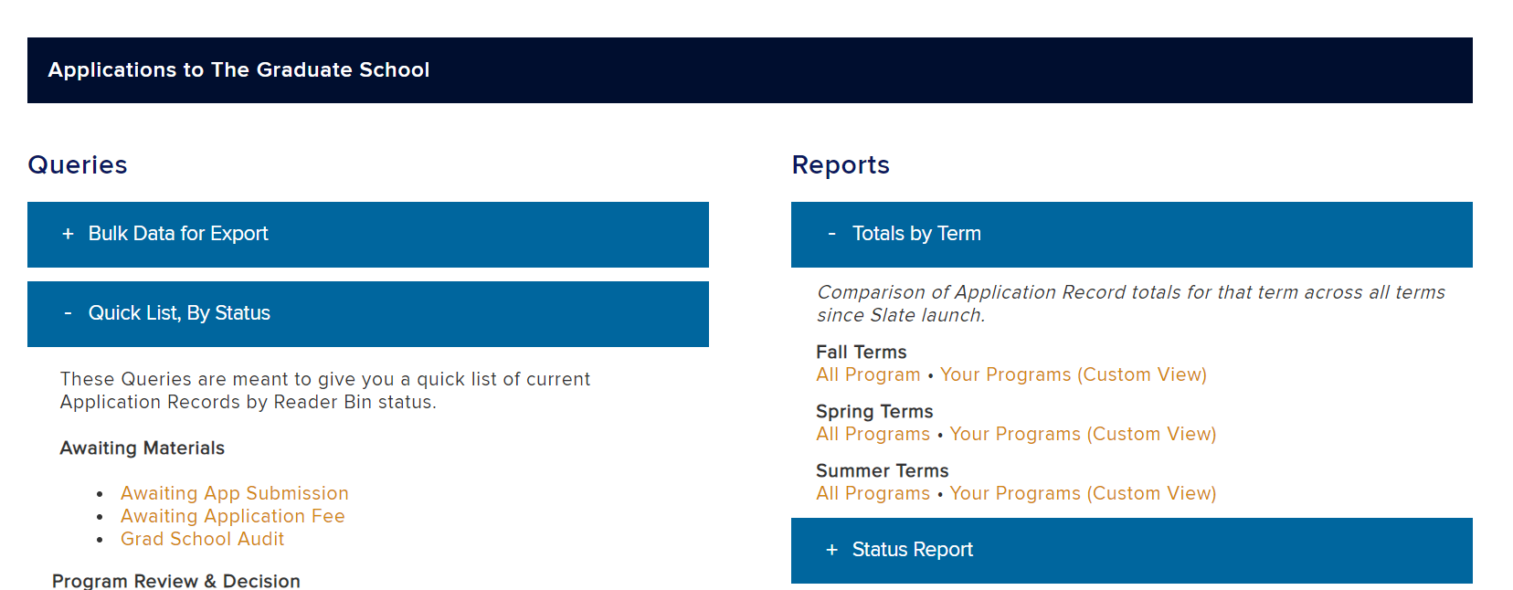
Queries and Reports
Clicking on a header (+) provides links to available resources, which open in Slate Manage.
Notes:
Lisa

Slide 17
Forms: Updating Application Requirements/Program Details
View/Update Application Requirements and Contact Information Using One Form
Notes:
Lisa

Slide 18
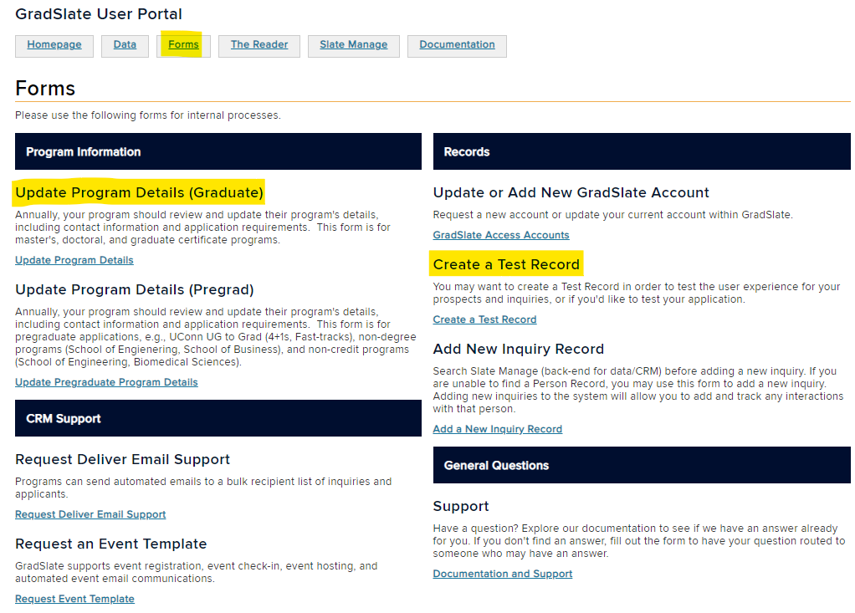
Program Details Form
The Forms Tab is located on the GradSlate User Portal:
Notes:
Lisa

Slide 19
Program Details
Application Requirements
Before the start of each application cycle, it is important to double-check that your program’s requirements are set up as expected in Slate. These program requirements are separate from the GPAR process.
To see your current requirements that are set up in Slate, please visit here
Tip:
One of the best ways to see how your program’s requirements are set up and to review your applicant’s overall user experience is to create a test application the form to do this also located in the Forms area under Create a Test Record.
Notes:
Lisa

Slide 20
Program Details
Staff Transition?
If there is a transition of a staff member, please continue to update this once new staff member is in place.
Note: All deferral requests (after a student has been accepted) will be sent to this address.
Deferral Requests will be sent to this address.
Withdrawal notifications will be sent to this address.
Request changes using the Program Details Form.
Notes:
Lisa

Slide 21
Application Requirements
If program requirements change, please update this information on the Update Program Details Form.
Graduate School Requirements (Can’t change these)
Program Requirements (Can change these)
Transcripts with proof of degree conferral
Degree equivalent to a US 4-year bachelor’s degree
GPA Requirements (not withheld)
Test of English Proficiency
TOEFL, IELTS, PTE, Duolingo
Or waiver
Letters of Recommendation. 0-3
Test Scores (e.g., GMAT, GRE)
Essays:
Personal Statement
Supplemental Essays
Uploaded Documents:
Resume/CV
Writing/research samples
Licensure/certifications
Notes:
Lisa

Slide 22
User Portal: Documentation Tab
Looking for documentation or need support?
KO
Notes:
Katie

Slide 23
Documentation Tab
The Documentation Tab is located on the GradSlate User Portal:
Notes:
Katie

Slide 24
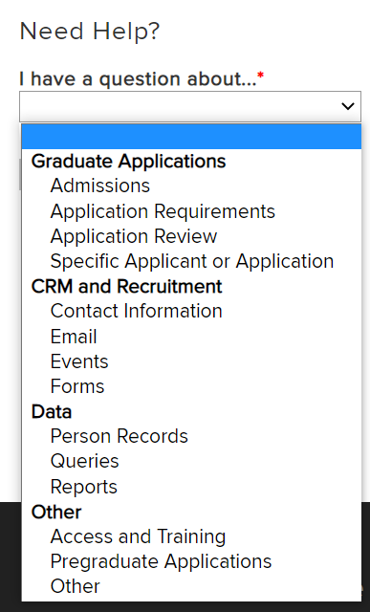
Documentation & Support
Documentation Tab of the GradSlate User Portal has been redesigned to be easier to navigate.
Choose your question topic to view related resources.
Still have a question? Submit a request for support to the GradSlate or Graduate Admissions team.
connect.grad.uconn.edu/portal/user?tab=documentation
Notes:
Katie

Slide 25
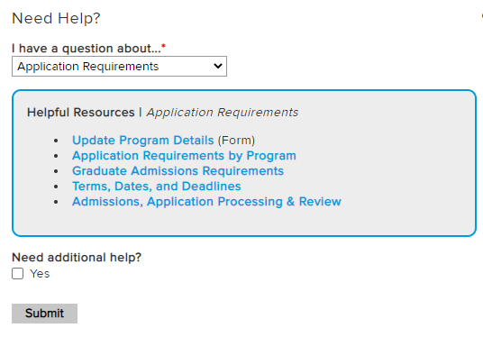
Need Help?
Choose a topic to
view available resources.
Notes:
Katie

Slide 26
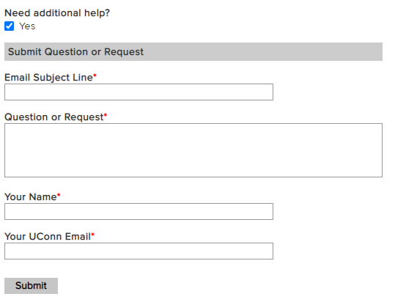
Need additional help?
If you need additional help,
submit your question right from this form.
Notes:
Katie

Slide 27
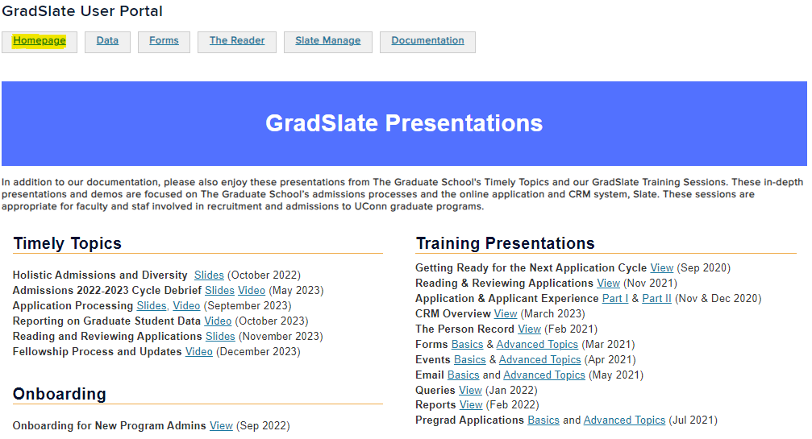
GradSlate User Portal: Presentations
connect.grad.uconn.edu/portal/user?tab=gradslate

Slide 28
Reminders
SRS
Notes:
Sarah

Slide 29
Late Arrival Form
An online process for students to request permission to arrive to campus late
SRS​
Notes:
Sarah

Slide 30
Requests for Late Arrival
Effective January 2023
The Graduate School has developed a new online process for students to request permission to arrive to campus late.
The form for incoming students and current students is available on our website.
The form is program facing, meaning the program must request the late arrival on behalf of the student.
The form will open about a week before classes begin.
Late Arrival Requests from students will be approved if:
They are able to arrive by the 10th day of the semester (September 9, 2024 for Fall 2024).
They have GA supervisor approval (GA only).
They have arranged a plan with their instructors to satisfy any course assignments missed until they are able to arrive in the U.S. for in-person instruction.
Communications about the Late Arrival Request process for Fall 2024 will be sent to staff, faculty, and students over the Summer.
SRS​
Notes:
Sarah

Slide 31
Applicants Switching Programs
Applicants are required to apply to their new intended program rather than switching the application over
SRS​
Notes:
Sarah

Slide 32
Process to Change Program on Existing Application
Effective July 1, 2023
Applicants who wish to “switch” their application from one program to another, will now be required to submit a new application to the new intended program.
A few things to note:
An applicant’s initial application will be withdrawn, and the $75 fee will be waived for the new intended program.
The new application will need to go through your program’s standard admission review process.
Applicants should request to apply to the new intended program before an admission decision has been entered, otherwise:
If an applicant has been admitted, the application fee will be waived for the new intended program, after the initial application has been withdrawn.
If an applicant has been denied, the application fee will not be waived for the new intended program.
Important: Applicants (not current students) can request to change Concentrations within the same program without needing to submit a new application.
SRS​
Notes:
Sarah

Slide 33
Graduate Students and Export Control
Issues to be aware of when admitting students from certain countries
SRS​
Notes:
Sarah

Slide 34
Graduate Students and Export Control
Currently, there are export control concerns due to U.S. government sanctions that apply to international students from the countries listed below.
Students from these countries cannot participate remotely in their courses or start their GA related duties until they physically arrive in the US. If the student is not able to arrive by the 1st day of the semester, they will need to arrange a plan with their instructors to satisfy any course assignments missed until they are able to arrive in the U.S. for in-person instruction.
Cuba
North Korea
Syria
Iran
Russia
Ukraine as of February 22, 2022
Belarus as of February 24, 2022
If you have any questions about Export Control, please email exportcontrol@uconn.edu.
SRS​
Notes:
Sarah

Slide 35
*New as of Summer 2023* Waiving Application Fees
Programs may waive application fees on an applicant’s behalf
SF
Notes:
Shirley

Slide 36
Program Application Fee Waiver
As of July 2, 2023, programs are able to waive the $75 application fee on an applicant’s behalf directly within the Slate application!
Benefits:
Programs will no longer need to submit a KFS Distribution of Income and Expenses or provide an e-doc # to Graduate Admissions for each applicant/group of applicants for whom they wish to pay the application fee before the applicant submits an application.
Programs can monitor the parameters of their application fee waivers (e.g., first 75 applicants, applicants who attended specific schools, etc.)
Programs have more control over the timing of when application fees are waived.
Notes:
Shirley

Slide 37
Program Application Fee Waiver
Noteworthy items:
Programs should only waive fees for applications that are Unsubmitted/Awaiting Payment.
If the program waives a fee accidentally on an Unsubmitted application, the program will need to email gradadmissions@uconn.edu to “un-waive” the fee ASAP. (Once an application has been submitted, The Graduate School cannot un-waive the fee. The program would be billed for that application fee.)
Refunds will not be issued if an applicant has already paid the fee.
The program will be responsible for notifying the applicant of the program-sponsored fee waiver. (Applicants will not be notified by The Graduate School.)
Notes:
Shirley

Slide 38
Program Application Fee Waiver
Additional noteworthy items:
Programs will be billed by the Budget Office starting July 2024 for all application fees waived by programs in the previous fiscal year.
The Budget Office asks that programs consider budgeting a specific amount of fee waivers per year for recruitment purposes.
For questions about the billing/transfer process, please contact budget@uconn.edu
Notes:
Shirley

Slide 39
When a Staff Member is also an Applicant
How to handle Test Records and access
Notes:
Shirley

Slide 40
What to do when a staff member is also an applicant?
If staff applying to any graduate program:
Use different email address than test application, record does not get merged with test record.
Staff can tell if real application is on their test record by new test record markers in application and Application Status Portal.
If staff applying to a program they administer…
Program needs to think carefully, staff member must not be involved in admissions decisions.
There may be issues with applicant seeing their own reader review comments from faculty.
Could potentially influence cohort for other applicants.
Be aware of power conflicts this could create if staff member is admitted. (Supervisors, potential instructors etc.)
Let TGS know as soon as possible to change user permissions.
Only for current admissions cycle, after cycle ends, permissions can be updated.
TGS will review these situations case by case.
Notes:
Shirley

Slide 41
What to do when a staff member is also an applicant?
Staff members can now see that they are applying on their test record, when they log in with their uconn.edu email address that is associated with their test record:
Notes:
Shirley

Slide 42
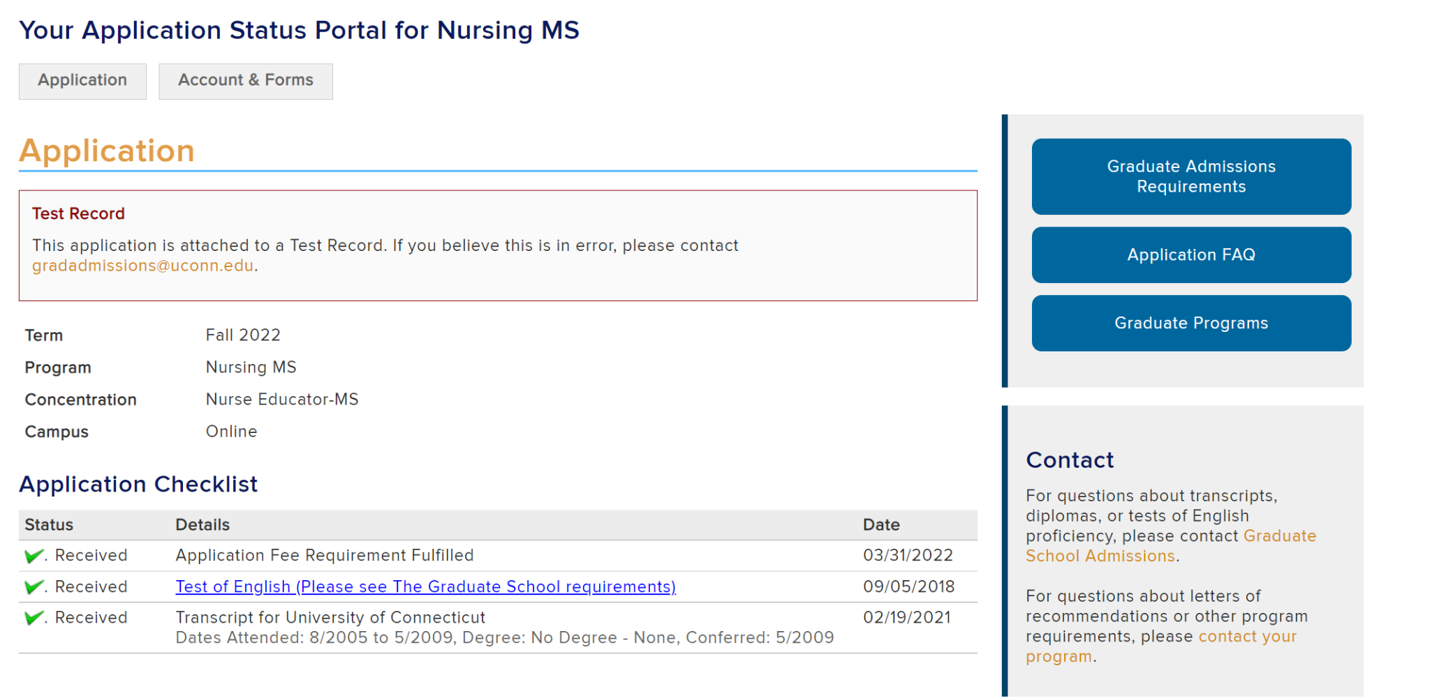
What to do when a staff member is also an applicant?
Test record marker will also show on Application Status Portal:
Notes:
Shirley

Slide 43
Application Deadlines
HB
Notes:
Holly

Slide 44
Deadline Definitions
Deadline Type | Definition
Application Opens | First day to submit an application
Submission Deadline | Last day for the applicant to submit an application
Reply to Offer Deadline | Deadline to reply to an offer of admission
Deposit Deadline | After accepting the offer, the deadline to pay the deposit if applicable. Domestic Application: 3 weeks after accepting admission International Application: 2 weeks after accepting admission
TGS Admission deadlines can be found on the next slide as well as on our website: Application Requirements | Admissions FAQ | Apply to UConn
Notes:
Holly

Slide 45
The Graduate School Deadlines
System/Hard Deadlines
Stops application submission (No exceptions)
Types:
Default - The Graduate School (List to left)
Custom - Requested by the Program
Request custom deadlines using the Program Details form.
Preferred/Soft Deadline
Not built into Slate
Does not stop application submission
Advertised by the program on program's website
Some programs appreciate the flexibility of a preferred deadline, over a custom deadline to fill their admission spots on a rolling basis, based on space. After a preferred deadline has passed, The Graduate School’s default deadlines will be implemented.
Please note: If a student has submitted their application before the program’s deadline, their application may take time to become visible for program review.
Summer 2024
Application Opens | Monday, September 11, 2023
Application Submission Deadline | Wednesday, August 21, 2024
Reply to Offer Deadline | Friday, August 23, 2024
Fall 2024
Application Opens | Monday, September 11, 2023
Application Submission Deadline | Wednesday, July 24, 2024
Reply to Offer Deadline | Friday, July 26, 2024
Spring 2025
Application Opens | Monday, January 29, 2024
Application Submission Deadline | Wednesday, December 18, 2024
Reply to Offer Deadline | Friday, December 20, 2024
Notes:
Holly

Slide 46
Graduate School Deadlines
Please remember to enter admission decisions into your Program Decision reader review form for all applicants by our ”Reply to Offer” deadlines, regardless if they are a(n):
Admit
Deny
Withdrawal Requested by Applicant
Fall 2024 decisions will be due July 26, 2024*
If applicants are missing materials/requirements by these deadlines, then please either deny the applicant or work with the applicant to request a possible deferral of their application.
Our office will send an email around 2 weeks prior to these deadlines to remind programs to enter admission decisions on all applications.
If admission decisions have not been entered on applications, Dean Shor may reach out to inquire about admission practices.
Notes:
Holly

Slide 47
Term Open/Close for Applicants
Deadlines • Email Reminders to In-Process Applicants
Notes:
Holly

Slide 48
Application Fees & Deadline
Applicants are able to submit an application before an application deadline, and then pay the fee at a later date.
Programs should clearly state application deadline policies on their websites, e.g., if your program will not accept an application when the fee is paid after the deadline.
If the program will not accept an application because the application fee was submitted after the deadline, the program can offer a deferral as an option to the student. For further questions please contact gradadmissions@uconn.edu
To identify applicants who submitted, but have not yet paid, please use the Bulk Data Query
Applicant names also appear as a section in the Current Application Query Report
Notes:
Holly

Slide 49
Term Open/Close for Applicants
When do applications open for the following semester?
Applications will open 10 days after the start of the current semester
Fall 2025 applications will open on Monday, September 9, 2024
Summer applications will open on the same date as the fall
Spring 2026 - 10th day after spring semester starts
Applications will open on Monday, February 3, 2025
NOTE: 10th day of the semester is magical!
What happens to open applications when the term closes?
After the application deadline passes, applicants still in progress for that term are sent an email letting them know when their application will be closed and how to request a deferral.
After the 10th day of the semester, all open applications without an approved deferral request are closed out in Slate.
Notes:
Holly

Slide 50
Deferral & Withdrawal Requests
How applicants make these requests and how the requests are processed.
KO
Notes:
Katie

Slide 51
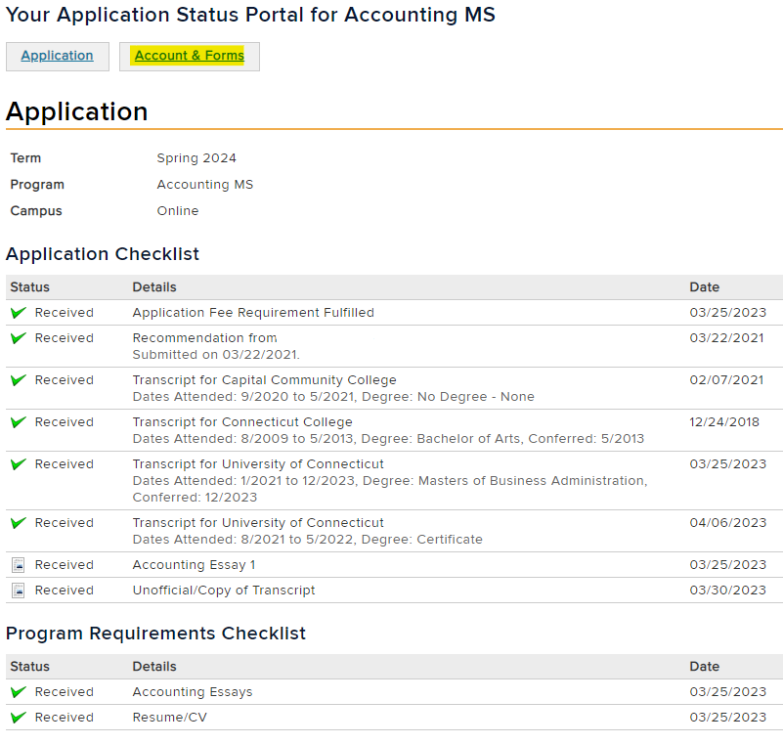
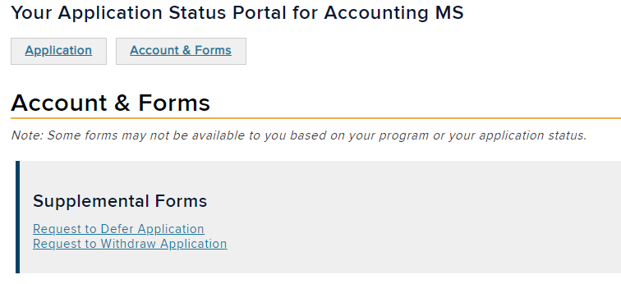
Deferral & Withdrawal
Two online forms can be found on an applicant’s Application Status Portal:
Notes:
Katie

Slide 52
Deadlines for Deferral and Withdrawal Requests
We strongly encourage requests for graduate students who have not been appointed as a GA to be made prior to the first day of the semester. (8/26/24 for Fall 2024)
To avoid payroll issues, graduate students who have been appointed as a GA must submit their requests prior to the start date of their GA appointment. (8/23/24 for Fall 2024)
These requests should be submitted no later than the 10th day of the semester.
After the 10th day, students not registered for courses will be voluntarily dismissed for failure to register. If registered, students will be required to fill out the Voluntary Separation Notification (VSN) form to be withdrawn.
Notes:
Katie

Slide 53
Requests for Deferral
Applicants can request to defer their application at any point throughout the application process.
Requests made by Admitted/Matriculated applicants:
If the applicant has already been admitted or matriculated, program approval is required.
Notification of deferral requests for admitted/matriculated students will be routed to the program’s Slate-associated email account for their approval.
To review or change which email address currently receives those Slate communications on behalf of your program, please visit the Program Details form.
Forward approved deferral requests to gradadmissions@uconn.edu
Please Note: Programs are not required to approve deferral requests. If a program denies a request to defer, the program is responsible for communicating this with the applicant. The application could be cancelled, and the applicant may reapply.
Notes:
Katie

Slide 54
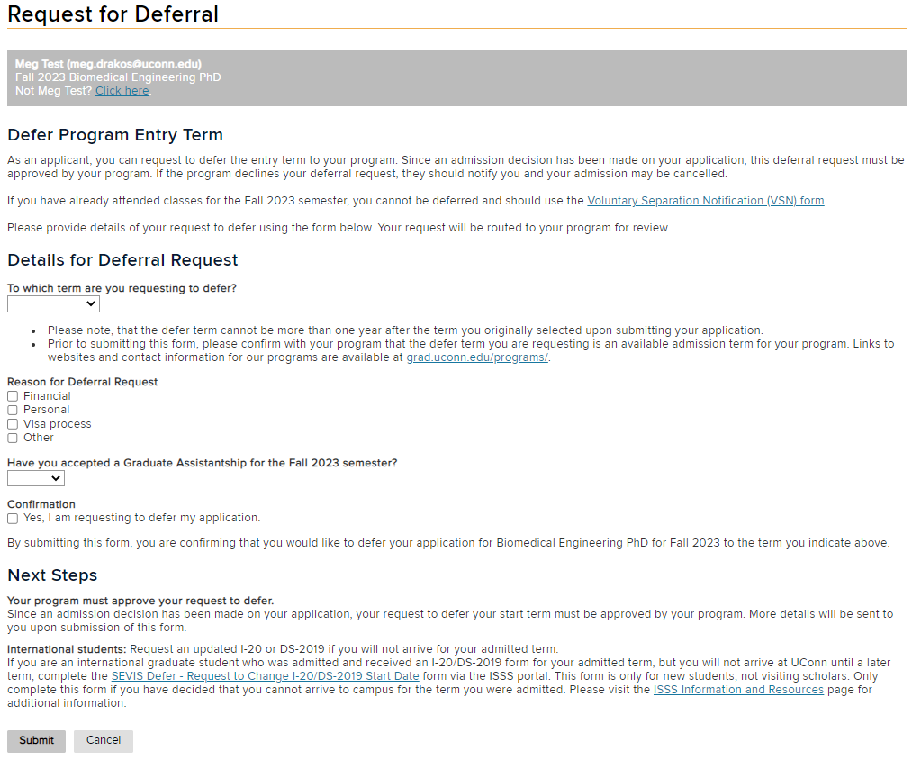
Request for Deferral Form
Notes:
Katie

Slide 55
Criteria for Deferral
Admitted applicants cannot be deferred if they meet any of the following criteria:
If an applicant has already attended classes for the semester they are admitted.
If the request is made after the 10th day of classes for the semester they are admitted.
If the defer term requested is more than one year after the original entry term.
In cases 1 and 2, please direct them to the Voluntary Separation Notification (VSN) form. Questions regarding the VSN form can be sent to gradseparation@uconn.edu.
In case 3, the application could be cancelled and the applicant may reapply to a later term.
Notes:
Katie

Slide 56
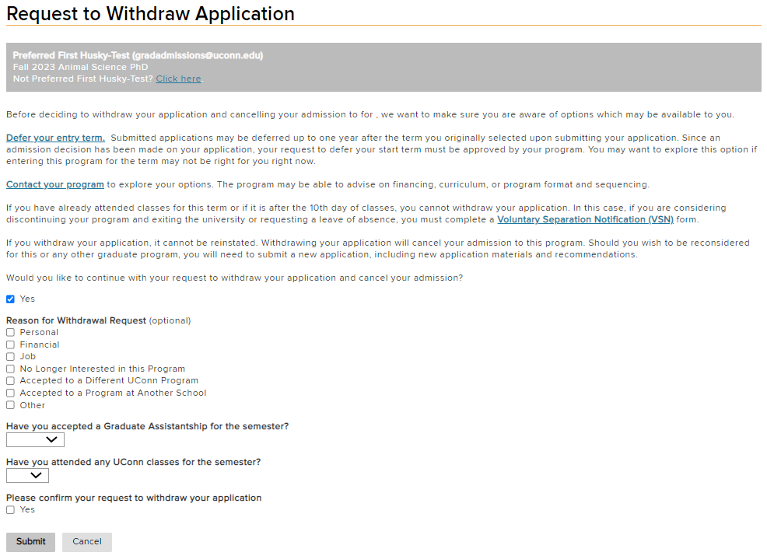
Requests for Withdrawal
Applicants do not need program approval to withdraw their application.
Requests to withdraw applications will not be sent to the program for approval.
If the applicant has already been matriculated, notification of the request will be routed to the program for their own records. (If student is GA, program will need to cancel payroll transaction.)
Notes:
Kaite

Slide 57
Questions? Comments? Feedback?
Type in the chat or unmute yourself to join the conversation!

Slide 58
Contact for Questions:
gradadmissions@uconn.edu
gradslate@uconn.edu
Questions concerning applications and the admissions process.
Who qualifies for a TOEFL waiver?
Can I admit a student with a 2.3 GPA?
When do applicants have to send in their official transcripts?
I just uploaded my missing documents. Can my application be updated?
Can I waive a program requirement?
How do I know if an applicant is still missing materials?
Can I download a PDF of an application?
Can I admit without a program requirement?
How do I know if an applicant has been matriculated?
Questions concerning the GradSlate system.
How do I (or my director) get access to Slate?
How do I make a change to my application requirements?
My program’s contact information is incorrect. How can I fix it?
How do I access training materials?
Can I get data on all of my applications?
How do I send an email from Slate?
Can I use Slate for my infosessions?
I’m encountering an error message; what should I do?
Notes:
Katie

Slide 59
Timely Topics
Administrative Track
PREPARING FOR FALL: GRADUATE ASSISTANT PAYROLL PROCEDURES
DATE: Thursday, May 23, 2024 (Date has been changed from 5/30)
TIME: 1:00 PM - 2:30 PM
FACILITATORS: Graduate Payroll Manager/Payroll Staff, Payroll Department
Ana Colón-Wallace, Educational Program Assistant, UCAELI
Megan Petsa, Director of Graduate Student Administration, The Graduate School
Jeannie Slayton, Director of Intercultural Programs and Support/UCAELI
This session will outline everything you need to know to successfully process graduate payroll transactions for this fall. We’ll cover SmartHR templates, important dates and deadlines, outline the payroll audit process, and discuss common mistakes and ways to prevent them. This session will also discuss how the English Proficiency Policy for TAs intersects with payroll so that departments can communicate with their GAs and plan accordingly.
More details on the Timely Topics Series: https://grad.uconn.edu/faculty-staff-resources/timely-topics/

