Slide 1
Timely Topics:
Dialogue with the Dean
Leslie Shor, VPGEDGS
September 12, 2024

Slide 2
1. A little about me…

Slide 3
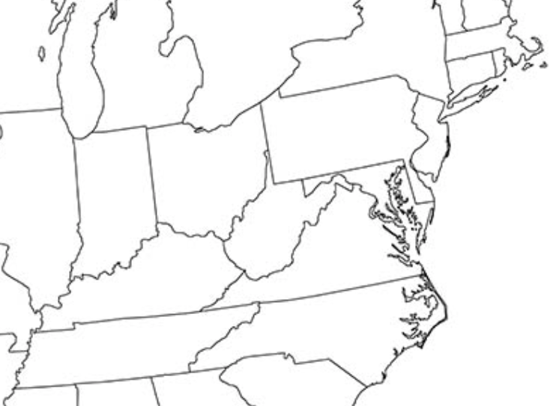
A little about me… (continued)
My “Niche”
Environ-
mental
Science
BA
Chemical Engineering
PhD
Biomedical Engineering Post-doc

Slide 4
My Approach
Qualities, Approaches, & Traits
Collaborative: Collegial. Eager to learn. Eager to share.
Practical: K.I.S.S.
Service-Oriented: Administration is service-leadership.
Systems Thinker: What is the next best “task” to remove obstacles and empower/advance others?
Introvert. Terrible at facial recognition. Bad “resting-bitter-face”.
Notes:
“Credit” is like love: the more you give, the more there is.
First year experiences, culturally competent sustained advising, strengthen life and career readiness in academic and co-curricular activities

Slide 5
2. Graduate Education @UConn 101

Slide 6
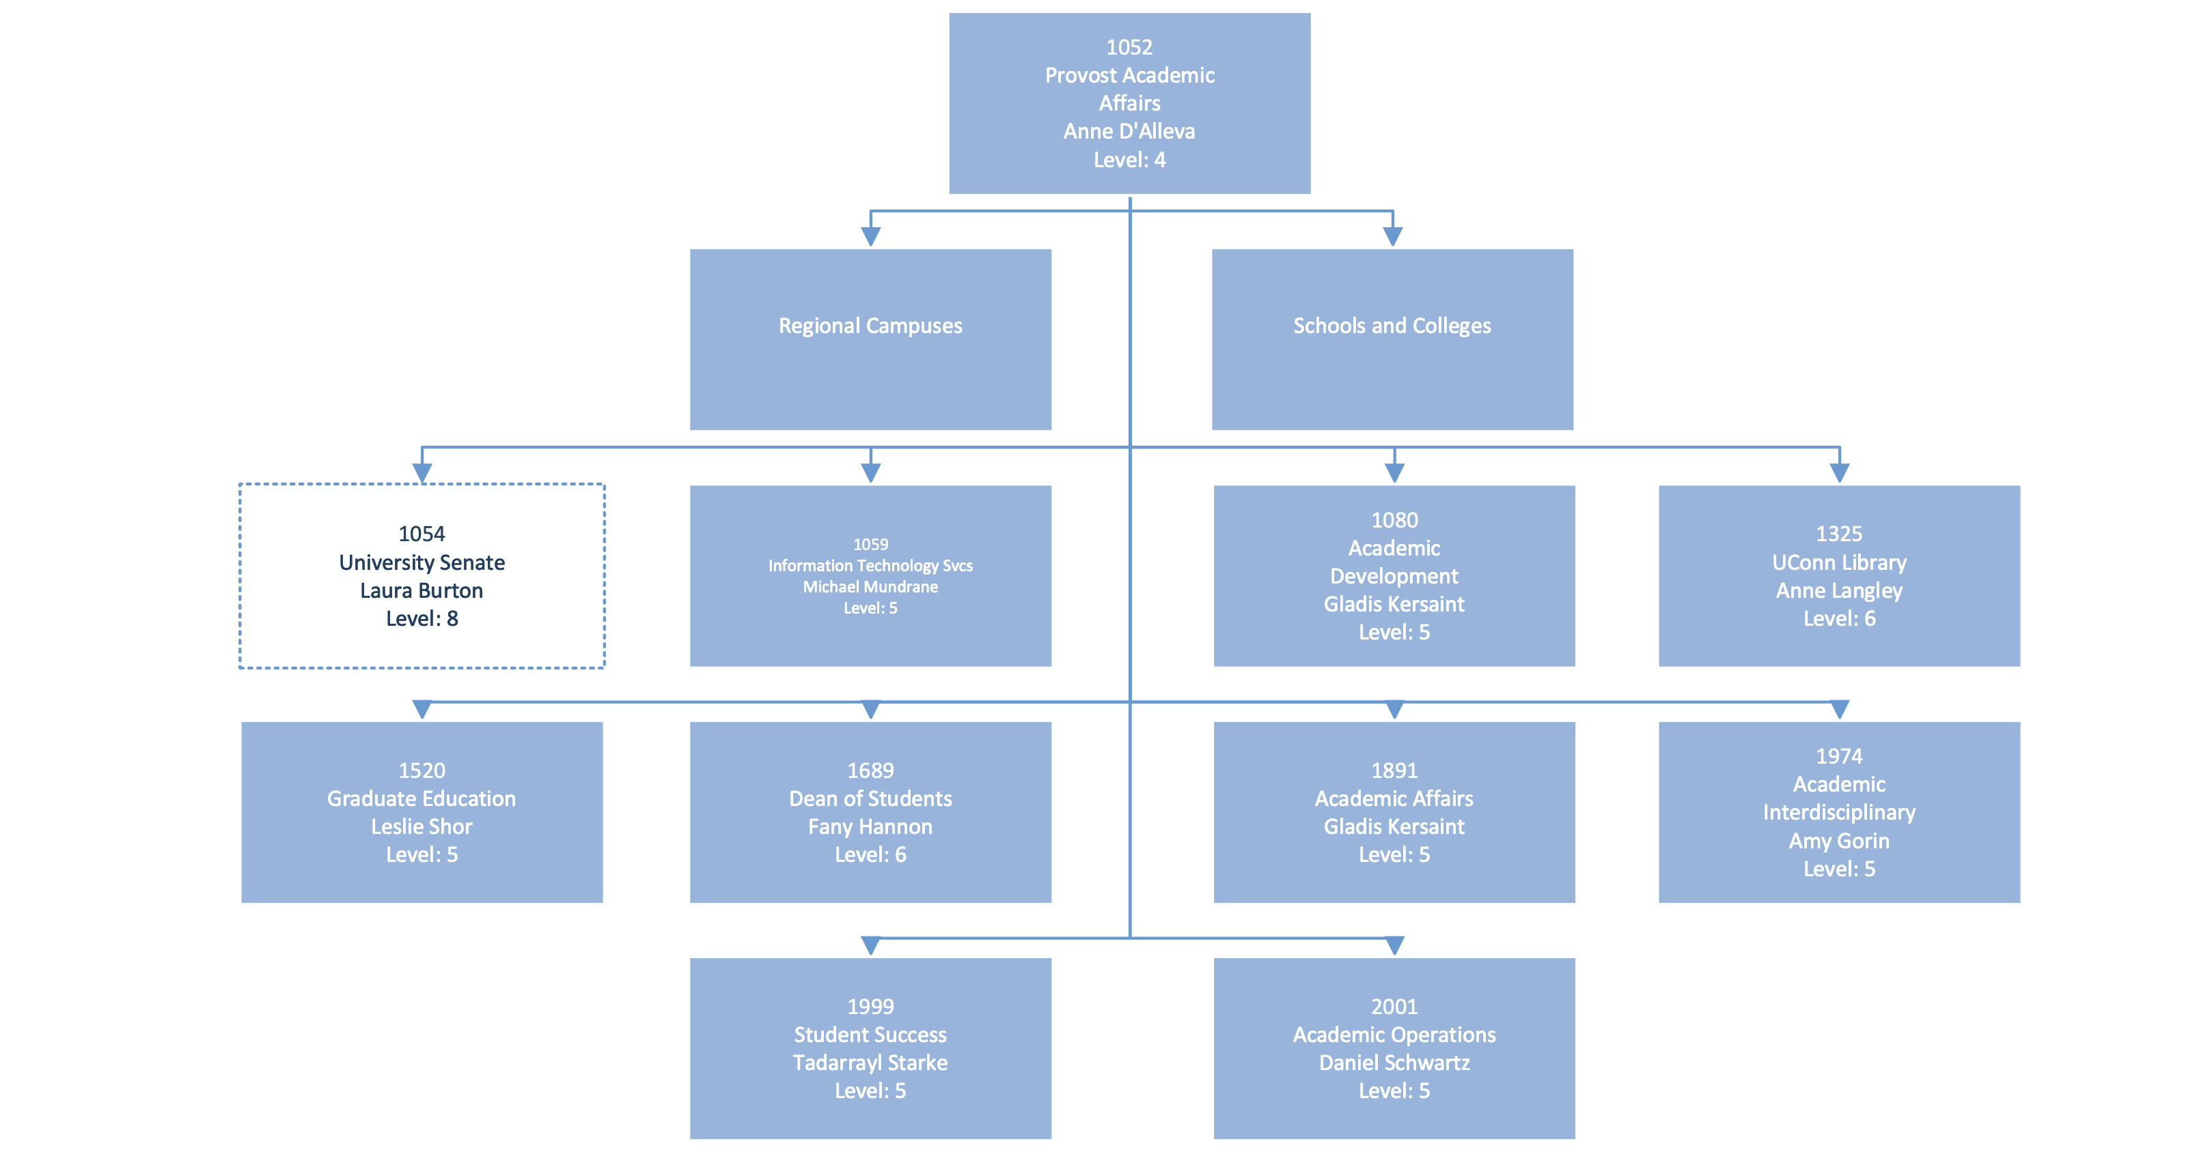
Academic Affairs @ UConn
https://bpir.media.uconn.edu/wp-content/uploads/sites/3452/2024/08/University-Org-Chart-8.13.24.pdf
Notes:
Vice Provost for Academic Affairs and Dean of the Graduate School
provide strategic vision and operational leadership to all aspects of graduate and postdoctoral education at the University of Connecticut,
set priorities for The Graduate School and lead innovation in graduate education
foster a thriving community of graduate students and postdoctoral scholars
provide flexible services to support graduate students, postdoctoral scholars, faculty, and staff.
The Vice Provost and Dean is the chief advocate for graduate and postdoctoral education at the University of Connecticut and will work collaboratively with the provost and vice provosts, other deans, department heads, and other university business units

Slide 7
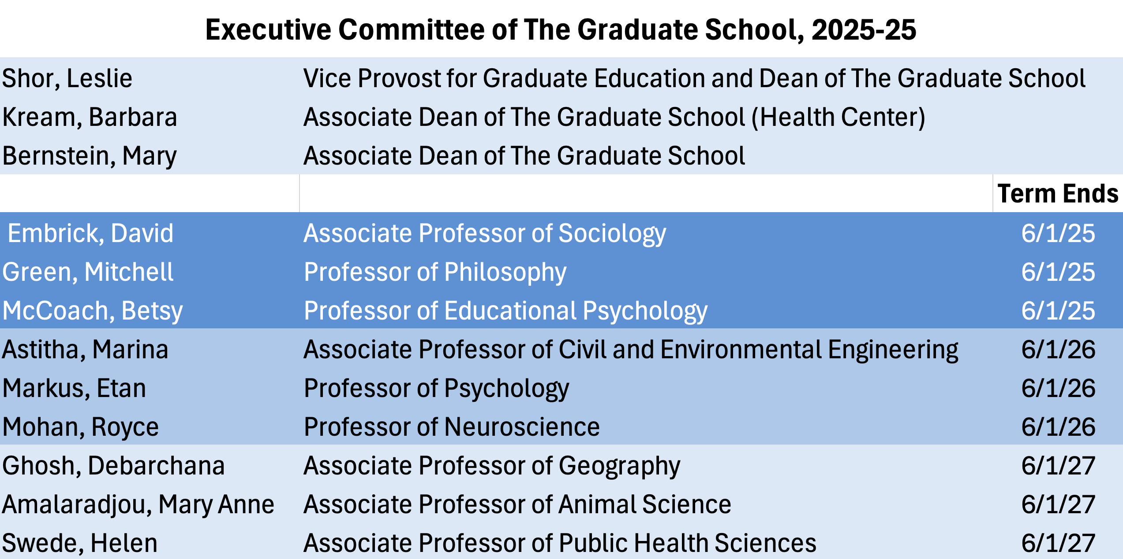
Administrative Structures of TGS
Executive Committee (EC) of The Graduate School
The Graduate Faculty Council (GFC)
Graduate Faculty
https://policy.uconn.edu/2018/11/21/by-laws-rules-and-regulations-of-the-graduate-faculty-council/
Notes:
: Advises the Dean on matters of policy and regulatory interpretation as these may affect the administration and status of graduate education at the University.
Specifically, the Executive Committee:
1. Evaluates for academic merit proposals for creation, modification, or elimination of Fields of Study, Areas of Concentration, and all associated degree and certificate programs;
2. Advises the Dean on the interpretation of Graduate School academic policies and regulations;
3. Advises the Dean on issues related to graduate education and graduate programs.
1. Provides leadership in developing academic policies that promote effective programs of graduate education;
2. Establishes minimum criteria for admission to The Graduate School;
3. Establishes minimum curricular and degree requirements for The Graduate School;
4. On behalf of the Graduate Faculty, approves conferral of degrees for students certified by the Dean to have completed graduation requirements for the degrees that are under the jurisdiction of The Graduate School;
5. Convenes meetings of the entire Graduate Faculty when appropriate.
1. Appointed by the Dean of The Graduate School.
2. Graduate Faculty Status is required to serve as the Major Advisors to Master’s and Doctoral committees.
3. Effective Fall 2024, faculty are required to complete 8-hr Mentor Training (curriculum based on CIMER, Center for Improvement in Mentored Experiences in Research) prior to appointment as Graduate Faculty.

Slide 8
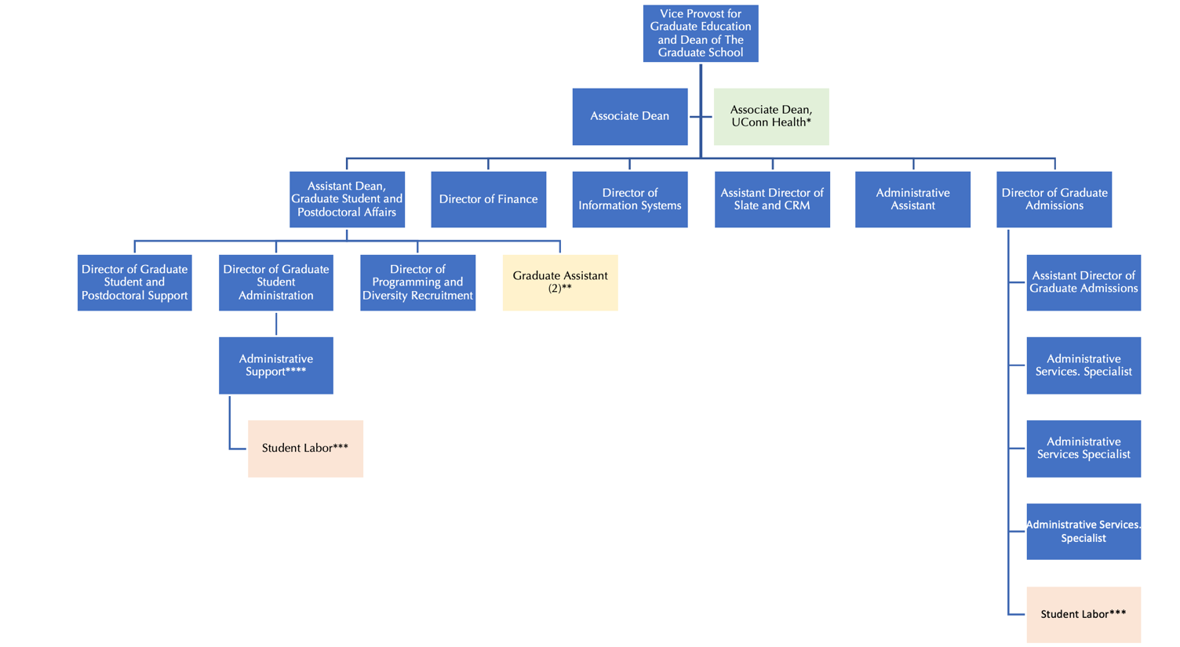
TGS Staff

Slide 9
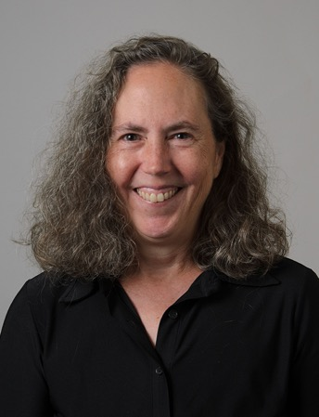
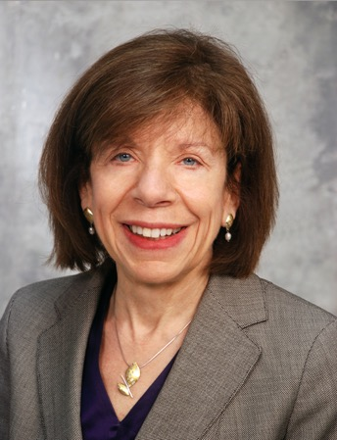
Associate Deans of The Graduate School
Mary Bernstein
Barbara Kream
Associate Dean of The Graduate School
mary.bernstein@uconn.edu
Associate Dean of TGS, UConn Health
kream@uchc.edu
Notes:
Mary Bernstein
develops programs to support effective mentoring of graduate students and postdoctoral scholars,
Advises departments in creation or modification of graduate degree and certificate programs; oversees the review of such proposals; updates to the Graduate Catalog,
Hearing officer for cases of academic misconduct, and academic dismissal,
Facilitates the work of the Graduate Faculty Council and the Executive Committee of TGS, including maintaining and recommending changes to The Graduate School Bylaws as necessary,
Represents The Graduate School on various university committees.
Barbara Kream
Provides oversight and coordination for the operation of graduate programs at UConn Health
Provides leadership for the recruitment, admission, and financial support of students in the Biomedical Science PhD program
Provides guidance to graduate students on academic matters and assists them in resolving problems

Slide 10
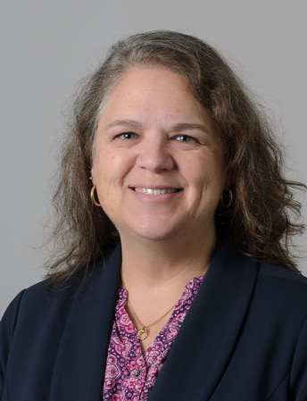
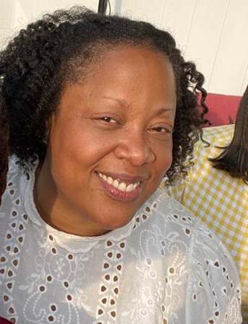
Graduate Student & Postdoctoral Affairs
Karen Bresciano
Kimberly Curry
Assistant Dean of TGS karen.bresciano@uconn.edu
Director of Graduate Student and Postdoctoral Support
kimberly.curry@uconn.edu
Notes:
Graduate Student & Postdoctoral Affairs’’
Seeks to improve systemic issues that affect the graduate education experience at UConn.
Aids faculty and staff who work with graduate students and post docs.
Provides one-on-one support, advocacy, and problem-solving assistance for graduate students and post docs facing issues related to their experiences in The Graduate School.

Slide 11
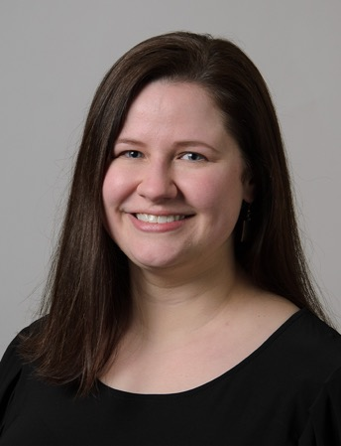
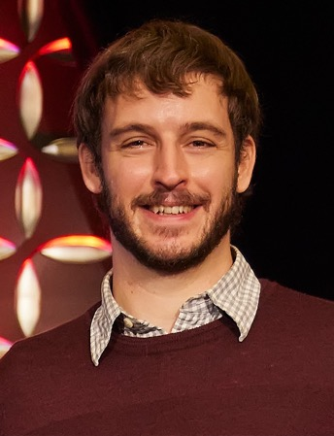
Graduate Student & Postdoctoral Affairs
Megan Petsa
Stuart Duncan
Director of Graduate Student Administration
megan.petsa@uconn.edu
Director of Programming & Diversity Recruitment
stuart.duncan@uconn.edu
Notes:
Megan Petsa
Provides guidance regarding administration of graduate assistantships
Reviews enrollment exceptions for graduate students and can answer questions about policies and procedures
Advises students on and processes voluntary separations and reinstatement
Leads the Timely Topics series, which has separate tracks for faculty, staff, and graduate students
Stuart Duncan
Programming for graduate students, including orientation, three-minute thesis competition, and grad appreciation week.
Programming for postdoctoral scholars, including the yearly seed award competition, datablitz competition, and postdoc appreciation week.
Support for Harriott, Jorgensen, and Crandall fellows and manages new Distinguished Masters and Doctoral fellows.

Slide 12
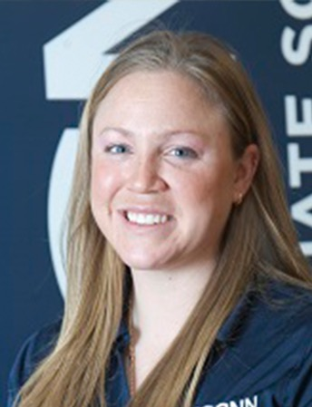
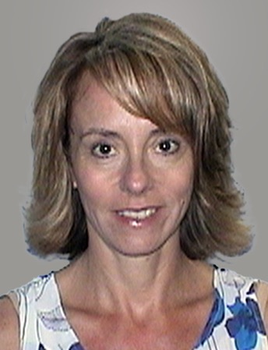
Admissions & Financial
Meg Buckley
Lisa Gorman
Director of Graduate Admissions
meg.buckley@uconn.edu
Graduate School Finance Director
lisa.gorman@uconn.edu
Notes:
Meg Buckley
Director for the ~ 5-person Graduate School admissions team.
Assists students in applying for graduate school
Receives and processes 13,000 applications (PhD, Master’s, Certificate); admits and matriculates graduate students.
Leads GPA and credential evaluation
Determines Residency (Tuition rates)
Lisa Gorman
Manages finances of TGS
Works with Faculty and Staff to apply UConn’s Policy on Financial Commitments to Institutional Training Grants and Nationally Competitive Graduate Fellowships.
Financial administration of the NSF Graduate Research Fellowship Program at UConn
Financial management of The Graduate School’s internal fellowships including Jorgensen, Harriott, Crandall, Predoctoral, Doctoral Dissertation, and Conference Participation
Coordinate with programs and apply tuition payments for The Provost's Professional Internship Program for Public Outreach, Service, and Engagement

Slide 13
3. Snapshot: Grad Education @UConn Today

Slide 14
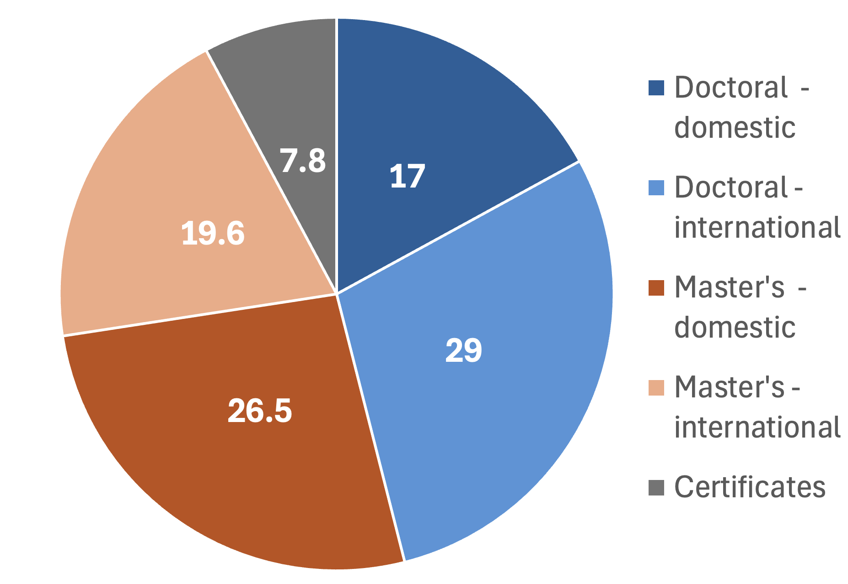
Application Volume (AY 23/24)
Total = 12,795
Doctoral = 5,897
including 3,720 international
Master’s = 5,901
including 2,511 international
Certificates = 997

Slide 15
Enrollment Totals for Fall 2023
Enrollment Totals | Fall 2023 |  | Fall 2024 (Prelim) |  | Change (%)
 | Master's | PhD | Master's | PhD | Master's | PhD
Agriculture, Health & Natural Resources | 259 | 265 | 266 | 262 | 2.7% | -1.1%
Business | 1,388 | 44 | 1267 | 42 | -8.7% | -4.5%
Education | 300 | 177 | 327 | 168 | 9.0% | -5.1%
Engineering | 315 | 606 | 342 | 611 | 8.6% | 0.8%
Fine Arts | 69 | 26 | 70 | 24 | 1.4% | -7.7%
Interdisciplinary | 38 | 1 | 108 | 11 | 184% | 1000%
Liberal Arts & Sciences | 396 | 1,187 | 417 | 1,198 | 5.3% | 0.9%
Nursing | 214 | 127 | 253 | 136 | 18% | 7.1%
Pharmacy |  | 53 |  | 56 |  | 5.7%
Social Work | 286 | 25 | 406 | 25 | 42% | 0.0%
UConn Health | 138 | 173 | 137 | 184 | -0.7% | 6.4%
 | 6,087 |  | 6,310 |  | 3.7%

Slide 16
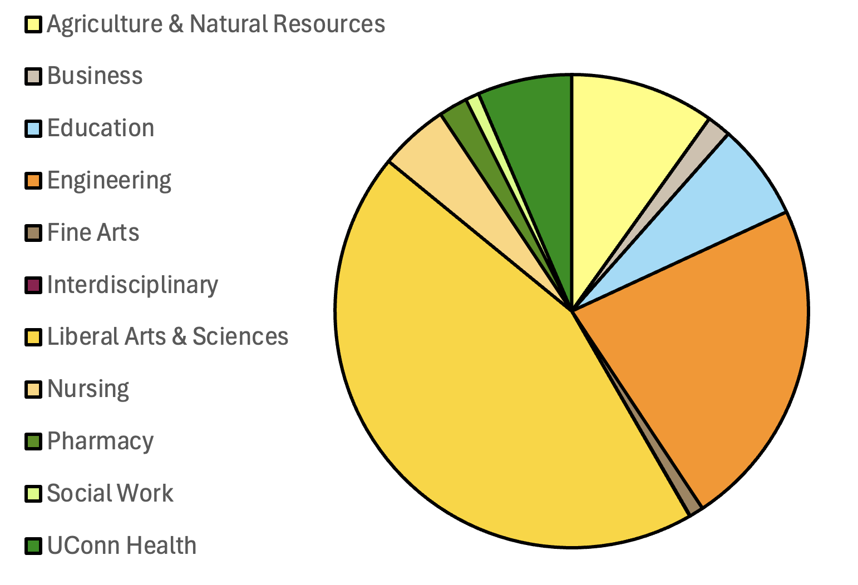
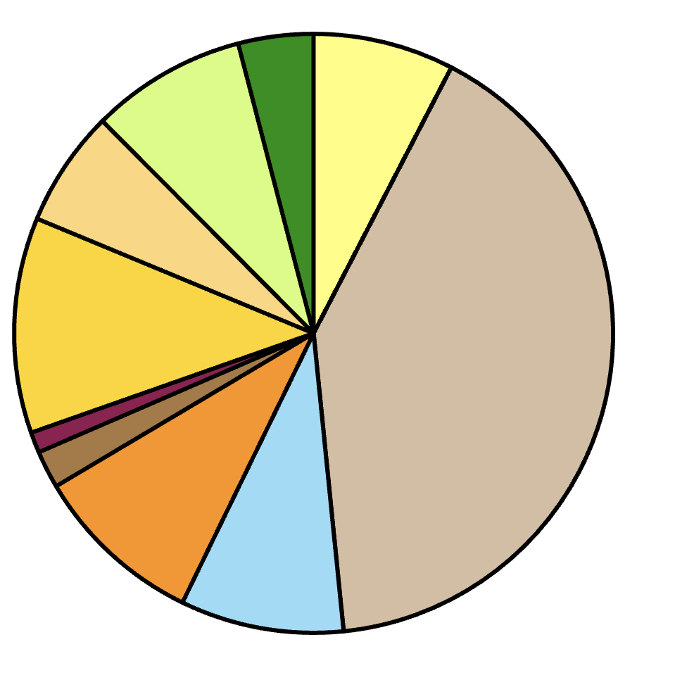
Fall ‘23 Enrollment
Master’s
Doctoral

Slide 17
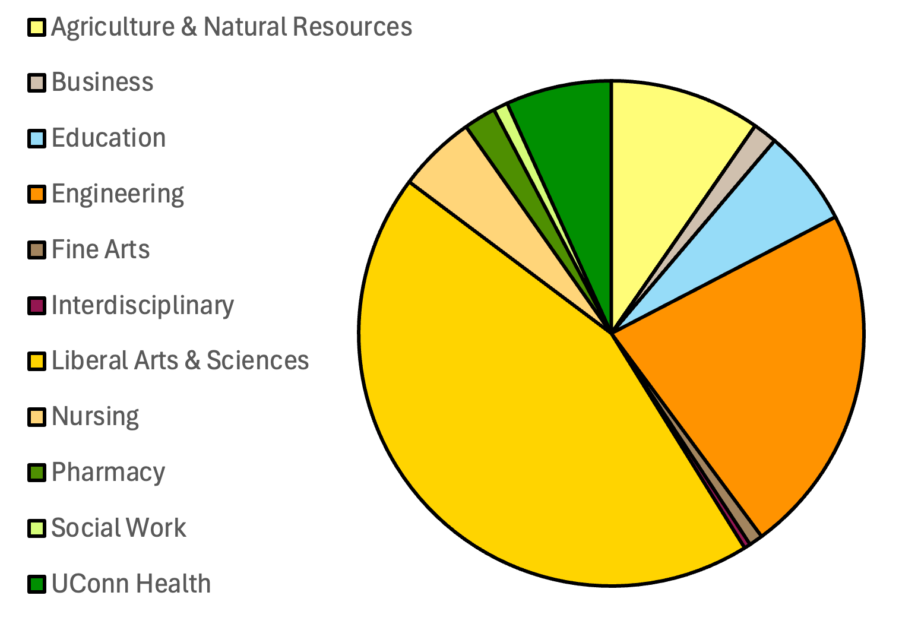
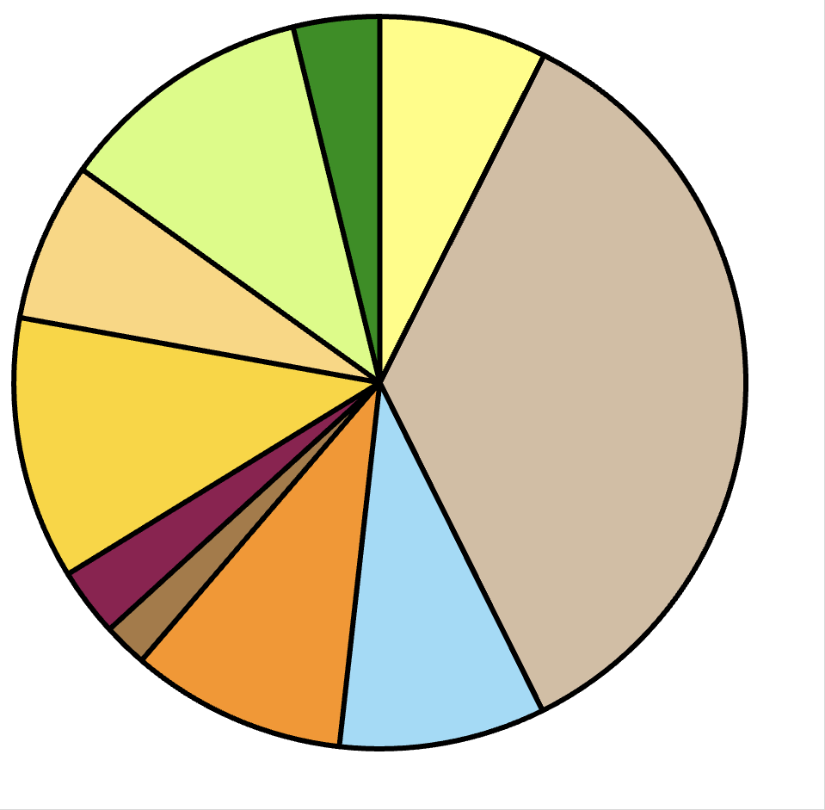
Fall ‘24 Enrollment
Doctoral
Master’s
Doctoral

Slide 18
Race & Ethnicity and gender identity of graduate students
Race & Ethnicity | Male | Female | Total
Asian American | 211 | 237 | 448
Black | 119 | 240 | 359
Hawaiian/Pacific Islander | 1 | 1 | 2
Hispanic/Latino | 253 | 382 | 635
International | 937 | 762 | 1699
Native American |  | 3 | 3
Two or More Races | 86 | 104 | 190
Unknown | 52 | 71 | 123
White | 1394 | 1875 | 3269
PRELIMINARY ESTIMATE | 3053 | 3675 | 6728

Slide 19
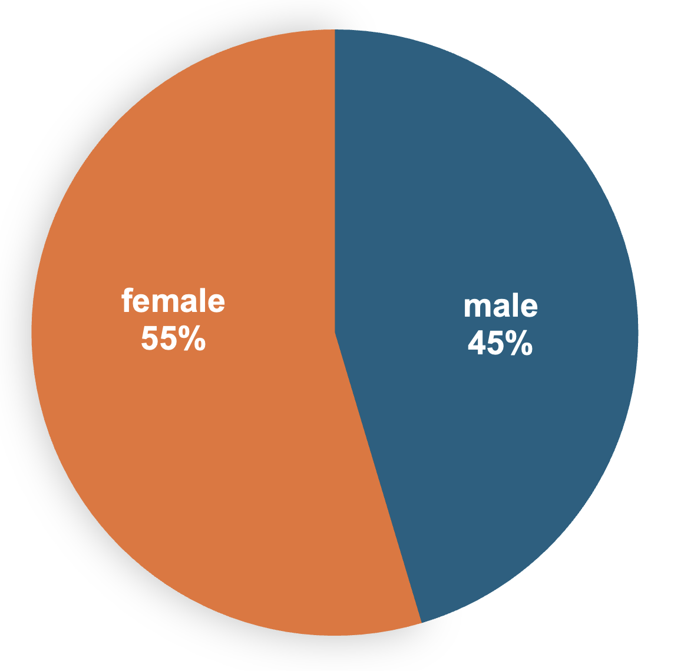
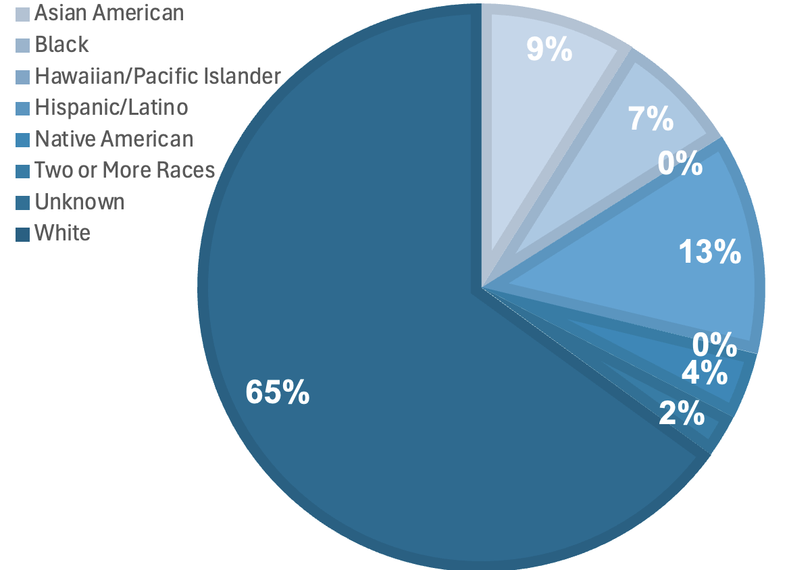
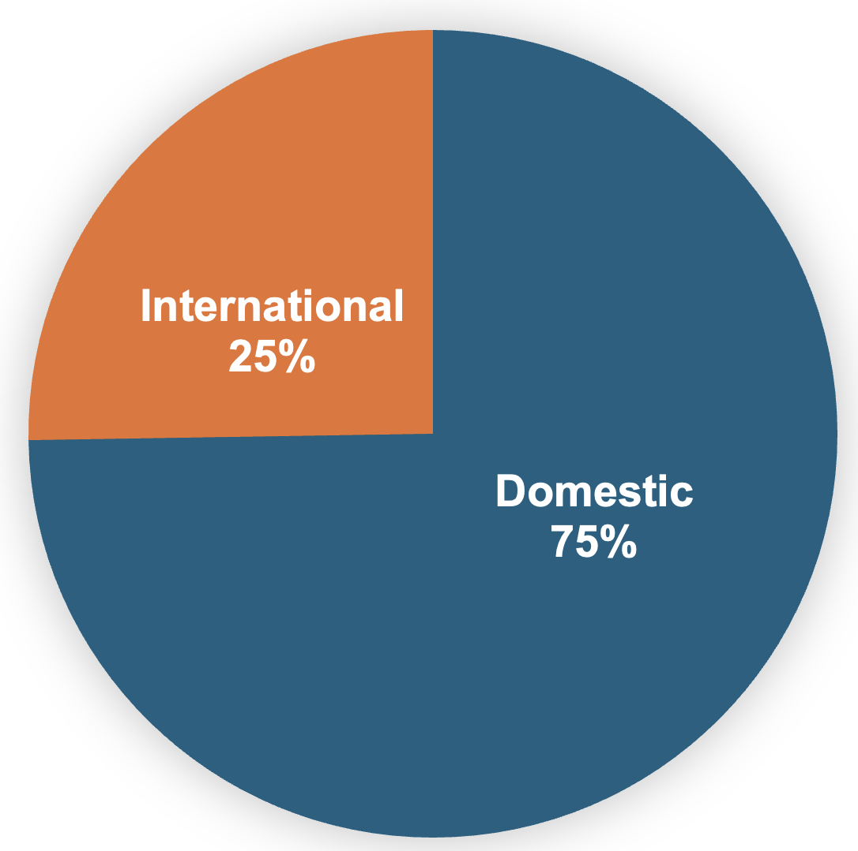
Race & Ethnicity and gender identity of graduate students (continued)

Slide 20
4. Challenges, Opportunities, Vision

Slide 21
A “Students First” Vision
A “Students First” Vision
Diverse students from around the world choose UConn for their graduate education or post-doctoral training journey.
Students are the informed and empowered CEO of their own graduate/post-doc journey, via:
Pre-enrollment program info including financials, time-to-degree, and career outcomes;
Robust on-boarding and first-year experience programming;
Quality, regular, culturally-competent mentoring and academic assessments annually;
Co-curricular enrichment and professional development opportunities aligned with student goals that also build community and provide a sense of belonging;
Robust health and wellness support.
Exit interview or climate/goals survey, plus ongoing interactions with UConn.
Students have overwhelmingly positive experiences at UConn, excellent outcomes after UConn, and stay invested and invest in UConn programs/departments/units in the future.

Slide 22
Challenges
Challenges
Student* Recruiting: The U.S. job market is hot. Demand for U.S. grad degrees from abroad (e.g., China) is down. Competition is fierce.
Student Experience: Students need, but do not always receive:
Support resources;
Sustained and culturally competent mentoring & advising;
Preparation for broader life and career goals.
DEI: Diversity of many graduate programs does not reflect population.
Programmatic: Formal assessment of all graduate programs is needed. Some programs are over-due for a comprehensive re-think.
Resources: Resources for grad/post-doc education & The Graduate School have been declining at UConn.
*Here, “Student” means Graduate Student and Post-doctoral Scholars
Notes:
First year experiences, culturally competent sustained advising, strengthen life and career readiness in academic and co-curricular activities

Slide 23
Opportunities
Opportunities
Rankings: Coordinate central (Institutional Research in BPIR) support for reporting, and support (CCD) identifying contacts for Recruiter Assessments.
Recruiting: Collaborate with (UComms, Global Affairs, u/g Admissions to expand graduate recruiting. Grow “Bridge+” programs to advance DEI.
Student Experience: Create FYE and professional development courses for Grads; Partner with Career on Work+ for GAs; Expand orientation/pre-arrival/on-boarding (also reduces the “melt”); Establish mentor training programs for faculty.
*“Student” means Graduate Students and Post-doctoral Scholars

Slide 24
Opportunities
Opportunities
Alumni: Require completion of “first destination” survey to build outcomes data & strengthen engagement with our grad school alumni.
Philanthropy: Work with Foundation to engage graduate alumni.
Build Capacity: Leverage graduate fellowship resources to build world-class, multi-faceted graduate education & research programs.
Career-focused innovations in graduate education
Multidisciplinary grad programs & new transdisciplinary collaborations
Develop community partnerships
JEDI
*“Student” means Graduate Students and Post-doctoral Scholars
Notes:
The graduate school has long allocated ~$1.5 M/yr in tuition dollars as Harriott, Jorgensen, & Crandall fellowships (HJC).
As of May 2024, HJC were discontinued in favor of
The Graduate School Distinguished Doctoral Fellows (DDF)
The Graduate School Distinguished Masters Fellows (DMF)
For ~ 20 new awards/yr, the central evaluation model costs:
TGS = 0.4 FTE (also = 40% of our total programming capacity)
Significant faculty time in schools & colleges (letters of recommendation, service on evaluation panels)

Slide 25
Opportuniti es
Opportunities
Let’s make it a place for graduate students & post-docs!
Build social and professional networks
Support with experiment design, data analysis, and writing
Office space for graduate organizations, including affinity groups and UAW-GEU
Programming, instructional, and “collaboreum” space
Offices for multidisciplinary graduate programs, such as the Data Sciences
*“Student” means Graduate Students and Post-doctoral Scholars
Notes:
First year experiences, culturally competent sustained advising, strengthen life and career readiness in academic and co-curricular activities
Fosters excellence in mentoring and advising at all career stages and disciplines.
Promotes an inclusive environment for all graduate students.
Creates a culture of mentoring at UConn.
Makes faculty more competitive in grant-writing.

Slide 26
What are your Concerns?
What are your Ideas??
September 12, 2024

Slide 27
Thank You!
The Graduate School
The Whetten Graduate Center, Second Floor
University of Connecticut
438 Whitney Road Extension, Unit-1152
Storrs, CT 06269-1152
Phone: (860) 486-3617
Fax: (860) 486-6739
Email: gradschool@uconn.edu
grad.uconn.edu
September 12, 2024

