Slide 1
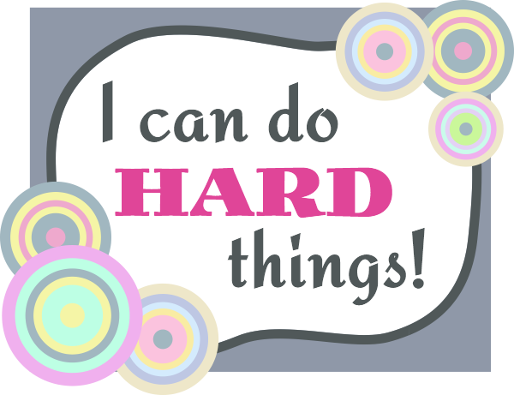
"How to Have Effective Conversations About Difficult Things in Graduate School and Beyond"
Timely Topics Series, September 18, 2024
Cinnamon Adams,
University Ombuds
Kimberly Curry,
Director of Graduate Student and Postdoctoral Support
Notes:
Intro to the topic and introduction to Cinnamon and Kim and their offices.

Slide 2
Goals for today…
Leave with 1-2 things.
Go with courage.
Remember our humanity.

Slide 3
What do you hope to gain from today’s webinar?
Notes:
What do you hope to gain from Today’s webinar?

Slide 4
Flow of our time together…
Why is this topic important? Why is it hard?
Preparing for conversation.
Tools for engagement.
Practice (mixed in throughout).

Slide 5
Think back to any conversations that you have had (or avoided) that you considered difficult

Slide 6
What makes difficult conversations difficult?
Notes:
Menti meter What makes difficult conversations difficult?

Slide 7
What factors contribute to the challenge of having difficult conversations in academic or professional settings?
Notes:
Menti- What factors contribute to the challenge of having difficult conversations in academic or professional settings? Is there anything additional or different than what we just discussed?

Slide 8
What makes a difficult conversation difficult?
What makes a difficult conversation difficult?
Stakes are High
Strong Emotions
Opposing Opinions
Fear Making Matters Worse

Slide 9
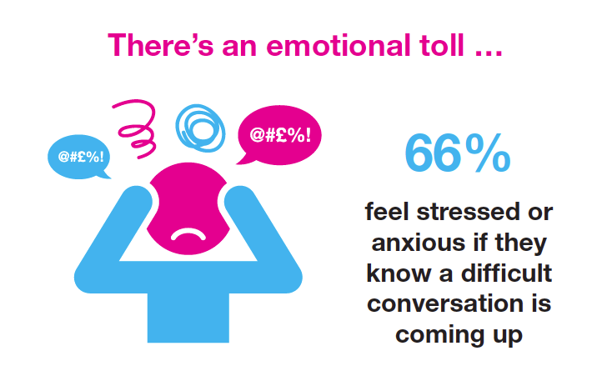
There’s an emotional toll…
(Scott 2015) CMI Study
Notes:
Charted Management Institute, a British organization that focuses on management/leadership helping companies/managers develop/grow in various areas, did a study of around 2,000 workers:
Difficult conversations are taking a heavy role on the workplace
Despite the prevalence of such conversations in the workplace, 80% said they had had no formal training on how to tackle them.
As a result, 43% of senior managers admit to losing their temper and shouting when placed in a difficult conversation, while 40% have admitted to panicking and telling a lie.
The survey also revealed that 57% of respondents said they would do almost anything to avoid a difficult conversation; and 52% said they would rather put up with a negative situation at work than have to talk about it.

Slide 10
Reasons for stress and anxiety
WHAT ARE THE FIVE MAIN CAUSES OF FEAR?
Not knowing how the other person will respond – 43%
Not being able to get a point across clearly – 31%
Being in a confrontational situation – 29%
Getting upset or emotional – 29%
The other person getting upset or emotional – 21%
(Scott 2015) CMI Study
Notes:
Despite the prevalence of such conversations in the workplace, 80% said they had had no formal training on how to tackle them.
As a result, 43% of senior managers admit to losing their temper and shouting when placed in a difficult conversation, while 40% have admitted to panicking and telling a lie.
The survey also revealed that 57% of respondents said they would do almost anything to avoid a difficult conversation; and 52% said they would rather put up with a negative situation at work than have to talk about it.
So how can we work to decrease the stress and anxiety? Becoming more aware of why these things are so hard to give us an opportunity to plan differently!

Slide 11
What tools have you found useful in navigating these types of conversations?
Notes:
Menti- What tools have you found useful in navigating these types of conversations?
What strategies, techniques, skills, practice, etc.

Slide 12
Identify strategies to help reduce stress & increase successful outcomes
Framework to consider:
Before the conversation...
When you can – prepare. Preparation is key.
During the conversation...
Be intentional and stay in tune with your emotions as well as theirs.
After the conversation...
Follow up and clarify as needed.

Slide 13
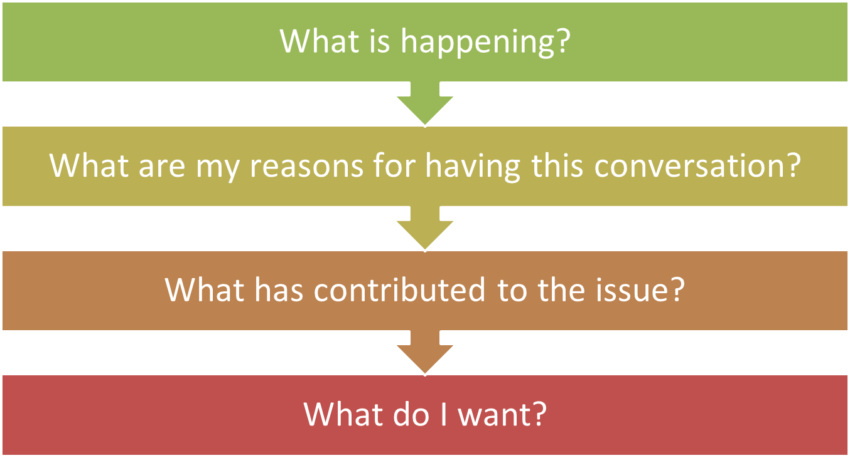
Before the conversation (preparation is key)

Slide 14
What is happening?
Take time to identify the difficulty/problem and acknowledge different points of view
How do I see the situation? (including observable behavior)
What emotions is this problem stirring up for me?
What assumptions am I making? What story am I adding?
What is the impact of this situation on me and what might I think the other person’s intentions are?

Slide 15
Case Study Example #1
Case Study: Addressing Work-Life Balance Challenges in Graduate School
Situation:
Mark Thompson is a second-year master’s student in Environmental Engineering, working on a project focused on developing sustainable water treatment technologies. Mark is highly motivated and has always been passionate about environmental issues. However, in addition to his demanding academic responsibilities, Mark has been working part-time as a teaching assistant (TA) and as a research assistant for another project unrelated to his thesis. The need to earn extra income to cover his living expenses has pushed Mark to take on these additional roles.
Over the past semester, Mark’s schedule has become increasingly hectic, and he’s been struggling to manage his time effectively. As a result, his thesis research has started to lag. He has missed several important lab meetings, delayed progress on key experiments, and submitted a draft of a literature review that Dr. Carter, Mark's advisor, found to be incomplete and lacking in depth. Dr. Carter has expressed concern about Mark’s performance, noting that his recent work doesn’t meet the high standards she expects from her students.
Mark recognizes that his current workload is unsustainable and that he’s falling behind in his research. He feels overwhelmed by the pressure to balance his academic work, teaching responsibilities, and financial obligations. Mark is hesitant to approach Dr. Carter about his situation because he fears she might view him as unfocused or unable to handle the demands of graduate school. However, Mark knows that if he doesn’t address these issues soon, his academic progress and future career prospects could be seriously jeopardized.
Notes:
Background:
Student: Mark Thompson
Program: Master’s in Environmental Engineering
Year: 2nd Year
Principal Investigator (PI): Dr. Emily Carter
Take time to identify the difficulty/problem and acknowledge different points of view
How do I see the situation? (including observable behavior)
What assumptions am I making? What story am I adding?
What emotions is this problem stirring up for me?
What is the impact of this situation on me and what might I think the other person’s intentions are?

Slide 16
What are the reasons for having the conversation?
Spend time considering if this conversation is worth having
What is my purpose in addressing the issue/having this conversation? What is my motive?
How is the problem affecting the productivity and morale of my department/program/class?
What will likely happen if I ignore the problem?
Be aware of the “Fool’s Choice”

Slide 17
Case Study Example #2
Case Study: Addressing Work-Life Balance Challenges in Graduate School
Situation:
Mark Thompson is a second-year master’s student in Environmental Engineering, working on a project focused on developing sustainable water treatment technologies. Mark is highly motivated and has always been passionate about environmental issues. However, in addition to his demanding academic responsibilities, Mark has been working part-time as a teaching assistant (TA) and as a research assistant for another project unrelated to his thesis. The need to earn extra income to cover his living expenses has pushed Mark to take on these additional roles.
Over the past semester, Mark’s schedule has become increasingly hectic, and he’s been struggling to manage his time effectively. As a result, his thesis research has started to lag. He has missed several important lab meetings, delayed progress on key experiments, and submitted a draft of a literature review that Dr. Carter, Mark's advisor, found to be incomplete and lacking in depth. Dr. Carter has expressed concern about Mark’s performance, noting that his recent work doesn’t meet the high standards she expects from her students.
Mark recognizes that his current workload is unsustainable and that he’s falling behind in his research. He feels overwhelmed by the pressure to balance his academic work, teaching responsibilities, and financial obligations. Mark is hesitant to approach Dr. Carter about his situation because he fears she might view him as unfocused or unable to handle the demands of graduate school. However, Mark knows that if he doesn’t address these issues soon, his academic progress and future career prospects could be seriously jeopardized.
Notes:
Background:
Student: Mark Thompson
Program: Master’s in Environmental Engineering
Year: 2nd Year
Principal Investigator (PI): Dr. Emily Carter
Spend time considering if this conversation is worth having
What is my purpose in addressing the issue/having this conversation? What is my motive?
What will likely happen if I ignore the problem?
How is the problem affecting the productivity and morale of my department/program/class?
Be aware of the “Fool’s Choice”

Slide 18
What has contributed to the issue?
Evaluate what issues are impacting the conflict/problem
Is the issue based on an EPISODE, PATTERN, and/or RELATIONSHIP?
How have I contributed?
Is it a process issue or a people issue?
How have others contributed?
Have cultural differences contributed, if so, how?

Slide 19
Case Study Example #3
Case Study: Addressing Work-Life Balance Challenges in Graduate School
Situation:
Mark Thompson is a second-year master’s student in Environmental Engineering, working on a project focused on developing sustainable water treatment technologies. Mark is highly motivated and has always been passionate about environmental issues. However, in addition to his demanding academic responsibilities, Mark has been working part-time as a teaching assistant (TA) and as a research assistant for another project unrelated to his thesis. The need to earn extra income to cover his living expenses has pushed Mark to take on these additional roles.
Over the past semester, Mark’s schedule has become increasingly hectic, and he’s been struggling to manage his time effectively. As a result, his thesis research has started to lag. He has missed several important lab meetings, delayed progress on key experiments, and submitted a draft of a literature review that Dr. Carter, Mark's advisor, found to be incomplete and lacking in depth. Dr. Carter has expressed concern about Mark’s performance, noting that his recent work doesn’t meet the high standards she expects from her students.
Mark recognizes that his current workload is unsustainable and that he’s falling behind in his research. He feels overwhelmed by the pressure to balance his academic work, teaching responsibilities, and financial obligations. Mark is hesitant to approach Dr. Carter about his situation because he fears she might view him as unfocused or unable to handle the demands of graduate school. However, Mark knows that if he doesn’t address these issues soon, his academic progress and future career prospects could be seriously jeopardized.
Notes:
Background:
Student: Mark Thompson
Program: Master’s in Environmental Engineering
Year: 2nd Year
Principal Investigator (PI): Dr. Emily Carter
Evaluate what issues are impacting the conflict/problem
Is the issue based on an EPISODE, PATTERN, and/or RELATIONSHIP?
Is it a process issue or a people issue?
Have cultural differences contributed, if so, how?
How have I contributed?
How have others contributed?

Slide 20
What do I want?
Identify the outcomes that you want
What do I really want for me, for the other person, and for the relationship?
Is the outcome I want realistic, possible, and/or negotiable?
Are there goals that both you and the other person care about (or do I need to learn more about their goals during our conversation)?
Notes:
Based on the story, what does Mark really want...

Slide 21
Script/Framework for Conversation
Notes:
Take some time to write this out ahead of time in the form of a script. I often recommend students do this even if they don’t need it or use it to read.
Spend some time preparing an opening line… in thinking about seeking first to understand, you might start the conversation by saying, “I’d like to hear your thoughts on this problem and to express my own. Then I think we should take some time to problem solve. Does that make sense to you as a way to spend the conversation?
This is certainly one way to format it, but feel free to format it in a way that makes sense.

Slide 22
Tools for effective engagement
Notes:
Often we want so much to be heard and do no want to be judged…..
Tool #1: Make it Safe to Talk
Care about the interests of others as well as your own
Offer mutual respect- as soon as someone perceives disrespect the interaction is no longer about the original purpose, it is now about defending dignity
Recognize the power dynamic, respond accordingly
When someone misinterprets your purpose or intent- use a contrasting statement. Clearly states message I’m not trying to send and states the message I am.
Ex. I am not trying to say that my program is more important than yours. I am trying to communicate that we both have high stakes involved in terms of success of our programs.
Tool #2: Listen
“Seek first to understand and then to be understood”
Skills be being a better listener:
Practice curiosity, listening with discernment
Be attentive to your internal voice (you may need to quiet it)
Ask open-ended questions
Paraphrase for clarity
Acknowledge other person’s feelings
Tool #3: Adopt the “Yes, and…” Stance
Essentially, you are leaving space for validation that both views have value
This doesn’t mean that after listening that you have to give up your own point of view
Critical component- you allow your self to share your view and listen to the other person’s view, when you make it to this point, you may be able to ask, “What’s a good way to resolve this problem?
Tool #4: Learn to Recognize Your Assumptions to Separate Impact and Intent
We often tell ourselves stories and add meaning to another’s behavior without actually checking if we are right
These stories can sometimes be why we avoid engaging
To avoid assumptions about other’s intent ask-
What did the other person actually say or do?
What is the impact of this on me?
Based on this impact, what assumption am I making about what the other person intended?
Tool #5: Use “I” Statements
This can be considered a super power
Statements that start with “You” sound accusatory and blaming and typically evoke defensiveness
“You keep rambling on and on and repeating the same things.” verses “I am not understanding you, help me hear what I am missing.”
Opportunity for reframing
Tool #6: Focus on Contribution, Not Blame
“How did we each contribute to this problem or conflict that we are experiencing?”
This answer will give us information to help us do something different in the future
This can also help us own our stuff and not own others stuff…..for example in my initial share, I was owning the other person’s responsibility and carrying it through my stress.
Tool #7- Asking questions, being curious, open ended, closed, probing.
What are other tools that you have found helpful in your conversations?

Slide 23
After the conversation
After the conversation
Follow up
Sending an email
Summarize the conversation, including any next steps
Follow through on next steps discussed

Slide 24
What are some of your takeaways from our time together?

Slide 25
Questions? Comments? Concerns?
Questions? Comments? Concerns?

Slide 26
Resources
www.Deborahdally.com: Difficult Conversations PowerPoint (link no longer accessible)
difficult-conversations-summary.pdf (harvard.edu) (handout for presentation)
Clark, Timothy R. Four Stages of Psychological Safety, 187.02.psychologicalsafety.pdf (porchlightbooks.com)
Grenny, Joseph; Patterson, Kerry; McMillian, Ron; Switzler, AL; Gregory, Emily. Crucial Conversations: Tools for Talking When Stakes are High. 3rd Edition McGraw Hill, 2023.
Scott, Matt. Difficult Workplace Conversation: The Best Strategies for Managing Them. July 29, 2015. https://www.managers.org.uk/insights/news/2015/july/difficult-workplace-conversations-the-best-strategies-for-managing-them
Stone, Douglas; Patton, Bruce; Heen, Sheila. Difficult Conversations: How to Discuss What Matters Most. Penguin Books, 2010.
All images courtesy of Google Images

