Slide 1
THE GRADUATE SCHOOL PRESENTS Timely Topics Application Processing in Slate and
Admissions Cycle Kickoff
SEPTEMBER 2024

Slide 2
Meet the Team:
Holly Brunette Graduate Admissions Specialist The Graduate School holly.brunette@uconn.edu
Meg Buckley Director, Graduate Admissions The Graduate School meg.drakos@uconn.edu
Shirley Fiasconaro Graduate Admissions Specialist The Graduate School shirley.fiasconaro@uconn.edu
Katie O’Keefe Graduate Admissions Specialist Specialty: School of Business katie.okeefe@uconn.edu
Lisa Pane Director for CRM & Data Management The Graduate School lisa.pane@uconn.edu
Sarah Redlich Shore Assistant Director, Graduate Admissions The Graduate School sarah.shore@uconn.edu
Paula Steele Assistant Director for CRM & Data Management The Graduate School paula.steele@uconn.edu

Slide 3
REMINDERS
Please mute your microphone.
Use the chat. Questions will be answered toward the end of the presentation.
Please send to “Everyone”
We are recording. This presentation will be available:
within the GradSlate User Portal: connect.grad.uconn.edu/portal/user
among the Timely Topics resources grad.uconn.edu/timely-topics/

Slide 4
AGENDA
Welcome
New: Faculty Mentorship Training
New: 3-Year Degrees
Life Cycle of an Application
The Reader Bins: Initial Grad School Audit & Program Audit
Requirements: Graduate vs. Program
Deferral Status
Program Contact Information Updates & Best Deadline Practices
Applicant Experience
Email Practices & Preferred Names
Graduate Students and Export Control
Questions? Comments? Wishlist?

Slide 5
The Graduate School’s Mission Statement
The Graduate School will be the heart of graduate and postdoctoral education at the University of Connecticut. It will foster excellence in graduate and postdoctoral education, and it will guide graduate students and postdoctoral scholars to personal and professional success.
A copy of The Graduate School’s Strategic Plan can be found on our website.

Slide 6
*New* Faculty Mentorship Training
MB

Slide 7
*New* Faculty Mentorship Training
In order to serve as a major advisor to a graduate student, faculty must be appointed to the UConn Graduate Faculty in addition to appointment in their home department.
Beginning in Fall 2024, all new faculty who want to be appointed to the Graduate Faculty will sign up to complete an 8-hour mentorship training as part of their onboarding.
After completing the training, new faculty can apply to be appointed to the Graduate Faculty.
Recommendation for Appointment to the Graduate Faculty
Slate access is still available for new faculty- regardless of GF status, but new faculty will not be able to be assigned as advisor in Slate and Ps until training is complete.
Request Slate Access
MB

Slide 8
*New* 3-Year Degrees
MB

Slide 9
3-Year Bachelor Degrees
Starting for Fall 2025, The Graduate School will be differentiating 3-year degrees from 4-year degrees in Slate.
3-year degree language
If you have completed, or will complete a bachelor’s degree that is 3 years in length from an institution outside of the US (excluding the UK) please select one of the following options:
3-Year Bachelor of Arts (Outside US)
3-Year Bachelor of Science (Outside US)
3-Year Bachelor of Commerce (Outside US)
For more details on our 3-year degree policy, please visit our Admissions FAQ webpage.
MB

Slide 10
Life Cycle of an Application
Helpful tips about where your applications are in the cycle
KO

Slide 11
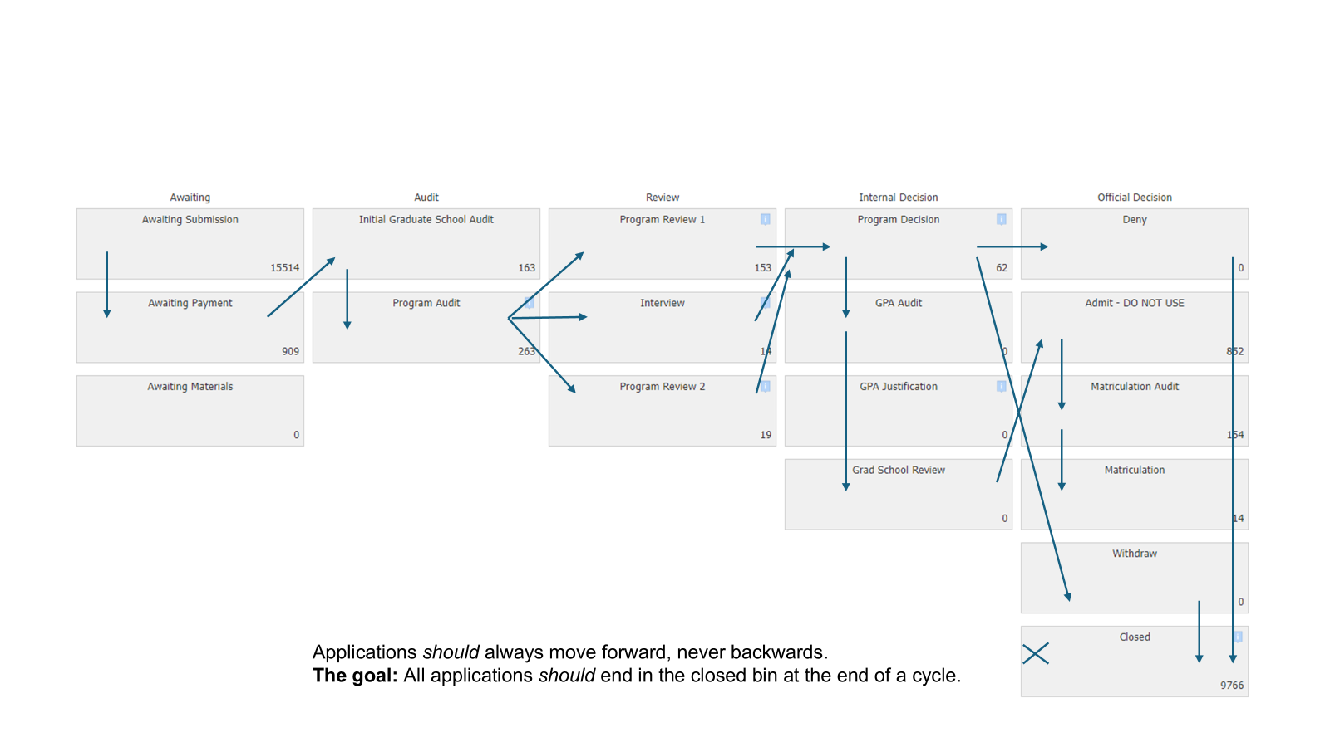
Life Cycle of an Application
KO

Slide 12
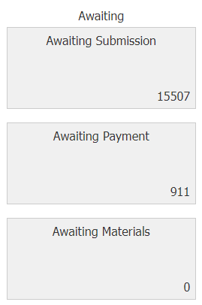
Step 1: Submission & Payment
Where is this?
Awaiting Submission bin, Awaiting Payment bin, and Awaiting Materials bin
Who has access?
Graduate Admissions
Applicant submits application to their program of interest
Applicant pays non-refundable application fee
Once application has been submitted and the fee has been paid, Graduate Admissions will do an initial review*
*Please note: applicants can submit applications by the deadline and still pay the fee after the deadline. The deadline does not prevent fee payment. Please determine whether your program's deadline required both application submission and fee payment by your deadline. If so, please state this on your website.
KO

Slide 13
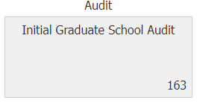
Step 2: Initial Review
Where is this?
Initial Graduate School Audit Bin
Who has access?
Graduate Admissions (no access for admins or faculty)
Applicant has submitted and paid the non-refundable application fee
Admissions Team reviews application for:
Complete unofficial transcripts and degree certificates/diplomas*
Waiver or Test of English scores (international applicants only)
Application pushed forward to Program Audit Bin when complete**
*Transcripts and degree certificates/diplomas for all schools listed. Please do not ever delete a school or transcript from an application.
**Timeline of when application is complete is dependent on applicant uploading all required materials and sending Test of English scores/waiver reason.
KO

Slide 14
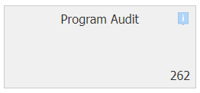
Step 3: Program Review - Admin Review
Where is this?
Program Audit Bin
Who has access?
Program Admins
Programs review applications in Program Audit Bin to determine if applicant has met all program requirements*
Push to Program Review 1, Interview, or Program Review 2 bin based on program's review process
*Timeline of when application is complete by program's standards is dependent on applicant uploading all program requirements and sending official test scores (if required).
KO

Slide 15
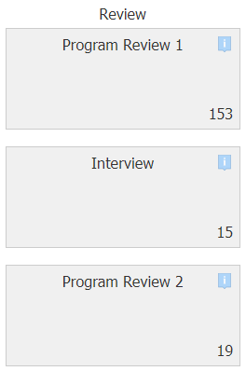
Step 4: Program Review - Reader/Faculty Reviewers
Where is this?
Program Review 1 Bin, and/or Interview Bin, and/or Program Review 2 Bin
Who has access?
Program Admins and Reader Reviewers (Faculty)
Programs review applications in Program Review 1, Interview, and Program Review 2 bin(s) and make admission decisions
Once program's admission decision is ready to be entered, application must be pushed to Program Decision Bin
KO

Slide 16
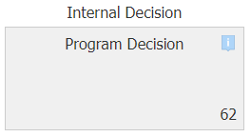
Step 5: Program Decision
Where is this?
Program Decision Bin
Who has access?
Program Admins
Program admins enter decisions in Program Decision Reader Review Form
Decision of Admit = Send to GPA Audit Bin
Decision of Deny = Send to Deny Bin
Decision of Withdrawal requested by applicant = Send to Withdraw Bin
Decision of Waitlist* = Keep in Program Decision Bin
*Graduate Admissions will not process an official decision of Waitlist on any application or send any communication out regarding a Waitlist decision. Your program can choose to utilize the Waitlist option in Slate or an internal waitlist outside of Slate until the program enters a final admission decision of Admit, Deny, or Withdrawal requested by applicant.
KO​

Slide 17
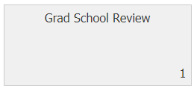
Step 6: The Graduate School/Official Decision
Where is this?
Grad School Review Bin
Who has access?
Graduate Admissions (No access for admins or faculty)
Graduate Admissions review applications with a program decision of Admit*
*Graduate Admissions does not review applications with a program decision of Deny.
KO

Slide 18
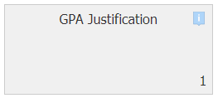
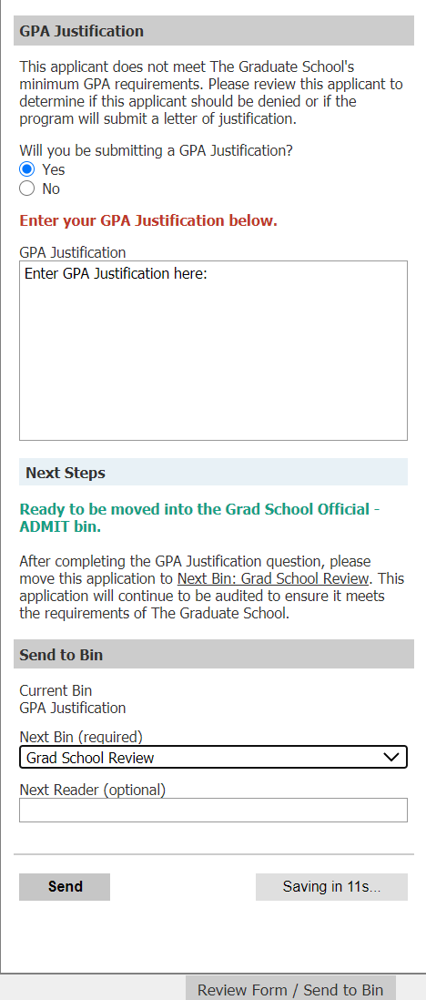
"Step 6.5": GPA Justification
Where is this?
GPA Justification Bin
Who has access?
Program Admins and Graduate Admissions
Applications that are in the GPA justification bin require a letter of justification to be added for admission because they did not meet the GPA requirements for Regular or Provisional Admission
GPA Justifications should be written by the major advisor or admissions chairperson. The justification should state why the applicant is a good fit despite their low GPA. Reasons often included are research experience, GRE scores, recommendations, etc.
To enter a GPA Justification:
Add application to queue
Open up Reader Review Form and select "Yes" to "Will you be submitting a GPA justification?"
Enter GPA Justification and then push application to the Grad School Review Bin
If not entering a GPA justification, select "No", leave the GPA Justification area blank, and push application to Deny bin
KO

Slide 19
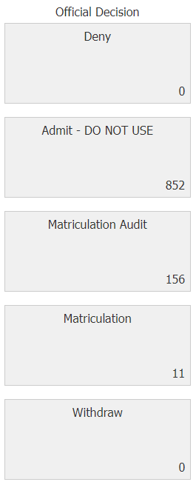
Step 7: Official Decisions
Where is this?
Admit – DO NOT USE Bin, Deny Bin, Withdraw Bin, Matriculation Audit Bin, Matriculation Bin
Who has access?
Graduate Admissions (No access for admins or faculty)
Applications are in respective bins based on the official admission decision that has been entered on the application
Decision of Admit = Admit – DO NOT USE Bin
Decision of Deny = Deny Bin
Decision of Withdrawal requested by applicant = Withdraw Bin
If applicant has accepted admission and paid deposit (if required), they will be in the Matriculation Audit Bin
If applicant has recently accepted admission, paid deposit (if required), AND submitted all official transcripts/degree certificates/diplomas, they will be in the Matriculation Bin
KO​

Slide 20
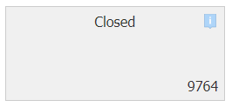
Step 8: Final Decisions
Where is this?
Closed Bin
Who has access?
Everyone
Applications are in the Closed Bin* after final admission decision has been entered of:
Intention to Matriculate
Applicant Withdrawal
Administrative Withdrawal
Deny
*Applications in the Closed Bin are accessible by everyone until the admission cycle is cleared from the Reader about 3 weeks into a term.
KO

Slide 21
The Reader Bins
KO

Slide 22
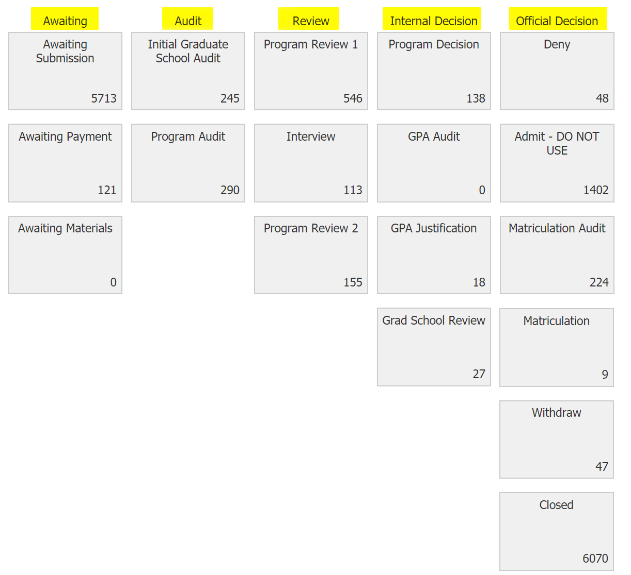
Bins in The Reader
Who has access?
The Graduate School has access to all bins.
Program Administrators:
Faculty & Reviewers:
KO​

Slide 23
How to Use The Reader Bins
The Reader is for reading and taking action on applications.
Applications still exist even if you can’t see them in The Reader.
Moving an application to another Bin requires a Reader Review form.
Do not use Edit Bin/Queue to move applications to another bin.
KO​

Slide 24
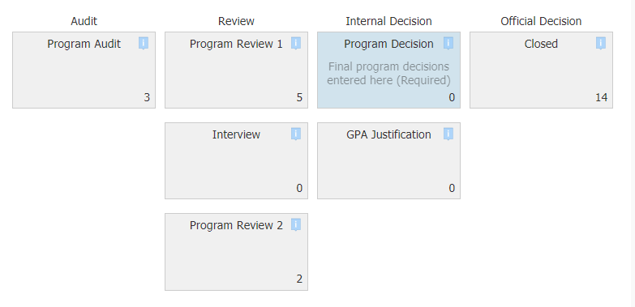
Bin Descriptions
Hover your cursor over a bin to read the description of that bin
KO

Slide 25
Graduate vs. Program Requirements
SF

Slide 26
Application Requirements
Graduate School Requirements
Program Requirements (Common Examples)
Transcripts. With proof of degree conferral
Degree equivalent to a US 4-year bachelor’s degree
GPA Requirements
Test of English Proficiency
TOEFL, IELTS, PTE, Duolingo: no more than 2 years old from the test date
Qualify for Waiver
Letters of Recommendation (0-3)
Test Scores
GMAT
GRE
Essays
Personal Statement
Supplemental Essays
Uploaded documents
Resume/CV
Writing/research samples
Licensure/Certifications
NOTE: Form to request changes to program application requirements:
https://connect.grad.uconn.edu/portal/user?tab=program_form
SF

Slide 27
GMAT/GRE Test Score Options
For programs that require these scores, the program can choose to waive this on applicants’ checklists if waiver requirements are met.
The program should update an applicant’s checklist to reflect the “Waived” status for the GMAT/GRE test scores. It is a manual process for each applicant.
Program establishes waiver criteria (if any).
The applicant meets the quality requirement in another way.
e.g., GPA of 3.5 or greater or a minimum amount of work experience
Waivers must be applied for all applicants who meet the established waiver criteria.
Waiving criteria based on citizenship status is not legal.
If your program offers requirement waivers, please outline your waiver criteria on your website, so it is clear to prospective applicants.
SF

Slide 28
Initial Grad Audit Bin
SF

Slide 29
Initial Grad Audit
Audit for initial grad school requirements:
Transcripts
Degrees (if awarded)
English Proficiency (for international students)
Related: GPA Review
grad.uconn.edu/admissions/requirements/
SF

Slide 30
Audit for Transcripts
Transcripts (w/proof of degree conferral):
Complete and up-to-date
All courses/grades
In-progress at the time of application submission (allowed)
For the school that awarded/will award 1st bachelor’s degree, and any school attended since then
Degrees awarded (if applicable)
(Most international schools do not include degree conferral dates on transcripts)
In English, and in the language that is the medium of instruction of the school
Unofficial to apply; official to matriculate
International: Course-by-course and degree evaluations by approved external credential evaluation services are accepted, but are not required ($$):
NACES (National Association of Credential Evaluation Services)
AICE (Association of International Credential Evaluators)
SF

Slide 31
Audit for Degree Equivalency
Degree equivalent to a U.S. 4-year bachelor's degree
3-year bachelor’s degrees from several countries are not considered equivalent by TGS
Even if the degree has been evaluated by a NACES or AICE member as a 4-year degree
Graduate Admissions can evaluate: gradadmissions@uconn.edu
SF

Slide 32
Audit for Test of English Proficiency
Policy on Waiver of Language Proficiency Examinations for international applicants:
Whose primary language is English.
Primary language (Applicant) = Native language (The Reader)
Who have received a degree from a post-secondary institution outside the U.S. whose language of instruction for the entire degree is English. Requires letter from the institution’s Registrar’s Office or Controller of Examinations.
Who have completed one year or more of full-time coursework at a post-secondary institution in the United States (30 credits undergraduate-level work or 18 credits graduate-level work) and have a cumulative GPA value of 3.0 or higher.
Who are current UConn graduate, UConn Health, or UConn Law students.
SF

Slide 33
Processing Test Scores
Applications requiring a test of English proficiency will not be forwarded to the Program Audit bin without an official test of English score that meets our requirement (unless the requirement can be waived).
The Graduate School only accepts official test scores electronically directly from the testing company (paper copies of scores, or scores that applicants upload themselves, are not treated as official).
Official test scores may take up to 15 business days to appear in applications after applicants have requested scores to be sent.
All test scores excluding the GMAT are loaded into Slate 2X a week.
SF

Slide 34
How an Applicant Submits Scores Electronically
Test | Instructions
GRE | Request ETS to send scores to school code: 3915 for Storrs, or school code 3931 for UCHC
GMAT | Request GMAT to send scores electronically to UConn Graduate School.
TOEFL | Request ETS to send scores to school code: 3915 for Storrs, or school code 3931 for UCHC
IELTS | Request IELTS to send scores to UConn Graduate School. Student may require Application ID (can be found on Application Status Portal) and the following information: Name of Department Head: Leslie Shor Email ID: gradadmissions@uconn.edu Contact #: (860) 486-3617
Duolingo | Request Duolingo to send scores electronically to UConn Graduate School.
PTE | Request PTE to send scores electronically to UConn Graduate School.
More test score details are available here
SF

Slide 35
GPA Review
Happens at the same time as Initial Grad Audit, in a different Workflow.
This means: an application is not held back from program review if they haven’t yet had their GPA calculated.
GPA Requirements
Minimum GPA requirement to offer regular admission is a 3.0
Regardless of GPA, the application will be sent to the programs for review
SF

Slide 36
Program Audit Bin
HB

Slide 37
Program Audit Bin
After The Graduate School’s Admissions Office has reviewed the application, we would move it to the Program Audit bin if the relevant transcripts have been uploaded, and if the English proficiency requirement has been met.
If the GPA evaluation is in progress, the application is still moved to Program Audit.
When an application is moved to the Program Audit bin, we do not add it to a queue. The application would be available for your program to process according to your internal procedures.
If the program’s application requirements have been met, then you could update the checklist to reflect this by changing the status of an item on the application checklist from “Awaiting” to “Received,” or to “Waived,” if the program has established reasons why you would waive one of your requirements.
HB

Slide 38
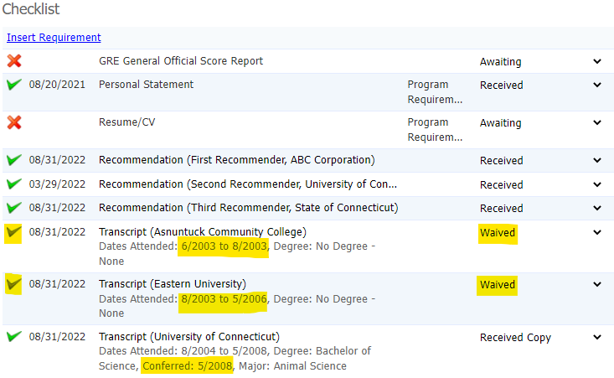
Program Audit Bin (continued)
A note about “Waived” transcripts: Please do not update this status on the checklist, even if your program requires that transcript.
The Graduate Admissions Office reviews
transcripts for:
the school that awarded the (first)
bachelor’s degree and
any other school attended since
being awarded the bachelor’s
“Waived” transcripts from previous schools
are still available for the program to review
if applicants uploaded them.
HB

Slide 39
Updating Materials
Using a recommendation letter and personal statement as examples, instructions to upload materials are reviewable at this link.
Regarding academic transcripts or English proficiency documentation, please contact gradadmissions@uconn.edu. The Graduate Admissions Office needs to be involved in uploading these specific materials, and in updating the corresponding items on an applicant’s checklist.
Contact gradadmissions@uconn.edu with questions regarding uploading application materials.
HB

Slide 40
Deferral Status
Program Action Required for Deferral Requests that are Routed to the Program
HB

Slide 41
Deferral Request Process
REMINDERS
Applications with no admission decision are not automatically deferred once the term they applied for is closed. Applicants need to fill out the Request to Defer form*
Please regularly check your inbox (and Junk/Clutter folders) for deferral requests and respond to them as soon as possible
There have been instances in the past where a deferral request was missed and the student did not receive an answer in a timely fashion or before the 10th day of semester deadline
The deferral term requested must not be more than one year after the original application entry term
*The form to request a deferral is located in the student’s Application Status Portal.
HB

Slide 42
Deferral Request Process
If an applicant requests a deferral prior to a decision being made, the request is routed directly to Graduate Admissions for processing
If an admitted student requests a deferral, the request is routed to the program contact via email
The program must either approve or deny the request
The process for obtaining approval varies from department to department; please check with your department’s Program Director and/or Department Head regarding the process
If the program approves the request, please forward the deferral request email to gradadmissions@uconn.edu and include written approval of the request
If the program denies the request, please email the student directly to inform them of the decision and the reasoning behind it
HB

Slide 43
Program Contact Information Updates & Best Review Practices
Program Action Required when Program Contact or Deadlines Change
LP

Slide 44
Program Contact Information
Who should be the program contact?
This is usually either the program admin or the graduate program director
When should the contact information be updated?
Anytime a contact leaves the university or changes roles
Reasons why this information should be kept up to date
Weekly GradSlate emails
Deferral requests
Important notifications from TGS
Program contact information listed on TGS Program Page
To update program contact info, complete the Program Details form in Slate:
https://connect.grad.uconn.edu/portal/user?tab=program_form
Other helpful info:
To request to join the GRADUATE_ADMINS_L listserv, email gradschool@uconn.edu
LP

Slide 45
Best Practices: Rolling Admission vs Deadline
Preferred/Soft Application Date or Rolling Admissions
Suggested Application Date, and defers to The Graduate School’s deadline
"Applications received by date X are assured for consideration." (This implies that programs will not be making decisions before day X.)
"Applications received after date X will be reviewed on a space available basis."
Hard Deadline
Coded into Slate, applicants are denied the ability to submit an application after this deadline passes.
Should not be undone/changed midcycle and carry over year to year
Program deadline date cannot be later than The Graduate School’s default deadlines.
Every application has a hard deadline, whether it be the program’s deadline or The Graduate School’s default deadline.

Slide 46
Applicant Experience
LP

Slide 47
After Application Submission (Applicant POV)
Application Fee Payment (unless waived)- Will see the payment portal.
Once non-refundable application fee paid or waived will see Application Status Portal
Application Status Portal
Checklists (can take 2-3 days to be updated)
Checklists will reflect what requirements have been received vs awaiting items.
Decisions will appear here
Email Communication
Missing Items
Applicants will be notified of missing items in their checklist by email.
Status Updates: Decisions
Item | Missing Action | Frequency | Population
1 | Missing Application Fee | Every 3 days | Submitted application but app fee due > $0.00
2 | Missing Graduate School Materials | Every 7 days | Submitted & paid fee but missing unofficial transcripts, unofficial diplomas, or language requirements
3 | Missing Program Review Materials | Immediately, then every 7 days | In Program Review bin and missing program requirements (e.g. recommendations, essays, etc.)
4 | Reminder to View Decision | Every 7 days | Applicants who have a released Admit decision but have not yet viewed their decision letter
5 | Missing Reply to Offer | Every 14 days | Applicants who have viewed their Admit letter but have not responded
LP

Slide 48
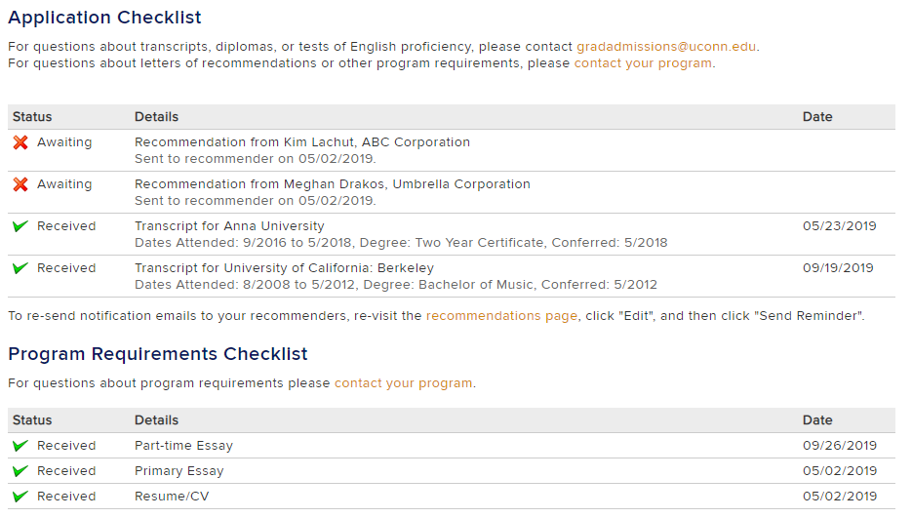
Application Status Portal
The applicants’ Status Page distinguishes between Graduate School requirements and Program requirements
(Exception: Recommendation Letters)
LP

Slide 49
Email Practices & Preferred Names
SRS

Slide 50
Weekly Reader Bin Status Email
Email notifications are sent to program admins when action on an application (e.g., application submitted, app ready for review, etc.) may be required.
When will it send? Every Monday morning
Who receives it? This email is sent to the program’s contact email address. (Tip: Fill out the Program Details form to request email changes.)
What does it include? Number of applications in each Reader Bin for that specific program. Links to Reader and to Queries. Highlights bins which need attention by the program.
What about Queue Emails? Reader Bin Status notifications are different than Queue notifications. Users with applications in their Queue will still receive weekly Queue notification emails.
SRS

Slide 51
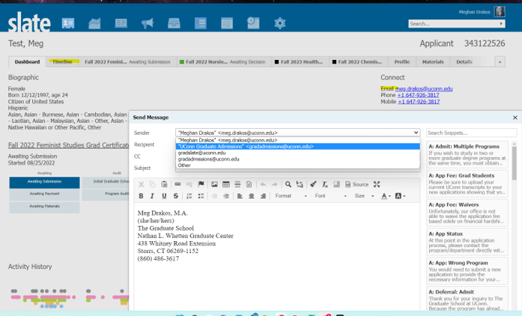
Sending Emails to Applicants in Slate
When sending emails to applicants in Slate:
Make sure that you are sending email from correct email address
Do not use gradadmissions@uconn.edu
Email will save on the Timeline tab under Interactions
SRS

Slide 52
Preferred Names
Preferred names for students are important for all communications, inside and outside of Slate.
Applications in Slate show student’s preferred name in parentheses - ex: Smith, Jonathan (John)
All communications in Slate use student’s preferred names indicated in application by student.
Preferred names do not load from Slate to PS.
Students that would like to update their preferred name should do so after they have been admitted:
https://kb.uconn.edu/space/IKB/10728767960/Changing+Your+Chosen+Name+in+UConn+Directories
Grad Milestone and Grad Enrollment reports that Megan Petsa sends out shows students’ preferred names (as long as the student has updated their preferred name).
SRS

Slide 53
Graduate Students and Export Control
Issues to be aware of when admitting students from certain countries
SRS

Slide 54
Graduate Students and Export Control
*Students are required to be in the U.S. before the first day of the semester*
Students should not work or study until they are in the U.S.
There are export control concerns due to U.S. government sanctions that apply to international students from the countries below. UConn is responsible to report any situations that violate U.S. government sanctions to Homeland Security.
Students from these countries cannot participate remotely in their courses or start their GA related duties until they physically arrive in the U.S. If the student is not able to arrive by the 1st day of the semester, they will need to arrange a plan with their instructors to satisfy any course assignments missed until they are able to arrive in the U.S. for in-person instruction.*
Cuba
North Korea
Syria
Iran
Russia
Ukraine as of February 22, 2022
Belarus as of February 24, 2022
If you have any questions about Export Control, please email exportcontrol@uconn.edu.
*An enrollment hold will be placed on a student's registration if Citizenship is one of these countries ("GEMB" hold). Students may have this hold removed when they check in with their ISSS advisor on U.S. soil.
SRS

Slide 55
Questions? Comments? Wishlist?
Type in the chat or unmute yourself to join the conversation!
Reminder - Applications will open for programs to make admission decisions for Summer and Fall 2025 on Tuesday, October 15th.
MB

Slide 56
RESOURCES
GradSlate User Portal
connect.grad.uconn.edu/portal/user Includes quick links, forms, and documentation
Questions About Applications
gradadmissions@uconn.edu Reading and reviewing specific applications, application status, admissions help, etc.
Questions About Slate
gradslate@uconn.edu
Access, recruitment communications, queries, system errors, etc.
MB

Slide 57
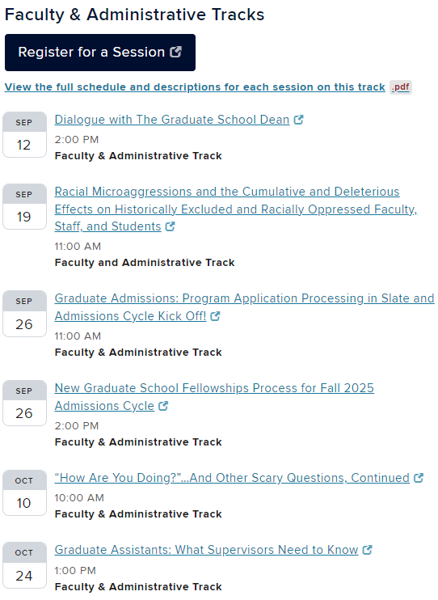
Timely Topics
View the full Fall 2024 Timely Topics schedule!
MP

Slide 58
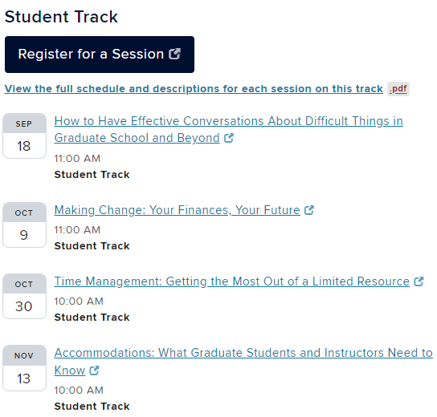
Timely Topics (continued)
View the full Fall 2024 Timely Topics schedule!
MP

