Slide 1
Time Management: Getting the most out of a limited resource
Oct 30, 2024
Rachel Prunier, PhD.
Director of Teaching and Learning in the Life and Physical Sciences

Slide 2
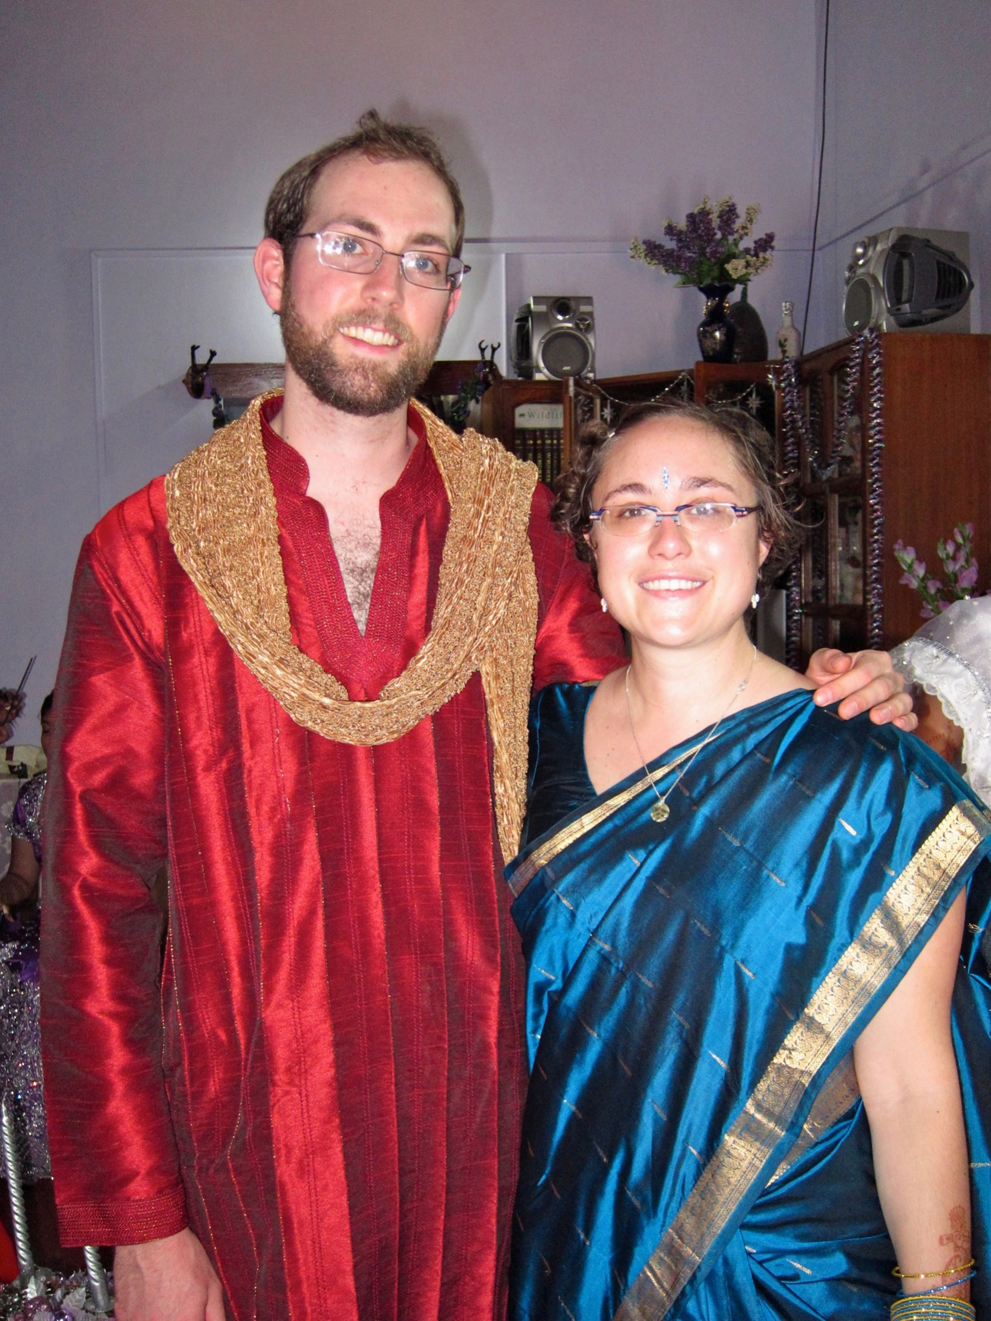
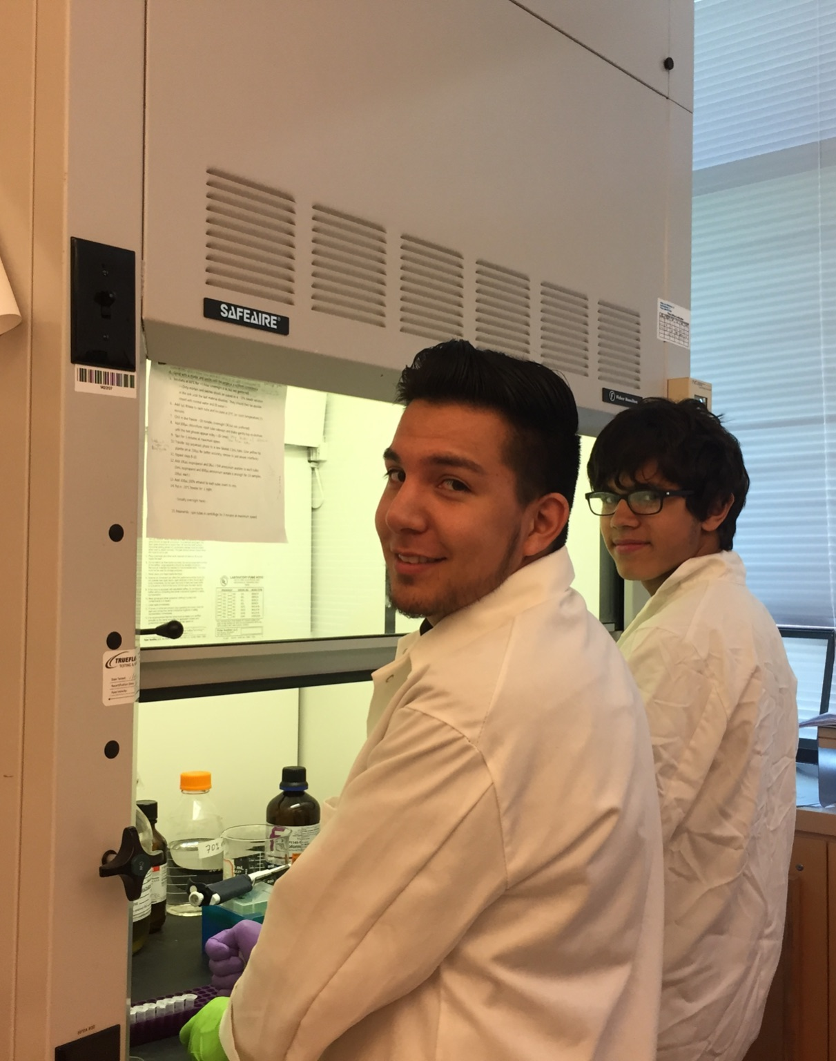
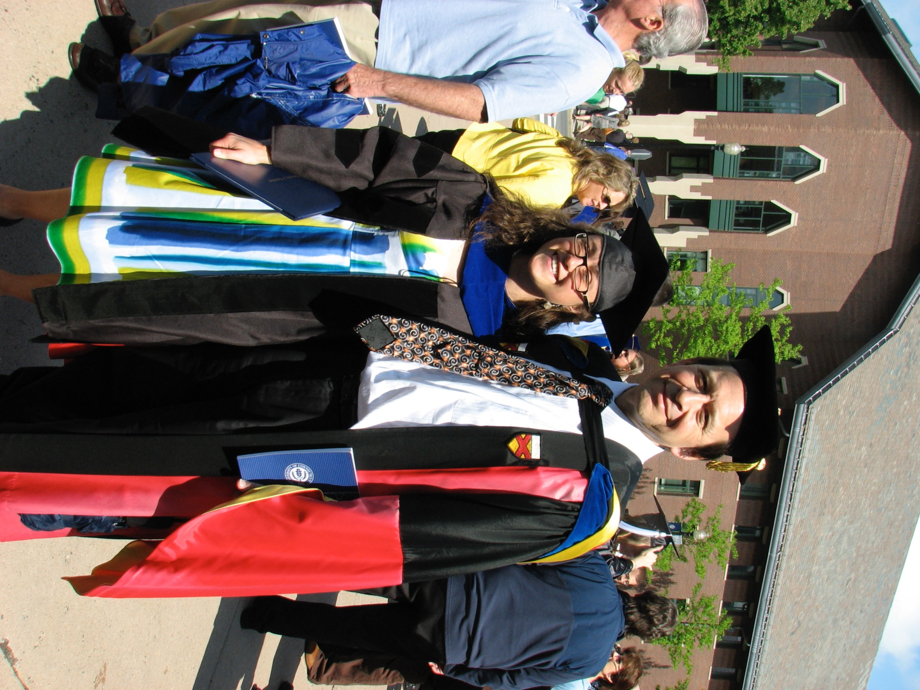
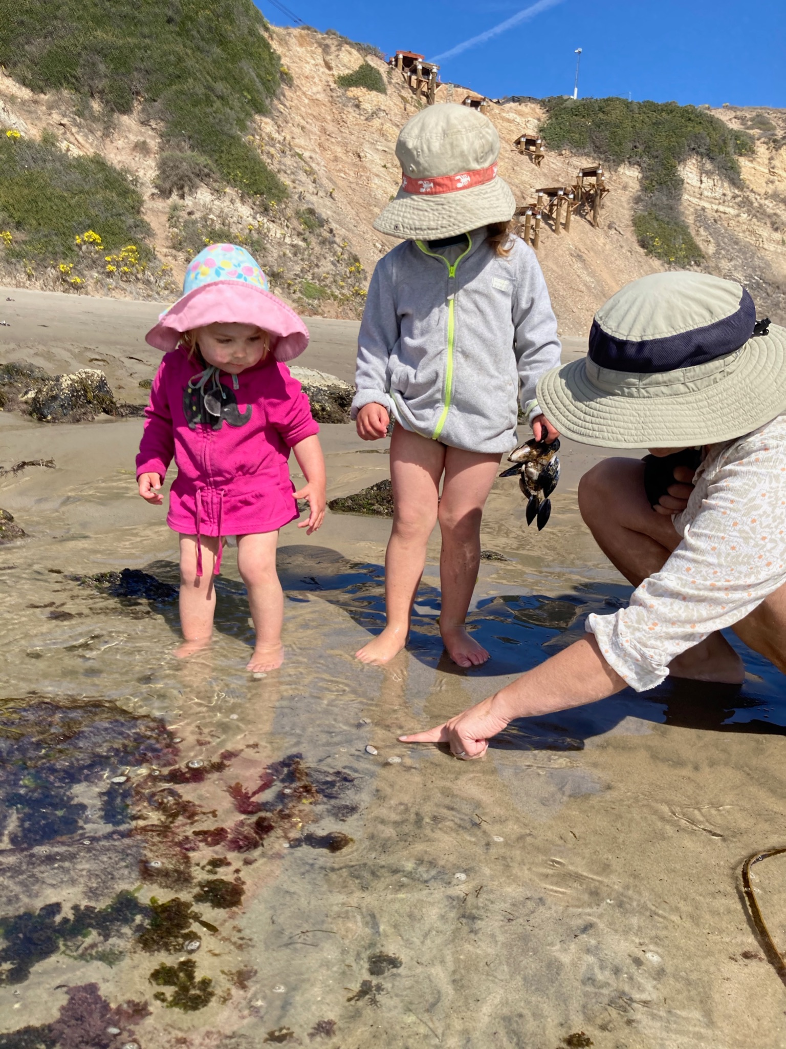
Dr. Rachel Prunier (RAY-chul prune-YAY)
she/her

Slide 3
My role at UConn
CETL (Center for Excellence in Teaching and Learning)
Programming for grads and post-docs
Skills to help you now
Skills to prepare you for your future career
GRAD 6000 – how to teach for TAs
Run CIRTL program @UConn
Email CIRTL@uconn.edu to get added to announcement list

Slide 4
Plan for this session
Present information on time management
Give you the opportunity to reflect on YOUR approach and if/how it isn’t working for you
There is no ONE right answer
Need a system that works for you

Slide 5
5 principles of time management:
Establish healthy boundaries.
Prioritize and set reasonable goals & deadlines.
Be organized and have a plan.
Avoid procrastination.
Institute a support network (for your academic as well as personal wellbeing).

Slide 6
Establish healthy boundaries
Different kinds of boundaries?
Temporal
Working hours
Meetings
Email
Physical
Where working
Interpersonal
You are always going to disappoint someone
Others?
Communicating Boundaries
Credit to Mika Schroeder at PhDwomanScot

Slide 7
Why might setting boundaries be hard?
Entrenched systems that exploit us
Academic
societal
Competitiveness
Power imbalances
Insecurity
Reflection: Do you struggle with setting boundaries with your advisor, students, or colleagues? What are some barriers to this that you can try to overcome?

Slide 8
If you are truly in a place where you can’t say “no”
Hypothetical: Your friend came to you freaking out that their PI had told them to finish a manuscript by Friday. There was no way they could get it done by then but also that they didn’t think they could let their PI down without repercussions.
What advice would you give them?

Slide 9
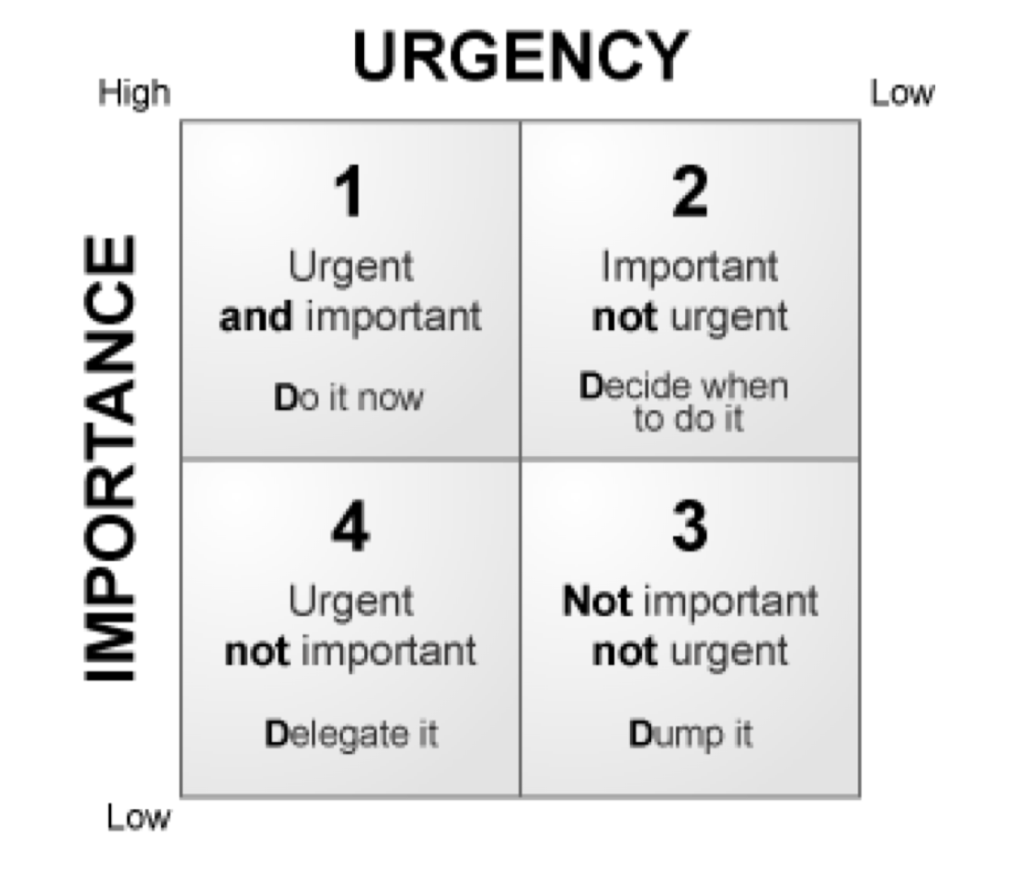
Prioritize and set reasonable goals & deadlines.
Priorities
Reflect on you, how you feel about tasks, when you work best, what REALLY matters
Reasonable Goals
Deadlines
Backwards plan
Eisenhower Matrix

Slide 10
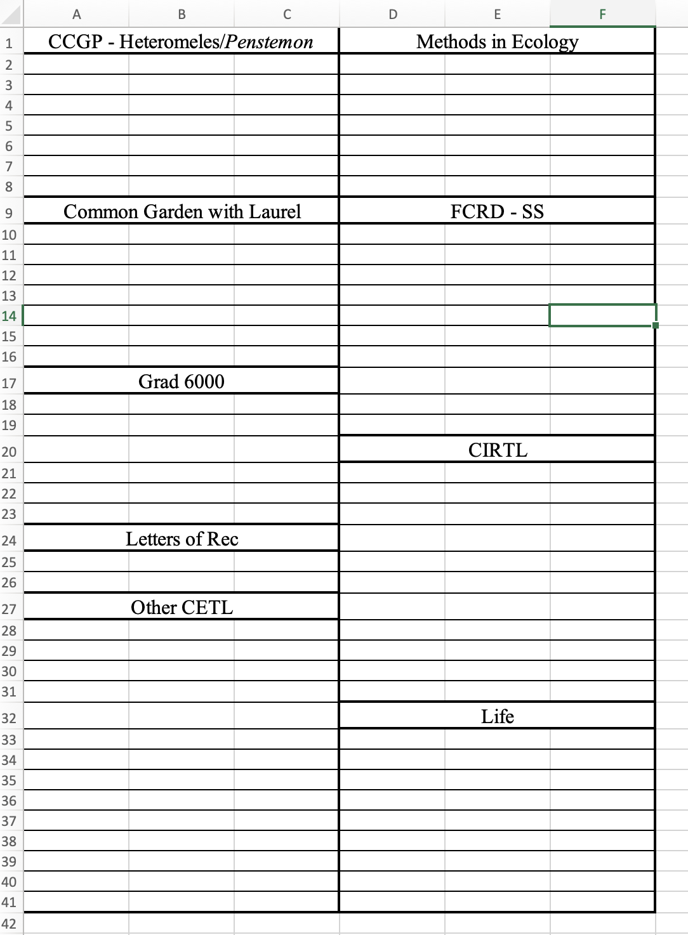
Be organized and have a plan.
Organize -
To-do lists
Calendar alerts
Prioritizing
Blocking out time
Plan out your day based on when you are your best you! (e.g. if you’re most productive in the mornings, do the hardest things then!)
How do YOU organize your time?

Slide 11
Avoid procrastination.
Why do we procrastinate?
Techniques for preventing procrastination?

Slide 12
Institute a support network
In the chat:
How can friends help with time management?
Accountability

Slide 13
Breakout Rooms: Time management
What are some challenges and some potential strategies to help you achieve those 5 principles of time management?
What are some concrete actions you can take now to help you manage your time in the future?
Why are you procrastinating? Is it tied to negative emotions/feelings?
What are some things that are out of your control? What challenges with delegating and managing others are affecting your productivity (e.g. perception of urgency/power dynamics)?
What are you doing to make time for yourself and the things you want to do for you?

