Slide 1
Accommodations: What Graduate Students and Instructors Need to Know
Presented by: Jennifer Lucia, Senior Associate Director
Center for Students with Disabilities
November 13, 2024

Slide 2
CSD Overview
5,920 students registered
Largest populations: Psychological conditions, Chronic health conditions
CSD is the University agent responsible for determining reasonable and appropriate accommodations for students with disabilities.
Accommodations available at all campuses

Slide 3
Types of Accommodations
Academic Adjustments (e.g., deadline extensions, participation modification, reduced courseload with full time status)
Alternate Media for Printed Materials
Assistive Communication (e.g., live captioning, post-production captioning)
Campus Access Accommodations (e.g., parking, Accessible Van Service)
Classroom Accommodations (e.g., alternate furniture, preferential seating)
Exam Accommodations
Notetaking Assistance (technology-based)
Residential Accommodations

Slide 4
Process for Graduate Students
Requesting Accommodations
Register with CSD using the online MyAccess platform (https://csd.uconn.edu/myaccess)
Student provides evidence of their condition(s) which includes:
  Student’s self-report and information about the impact of their condition(s) on their daily functioning
  Documentation from an appropriate medical provider (Documentation Guidelines are available for students to share with their providers on the CSD website)
Student gets assigned to work with a Disability Service Professional (DSP)
DSP engages in the interactive process with the student to determine appropriate accommodations

Slide 5
Approved Accommodations
Student requests accommodations letters through their MyAccess portal
DSP generates accommodation letters which are viewable in the student and instructor MyAccess portals
  Instructors receive an email directing them to their MyAccess portal to view student accommodation letters
Student is responsible for communicating any difficulties related to their accommodations to their DSP

Slide 6
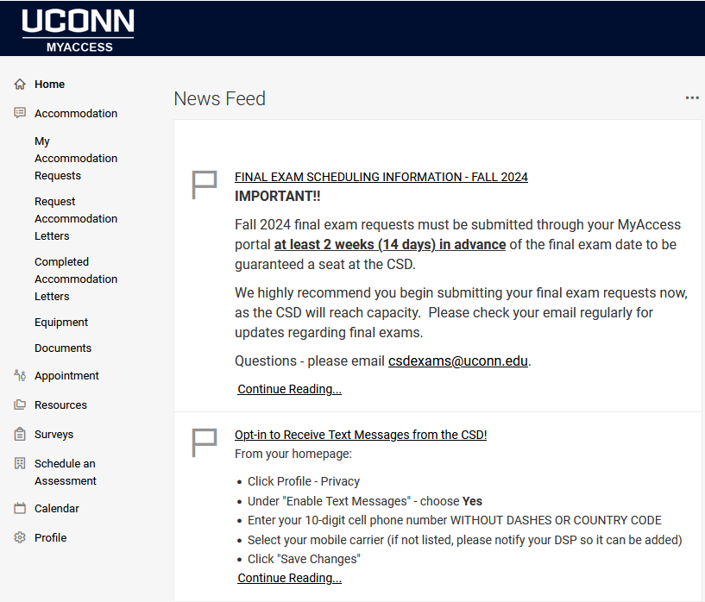
MyAccess Student Homepage

Slide 7
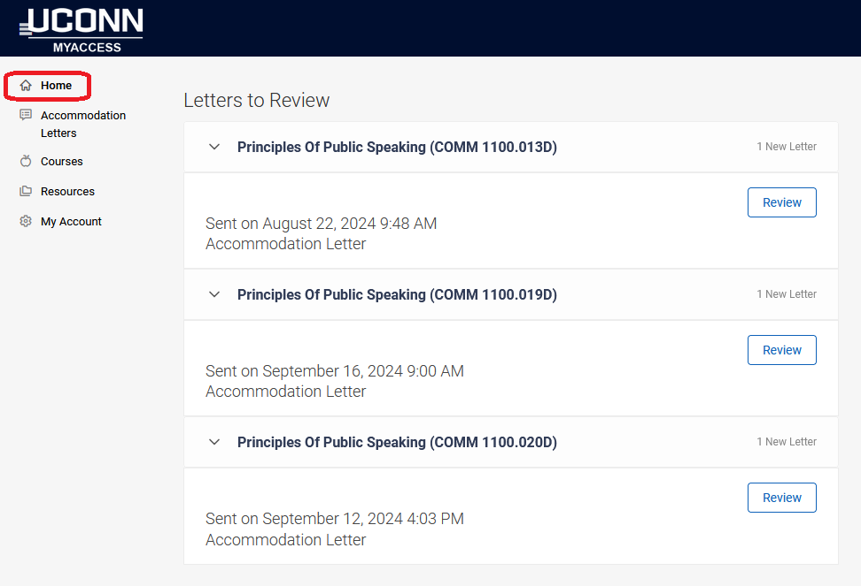
MyAccess Instructor Homepage

Slide 8
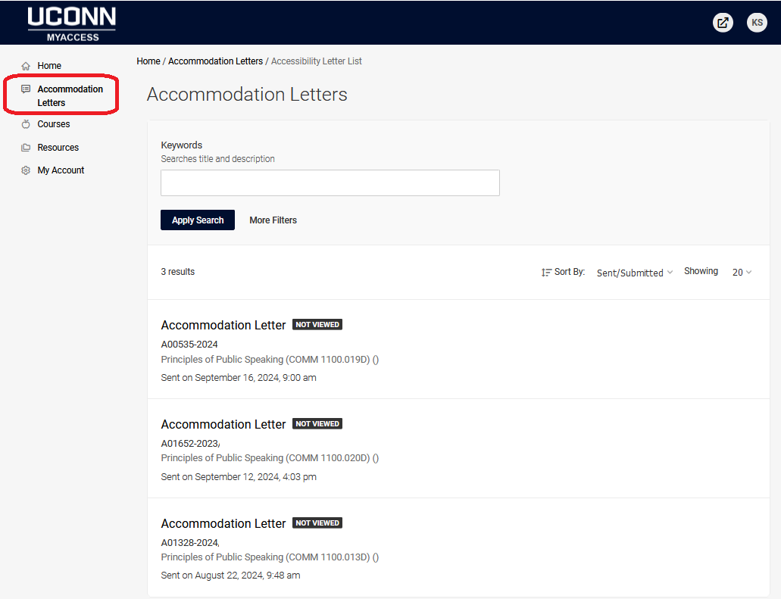
Instructor Accommodation Letters

Slide 9
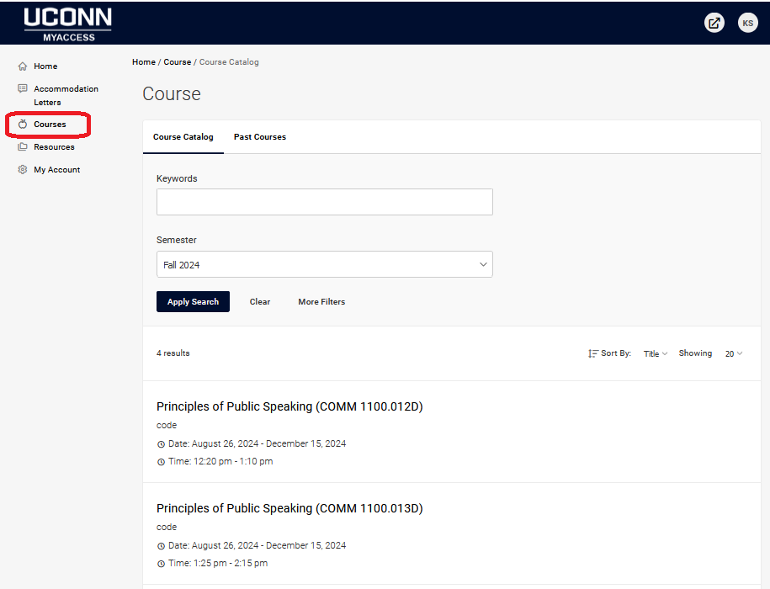
Instructor Course View

Slide 10
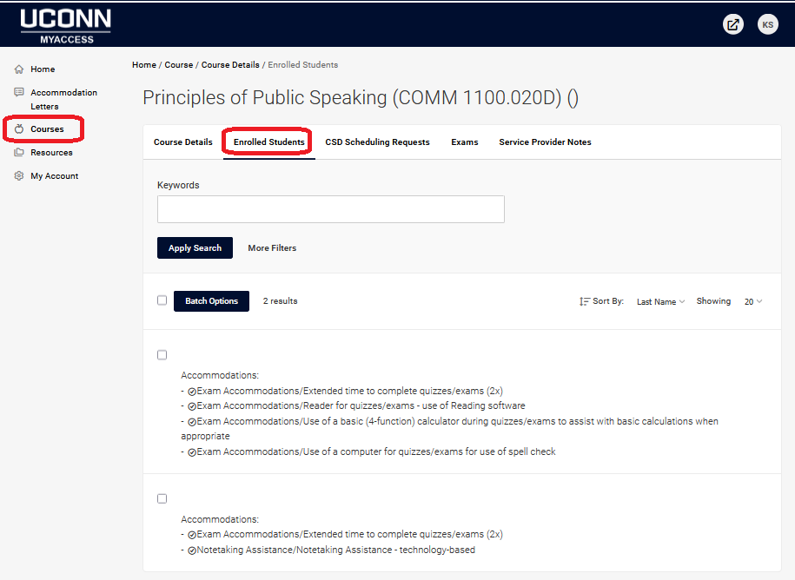
Enrolled Students View

Slide 11
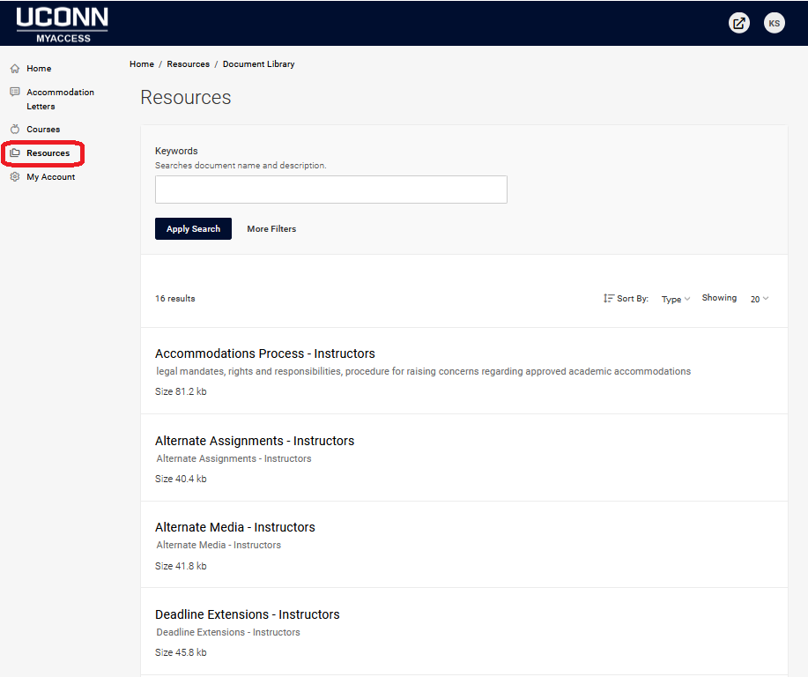
Instructor Resources

Slide 12
Student Rights
Equal access to courses, programs, services, jobs, activities, and facilities available through the University.
Reasonable and appropriate accommodations, academic adjustments, policy modifications, and/or auxiliary aids determined on a case-by-case, course-by-course basis.
Confidentiality of all information pertaining to the condition(s) with the choice of whom to disclose disability specific information to except as required by law.
Information in accessible formats.
File a formal grievance through the Office of Institutional Equity (OIE) and/or through external agencies (e.g., Office of Civil Rights) because of disability discrimination.

Slide 13
Student Responsibilities
Meet the University’s qualifications and essential technical, academic, and institutional standards, including the Student Code.
Identify oneself as an individual with a disability to the CSD when seeking accommodations.
Provide evidence (student self-report) and documentation from an appropriate professional source as indicated that verifies the nature of the disability, functional limitations, and the need for specific accommodations.
Participate in the interactive process with CSD staff, faculty, and other University personnel as indicated to obtain and coordinate reasonable and appropriate accommodations, academic adjustments, policy modifications, and/or auxiliary aids and services.

Slide 14
Faculty Rights
Hold all students to the same essential course requirements and behavior expectations.
Receive information from the CSD regarding any student approved for accommodations in their course(s), along with information on how to assist with implementing approved accommodations (MyAccess portal).
Give input into the means of implementing an approved accommodation by the CSD; however, faculty may not refuse to provide an accommodation approved by the CSD.
Contact the CSD if they believe an approved accommodation constitutes a fundamental alternation of the course objectives or program technical standards.
  Refer to Procedure for Raising Concerns Regarding Academic Accommodations (https://csd.uconn.edu/policies/)

Slide 15
Faculty Responsibilities
Provide approved accommodations specific to the course, either personally, through a Teaching Assistant (TA), or by planning with the CSD.
Ensure all teaching professionals associated with a course are listed as instructors in the Student Admin (PeopleSoft) system so they can access accommodation letters and assist in the coordination of approved accommodations.
Discuss with the student’s DSP any concerns related to approved accommodations
Refer a student requesting accommodations to the CSD if formal notification (accommodation letter) has not been received from the CSD.
Assure the privacy of information regarding students with disabilities. Any conversation with a student regarding accommodations should be conducted with discretion and in private.

Slide 16
Graduate Student Employment Accommodations
Accommodation requests related to a student’s graduate/teaching/research assistantship (workplace) are reviewed in Human Resources – Tiffanie Roback, ADA Case Manager (tiffanie.roback@uconn.edu)
Employee Accommodation Process - https://hr.uconn.edu/ada-compliance/

Slide 17
UConn Communication Access and Interpreting Services (UCIS)
Unit within the CSD that provides communication access and interpreting services to all UConn constituents – students, faculty, staff, visitors
Audrey Silva, Director – audrey.silva@uconn.edu
https://ucis.uconn.edu/

Slide 18
Thank You!
Questions????
https://csd.uconn.edu
jennifer.lucia@uconn.edu

