Slide 1
The Graduate School:
Using Pronouns: Actualizing Inclusivity
Updated 2024-11- 7

Slide 2
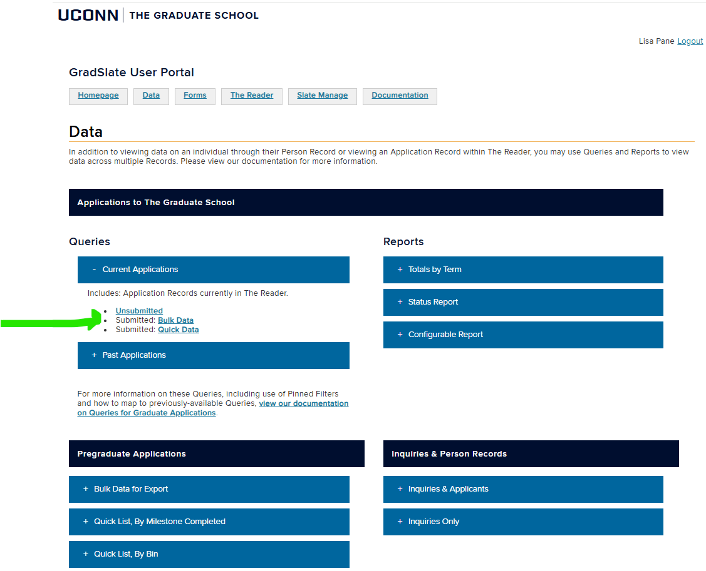
Where to find pronouns (1/3):
Pronouns can be found in the Bulk Data Query under the Data Tab of your User Portal.

Slide 3
Where to find pronouns (2/3):
Once the Bulk Data query loads, scroll over to Pronouns column:

Slide 4
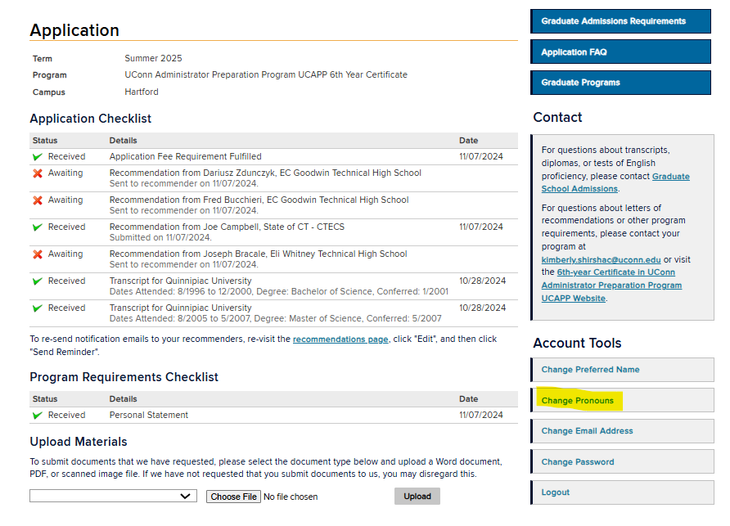
Where to find pronouns (3/3):
Applicants can update their pronouns on their Application Status Portal.

Slide 5
Where to find preferred names (1/3):
Preferred Names can be found in the same Bulk Data Query under the Data Tab of your User Portal.

Slide 6
Where to find preferred names (3/3):
Preferred names are use in all admission letters
Please use preferred names in your correspondence.
GA offer letters require the student’s legal name.

Slide 7
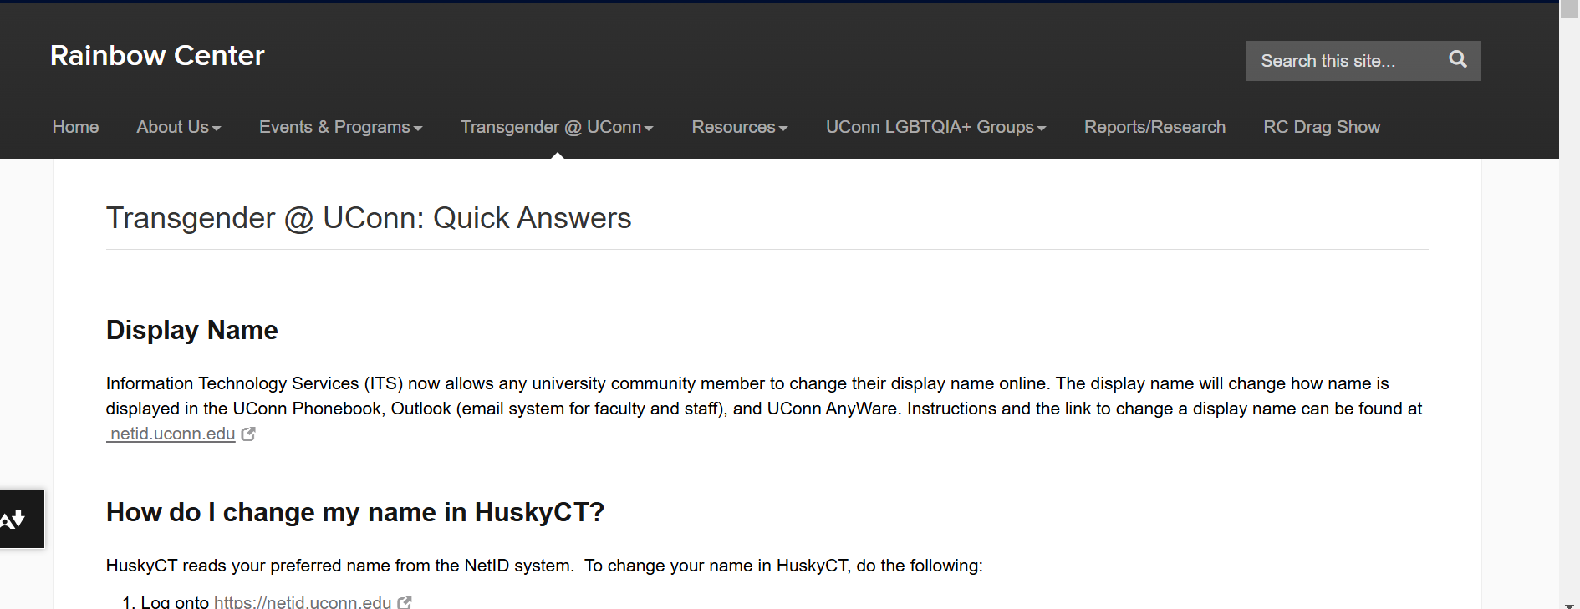
Where to find preferred names (2/3):
*Students who wish to change their preferred name after matriculation will need to update their information with at a later time.
The Rainbow Center has an excellent resource for students: https://rainbowcenter.uconn.edu/transgender-uconn-quick-answers/ **

Slide 8
Questions?
Is there a preferred place programs would like this information stored in the application?
Updated 2024- 7

