Slide 1






Inclusive Language
Inclusive Language
Presented by:
Ian Shick (they/them)
Assistant Director - Rainbow Center

Slide 2






Agenda
Brief Overview of the Rainbow Center
Intro to Gender and Pronoun Usage
Inclusive Language
Resources

Slide 3




Mission Statement
Mission Statement
The Rainbow Center's mission is to operate in the service of a more equitable world for all students, faculty, and staff at the University of Connecticut. Using an intersectional lens, we center our work on advocating for and increasing education, access, retention, identity development, and community-building for queer and trans communities. (Revised 2019).

Slide 4

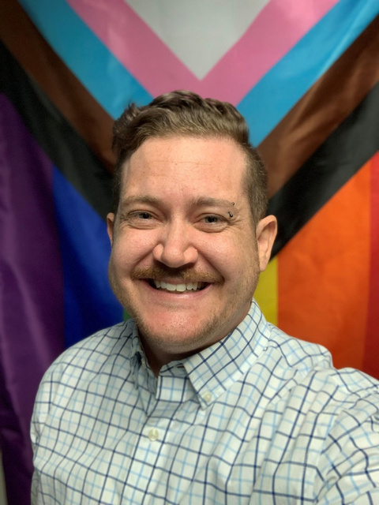
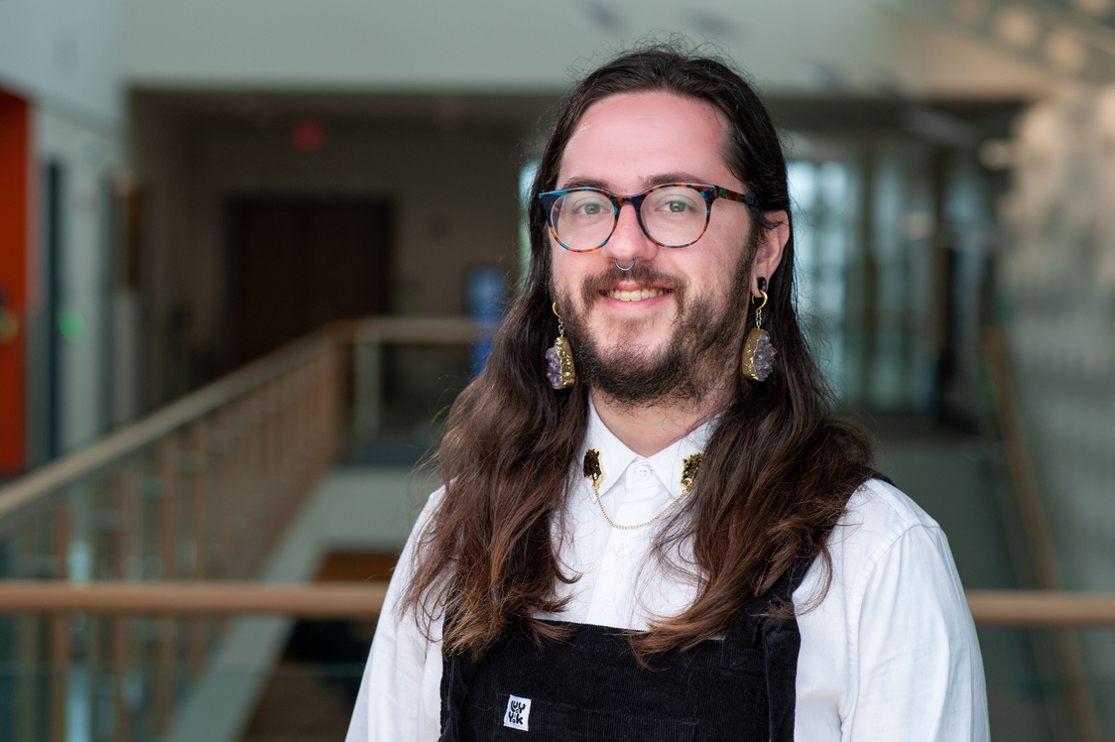
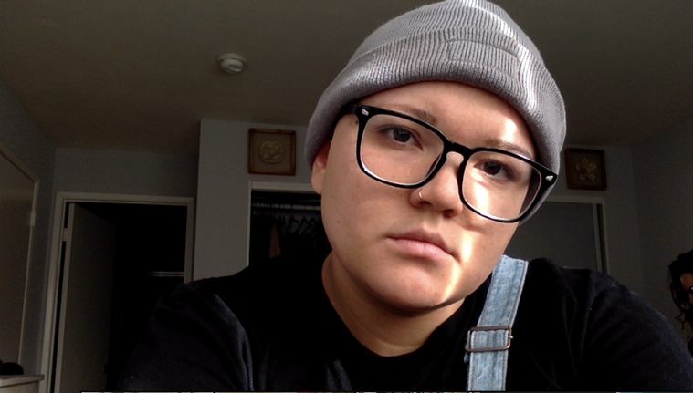


Meet Our Pro Staff
Kelsey O’Neil | Ian Shick | Lene Reynolds
Director they/them | Assistant Director they/them | Graduate Assistant they/them
We also have 25 student employees who help us with programming, operations, and community projects.

Slide 5
Who has ever completed a queer and/or trans allyship training?
(or something similar)

Slide 6
Transgender vs. Cisgender
transgender
describing an experience or a person whose gender identity is not traditionally aligned with their sex assigned at birth
cisgender
describing an experience or a person whose gender identity is traditionally aligned with their sex assigned at birth

Slide 7


Pronouns
transgender
person
nonbinary
person

Slide 8
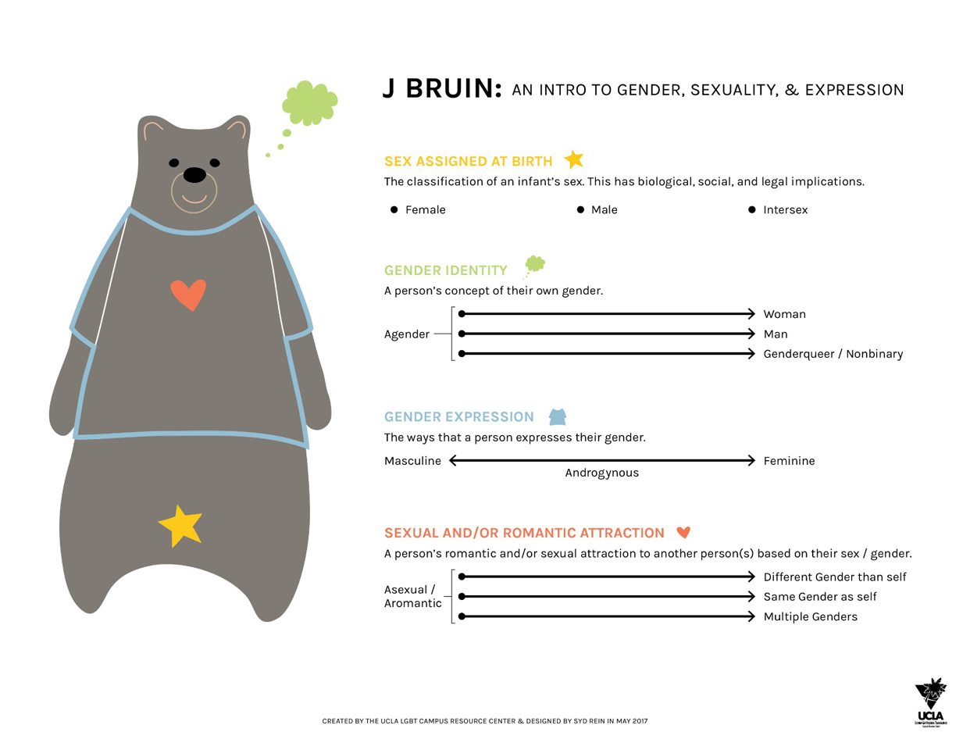
J Bruin: An Intro to Gender, Sexuality, and Expression

Slide 9
J Bruin: An Intro to Gender, Sexuality, and Expression (cont.)

Slide 10


In the context of the classroom:
you cannot know unless someone discloses that to you!
do not presume that you can “tell” that someone is trans, nonbinary, or queer

Slide 11


Transgender Umbrella
Transgender
Trans Woman
Trans Man
Genderfluid
Nonbinary
Gender Nonconforming
Genderqueer
Agender
Bigender

Slide 12

Culturally Specific Terms
boi
stud
same-gender loving
Two-Spirit
Black communities
Indigenous communities (but not all!)

Slide 13


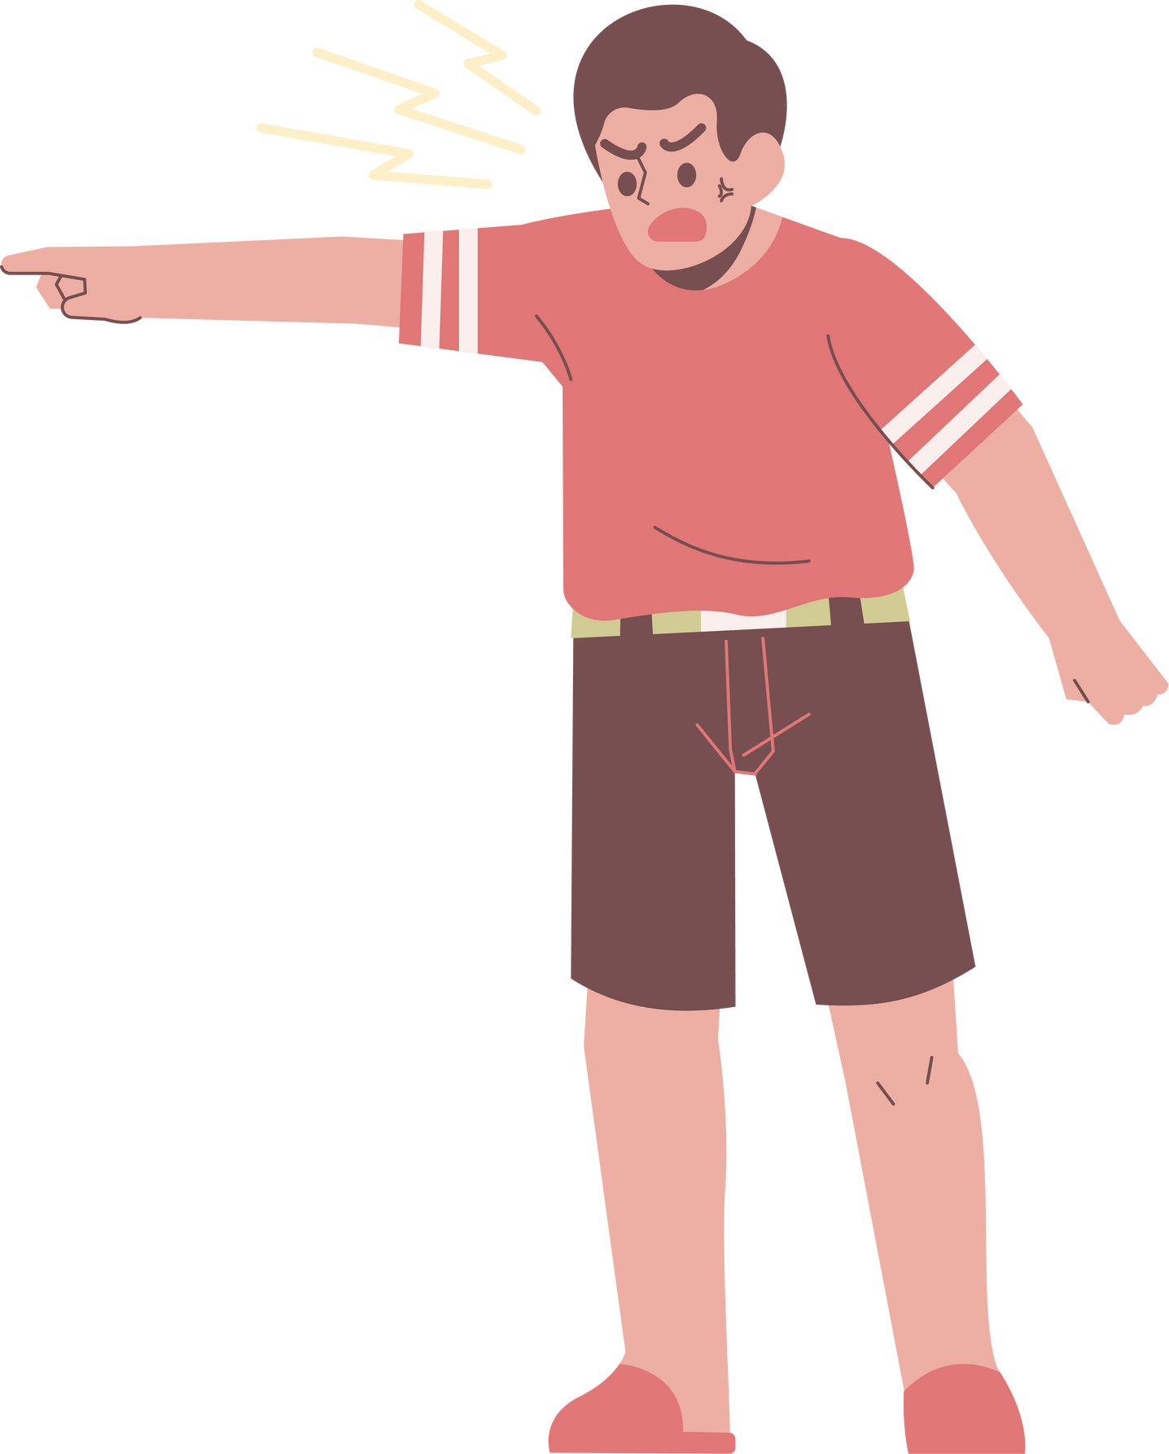
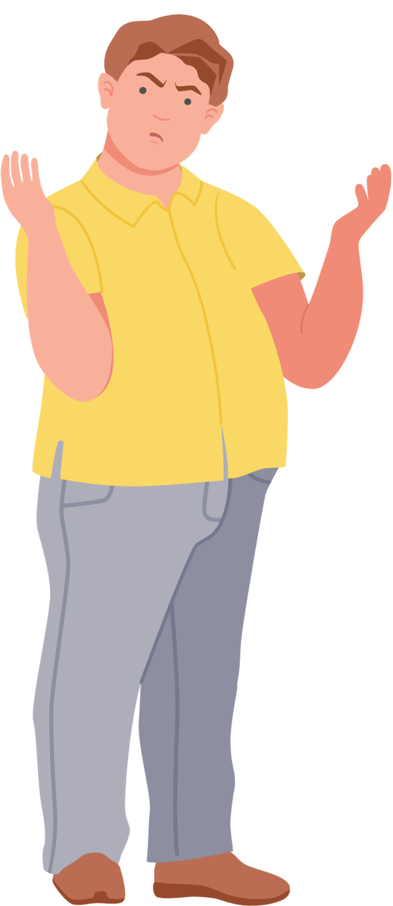
Cisgender Man
Don’t call me
‘cisgender’!
I’m a man!
Am I not?

Slide 14
Nonbinary vs. Gender Nonconforming
nonbinary
a person whose gender identity does not align with the western man/woman binary
gender nonconforming
a person whose gender identity and/or expression does not conform to binary gendered roles, expectations, etc.

Slide 15
Misgender vs. Deadname
misgender
a form of violence
using wrong pronouns or other incorrectly aligned gendered language
deadname
a form of violence
using a person’s previous name that they no longer use (especially name given at birth)

Slide 16

Scenarios

Slide 17


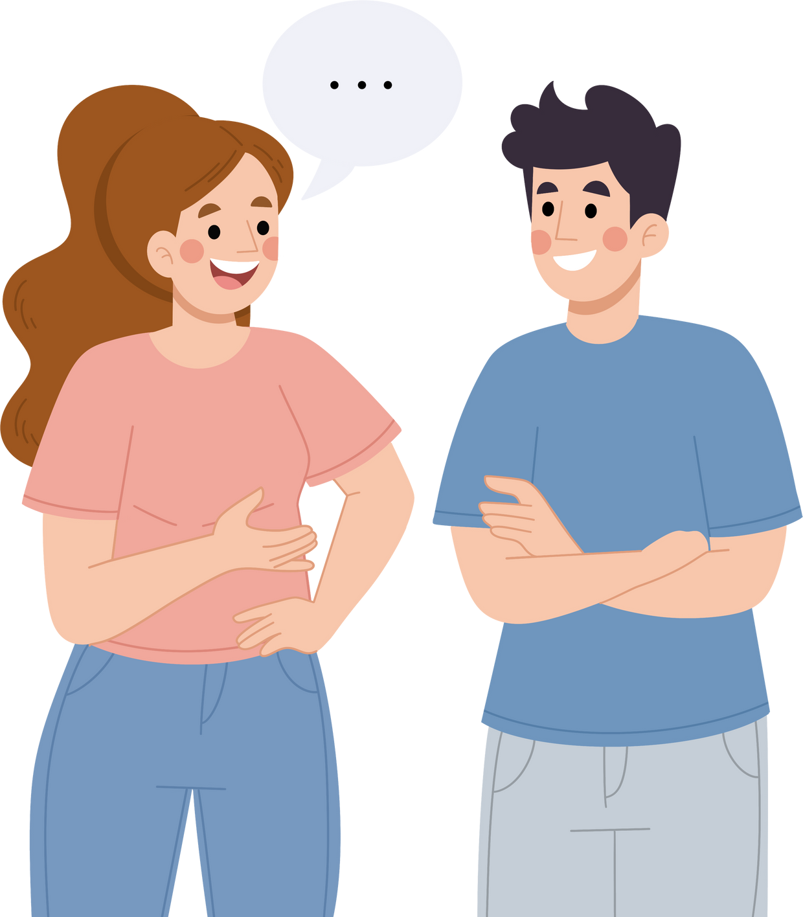
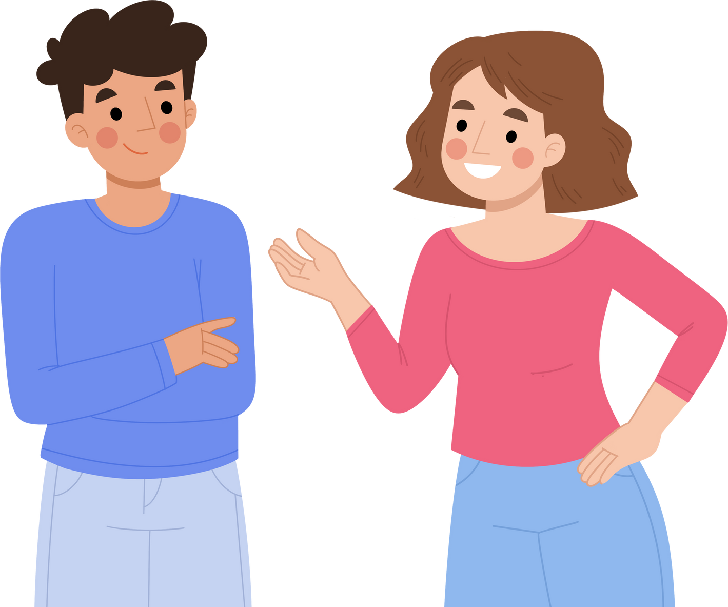
Cleo Scenario 1
Hi, I’m Cleo. My pronouns are she/they.
Cleo is a trans woman, she may be able to help

Slide 18

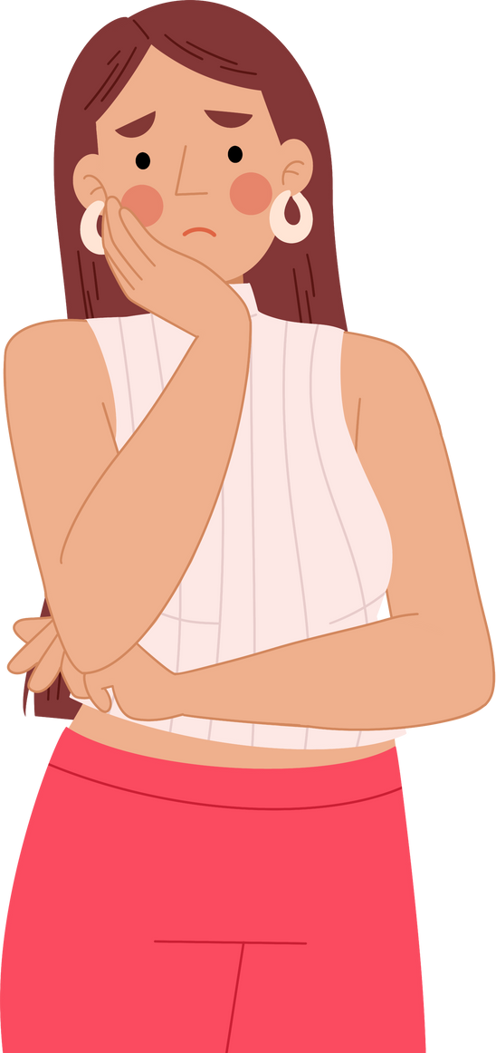
Cleo Scenario 2
I’m nonbinary actually, but I’m working on coming out
Cleo is nonbinary and I want to support her coming out journey. Can you help?

Slide 19

Rule of Thumb
Don’t use terms for people that they haven’t used for themselves
OR
that they haven’t indicated that they use publicly
In many cases, its ok to ask, if you’re not sure what someone wants you to do!*
*be aware of where you are when you ask

Slide 20
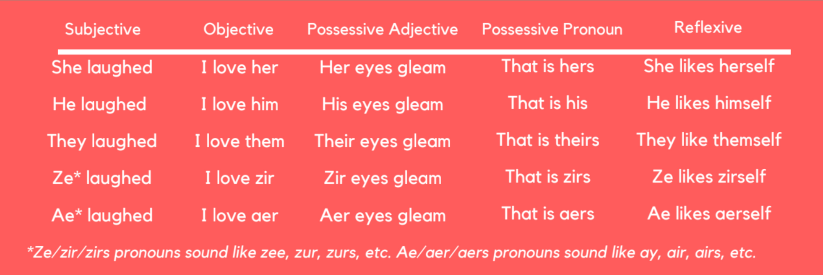
Pronoun Chart

Slide 21
Who is familiar with neo-pronouns?

Slide 22
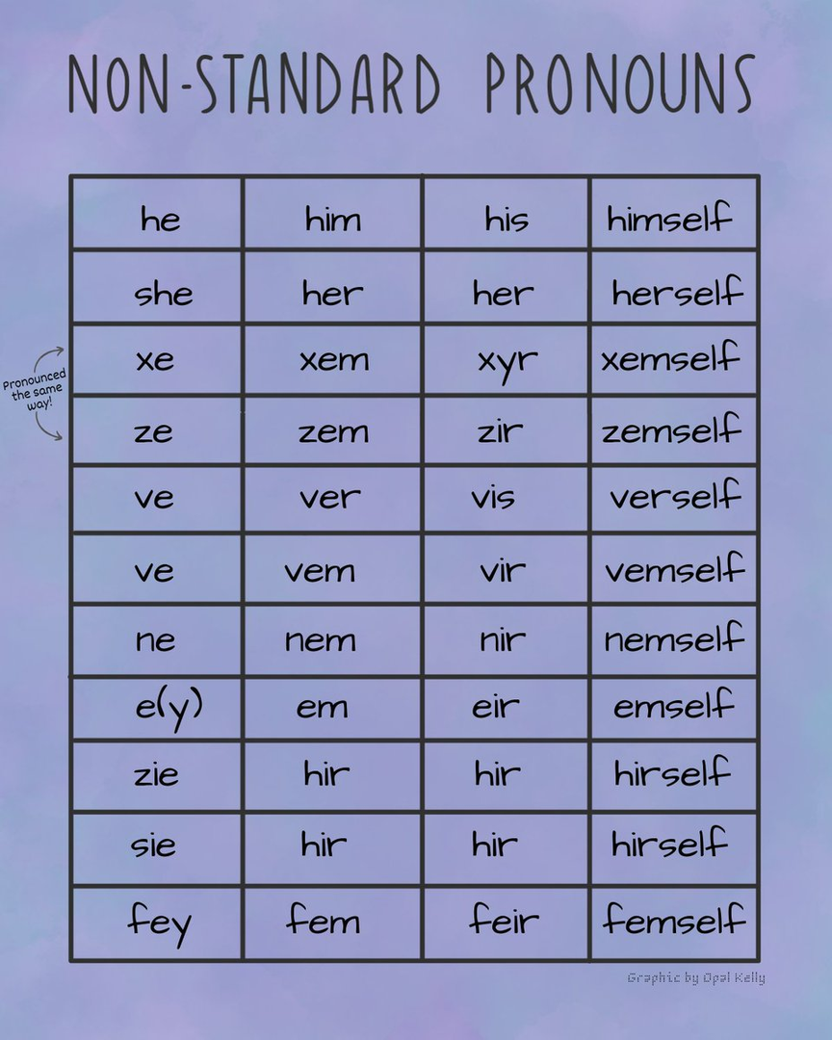
Neopronouns
anything other than he/she/they

Slide 23
How do I ask for pronouns in person?

Slide 24






Asking for pronouns, example 1
Hi, I’m Sami, my pronouns are she/her.
Great to meet you!
Hi, I’m Sami, my pronouns are she/her.
What are your name and pronouns?
I’m Jenna, they/them
Jenna, they/them
OR
OR
I don’t have pronouns
Sure. Uhhh, I’m Jenna

Slide 25
Asking for pronouns, example 2
I don’t have pronouns
I’m a female...?
...and uhhh girl pronouns
“Okay, great! When you refer to me, you can say ‘she is my friend’. In case I’m ever referring to you, I want to be sure to talk about you in a way that makes you feel comfortable. What pronouns would you like me to use for you?”
“What do you mean by that?”
“Ok, I’ll just refer to you by your name only.”

Slide 26
Asking for pronouns, example 3
What do you mean by, ‘pronouns’?
Why are you asking that?
“I’m working to be sure I’m not making assumptions about anyone. I’m asking this question of everyone I meet!”
“Pronouns are one way I and others can refer to you. When you refer to me, you might say ‘she was talking to me’. Do you have pronouns you’d like me to use for you?”

Slide 27
Gender Inclusive Language in Practice
Instead of this: | Say this:
ladies and gentlemen | folks/friends/guests/colleagues/scholars
“he or she,” “his or hers” | they, theirs
mailman/fireman | postal worker/firefighter
freshman | first-year student
yes ma’am*/yes sir | yes / yes, my friend / yes, professor

Slide 28
Gender Inclusive Language in Practice - Chart
Instead of this: | Say/Do this:
Pointing people in the direction of the restroom you think they’ll want to use | “Men’s and Women’s restrooms are to the left, the gender inclusive restroom is down the hall to the right.”
Making assumptions about the genders/pronouns of people’s partners | Avoid gendered terms like husband/wife/boyfriend/girlfriend until you hear them used.
Associating certain professions with genders (nurse=woman, farmer=man, etc.) | Remember: It would be VERY rare for gender to dictate positions that people could hold (i.e. spy, actor)
Associating certain names with pronouns/genders (from resumes/emails) | Remember: Names don’t have genders or pronouns. People do! Until a person tells you theirs, you won’t know.

Slide 29



What if I make a mistake?

Slide 30


What to do when making a pronoun mistake
  Don’t make it about you
  Apologize, indicate you know you made a mistake
  Move on, using the correct language
    Don’t overdo it!
  Avoid looking to be absolved
  Practice to do better next time
“I’m sorry. I meant to say...”
“That’s my mistake...”

Slide 31
What if someone else makes a mistake?
(or says something offensive on purpose)

Slide 32





What to do when someone else makes a pronoun mistake
Being an ally is about constantly doing better, and encouraging others to do the same!
1. Tell people when they mess up
2. Tell people sooner rather than later*
3. It’s easier to do it when you’re in a more private environment
4. Offer facts!
Zac actually uses they/them pronouns, not sure if you were aware
None of us should ever think we’re 100% allies, “good at this stuff,” “inclusive,” etc. The second you think, “I’m a totally gender-inclusive person,” you can know with certainty that you’re wrong.
That’s so interesting that you think that... why? ‘Cause for me, I know that that’s not been my experience.

Slide 33

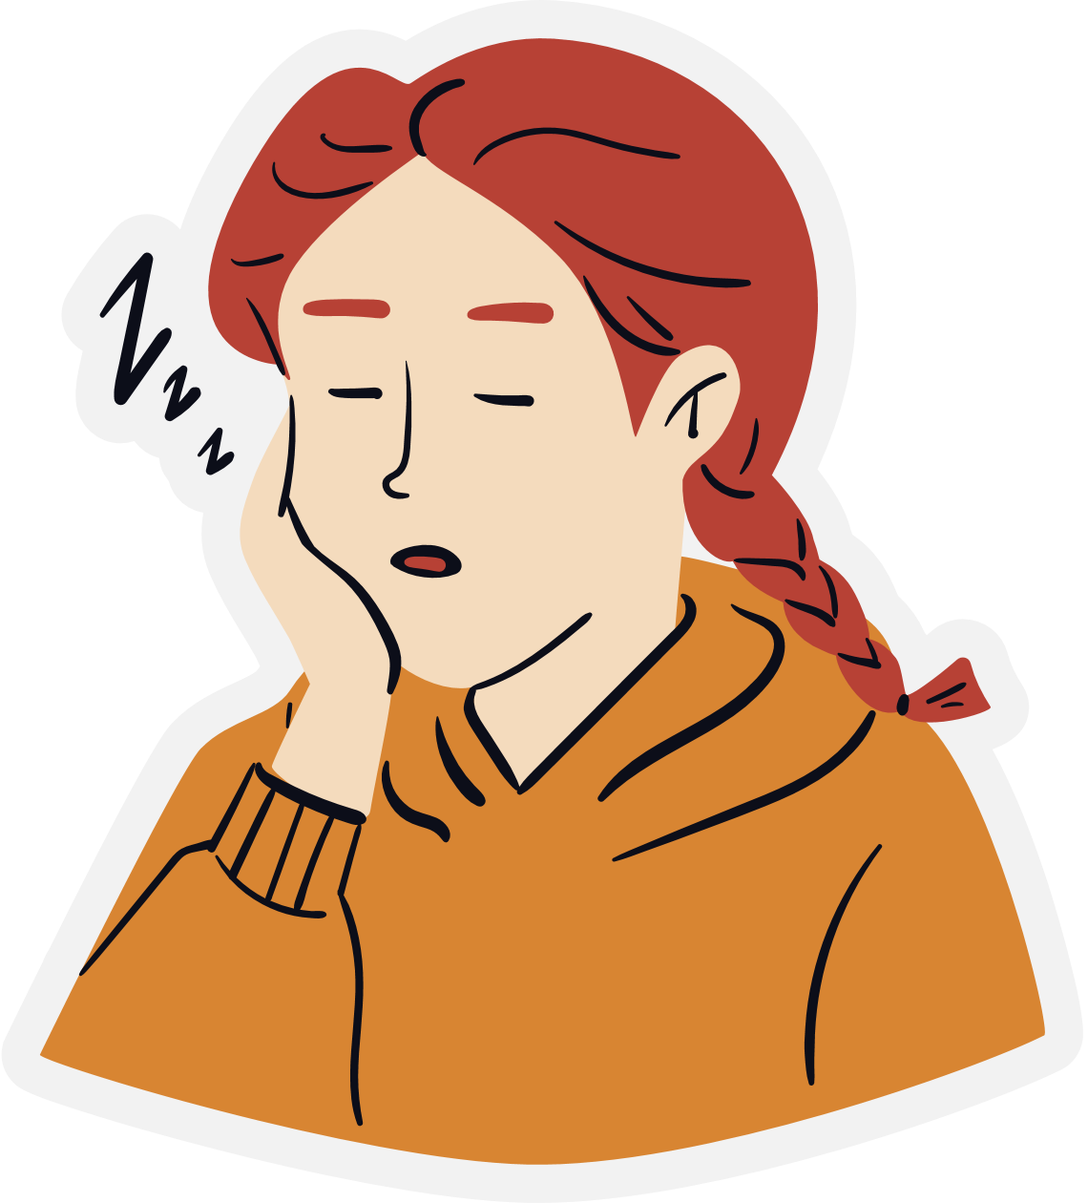

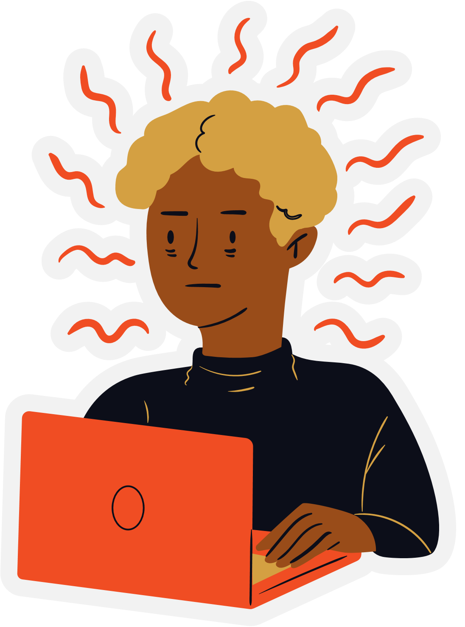
that was a lot of info...
questions?

Slide 34


What questions or fears do you have?
What you are being asked to do is not always easy.

Slide 35

Resources Video

Slide 36
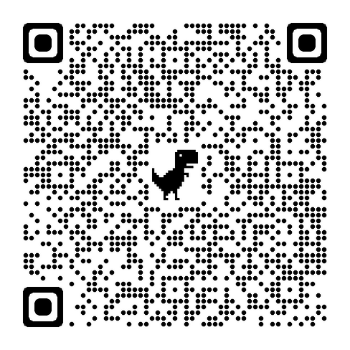
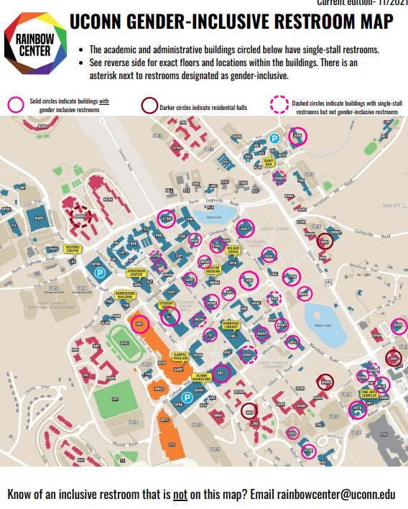
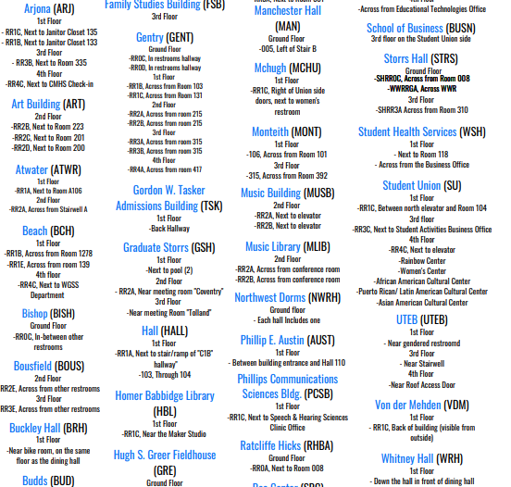
Gender Inclusive Bathroom Map
on RC website
Print versions in RC

Slide 37
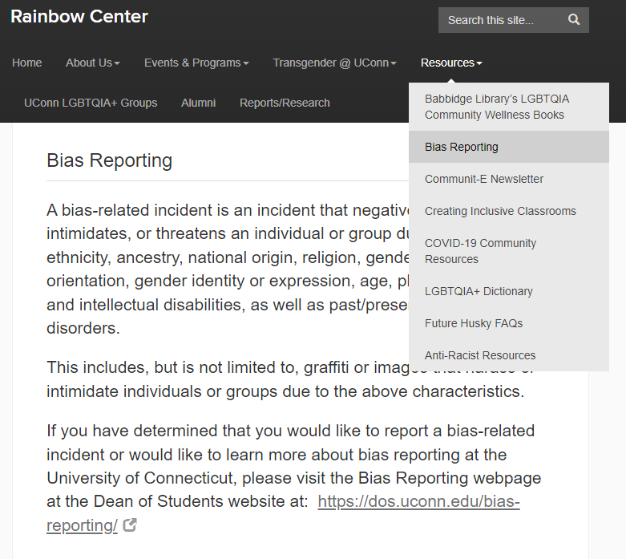
Bias Reporting

Slide 38
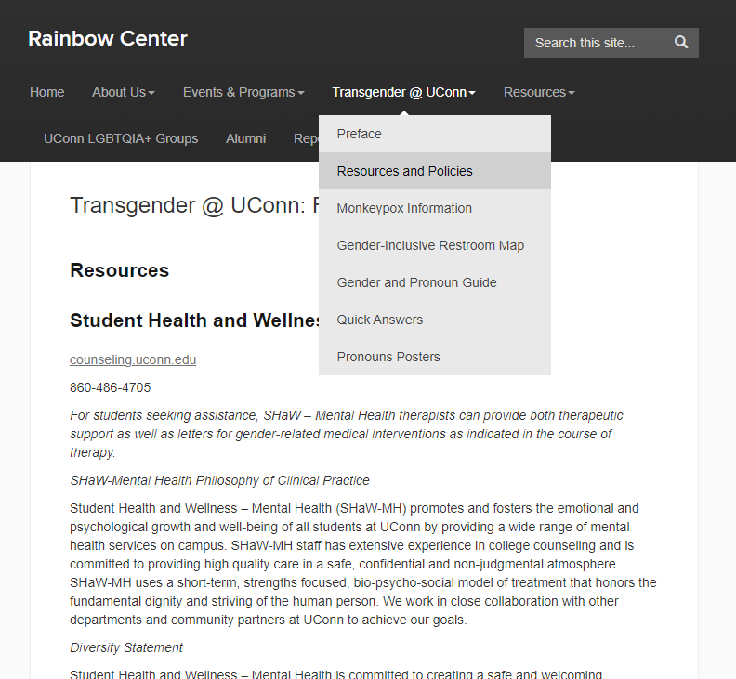
Rainbow Center Resources and Policies

Slide 39
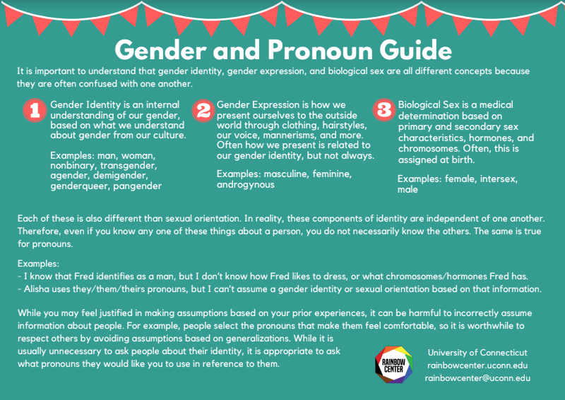
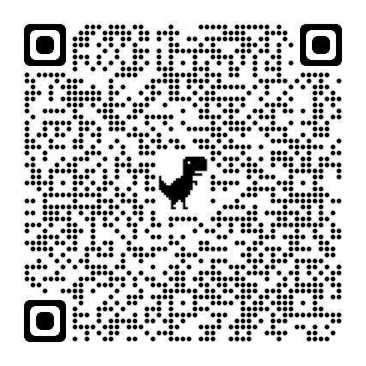
Gender and Pronoun Guide
developed by a student employee in the Rainbow Center

Slide 40
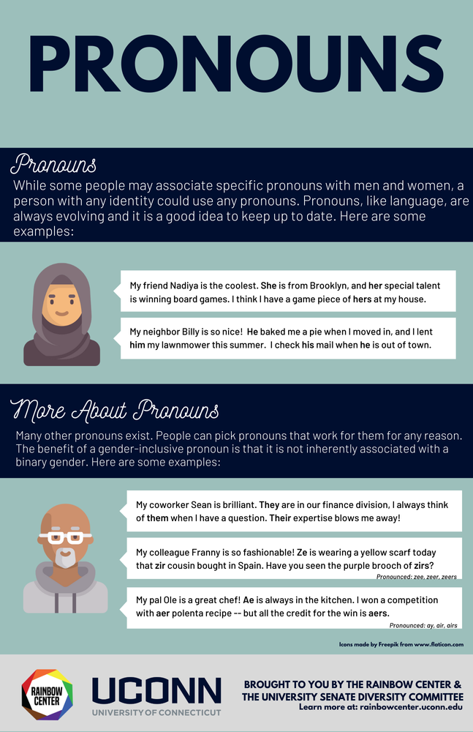
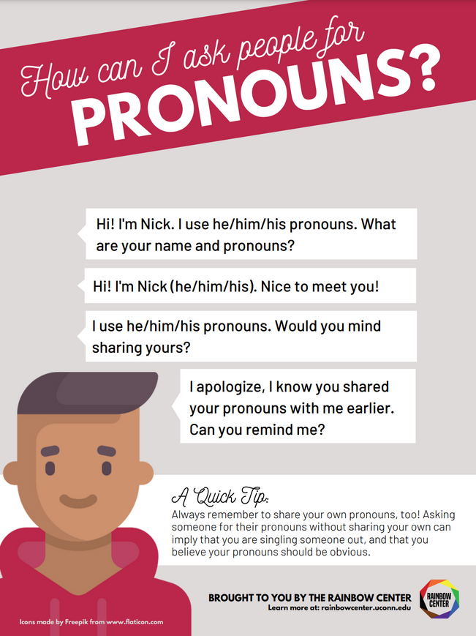
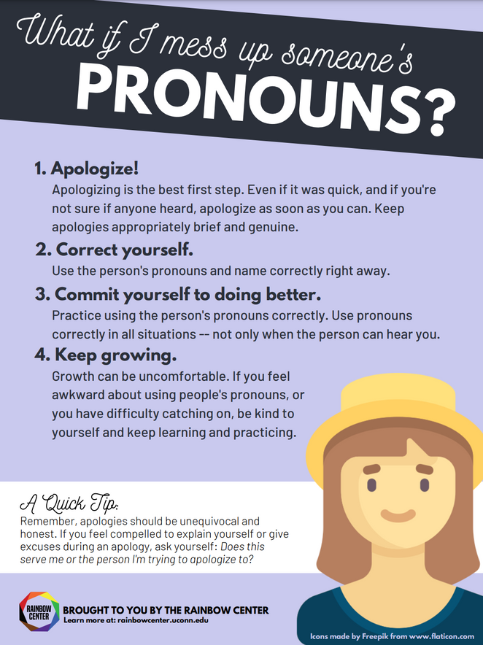
Pronoun graphics

Slide 41
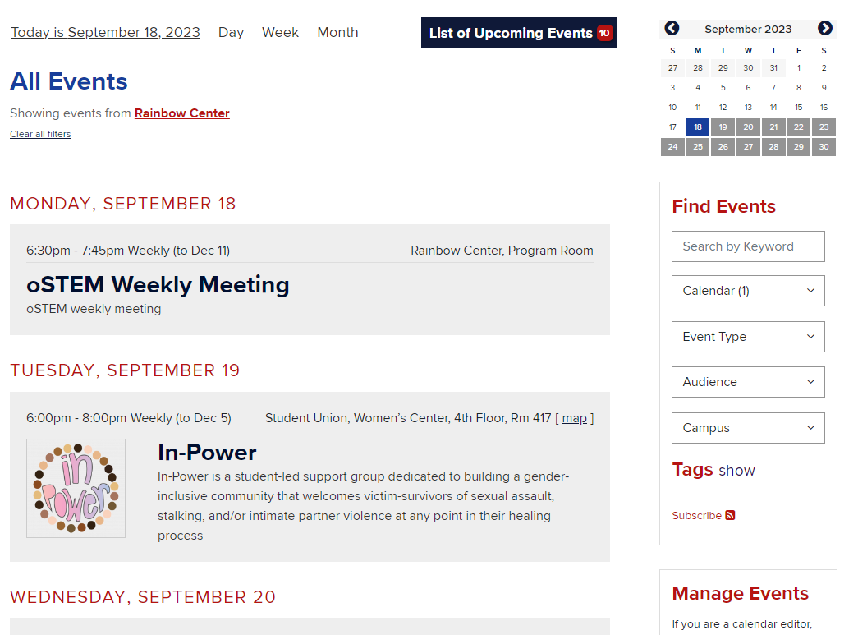
Rainbow Center Events
events.uconn.edu

Slide 42
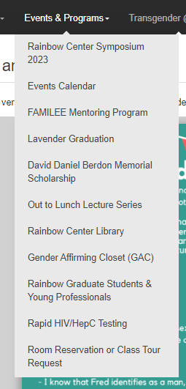
Rainbow Center Events and Programs

Slide 43
Thank you!
Thank you!

