Slide 1



THE GRADUATE SCHOOL PRESENTS
Timely Topics:
Reading and Reviewing Applications
October 31, 2024
M
Notes:
Meg

Slide 2
Meet the Team:
Holly Brunette
Graduate Admissions Specialist
The Graduate School
holly.brunette@uconn.edu
Meg Buckley
Director, Graduate Admissions
The Graduate School
meg.buckley@uconn.edu
Shirley Fiasconaro
Graduate Admissions Specialist
The Graduate School
shirley.fiasconaro@uconn.edu
Katie O’Keefe
Graduate Admissions Specialist
Specialty: School of Business
katie.okeefe@uconn.edu
Lisa Pane
Director for CRM & Data Management
The Graduate School
lisa.pane@uconn.edu
Sarah Redlich Shore
Assistant Director, Graduate Admissions
The Graduate School
sarah.shore@uconn.edu
Paula Steele
Assistant Director for CRM & Data Management The Graduate School
paula.steele@uconn.edu
M
Notes:
Meg

Slide 3

REMINDERS
Chat with us!
Use to chat to say hello, ask your questions, and share comments!
We are recording. This presentation will be available:
  within the GradSlate User Portal: connect.grad.uconn.edu/portal/user
  among the Timely Topics resources
  grad.uconn.edu/timely-topics/
M
Notes:
Meg

Slide 4
AGENDA
How TGS Categorizes GPAs
The Reader
  Workflows
  Roles
  Reader Bins
  Queues
  Reader Tools
  Reader Review Forms & Tabs
Decisions
  Admitting an Applicant
  Other Decisions
GPA Justification
Frequently Asked Questions
Questions? Comments? Wishlist?
M
Notes:
Meg

Slide 5

The Graduate School’s Mission Statement
The Graduate School will be the heart of graduate and postdoctoral education at the University of Connecticut. It will foster excellence in graduate and postdoctoral education, and it will guide graduate students and postdoctoral scholars to personal and professional success.
Copy of The Graduate School’s Strategic Plan can be found on our website.
M
Notes:
Meg

Slide 6
*Reminder* How TGS Categorizes GPAs
SRS
Notes:
Sarah

Slide 7
GPA Calculation Process
Once an applicant has submitted an application and paid the $75.00 non-refundable application fee, our admissions team will perform a GPA calculation as part of our standard review process.
Although The Graduate School does not require a third-party credential evaluation, a course-by-course and degree evaluation from a member of the following services are welcome if the applicant would like to have their GPA converted to the U.S. 4.0 grade scale prior to applying to The Graduate School:
  NACES (National Association of Credential Evaluation Services) or
  AICE (Association of International Credential Evaluators)
During peak periods (November through March) it may take a few weeks for GPAs to be calculated on recently submitted applications.
SRS
Notes:
Sarah

Slide 8
GPA Categories
Eligible for Regular admission:
A cumulative GPA for their most recent degree of 3.0 or higher for the entire degree, or
If the most recent degree is an undergraduate degree or the student has not yet completed their undergraduate degree:
  A GPA of 3.0 or higher for the entire two most recent years of full-time undergraduate coursework (60 credits), or
  A GPA of 3.5 or higher for the entire most recent year of full-time undergraduate coursework, or
If a student has taken at least the equivalency of one semester of full-time study (9 credits) following the completion of the most recent undergraduate or graduate degree, a GPA of 3.0 or higher for all of their post-degree coursework.
Eligible for Provisional admission OR for program to write a GPA Justification for Regular admission:
(Note: Provisional admission is not offered to international students intending to get a F-1 or J-1 visa and Provisional admission is not offered to PhD students. Students on provisional admission are not eligible for Grad Payroll).
Overall GPA of bachelor’s degree is at or above 2.60, but below 3.00.
SRS
Notes:
Sarah

Slide 9
GPA Categories (continued)
Eligible for program to write a GPA Justification for Provisional admission:
(Not offered to students applying to PhD programs).
Domestic/Permanent Resident overall 2.3 GPA or higher for Provisional admission.
GPA Too Low for Justification - Domestic/Permanent Resident applicant
Overall GPA of bachelor’s degree is below 2.3
AND
If full time coursework after most recent degree (9 credits) is below a 3.0.
GPA Too Low for Justification - International applicant intending to get a F-1 or J-1 visa
Overall GPA of bachelor’s degree is below 2.599
AND
If full time coursework after most recent degree (9 credits) is below a 3.0.
SRS
Notes:
Sarah

Slide 10
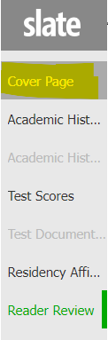
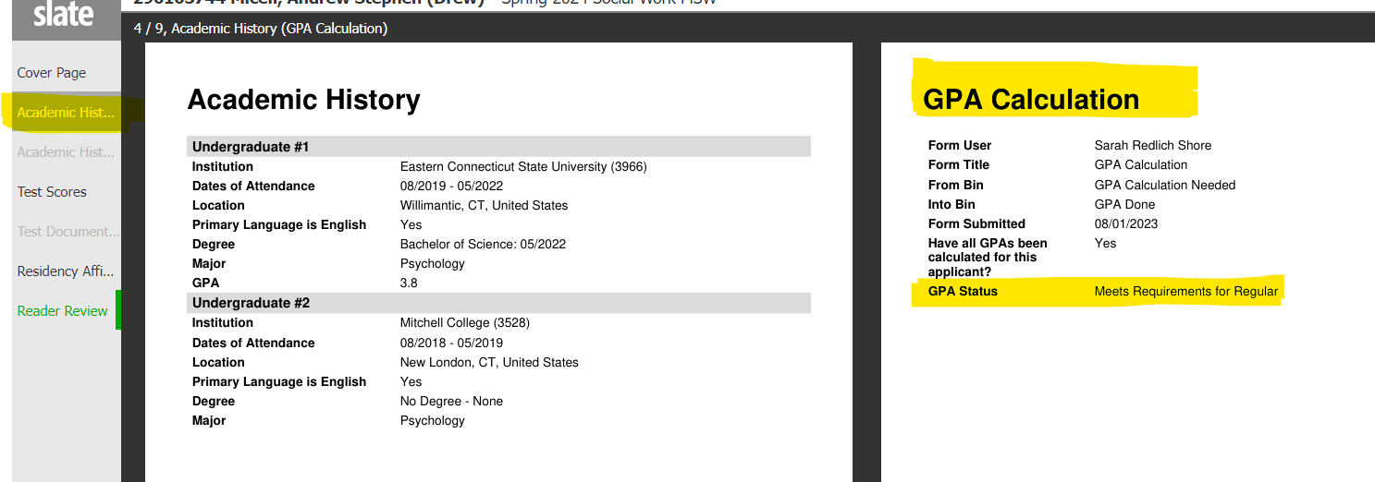
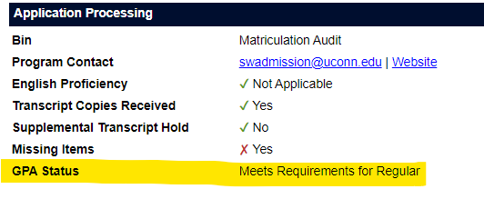
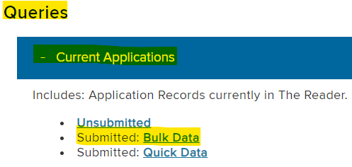
Where can programs view the GPA status of applicants?
Cover Page of the application in the Reader under “Application Processing”
Academic History section of the application in the Reader on the “GPA Calculation” review form
GradSlate User Portal: Data tab
Queries: Current Applications Submitted: Bulk Data
(“GPA Status” column)
SRS
Notes:
Sarah

Slide 11
The Reader Workflows
K
Notes:
Katie

Slide 12
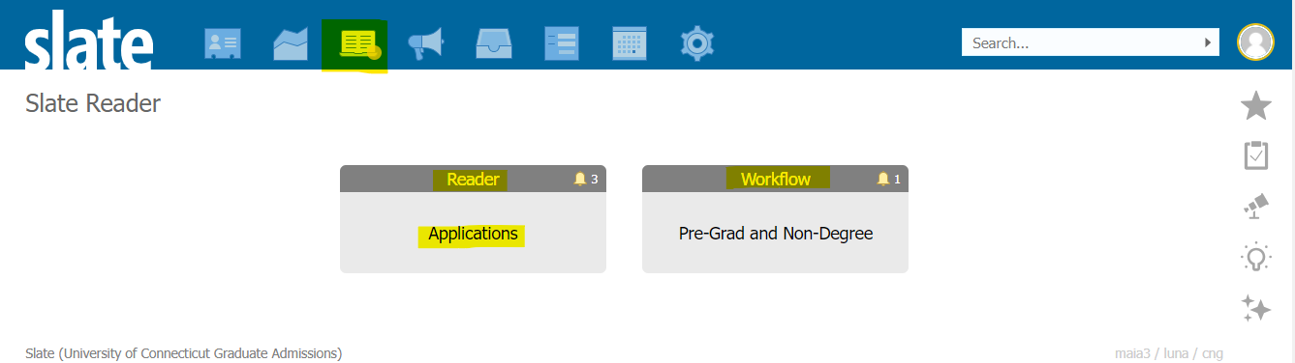
Accessing The Reader Workflow
To log into The Reader, users should click on the widget shown below on the top ribbon of their Slate homepage. Users can also log in directly at connect.grad.uconn.edu/manage/reader from the User Portal.
Users may see different workflows, please choose “Applications” to review applications for admission.
K
Notes:
Katie

Slide 13
The Reader & Roles
K
Notes:
Katie

Slide 14
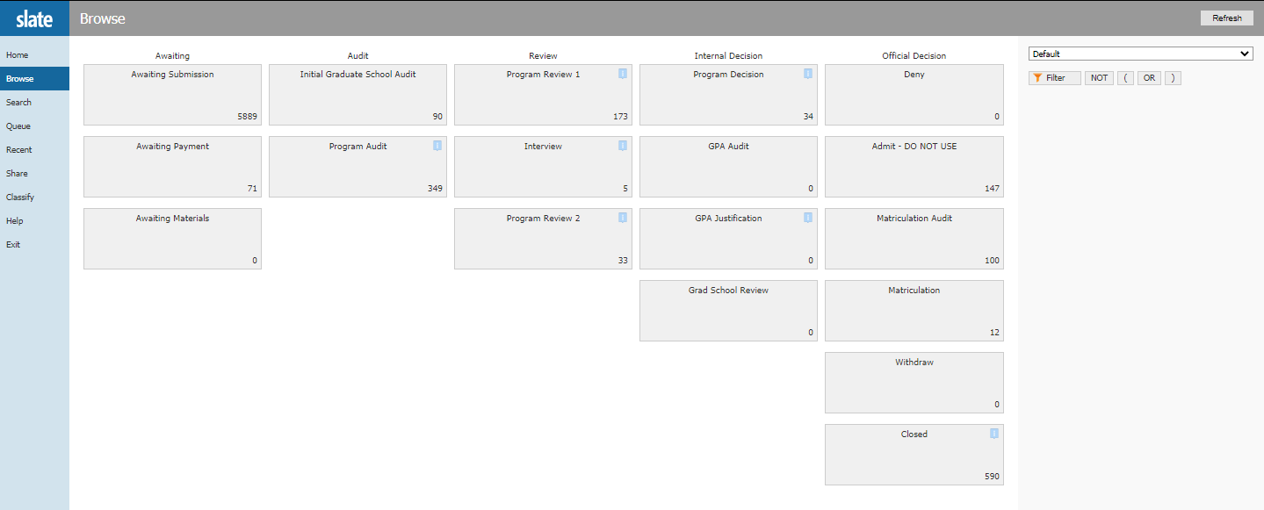
The Reader & Roles (cont.)
Note: Not everyone sees the same bins. Below are all of the bins The Graduate School sees with administrator access.
Reader access is based on Roles
2 Main roles programs have assigned are:
Program Admin
Reader Reviewer
(Once in reader, click on “Browse” on left hand column to access bins)
K
Notes:
Katie

Slide 15
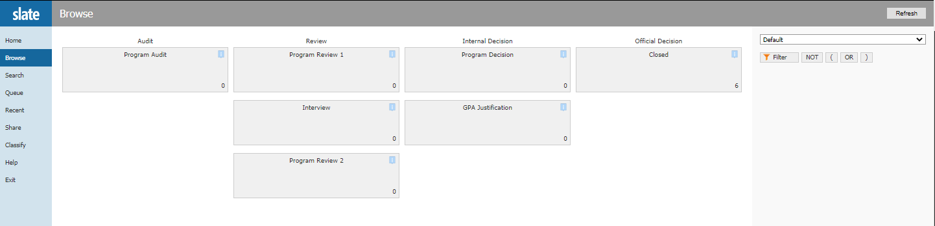
Program Admin Role
This role is usually for faculty, program admins, or members of the graduate admissions committee who process applications for requirements or official decisions.
Below are the bins the program admin role has access to.
K
Notes:
Katie

Slide 16
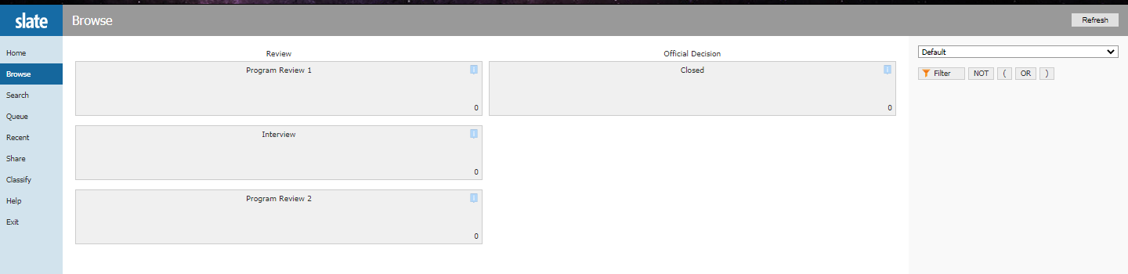
Reader Reviewer Role
This role is usually for faculty or members of the graduate admissions committee who review applications for admission but do not process applications for requirements or official decisions.
The reader reviewer role does not have access to the Program Audit bin, Program Decision bin, or GPA Justification bin.
Below are the bins the reader reviewer role has access to.
K
Notes:
Katie

Slide 17
Reader Bins
K
Notes:
Katie

Slide 18
Reader Bins (cont.)
Applications only move forward in the bins, never backwards.
If an application needs to be moved backwards, please contact gradadmissions@uconn.edu and we will move it back for you.
Applications can skip bins if you do not use them in your admission process.
  Example: Skip Interview bin if program does not interview applicants.
Programs are welcome to utilize these bins using their own best practices to review applications.
  Example: Reader reviewers may want to see applications before all program requirements have been met, but they do not have access to the Program Audit bin. Applications that do not have all requirements met could be kept in the Program Review 1 bin, while completed applications could be kept in the Program Review 2 bin to show this differentiation.
K
Notes:
Katie

Slide 19
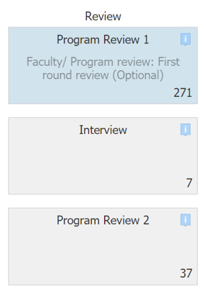
Reader Bin Definitions
Reader bins have definitions of the purpose of each bin when hovered over with the mouse.
K
Notes:
Katie

Slide 20
Reader Bin Definitions (cont.)
Program Audit Bin: New Applications: Review for program requirements
Program Review 1 Bin: Faculty/ Program review: First round review (Optional)
Interview Bin: (Optional)
Program Review 2 Bin: Faculty/ Program review: Second round review (Optional)
Program Decision Bin: Final program decisions entered here (Required)
GPA Justification Bin: Does not meet TGS GPA minimum requirements (A justification is required to admit)
K
Notes:
Katie

Slide 21
Queues
HB
Notes:
Katie

Slide 22
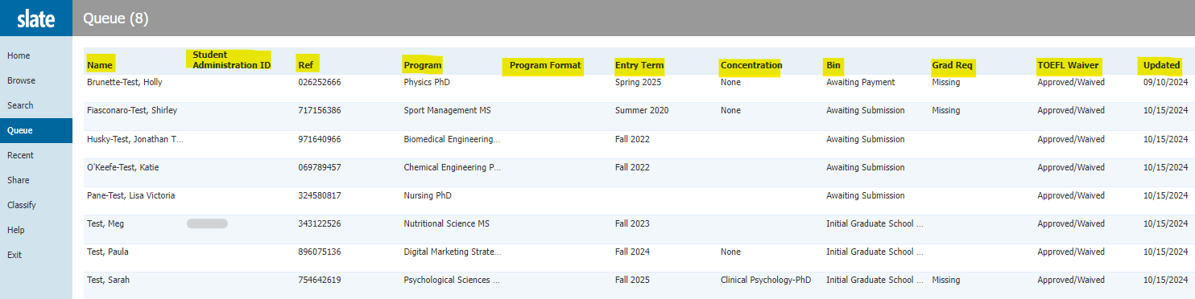
Queues (cont.)
Every user has a Queue in The Reader.
In order to take any action on an application in the Reader, the application must be added to your Queue.
You can sort items in your Queue, by selecting the title of a column
HB
Notes:
Katie

Slide 23
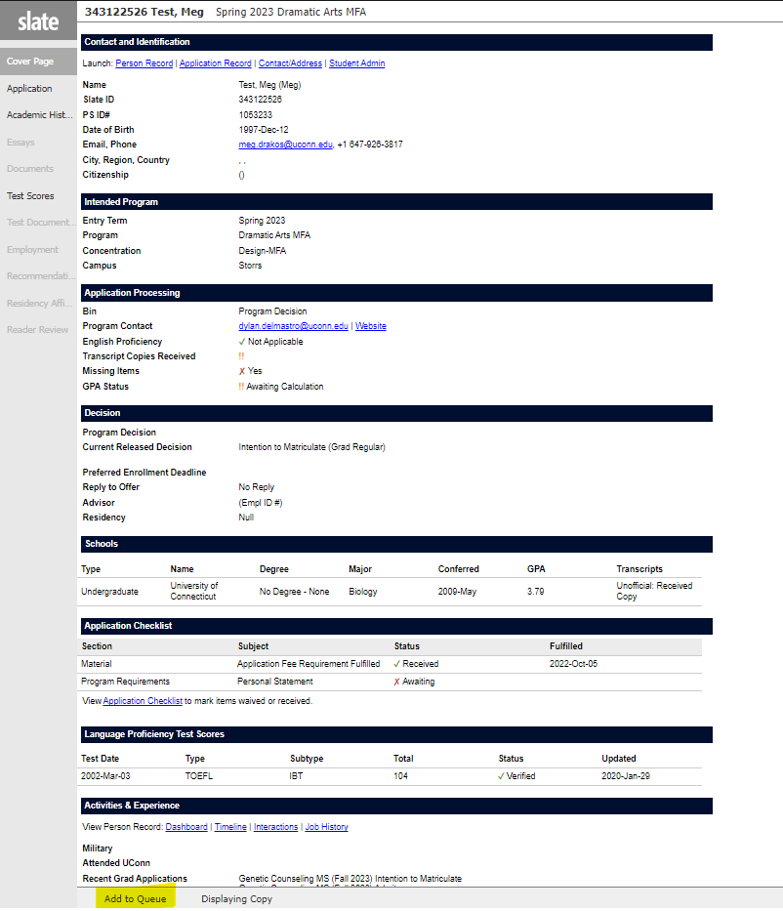
The “Bermuda Triangle Dance”
(Adding Applications to your Queue 1 at a time)
Step 1: Click on bottom left of application where it says “Add to Queue”
HB
Notes:
Katie

Slide 24
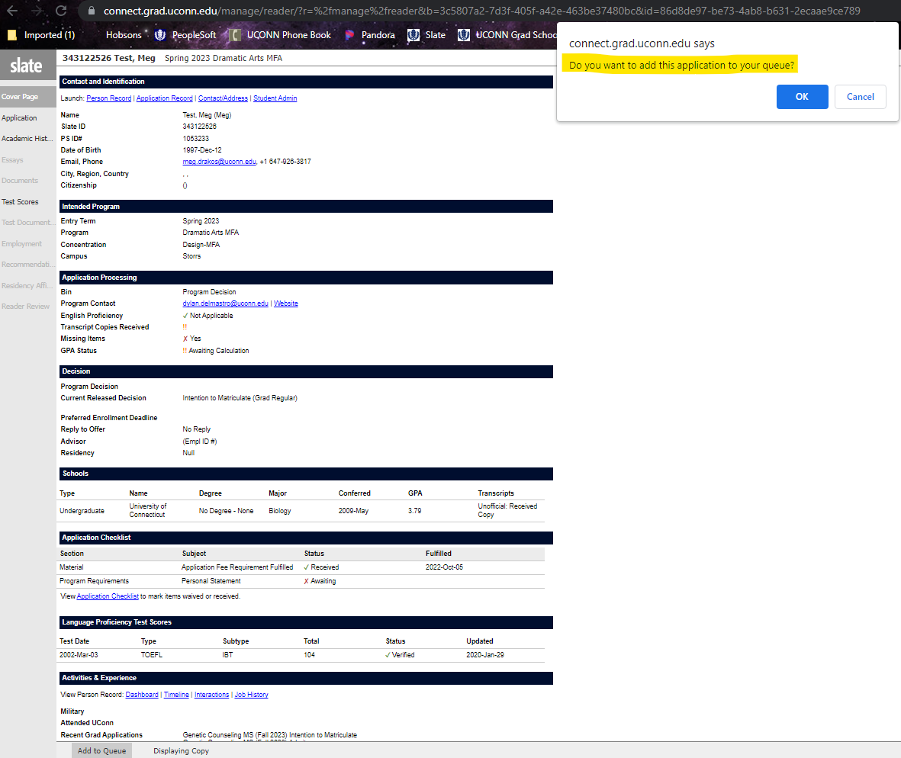
The “Bermuda Triangle Dance”
(Adding Applications to your Queue 1 at a time) (cont.)
Step 2: Click “OK” toward the top of application. “Do you want to add this application to your queue?”
HB
Notes:
Katie

Slide 25
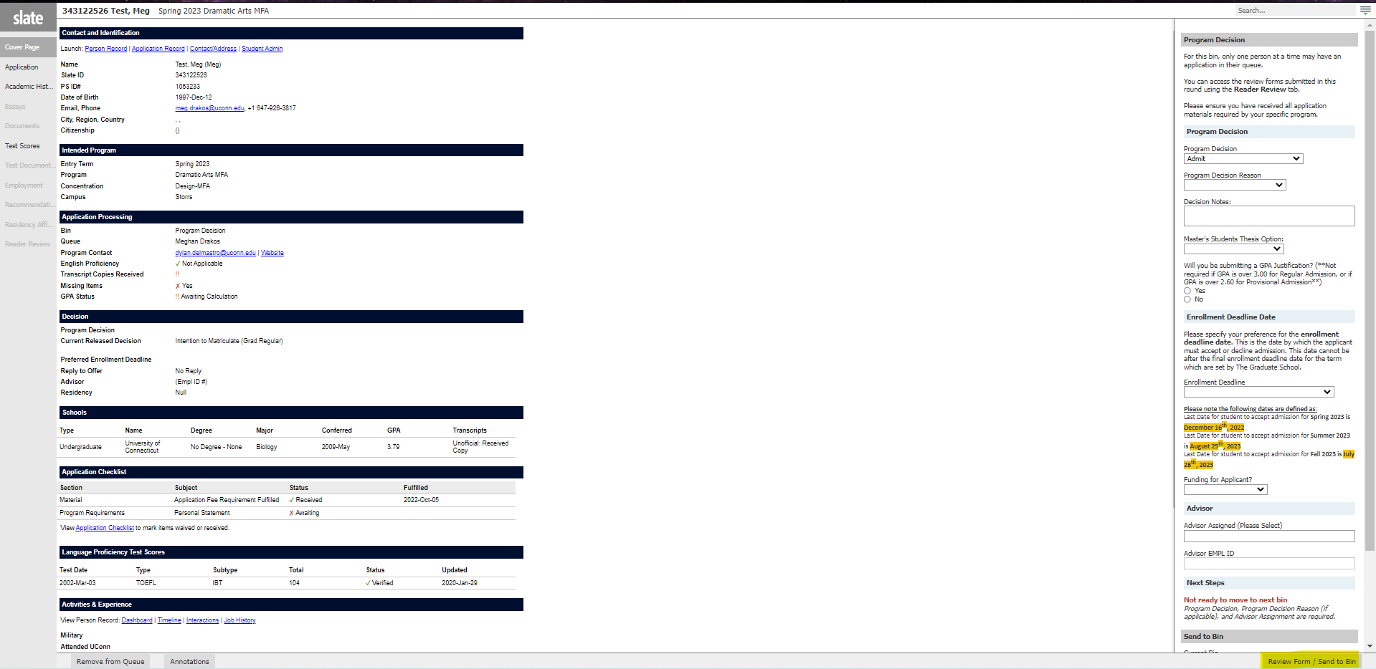
The “Bermuda Triangle Dance”
(Adding Applications to your Queue 1 at a time) (cont.)
Step 3: Click on bottom right of application where it says “Review Form/Send to Bin”
HB
Notes:
Katie

Slide 26
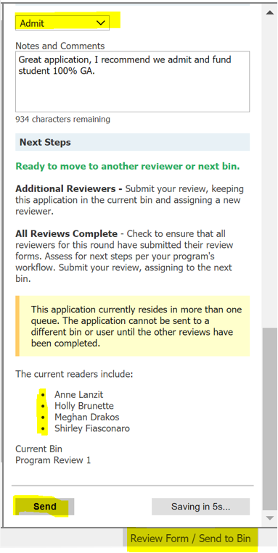
Queues & Reader Review Forms
The Reader Review Form button “Review Form/Send to Bin” will only show in the bottom right corner of an application if that application is in your queue.
To fill out a reader review form in your queue, select “Review Form/Send to Bin” in bottom right corner of an application that is open.
Applications can be in multiple queues at once, unless in Program Decision bin.
The application will stay in the bin it is in, and will only move forward to the next bin that is selected when the last reader reviews the application and selects a new bin.
*Please be objective in reviews.*
HB
Notes:
Katie

Slide 27
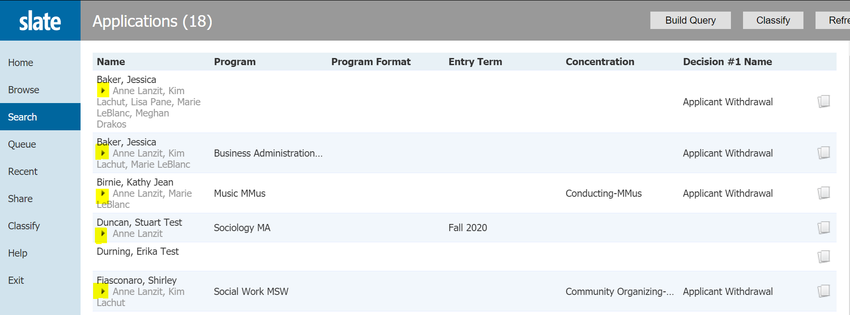
Tip: Who Submitted a Review?
When a user submits a Reader Review Form for an applicant, their name will be listed under the applicant’s name in the bins and in your queue:
HB
Notes:
Katie

Slide 28
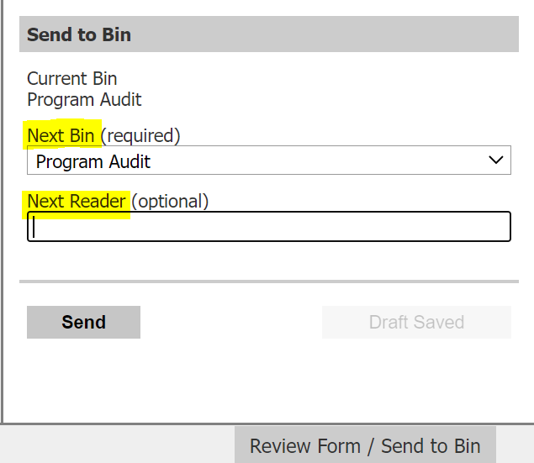
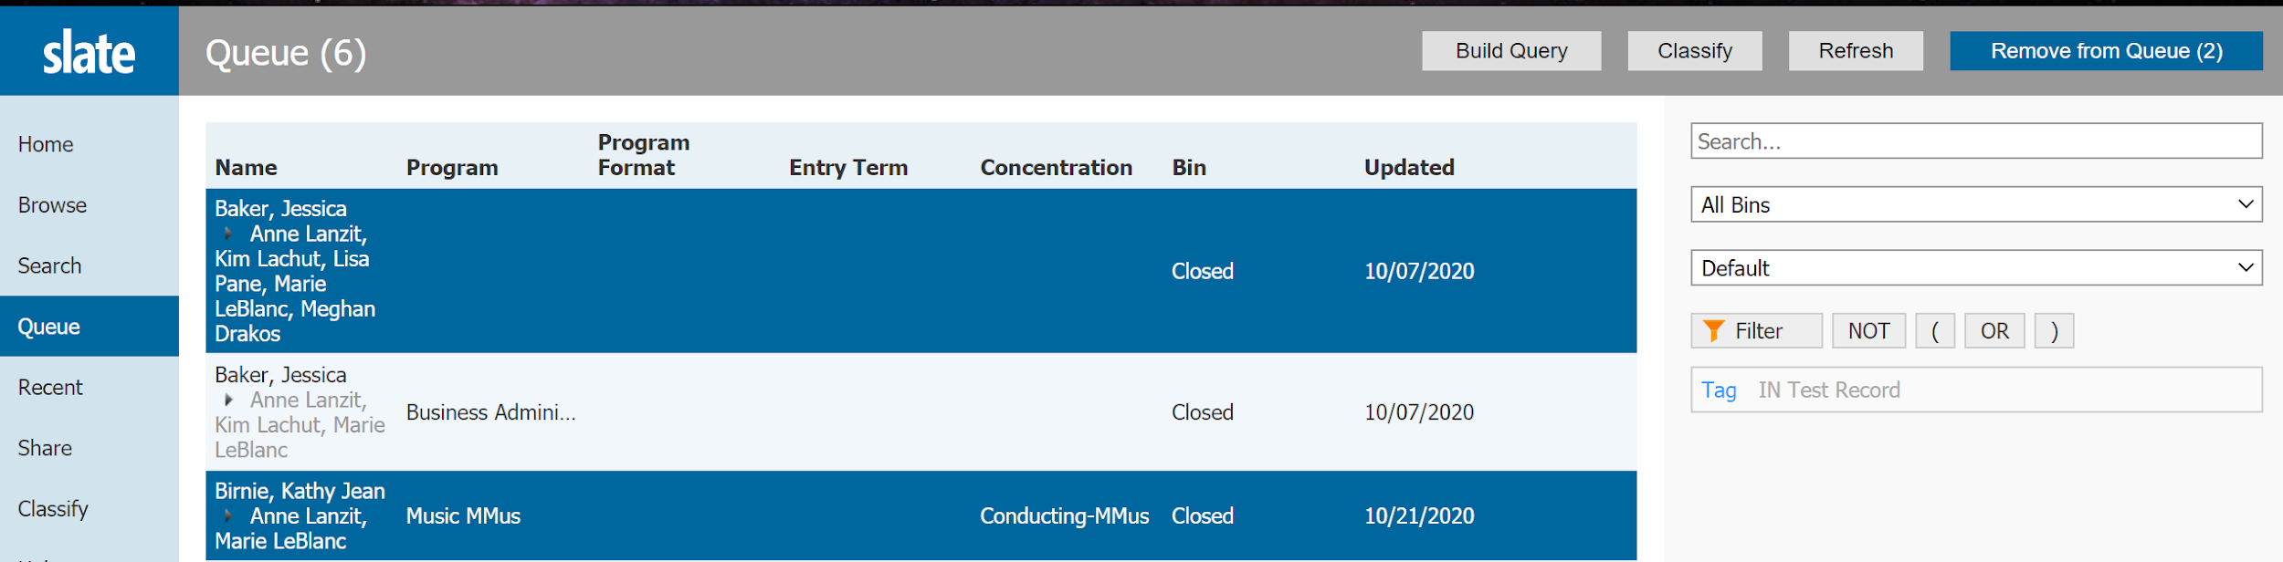
Removing an Application from Your Queue
There are 3 ways to remove an application from your queue:
Fill out the Reader Review form on an application in its current bin, and “Send” application to new bin, or same bin and delete your name as next reader.
2. In your Queue, click on “Remove from Queue” in top right corner of reader. Click on applications you wish to
remove (they will become highlighted in blue), then click on “Remove from Queue” again:
HB
Notes:
Katie

Slide 29
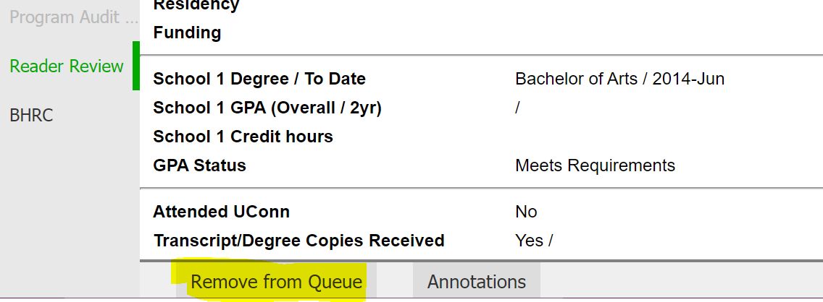
Removing an Application from Your Queue (cont.)
There are 3 ways to remove an application from your queue (continued):
3. Once application is open in your queue, click on “Remove from Queue” in bottom left corner of
application:
HB
Notes:
Katie

Slide 30
Reader Tools
SF
Notes:
Shirley

Slide 31
Reader Tools
Once applications are in your queue, you can use tools in the bottom left corner (not available on Cover Page or Test Score tabs).
Drag Pages (Scroll through)
Select Text
SF
Notes:
Shirley

Slide 32
Reader Tools (cont.)
Highlight. Use to highlight important information in application.
Remove Highlight. Only usable if you made the highlights. *Highlights will not export into a PDF.*
Note. Digital “Post-It”. Can delete only if you made the notes.*Notes will not export into a PDF.*
SF
Notes:
Shirley

Slide 33
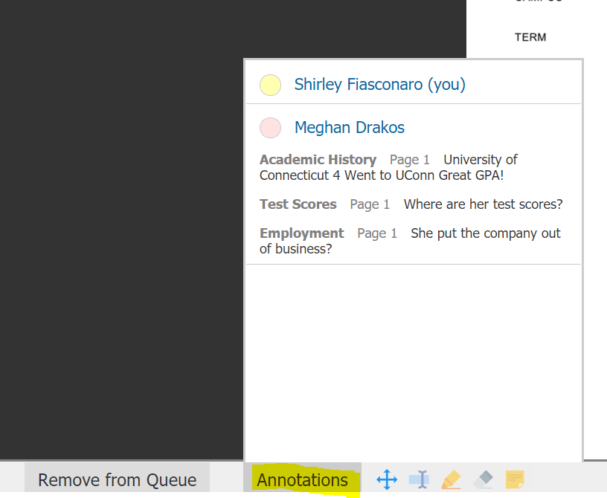
Reader Tools (cont.)
Annotations. Will consolidate comments, and highlights made on application, shows who made comments/highlights and in what section of the application with page #. *Notes and Annotations will not export into a PDF.*
SF
Notes:
Shirley

Slide 34
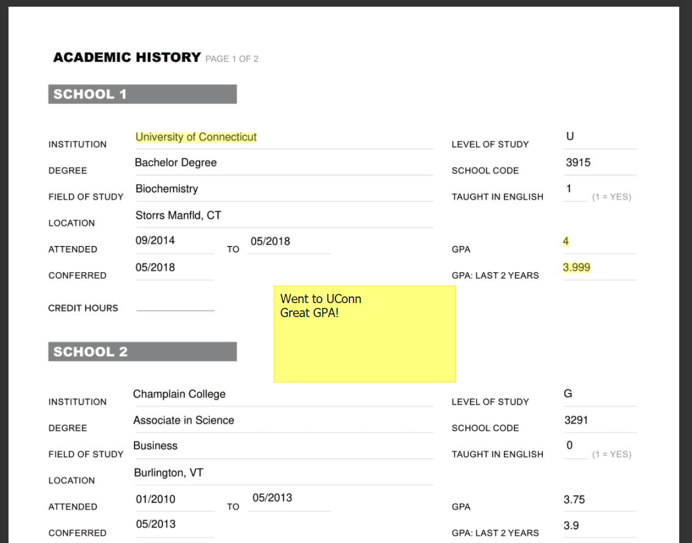
Highlights and Notes
Highlights and notes will be in yellow if you have entered them yourself.
Highlights and notes can be made anywhere in the application.
*Highlights and Notes will not export into a PDF.*
SF
Notes:
Shirley

Slide 35
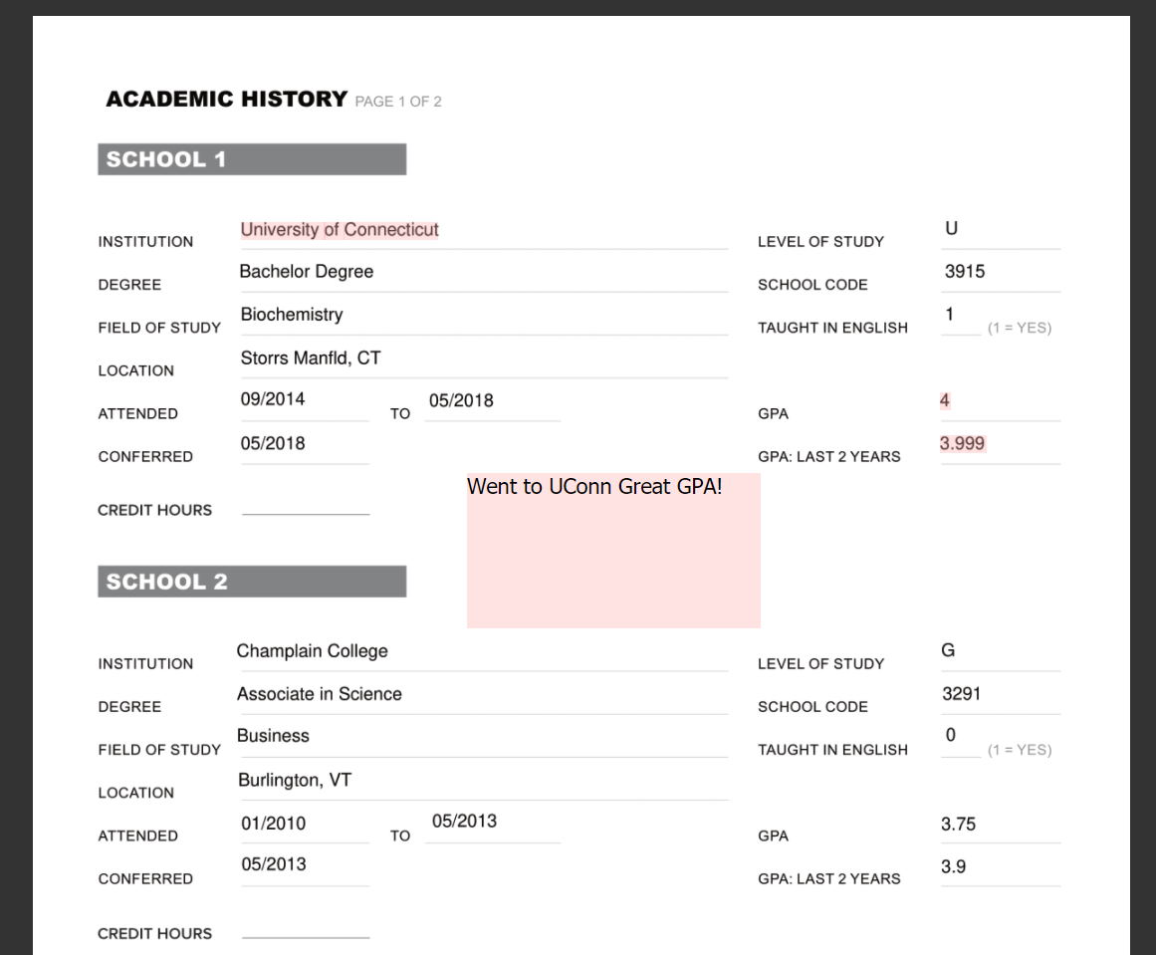
Highlights and Notes (continued)
Highlights and notes will be in red to anyone who did not enter them.
*Highlights and Notes will not export into a PDF.*
SF
Notes:
Shirley

Slide 36
Reader Review Forms & Tabs
SF
Notes:
Meg

Slide 37
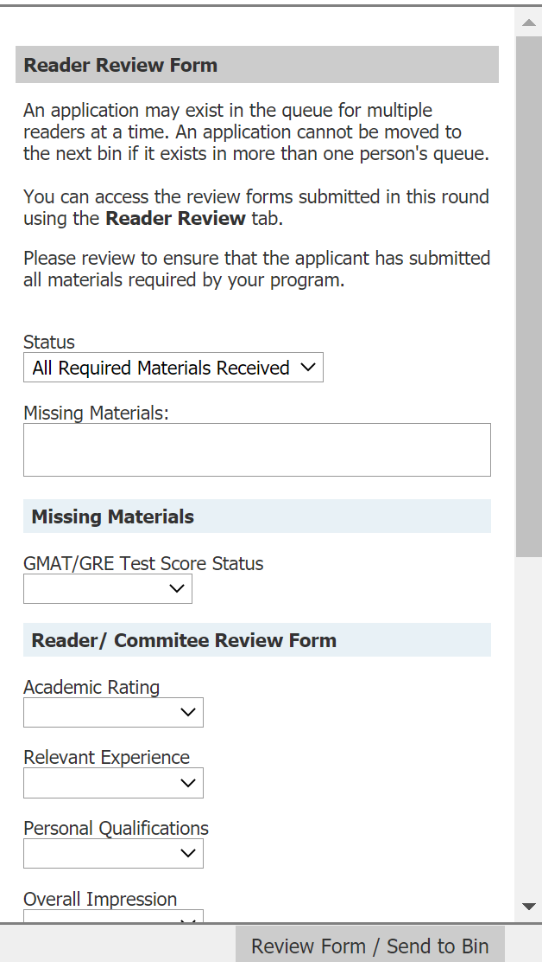
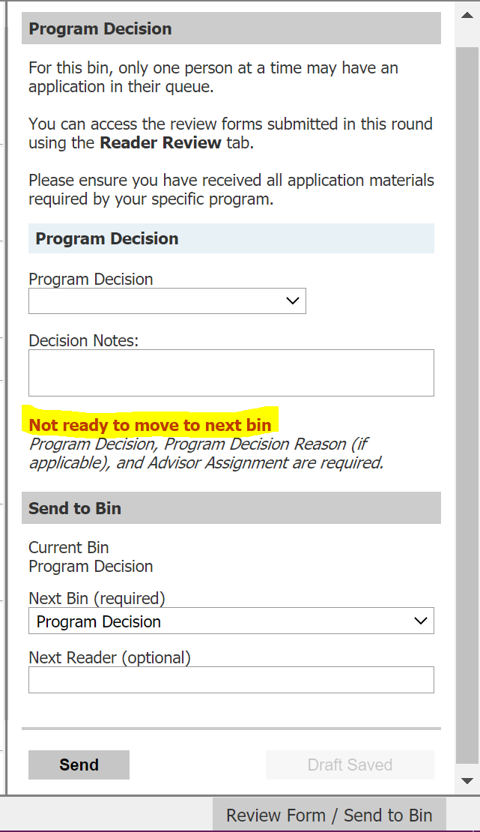
Reader Review Forms
Every Bin has a Reader Review Form associated with it.
To open Reader Review Form, remember “Bermuda Triangle” Step #3, after application is in your queue.
In order to take any action on an application or to move an application forward to a new bin, a user must fill out a reader review form.
Applications will not move forward to next bin assignment unless all required fields have been entered.
*Please be objective in reviews.*
SF
Notes:
Meg

Slide 38
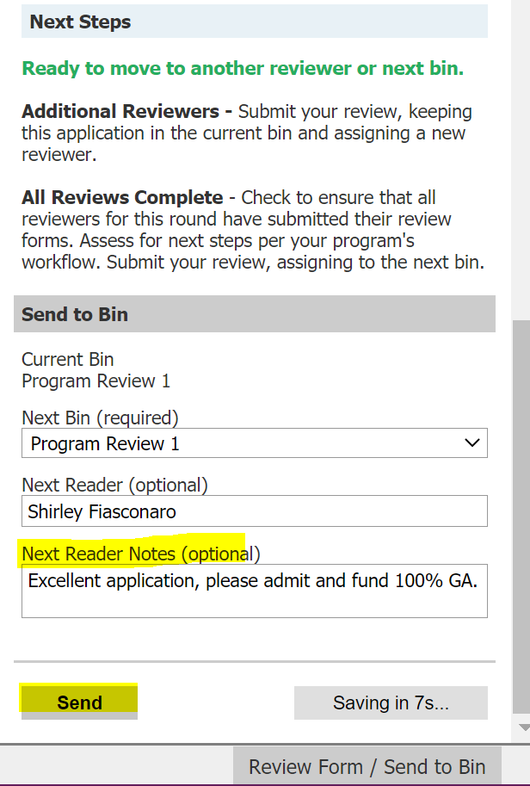
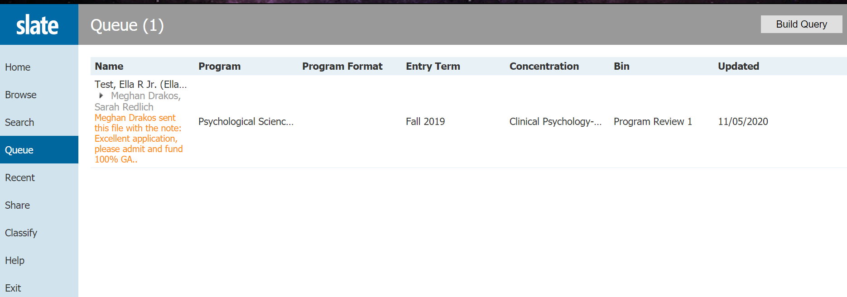
Sending to Another Reviewer
When queuing an application to another reviewer, users can send notes with the application that will show in orange to the next reviewer that it is queued to.
Because these notes are intended for the next queued reader, they will disappear after the application has been moved forward to the following bin or reader. (Useful for quick comments/questions; won’t be part of record.)
SF
Notes:
Meg

Slide 39
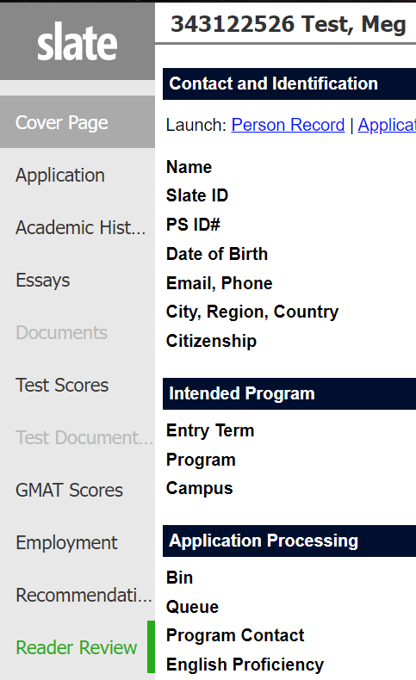
Reader Tabs
Tabs are on the left-hand side of the reader, when you open an application.
Tabs organize application materials by category.
Forms are added to the “Reader Review Tab” on the left-hand side of the reader, for any forms that have previously been filled out by the program in any bin.
Any new Reader Review Form entries will cause the tab to highlight in green.
SF
Notes:
Meg

Slide 40
Admission Decisions
SRS
Notes:
Sarah

Slide 41
Admitting an Applicant
SRS
Notes:
Sarah

Slide 42
When can I start admitting applicants?
Spring 2025: Currently open for program decisions.
Summer 2025: Currently open for program decisions.
Fall 2025: Currently open for program decisions.
SRS
Notes:
Sarah

Slide 43
What is the earliest deadline I can give an applicant with funding for Fall?
The UConn Graduate School adheres to the Council of Graduate Schools (CGS) April 15 Resolution which states that if an offer of financial support is made prior to April 15 (such as a graduate scholarship, fellowship, traineeship, or assistantship), applicants have until April 15 to accept it and the program should honor that commitment through April 15.
Extension of this deadline beyond April 15 is up to the individual program.
Programs are free to make offers of admission and of financial support after April 15 if they choose to do so. They may set any deadline for acceptance of the offer, as long as the deadline is after April 15.
April 15th Resolution
SRS
Notes:
Sarah

Slide 44
How do I enter an admit decision?
*Only those with Program Admin Role can make final admission decisions on applications. Bulk admission decisions are not available due to possible errors*
1.) Make sure application is in Program Decision bin and in your queue.
2.) Fill in “Program Decision” field with “Admit”
3.) Fill in “Decision Reason” field with “Regular Admit” or Provisional Admit” (Required)
3.) Fill in “Decision Notes” field (Optional)
4.) Fill in “GPA Justification” field (Only if required)
5.) Fill in “Enrollment Deadline” field (Required)
6.) Fill in “Funding for applicant?” field (Required)
7.) Fill in “Advisor” field(Required) (If advisor is not listed in the drop down, contact Lisa.Pane@uconn.edu )
SRS
Notes:
Sarah

Slide 45
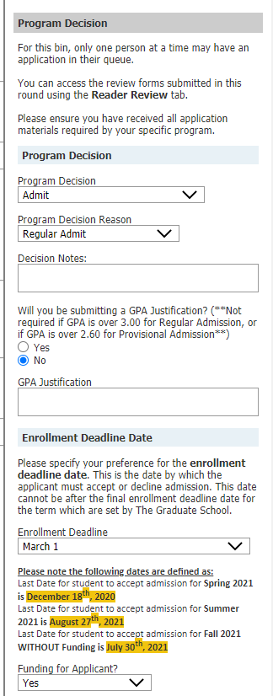
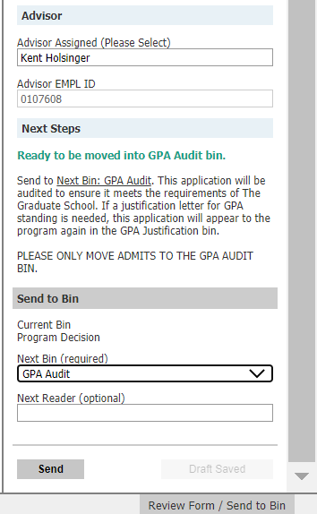
How do I enter an admit decision? (Continued)
After reader review form has been filled out, send it to the GPA Audit bin (you cannot see this bin, only TGS staff can).
This form must be completely filled out for The Graduate School to review and make an official admission decision.
SRS
Notes:
Sarah

Slide 46
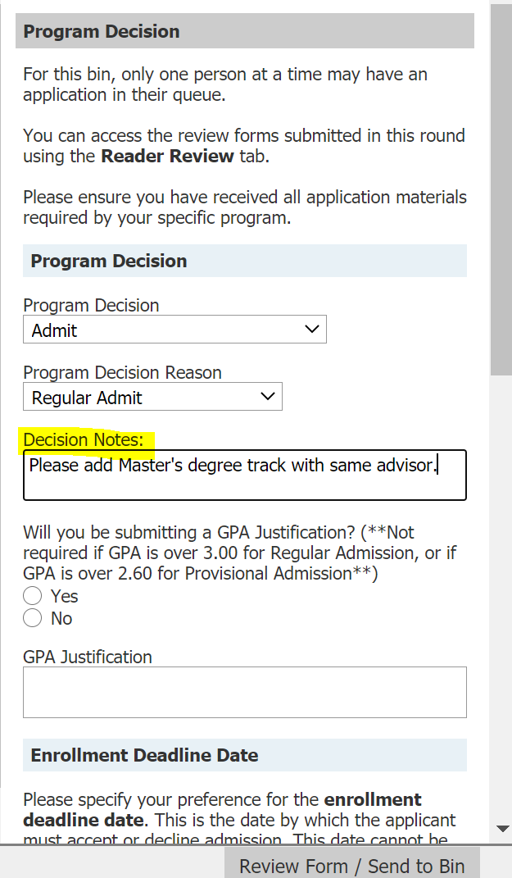
How do I have an extra degree track added to my applicant’s record in PS?
While making a program admission decision: Please enter this request in “Decision Notes” area of reader review form.
SRS
Notes:
Sarah

Slide 47
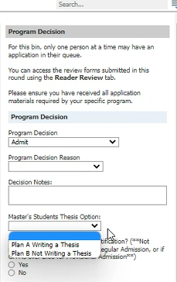
How do I choose a master’s thesis option for my applicant?
While making a program admission decision, please choose either Plan A Writing a Thesis or Plan B Not Writing a Thesis from the drop-down menu under “Master’s Students Thesis Option” (Optional).
This option will only show for master’s programs, excluding those from the School of Business.
SRS
Notes:
Sarah

Slide 48
Other Decisions
SRS
Notes:
Sarah

Slide 49
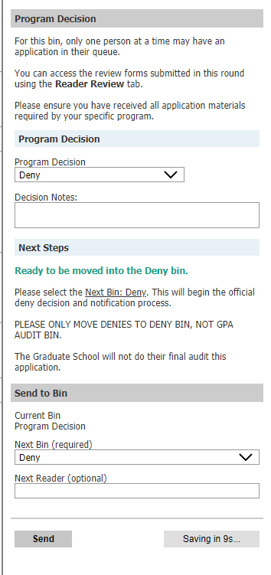
How do I enter a Deny decision?
*Only those with Program Admin Role can make final program admission decisions on applications.*
1.) Make sure application is in Program Decision bin and in your queue.
2.) Fill in “Program Decision” field with “Deny” (Required)
3.) Fill in “Decision Notes” field (Optional)
After reader review form has been filled out, send it to the Deny bin (you cannot see this bin, only TGS staff can).
Deny notifications are sent on Wednesdays.
SRS
Notes:
Sarah

Slide 50
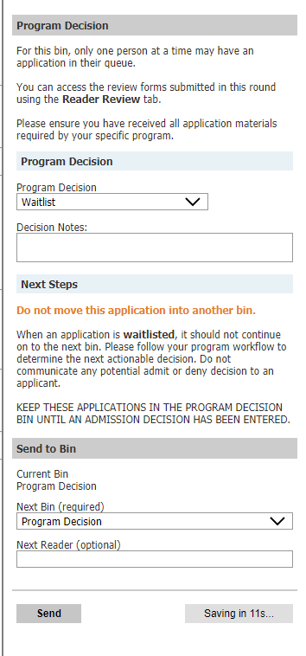
How do I enter a Waitlist decision?
*Only those with Program Admin Role can make final admission decisions on applications.*
To Waitlist an applicant:
1.) Make sure application is in Program Decision bin and in your queue.
2.) Fill in “Program Decision” field with “Waitlist” (Required)
3.) Fill in “Decision Notes” field (Optional)
After reader review form has been filled out, keep application in Program Decision bin, do not push forward to any other bin.
Programs should keep track of waitlisted applicants, and then enter a final program decision before application cycle closes.
SRS
Notes:
Sarah

Slide 51
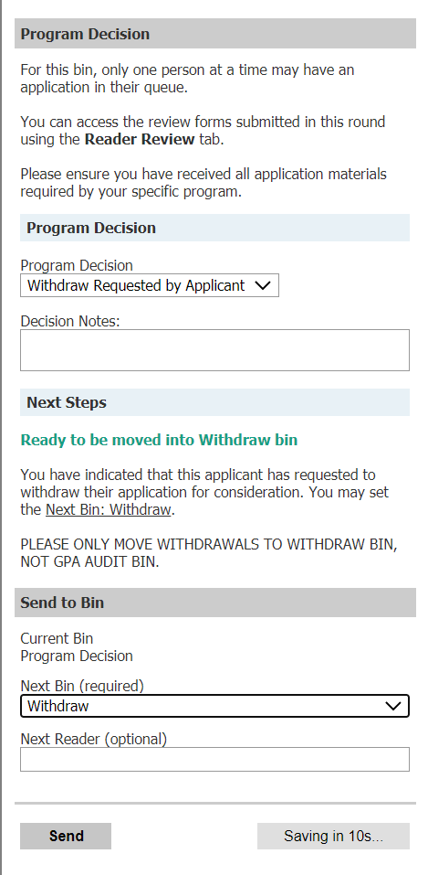
How do I enter a Withdraw Requested by Applicant decision?
*Only those with Program Admin Role can make final admission decisions on applications.*
To enter a Withdraw Requested by applicant:
Make sure application is in Program Decision bin and in your queue
Fill in “Program Decision” field with “Withdraw Requested by Applicant” (Required)
Fill in “Decision Notes” field (Optional)
After reader review form has been filled out, send it to the Withdraw bin (you cannot see this bin, only TGS staff can).
Programs are required to retain documentation of Applicant’s request to withdraw their application.
SRS
Notes:
Sarah

Slide 52
GPA Justification
M
Notes:
Meg

Slide 53
GPA Justification Bin?
*Action is required on these applications in order to admit these students.*
Applications that are in the GPA justification bin, require a letter of justification to be added for admission because they did not meet the GPA requirements for Regular or Provisional Admission.
*GPA Justifications should be written by the major advisor or admissions chairperson. Reasons should state why the applicant is a good fit despite their low GPA. Often reasons include research experience, GRE scores, recommendations, etc.*
M
Notes:
Meg

Slide 54
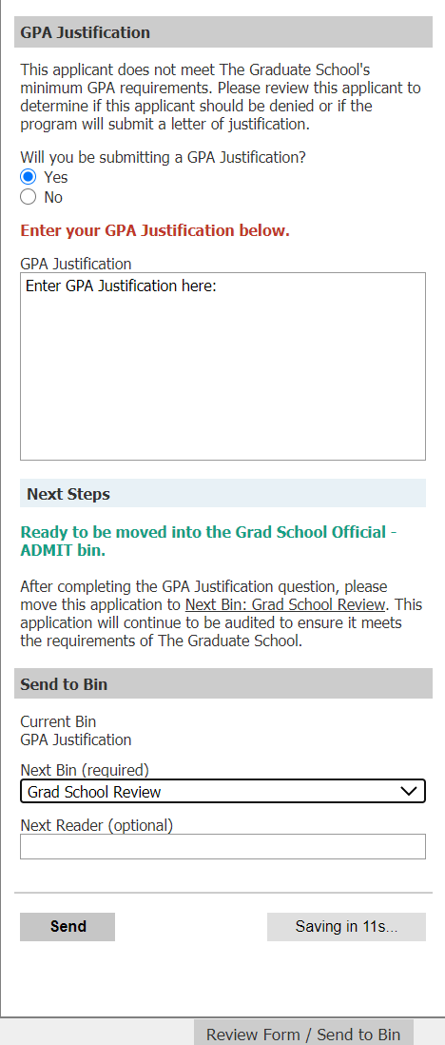
What do I do if there is an application in the GPA Justification Bin?
To enter a GPA Justification:
Add application to queue.
Open up reader review form and select “Yes” or “No” to “Will you be submitting a GPA justification?”
If “Yes”, enter GPA justification and then push application to the Grad School Review bin.
If “No, leave GPA Justification area blank and push application to Deny bin.
M
Notes:
Meg

Slide 55
Frequently Asked Questions
M
Notes:
Meg

Slide 56
When do I enter an admission decision?
Admits: After a program has admitted an application in the Program Decision bin and pushed it forward to the GPA Audit bin, it may take up to 10 business days for TGS to review application for official admit during busy times (December-March)
  If your program sends out departmental admission letters or GA offer letters
    Please wait to send the letter until admission has been officially processed by TGS
    Do not assume gender identity of applicants
      Not recommended to use Mr. or Ms. to address an applicant unless program is certain of the applicant's preferences
M
Notes:
Meg

Slide 57
When do I enter an admission decision? (cont.)
Denies: After a program has denied an application in the Program Decision bin and pushed forward to the Deny bin, TGS will process the deny and send notification to the applicant the following Wednesday.
  Do not send out denial letters
    The Graduate School sends denial notifications every Wednesday, no need to send additional letter.
M
Notes:
Meg

Slide 58
When should all admission decisions be entered by the program?
Each application needs an admission decision entered.
Please enter all program decisions by the highlighted deadlines for each term listed. (Admits, Denies, and Withdrawal Requested by Applicant)
*Important*
Programs will not be able to enter decisions on applications in the Program Decision bin after these deadlines have passed.
Spring 2025
Application Opens | Monday, January 29, 2024
Application Submission Deadline | Wednesday, December 18, 2024
Reply to Offer Deadline | Friday, December 20, 2024
Summer 2025
Application Opens | Monday, September 9, 2024
Application Submission Deadline | Wednesday, August 20, 2025
Reply to Offer Deadline | Friday, August 22, 2025
Fall 2025
Application Opens | Monday, September 9, 2024
Application Submission Deadline | Wednesday, July 23, 2025
Reply to Offer Deadline | Friday, July 25, 2025
M
Notes:
Meg

Slide 59
How do I move an application to the correct bin, if I selected the wrong Bin?
Contact gradadmissions@uconn.edu, and we will move the application into the correct bin for you.
M
Notes:
Meg

Slide 60
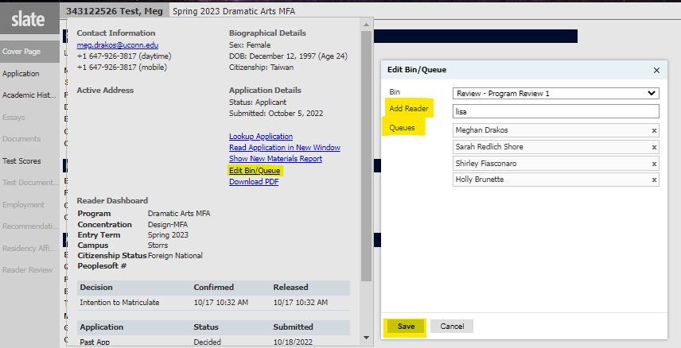
How do I add an application to multiple queues?
Click on applicant’s name in top left corner.
Select “Edit Bin/Queue”
Add multiple readers
Click save
*Please note: When assigning applications to multiple queues at once, please do not change the bin.*
M
Notes:
Meg

Slide 61
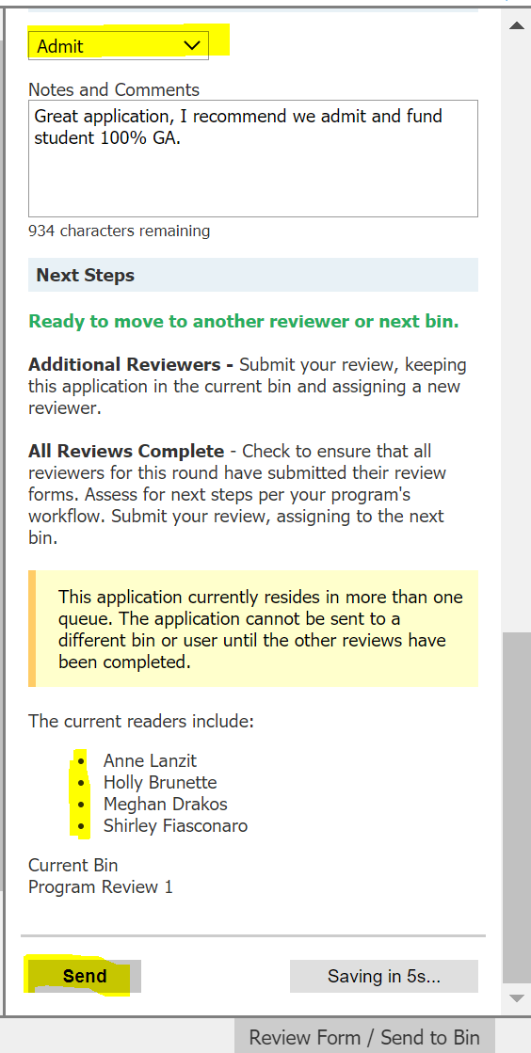
How do I move an application forward to a new Bin if it is in multiple queues?
If an application is in multiple queues, readers can fill out the Reader Review form. They must select “Send” after they fill out the Reader Review form, and the application will be removed from their queue, while remaining in the other users’ queues.
The application will stay in the bin it is in, and will only move forward to the next bin that is selected when the last reader reviews the application and selects a new bin.
M
Notes:
Meg

Slide 62
Questions? Comments? Wishlist?
Type in the chat or unmute yourself to join the conversation!
M
Notes:
Meg

Slide 63
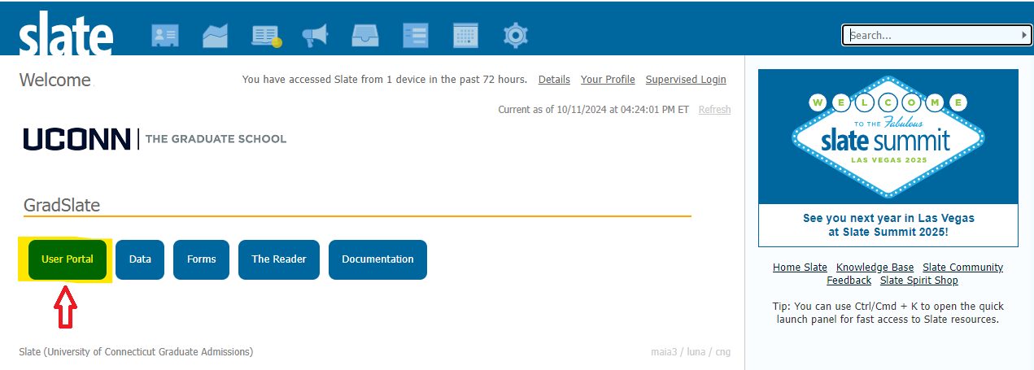
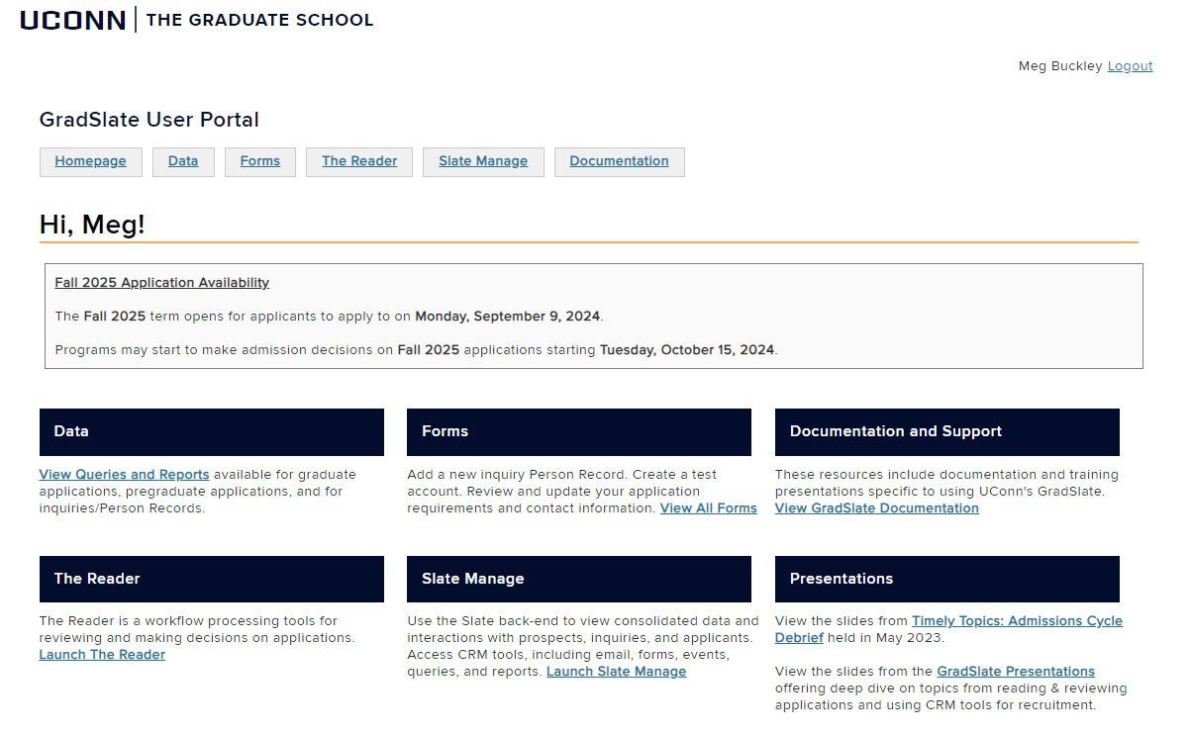
GradSlate
USER PORTAL
Accessed from Slate manage homepage: https://connect.grad.uconn.edu/manage/
Quick access to:
Data (Queries & Reports)
Forms
The Reader
Slate Manage
Presentations
Documentation & Support
All slides are available in the GradSlate User Portal at http://connect.grad.uconn.edu/portal/user.
M
Notes:
Meg

Slide 64
RESOURCES
GradSlate User Portal
connect.grad.uconn.edu/portal/user
Includes quick links, forms, and documentation
Questions About Applications
gradadmissions@uconn.edu
Reading and reviewing specific applications, application status, admissions help, etc.
Questions About Slate
gradslate@uconn.edu
Access, recruitment communications, queries, system errors, etc.
M
Notes:
Meg

Slide 65
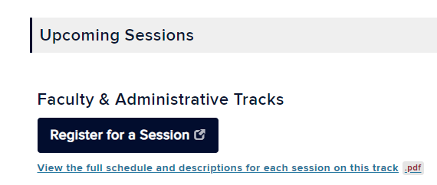
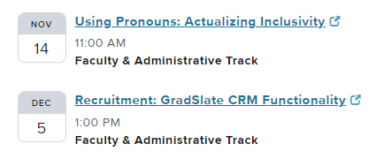
Upcoming
TIMELY TOPICS
Timely Topics is a series of opportunities to engage with subject matter experts on topics relevant to those who support and advise graduate students and programs.
Every session is available to all UConn faculty and staff and provides information and tools that will help you best support your students and program.
If you have any questions or topic suggestions for the Timely Topics Series, please contact Megan Petsa (megan.petsa@uconn.edu).
Register for Future Timely Topics Sessions
Notes:
Meg

