Slide 1
Maximizing Recruitment with Grad Slate
Maximizing
Recruitment with
Grad
What’s the strangest food you’ve ever eaten?

Slide 2
Overview
A robust system supporting graduate recruitment beyond application processing
Key tools: Data collection, event management, communication campaigns

Slide 3
Today’s agenda
Transforming Prospective Student Engagement through Forms, Events, and Communication
Today’s Agenda
Overview of Forms, Events, and Communication
APDS Case Study – Engagement Tools in Action
Your Use Cases & Questions

Slide 4
Forms: The Backbone of Data Collection
Forms capture key prospective student data.
Common types:
graduate applications (series of forms)
Inquiry forms (brief yet informative)
Inquiry forms trigger automated emails to both the student and program.

Slide 5
Forms: The Backbone of Data Collection (cont.)
Key Data Points:
Email
first name
last name
program of interest
optional: concentration, cohort, campus

Slide 6
Streamlining Events with GradSlate
Key Features:
Event promotion through email, program website, or Slate portal
Centralized event registration for virtual/in-person events
Email confirmation and reminders
Host virtual events in Slate Share or another platform
Automatic or manual attendance tracking
Post event emails

Slide 7
Streamlining Events with GradSlate (cont.)
Example Events
Virtual Information Sessions
Virtual Open Houses
In-Person Events requiring registration before the event
In-Person Check-in Events – attendees scan QR code at the event

Slide 8
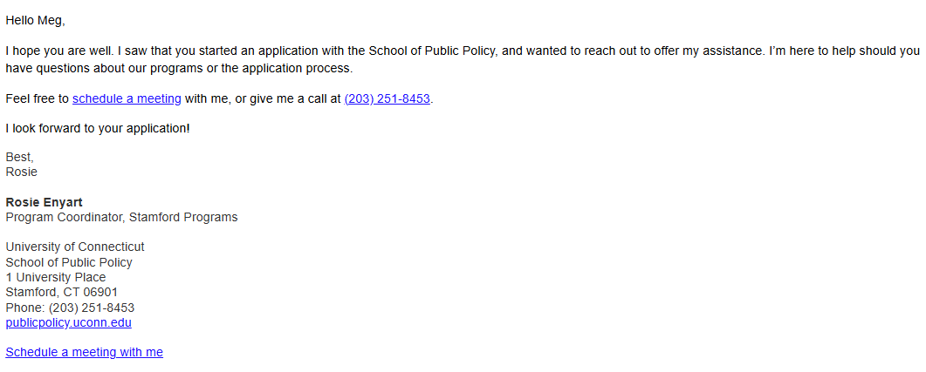
Mass Emails Made Simple with Deliver
Plain text emails can feel more personal.

Slide 9
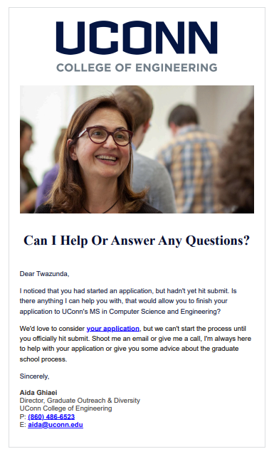
Mass Emails Made
Simple with Deliver (cont.)
Wordmark
Optional header photo
Consistent fonts
Signatures

Slide 10
Mass Emails Made Simple with Deliver (cont.)
Two types of emails:
One-off Emails: Event invites, deadline reminders
Ongoing Campaigns:
Transactional emails (application updates)
Drip campaigns (automated, based on populations)

Slide 11
APDS Case Study – Engagement Tools in Action
Bill Page, Director of Marketing
Brian Schremser, Enrollment Support Specialist

Slide 12
APDS Outreach and Student Support
The Enrollment Support Team reaches out to each inquiry within 24 hours of first inquiry and then follows up 7 days later.
5.21% increase in applications started
2.16% increase in applications submitted
54.13% of students started their application after having at least one interaction
86.67% of students submitted their application after having at least one interaction
17 more accepted students and 14 more matriculated students for every 1,000 inquiries
Increase of 119 more matriculated students per year

Slide 13
Questions
Paula Steele, Assistant Director for CRM & Data Management
paula.steele@uconn.edu
Bill Page, Director of Marketing
william.page@uconn.edu
Brian Schremser, Enrollment Support Specialist
brian.schremser@uconn.edu

