Slide 1


Title slide
Dr. Vin Moscardelli, Director
January 30, 2025

Slide 2
About the Office
The Office of National Scholarships & Fellowships (ONSF) advises and mentors students at the University of Connecticut who are competing for prestigious, nationally-competitive scholarships and fellowships. ONSF’s mission is to foster the intellectual growth of students from all backgrounds who are applying for nationally-competitive awards.
ONSF is part of UConn Enrichment Programs and is open to all graduate and undergraduate students at the University, including students at the regional campuses.
To learn more about ONSF, visit us at onsf.uconn.edu.

Slide 3
Who We Are
Schedule an appointment via Nexus (nexus.uconn.edu)
Vincent G. Moscardelli, Ph.D., Director
Email: vin.moscardelli@uconn.edu
Michael Cunningham, Ph.D., Assistant Director & Fulbright Program Advisor
Email: michael.cunningham@uconn.edu
368 Fairfield Way, Unit 4147
Phone: 860-486-4233
onsf.uconn.edu
onsf@uconn.edu

Slide 4
What Are National Scholarships?
National scholarships are highly competitive, prestigious, and often lucrative awards that provide support for a wide range of enriching experiences, including study abroad, graduate study (and sometimes undergraduate study also), federal employment, language learning, teaching, research, and public service.
You may have heard of some national scholarships – the Rhodes, Fulbright, and NSF Graduate Research Fellowship Program are among the best known to faculty and students across disciplines – but many students aren’t aware of the variety and volume of national scholarship opportunities for both graduate and undergraduate students.

Slide 5
Why Apply?
Value the Process
Applying for a national scholarship is a challenging experience. While I certainly hope that many of you will learn about, apply for and ultimately receive national scholarships, I want to emphasize that competing for these awards can be a rewarding experience in itself – regardless of whether you are ultimately selected.
Working closely with our staff, the experience of applying for a national scholarship should help you:
  Clarify your academic, career and personal goals;
  Become more aware of your strengths, interests, and commitments;
  Improve your writing skills and enhance your self-presentation;
  Get a better sense of the most appropriate graduate or professional study paths for you; and
  Gain an experience for learning and personal growth that is not normally possible in the classroom.

Slide 6
Why Apply?
Value the Process
The experience of applying for a nationally competitive scholarship can help you reflect on and make well-informed decisions about academic plans, internships, study abroad, service activities, work and graduate or professional study.
For graduate students, external fellowship applications are a great opportunity to gauge the appetite for the type of work you do outside of your lab or your dissertation committee.

Slide 7

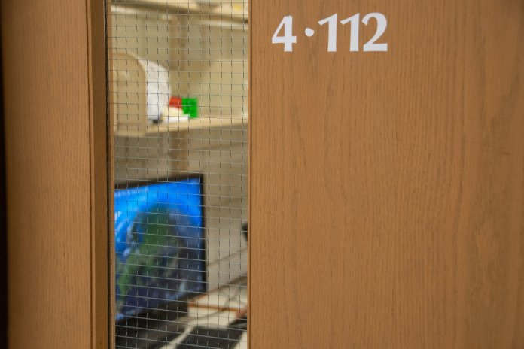
Why Apply?
Value the Process
This is NOT your audience.

Slide 8

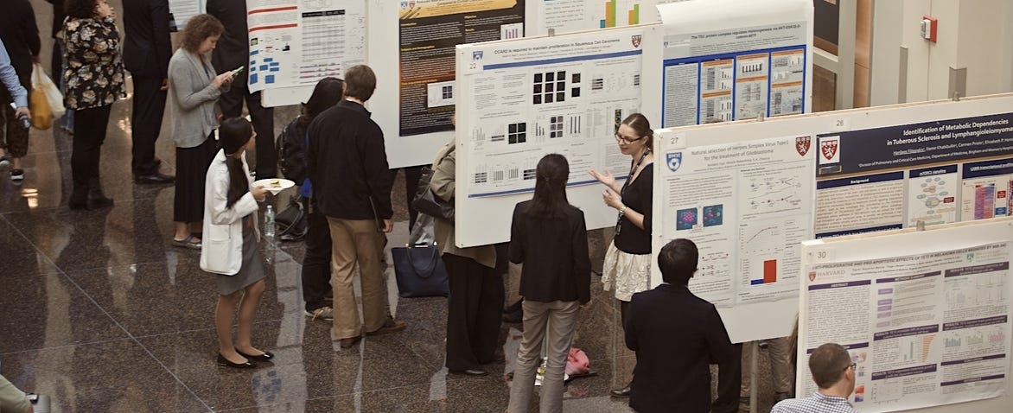
Why Apply?
Value the Process
THIS is your audience.

Slide 9
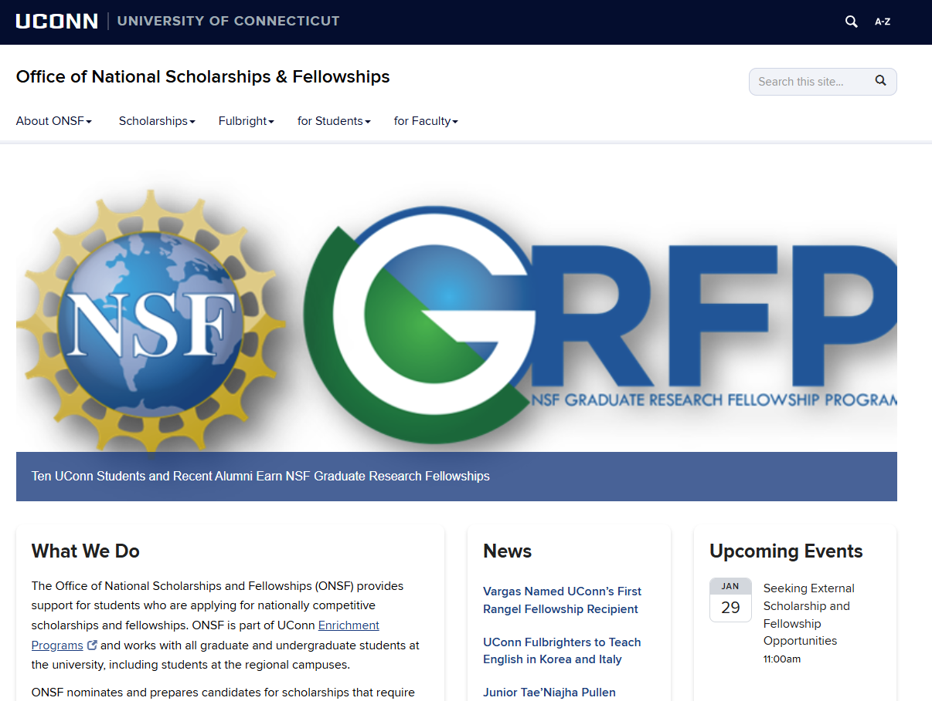
Where to Start? onsf.uconn.edu

Slide 10
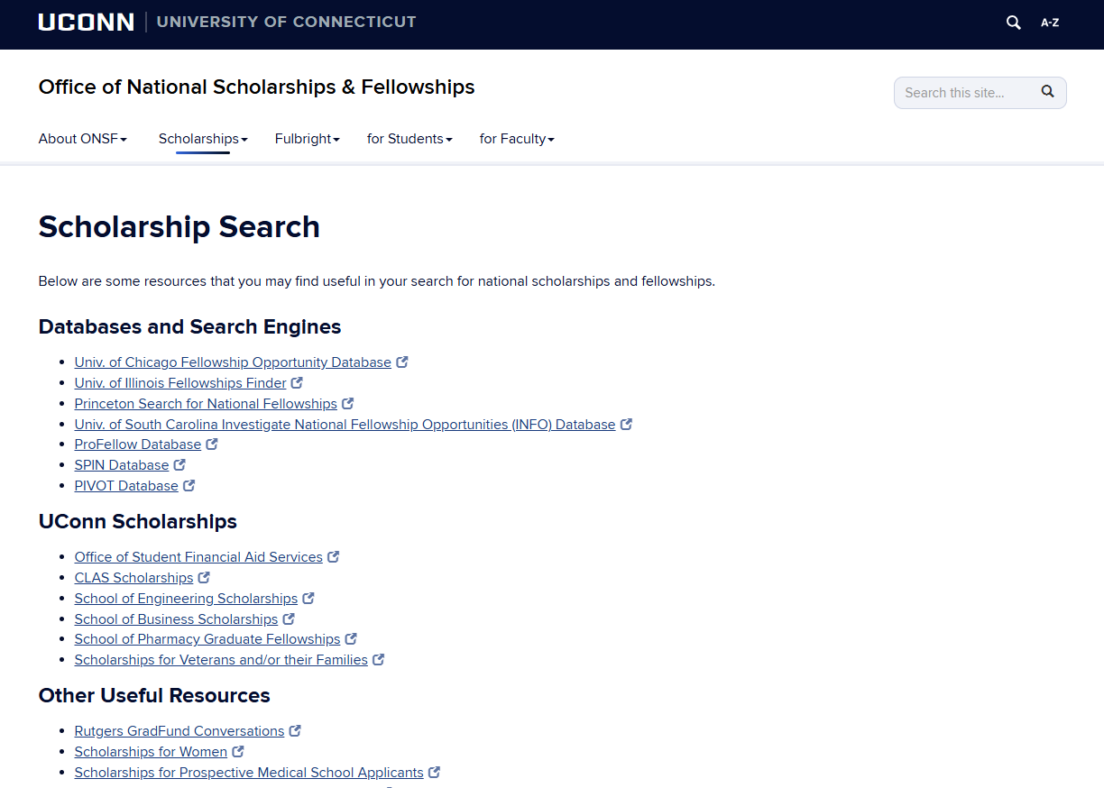
Where to Start? onsf.uconn.edu

Slide 11
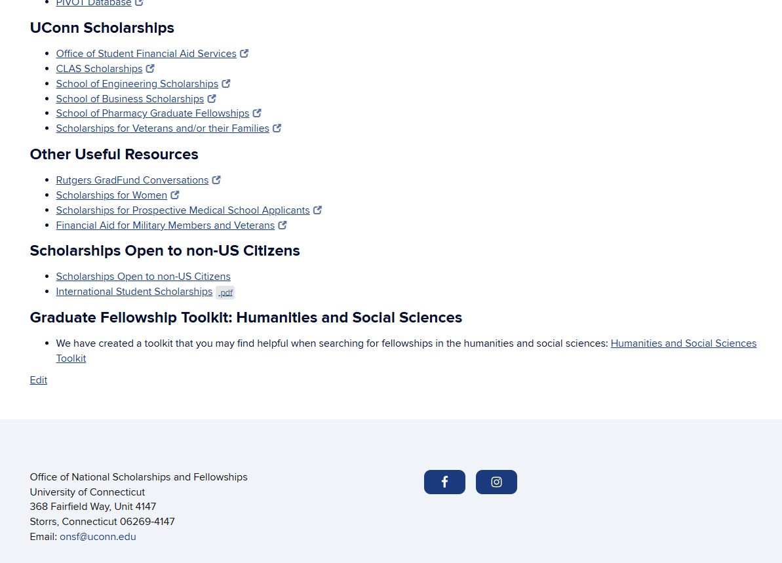
Where to Start? onsf.uconn.edu

Slide 12
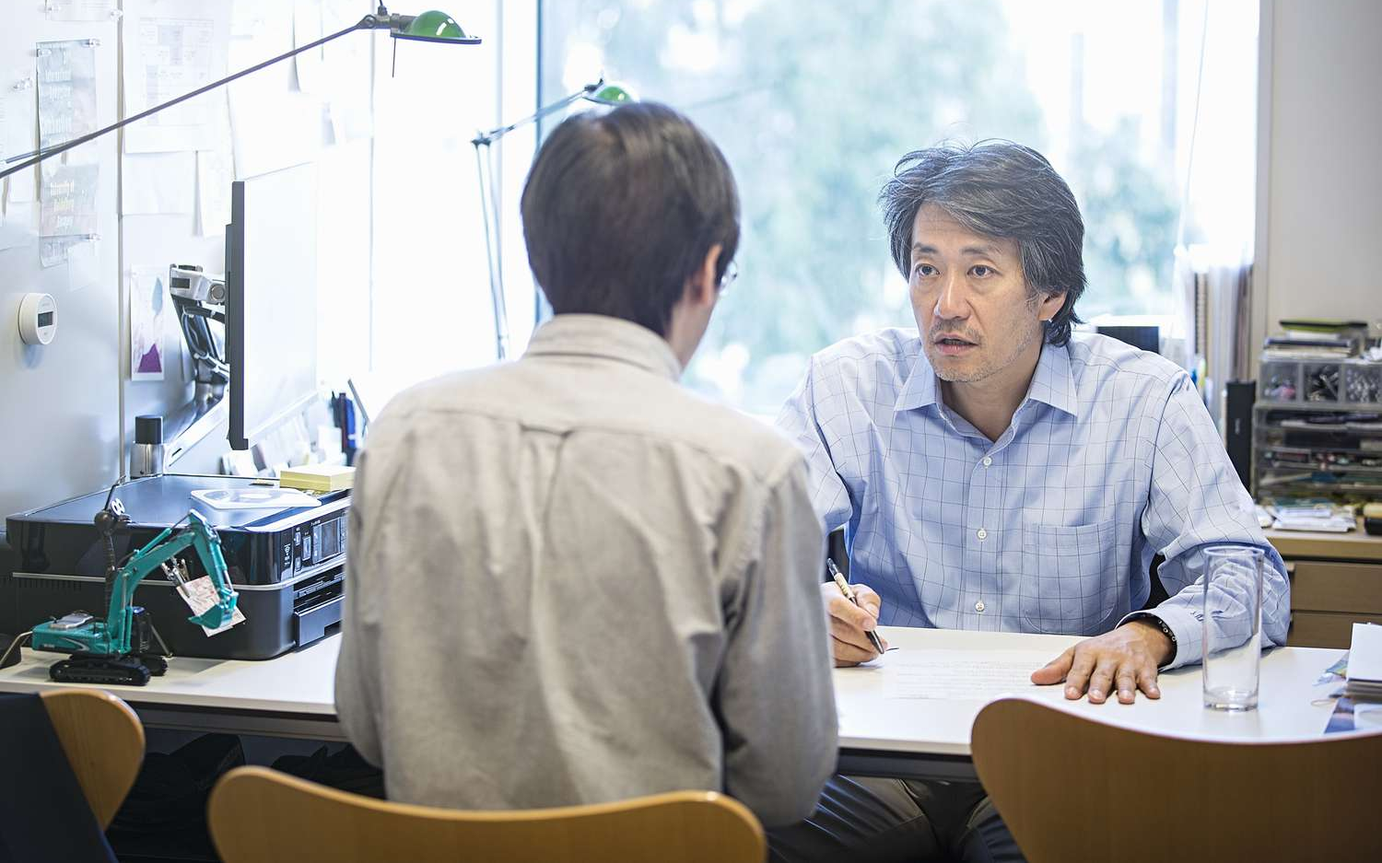
Finding the Right Fit
Most of this process is about FIT. You’ll never be competitive pretending to be something you aren’t. Do your own research.
Talk to your mentors and others in your program; they are the most valuable resource you have. What have others applied for in the past?

Slide 13
How to Build Your National Scholarships Profile
Make Time & Start Early
  Success in one competition breeds success in others. And sometimes not being selected – or even nominated – might indicate the need for a mid-course correction.
  Are you really preparing yourself to do things you say you want to do?

Slide 14
How to Build Your National Scholarships Profile
Think big, and then narrow your focus
  Be ambitious, but don’t let intractable problems slow you down
  Identify your passion project, and then break it into manageable chunks
  What is the connective tissue or thread the holds your application (your life’s work?) together?

Slide 15
How to Build Your National Scholarships Profile
Build Your Network of Advocates and Supporters
  Most competitions require 3-4 letters, but some require 4-5 and the Rhodes requires 8. Start building your network NOW.
  Talk to mentors about your interests and your goals.
  Prepare them for when you eventually start requesting letters. Ask them what they need from you to write the best letter possible.
  And of course, ask early.

Slide 16

How to Build Your National Scholarships Profile
Drafts, Drafts, and More Drafts
  No substitute for writing. The act of writing clarifies, refines, and deepens our understanding of the topic about which we write.
  Also, take advantage of workshops hosted by ONSF, the Writing Center, the Center for Career Development, your departments, centers, and institutes, and of course the funding agencies themselves.

Slide 17
How to Build Your National Scholarships Profile
Apply, Apply, Apply
  Yes, the applications are hard work; most require 2-3 separate essays, and the most extreme applications require 7-8.
  But there is little-to-no “wasted work” when it comes to these fellowship applications.
  Your odds of becoming a recipient will go up with every application you submit – for both purely mathematical reasons AND because of the development that takes place.

Slide 18
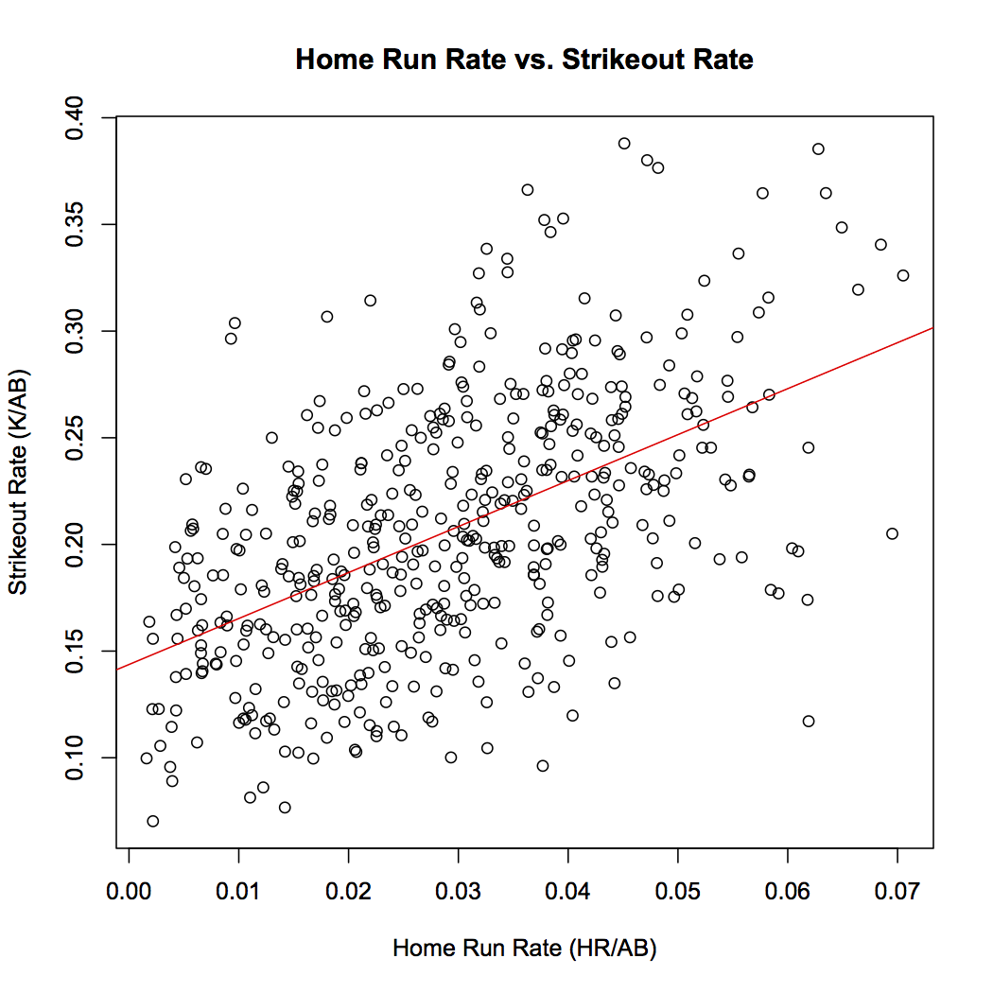
“What do I think about when I strike out? I think about hitting home runs.”
— Babe Ruth

Slide 19
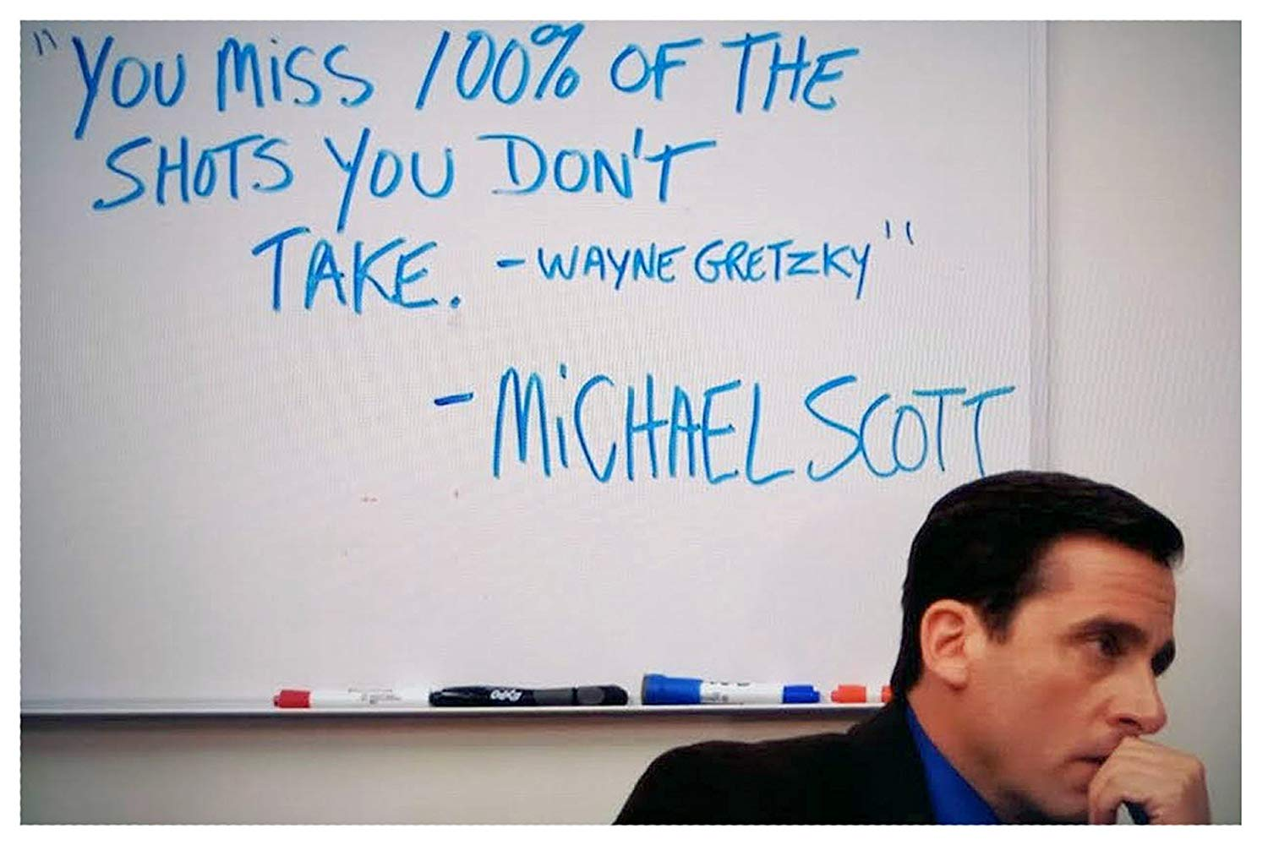
“You miss 100% of the shots you don’t take.”
-Wayne Gretzky (or Michael Scott)

Slide 20

“You know what the happiest animal on Earth is? It’s a goldfish. It has a 10-second memory.¹ Be a goldfish.”
-Ted Lasso
¹ This sounds great, but it is almost certainly not true. And furthermore, scientists haven’t believed it to be true for decades (https://www.livescience.com/goldfish-memory.html).

Slide 21
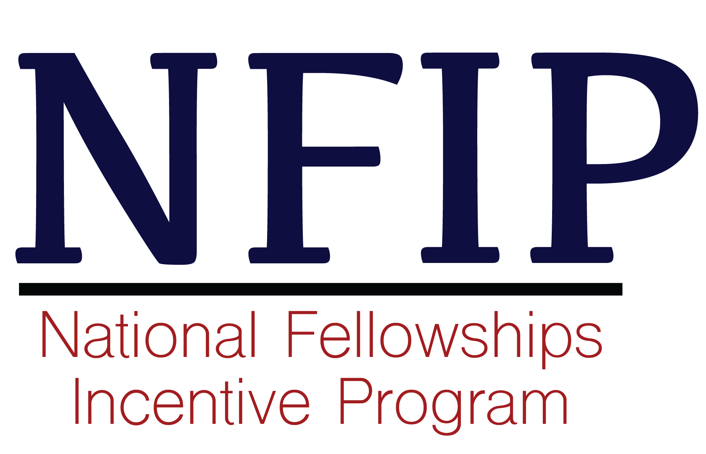
A Little Nudge
Under this program, full-time UConn graduate students who apply for prestigious external fellowships during the 2024-25 academic year (July 1, 2024 through June 10, 2025) are eligible for a $250 scholarship to recognize the work involved in developing proposals and submitting applications for such awards.
Learn more at https://onsf.uconn.edu/nfip.

Slide 22

Think Big

