Slide 1
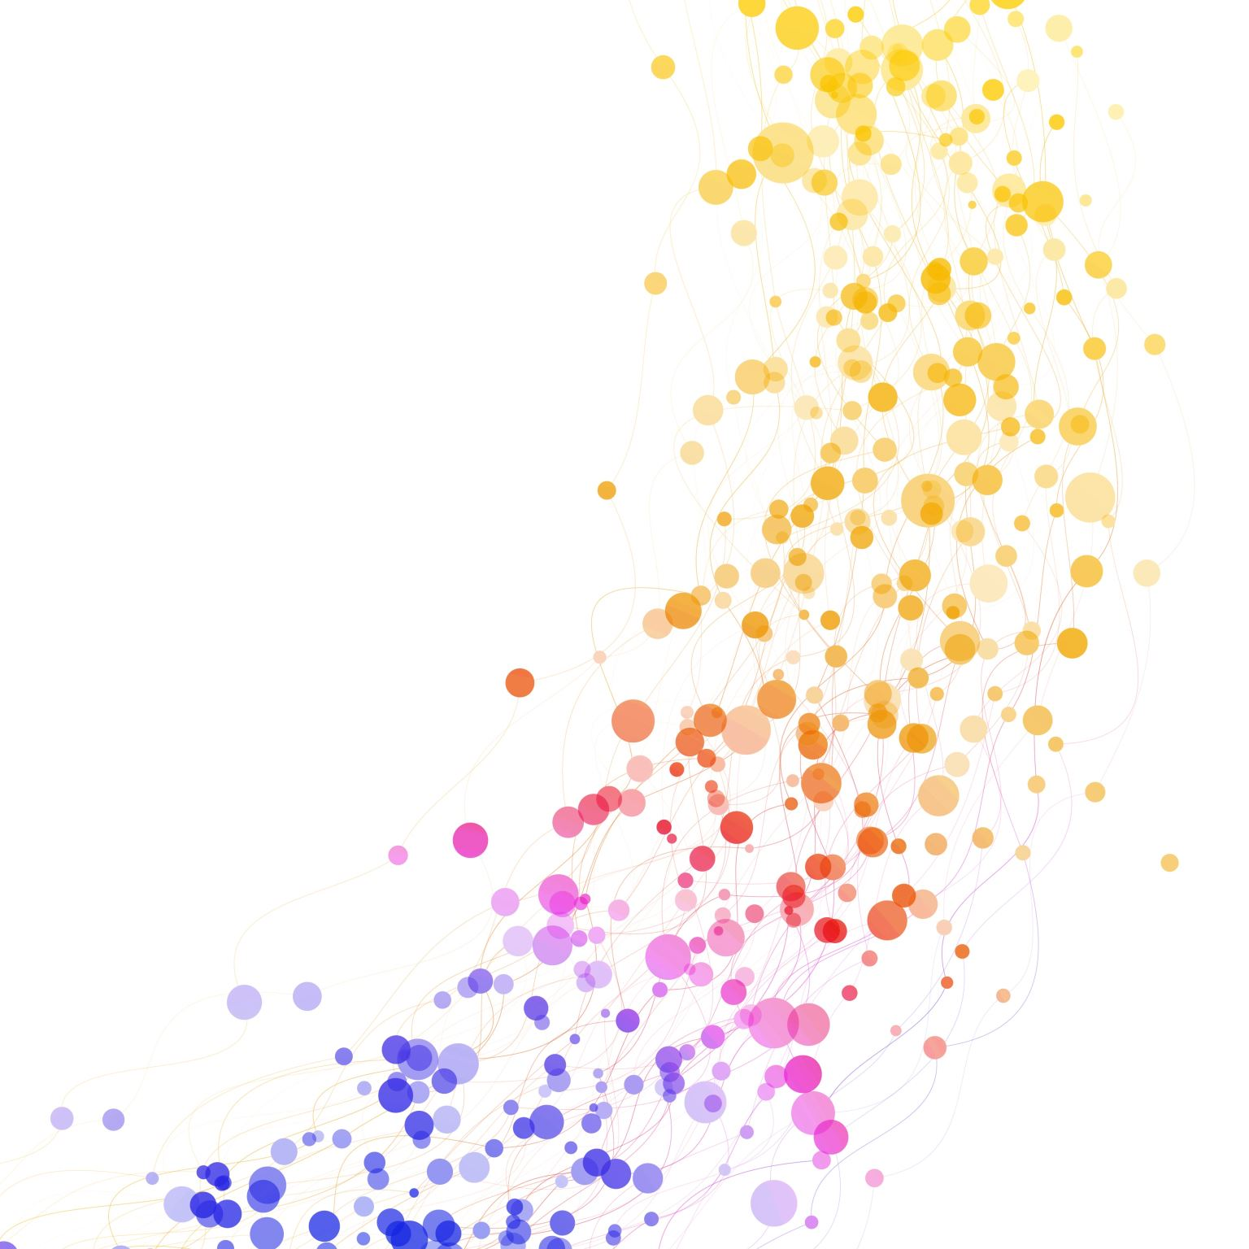
Using AI Tools (with integrity) as a Research Partner
Presented by
Erica Charis-Molling
February 6, 2025

Slide 2
Generative AI: A pitch for perplexity
It cites its sources.
It’s known for concision and a low hallucination rate.
It will admit its limitations and offer alternative strategies outside of AI.

Slide 3
ChatBoT as a Research Process Assistant
Background research and text summarization
Sample prompt
Brainstorming search terms
Sample prompt
Assistance with project management
Sample prompt

Slide 4
Chatbot as Understanding enhancement tool
Surrogate texts at lower lexical levels
Sample prompt
Explaining complex concepts
Sample prompt
Translation, to or from English
Sample prompt

Slide 5
Simple Prompt Engineering to Improve AI Outputs
Make it CLEAR: concise, logical, explicit, adaptive, and reflective
Refine: Prompt for questions or suggestions that would make the prompt better
Review: Prompt to correct errors or give better outputs.
Reinforce: Attach source texts to guide its response and reduce hallucinations

Slide 6
AI tools for research support
LITERATURE SEARCH
UNDERSTAND & SUMMARIZE
Research Rabbit
OUTLINE, TRANSLATE, & EDIT
PROJECT MANAGEMENT & DATA VIZ
Powerdrill
Mind the Graph

Slide 7
Library resources for AI support
Artificial Intelligence: A Guide for Students & Faculty
Primer of AI basics
Extensive list of more “AI Tools for Research”
How to Cite AI
UConn Library AI Literacy module coming soon!
University of Maryland Libraries’ AI Literacy guide

Slide 8
Questions? tips/tricks to share?
erica.charis-molling@uconn.edu

